Slide 1
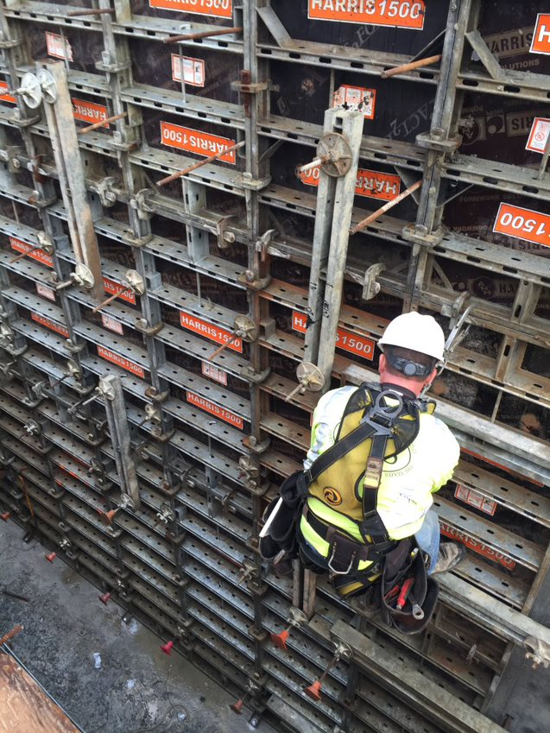
EEA Dam and Seawall Program
Began in 2013
Offers grants (loan program under review)
Supports dams, coastal infrastructure, and inland flood control
Grants: over $119,629,000 issued
(166 awards for $52 million dams, 55 awards for $67 million coastal)
Funded by annual capital and the Dam and Seawall Fund
State Fiscal Year 2025 funds: $12,350,000

Slide 2
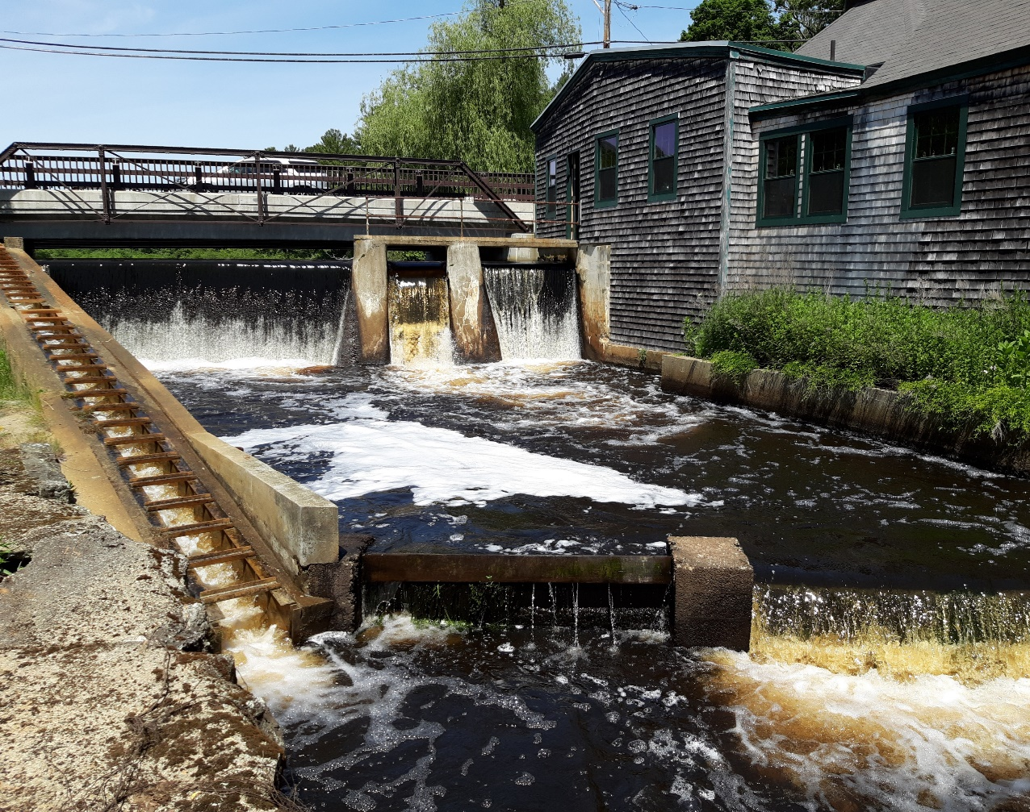
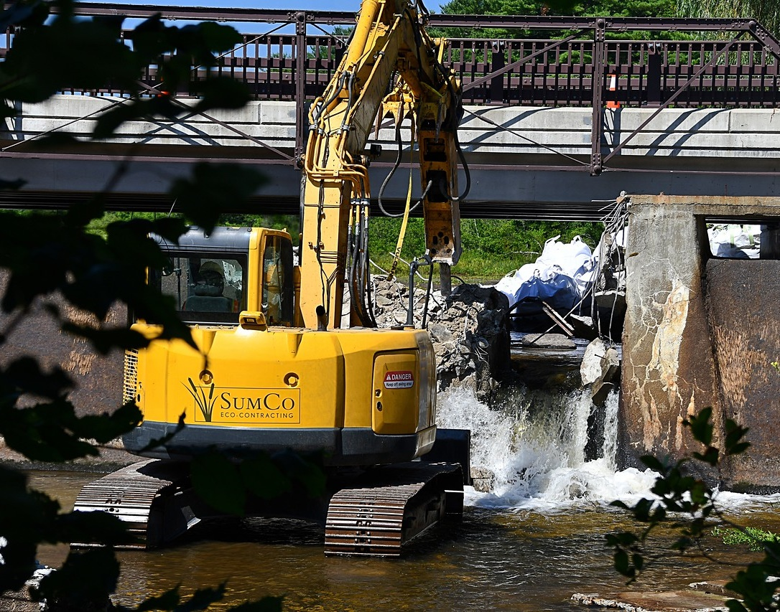
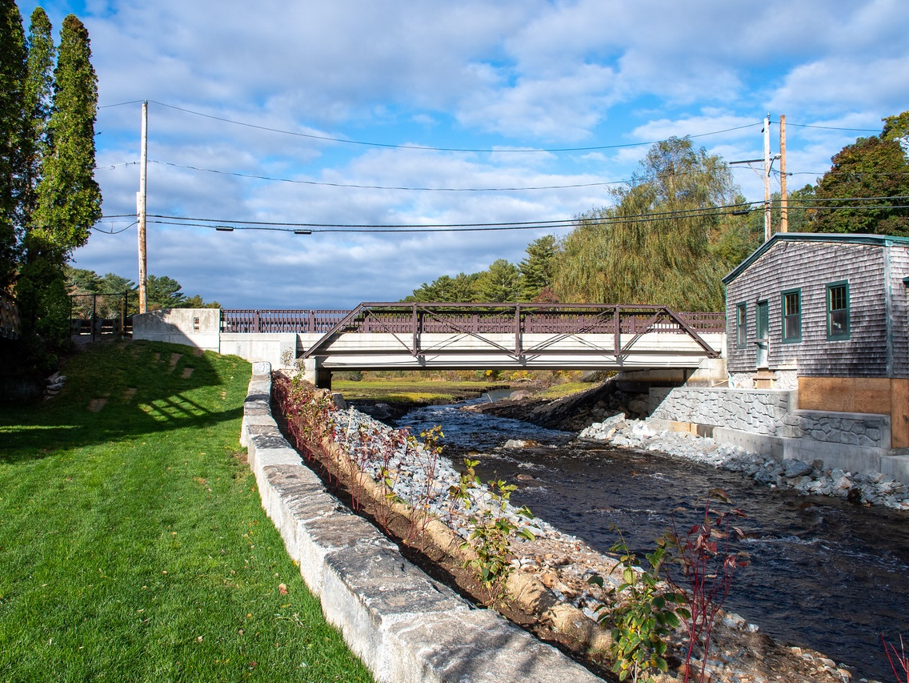
EEA Dam and Seawall Program
Publicly owned structures only – Municipal or 501(c)(3) nonprofit
Repair or replace with higher or more resilient designs
Consider removal when appropriate
EEA programs encourage nature-based solutions when feasible
Photo: Jones River Watershed Association
Photo: W. Hinkley
Photo: Jones River Watershed Association

Slide 3
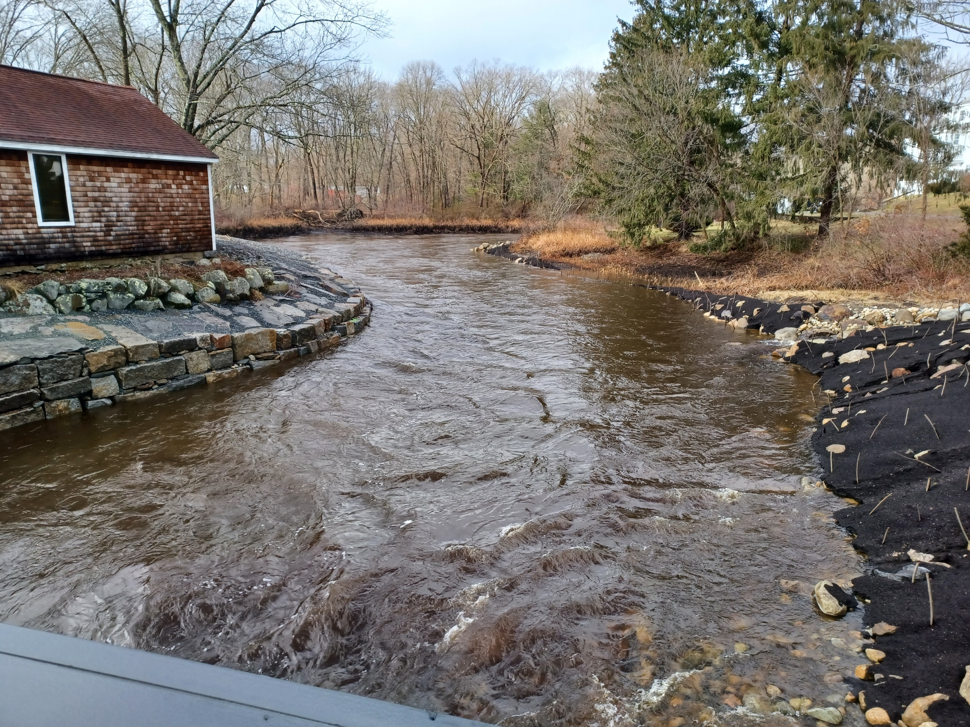
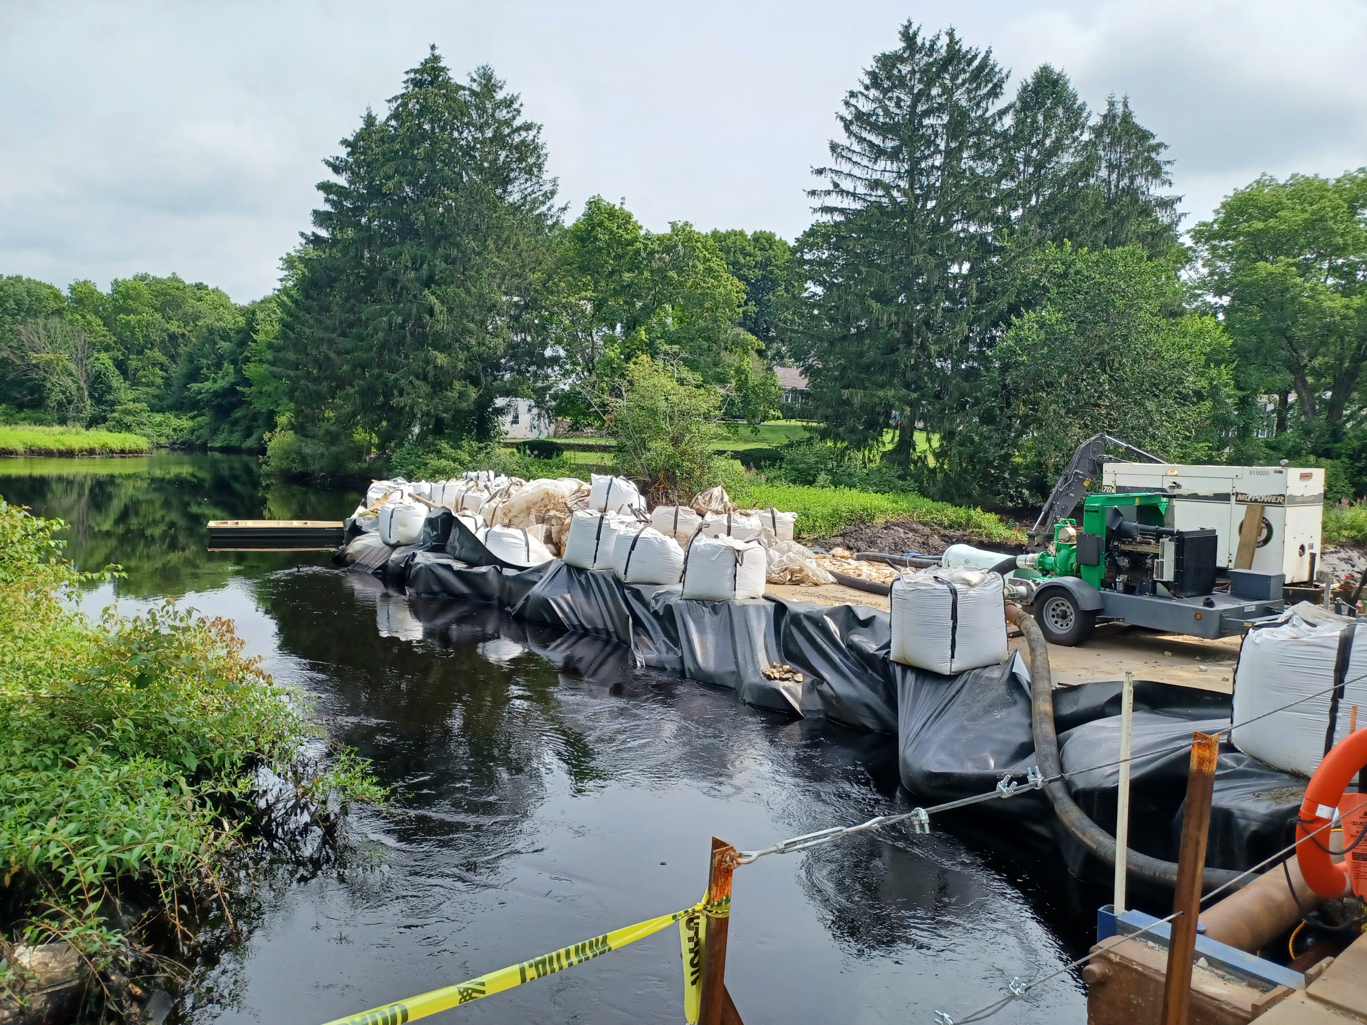
EEA Dam and Seawall Program
This is a SAFETY program first!
Intended to support the Dam Safety Regulations at 302 CMR 10
Prioritize dams classified as “HIGH” or “SIGNIFICANT” hazards
Prioritize dams in “POOR” or “UNSAFE” physical condition
Dam removal projects are eligible
Non-Jurisdictional Dams are NOT eligible

Slide 4
Grants
APPLICATION PERIOD OPEN NOW UNTIL APRIL 25, 2025
For projects beginning July 2025
Design and Permit Grants
Up to $250,000 for dams and levees, $500,000 for coastal projects
To advance project to bidding stage
MEPA, Corps of Engineers, Conservation Commission, DEP 401 and Ch. 91, Dam Safety, etc.
Construction Grants
Up to $1,000,000 for dam and levees, $3,000,000 for coastal projects
For construction only. Permits must be in place. “Shovel ready”
Minimum 10% cash matching funds required
Projects must have a clear public purpose
Very competitive! Less than ½ of applications are funded
Public access is very important. Projects without public access are less competitive.
Grants are on a reimbursement basis

Slide 5
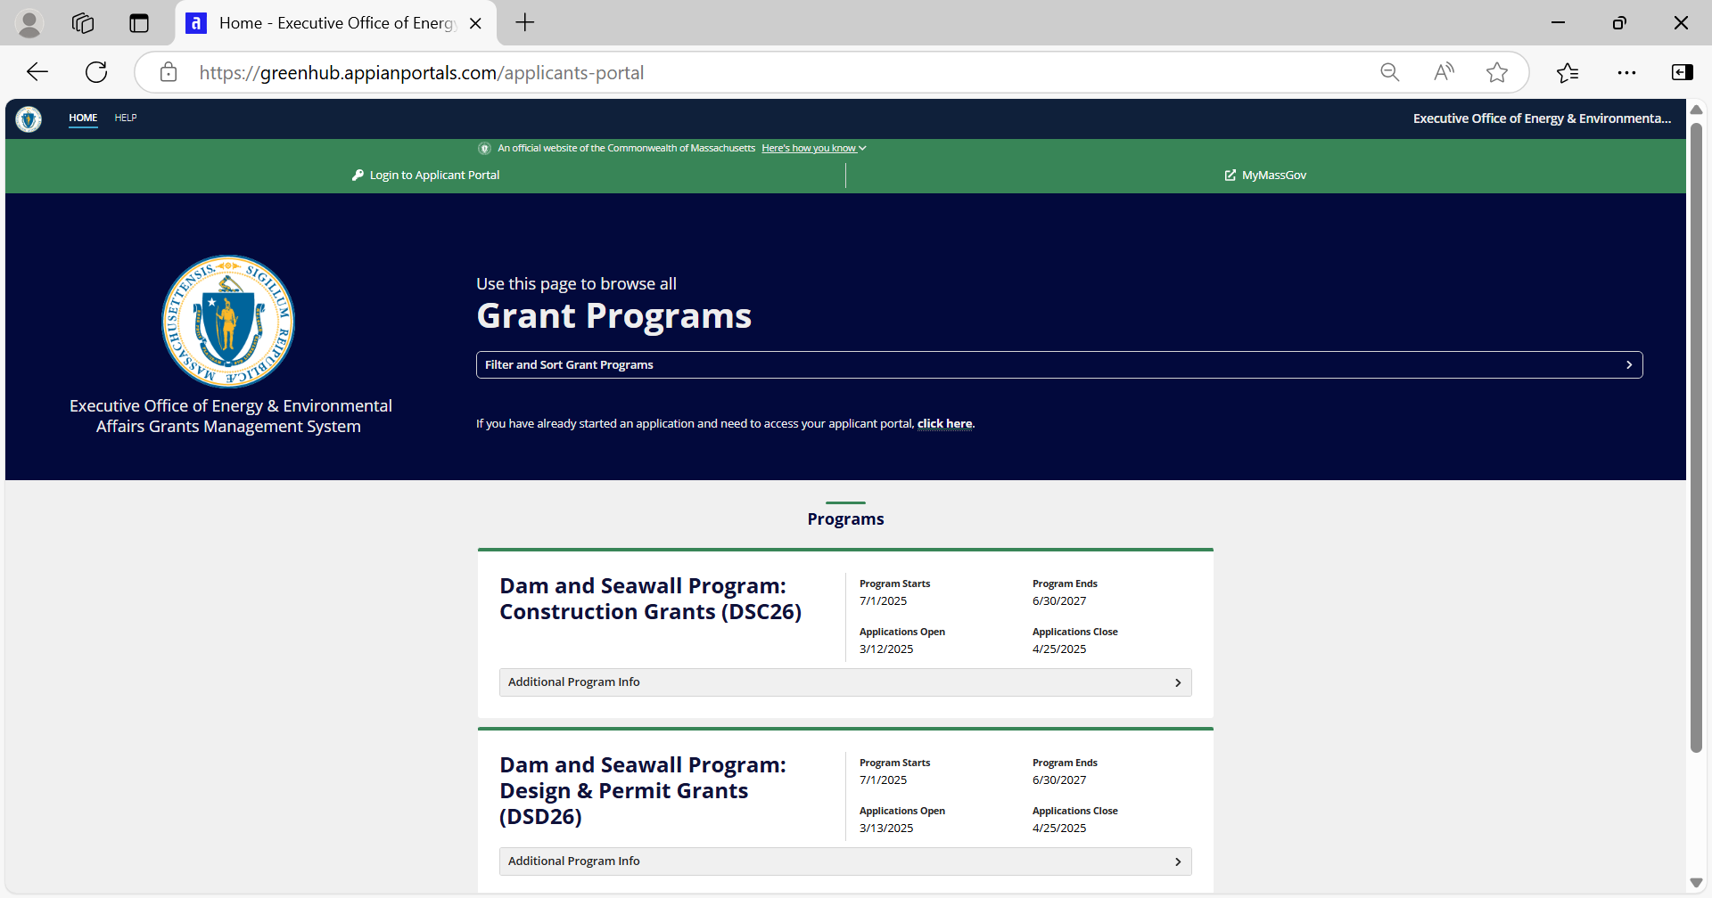
Apply with the new EEA Grants Management System: https://greenhub.appianportals.com/applicants-portal
Click HELP for user guide and YouTube video tutorial playlist
GMS uses the MyMassGov tool for user name, password, and multifactor authentication
https://www.mass.gov/mymassgov-for-personal-or-business-use

Slide 6
Addressing Private and Abandoned Dams
In partnership grants:
Municipality or Nonprofit must be responsible for all aspects of project
Finances, including reimbursement
Matching Funds
Public Bidding and Procurement Compliance
Vendor/Contractor Supervision & Coordination
Reporting

