Slide 1
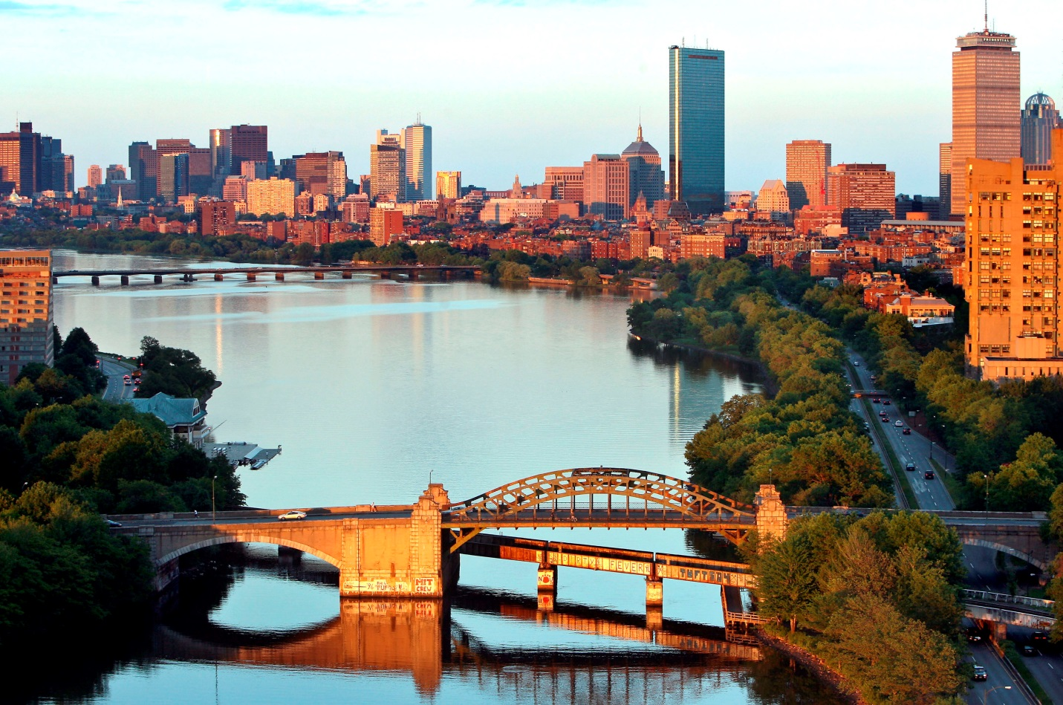

CHARLES RIVER WATERSHED ASSOCIATION
Adopting the
Climate Adaptation Stormwater Standard in the Charles River Watershed
September 25, 2025
Notes:
“Good afternoon], everyone, and welcome!
Thank you for joining us for today’s webinar: Rain Check – Strengthening Stormwater Rules for Climate-Resilient Communities. My name is Arianna Proia , and I am the community organizer at Charles River Watershed Association, and we’re thrilled to have you with us.
As communities throughout the region face increasing challenges from more intense storms, flooding, and aging infrastructure, strengthening our local stormwater policies has never been more important.
Today, we’ll be sharing findings and recommendations developed in partnership with the UNH Stormwater Center, focused on how tiered, practical updates to stormwater regulations can reduce flood risk, improve water quality, and support climate resilience.
Before we get started, a quick few housekeeping notes:
This webinar is being recorded and will be made available afterward.
Please feel free to drop your questions into the Q&A box at any time—we’ll have a dedicated Q&A session toward the end.
If you experience any technical difficulties, use the chat and our team will assist you.
Again, thank you for joining us. We’re looking forward to a great discussion—let’s dive in!”*

Slide 2
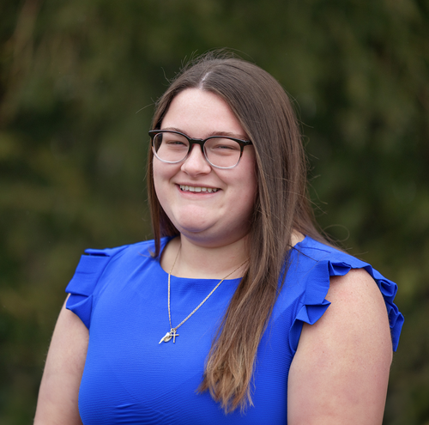
SPEAKERS
Arrianna Proia
Community Organizer, CRWA

Slide 3
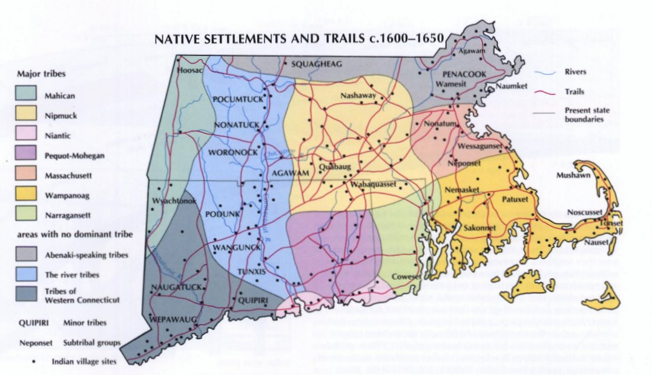

LAND & WATER ACKNOWLEDGEMENT
Charles River Watershed
We acknowledge the Massachusett, Wampanoag, and Nipmuc Nations as the past, present, and future caretakers of this land.

Slide 4
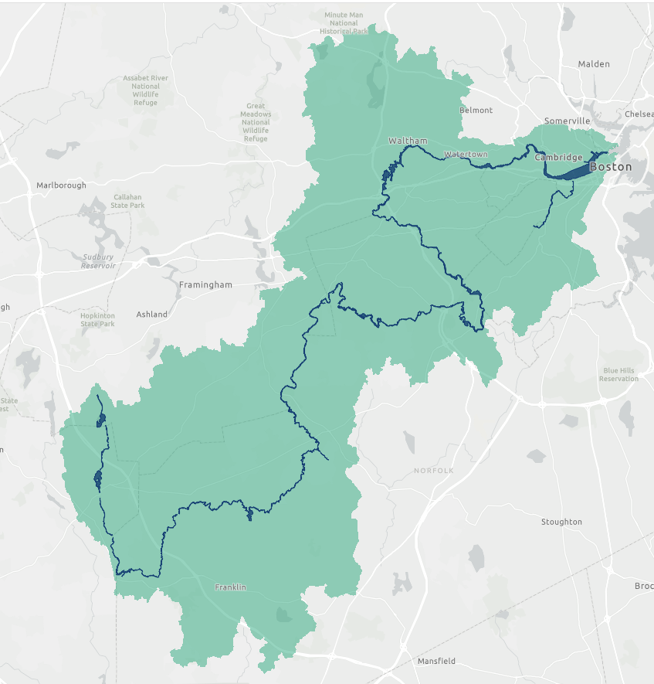

CHARLES RIVER WATERSHED ASSOCIATION
80-mile long river
308 mi² watershed
35 towns & cities
1M+ residents
60% of residents in Environmental Justice neighborhoods (primarily Lower watershed)
OUR MISSION
Protect, restore and enhance the Charles River and its watershed through science, advocacy, and law.

Slide 5
CLIMATE CHANGE
ISN'T COMING….
IT IS HERE

Slide 6
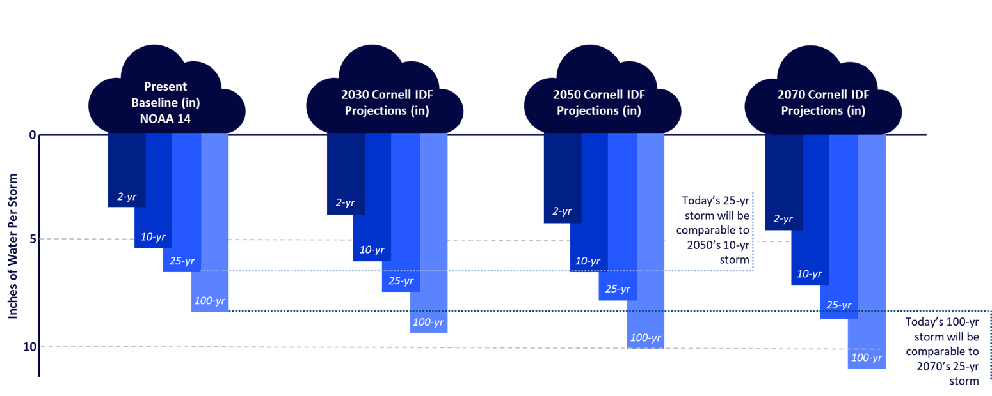
STORMS ARE GETTING STRONGER
Just a few more inches of rainfall could increase the Charles River’s volume by millions of gallons during a heavy storm.

Slide 7


WHAT TOWNS ARE FACING?
$
$
$
1. Compliance with the phosphorus reduction requirements set by the MS4 Permit
2. Climate related Flooding is increasing in frequency
3. Existing storm drain networks are aging and too small.

Slide 8
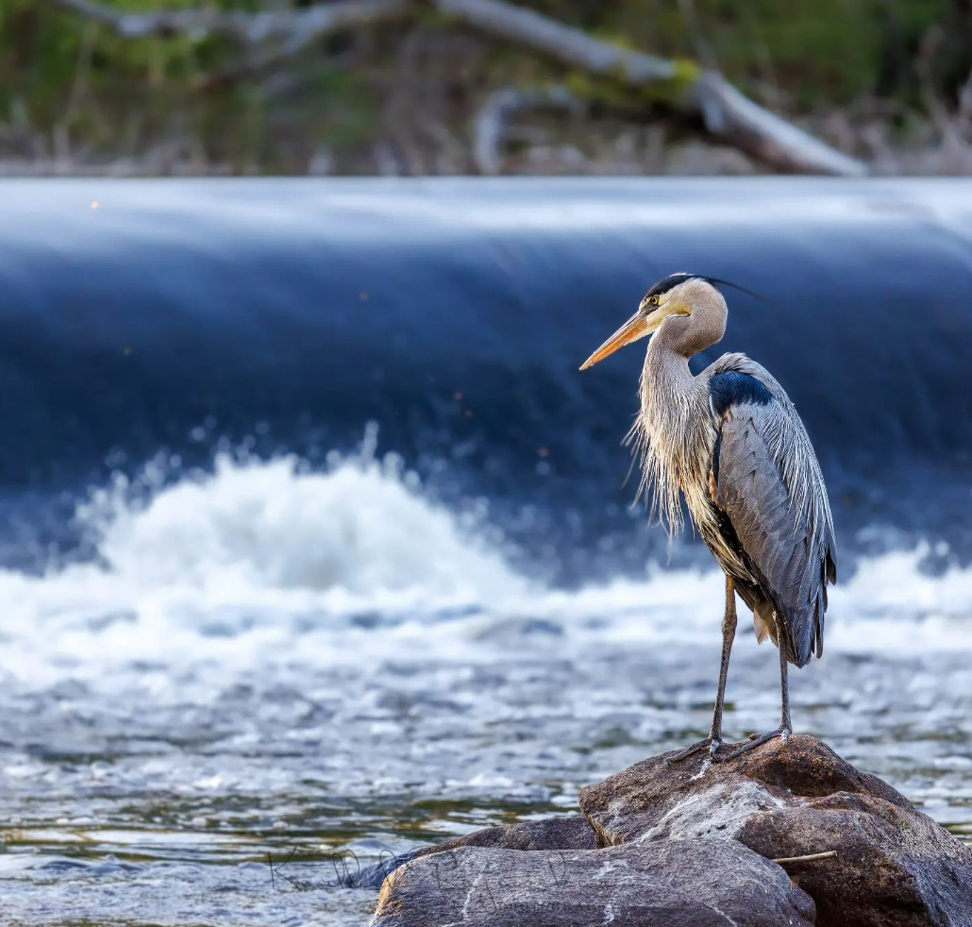
How do we
meet this challenge
Can strengthening local regulations:
Protect the river?
Save $?
Mitigate climate change?

Slide 9
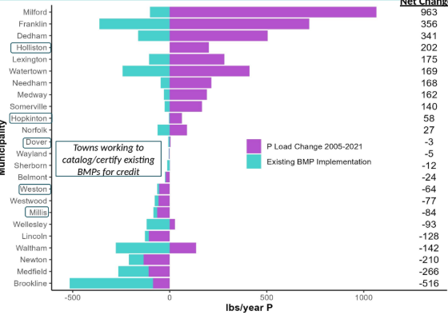
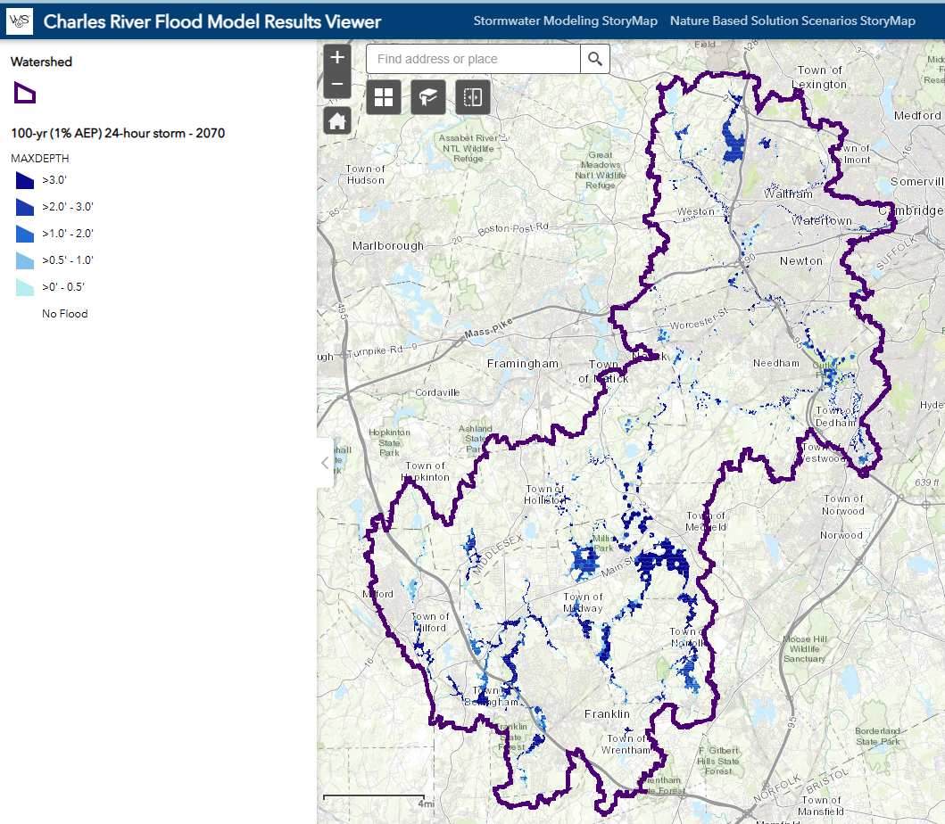
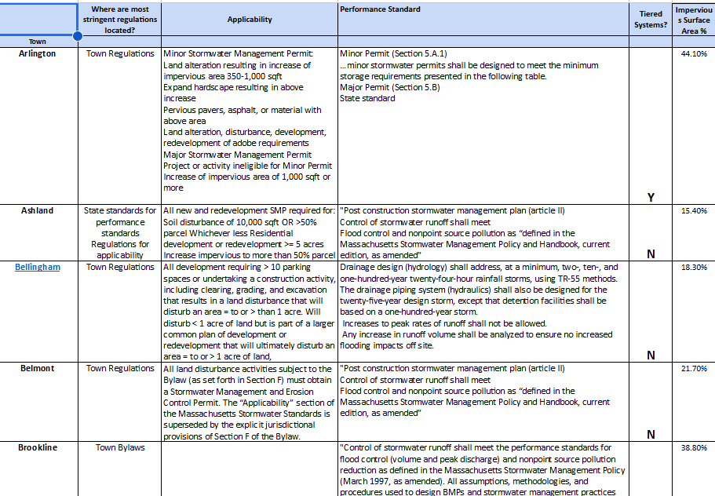
WHAT WE DID…
2023 PCP Review
CRWA
Flood
Modeling
2024-25 Bylaw Review

Slide 10
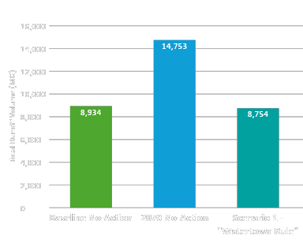
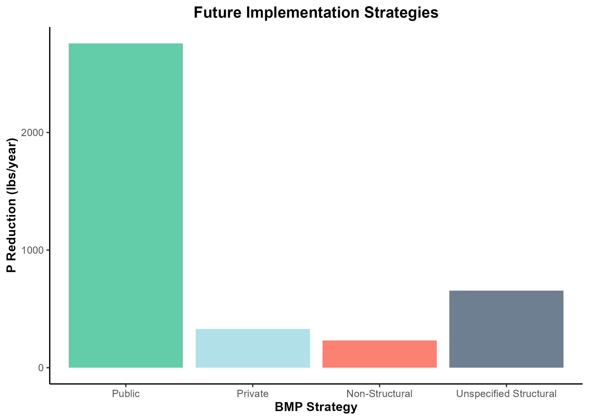
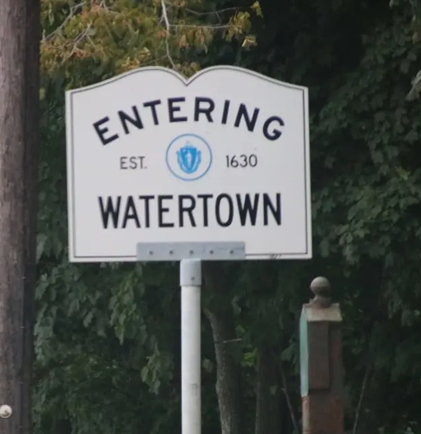
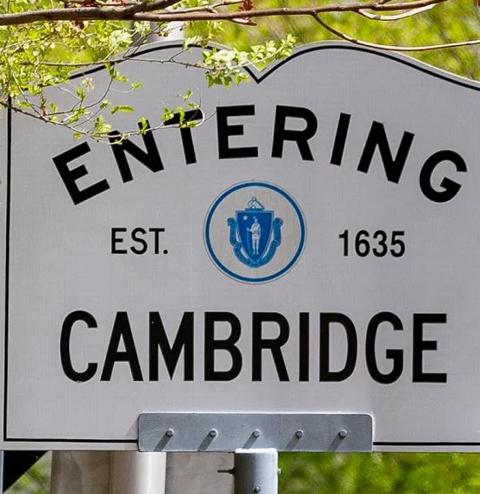
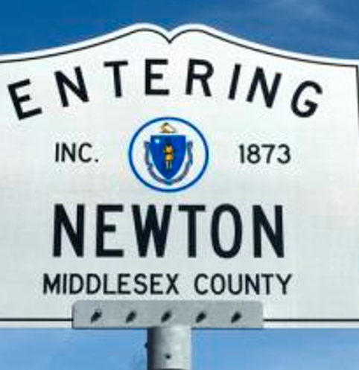
WHAT WE FOUND
2023 PCP Review
CRWA
Flood
Modeling
2024-25 Bylaw Review
UNEQUAL APPROACHES

Slide 11
Introducing
C.A.S.S
Climate
Adaptation
Stormwater
Standard

Slide 12

Importance of the 100 year retention system
Adopted by Waltham(2024) & Watertown (2022)
Adds climate resiliency & protects public safety
Reduces burden on aging infrastructure
Exceeds all local, state, and federal standards

Slide 13

Importance of a Tiered Permit System
Widely Adopted
  Already in use by communities like Newton, Arlington, Waltham, Somerville, and Brookline.
Scalable Regulation
  Requirements scale based on the size and impact of a project.
Broader Coverage
  Expands permit reach to more projects.

Slide 14
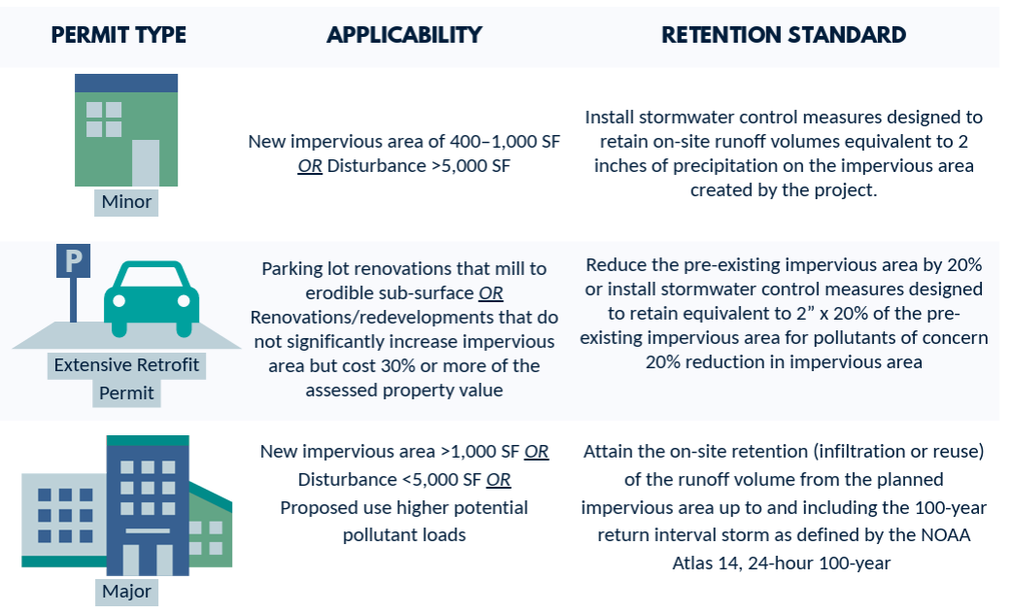
CASS Recommendations

Slide 15
Does it
work?
A case study on Watertown’s Regulations

Slide 16



OVERVIEW - What’s the Impact?
100-year Retention Standard IN ACTION in 2024…
8
29
Projects requiring stormwater report out of 20 total
Pounds of phosphorus removed from Charles per year
520,000
700,000
Cubic feet of runoff infiltrated (4 million gallons)
Square feet of impervious surface treated for the 100-year storm (16 acres)

Slide 17
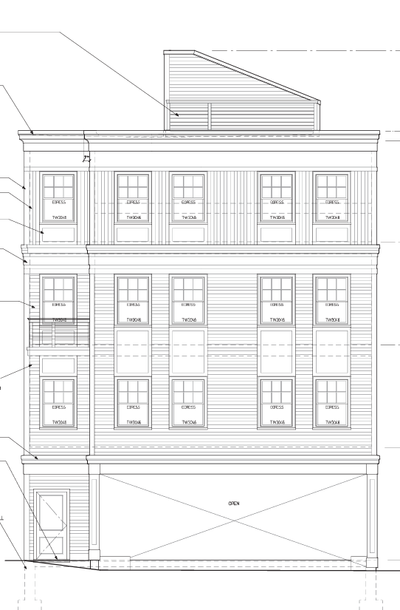
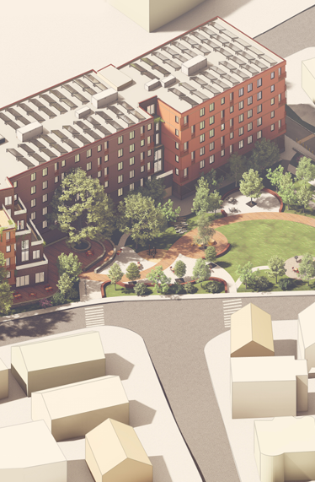
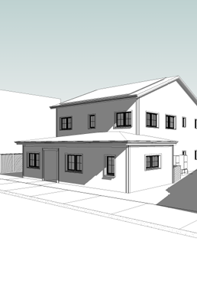
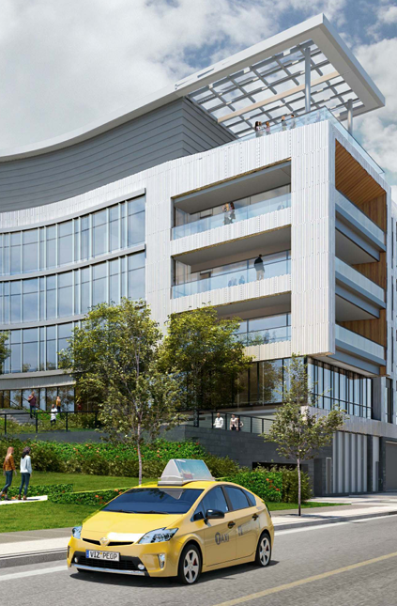
OVERVIEW - What Does it Look Like?
CLIMATE ADAPTATION INFRASTRUCTURE
Case Studies (Watertown, MA)
103 NICHOLS AVE.
8 QUIMBY ST.
Site Area (SF) | 2,800
Impervious Area (SF) | 2,040
100-yr Storm Volume (CF) | 1,510
Infiltration Rate (in/hr) | 8.27
Storage Volume (CF) | 500
Site Area (SF) | 107,000
Impervious Area (SF) | 74,500
100-yr Storm Volume (CF) | 55,300
Infiltration Rate (in/hr) | 2.41
Storage Volume (CF) | 23,500
12 CHURCH HILL ST.
66 GALEN ST.
Site Area (SF) | 4,950
Impervious Area (SF) | 3,390
100-yr Storm Volume (CF) | 2,520
Infiltration Rate (in/hr) | 2.41
Storage Volume (CF) | 708
Site Area (SF) | 111,000
Impervious Area (SF) | 77,900
100-yr Storm Volume (CF) | 57,800
Infiltration Rate (in/hr) | 8.27
Storage Volume (CF) | 18,100

Slide 18
Implementing
CASS
How we engage the Charles River Watershed
Communities to adopt these regulations

Slide 19
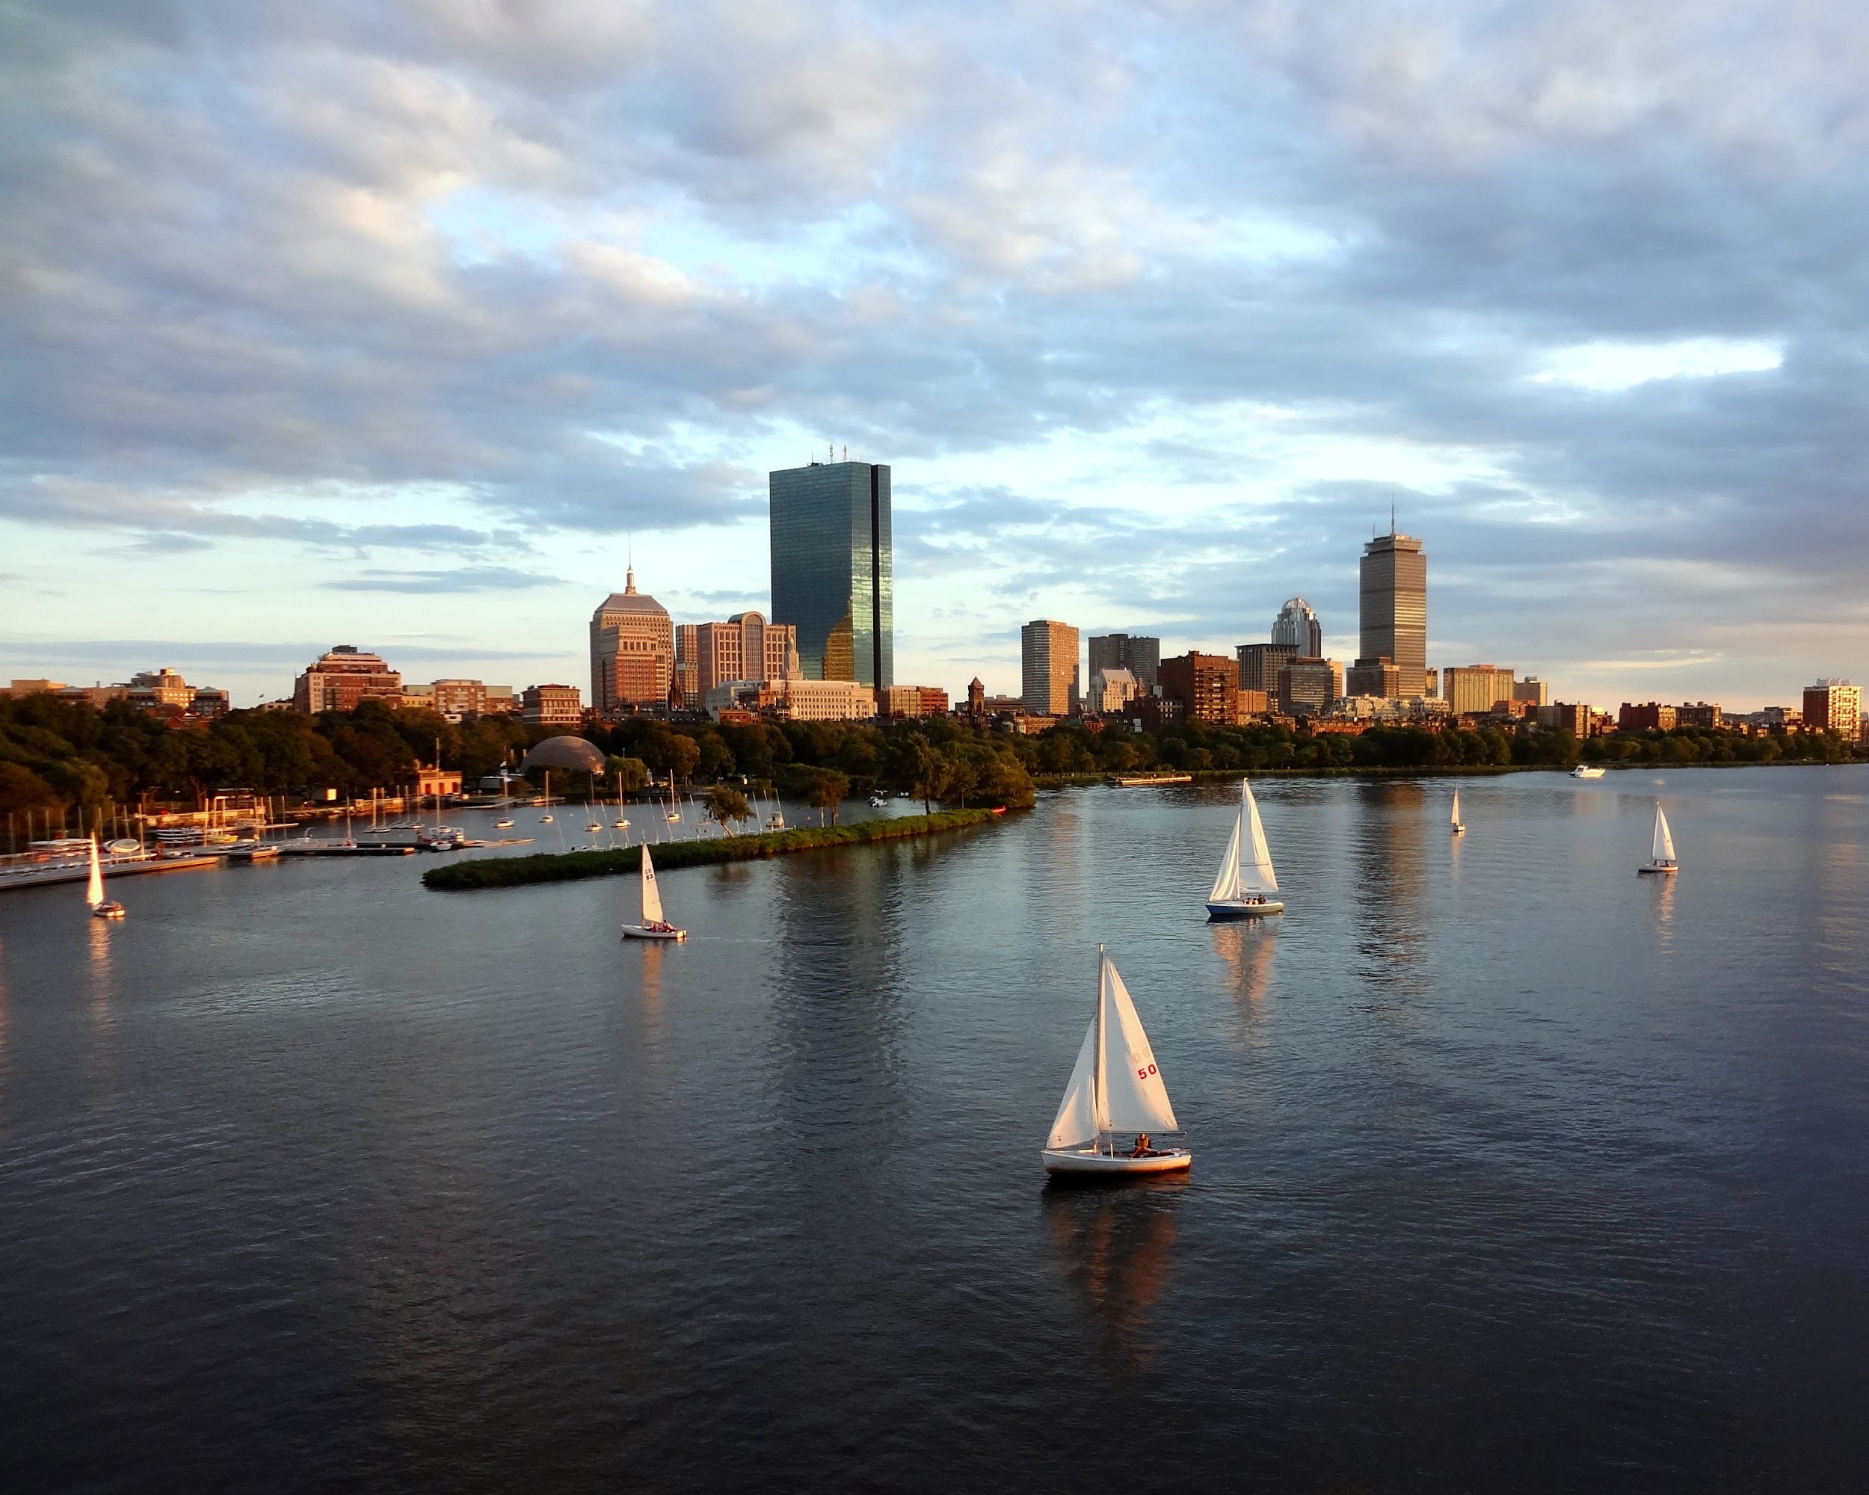



Questions?
Thank you!!
MAKE A GIFT TO SUPPORT OUR WORK
SUBSCRIBE TO OUR MONTHLY NEWSLETTER

