Slide 1
Municipal Vulnerability Preparedness Program
Photo Credit: Sean McCanty, NepRWA, 2022
Kara Runsten
MVP Program Director
MA Executive Office of Energy and Environmental Affairs

Slide 2
Climate resilience is the ability of a community to address the needs of its built, social, and natural environment to anticipate, cope with, and rebound stronger from events and trends related to climate change hazards.
Resilient communities don’t just recover—they continuously build capacity to reduce the impacts of future climate events.
Photo Credit: Sean McCanty, NepRWA, 2022

Slide 3
FY26 Action Grant Round Details
Eligible entities: Municipalities, political subdivisions, tribal governments
Max $3M for individual; $5M for regional projects
10% match required, with exceptions
Reimbursement based
RFR release: Late February 2025
Access the application on CommBuys
Applications due: April 4, 2025
Award announcement: ~June 2025
Projects start: ~September 2025
Projects end: June 30, 2026 OR June 30, 2027 (make clear phases in each fiscal year)

Slide 4
MVP Core Principles
Furthers a community identified priority action to address climate change impacts.
Employs Nature-based solutions (NBS).
Increasing equitable outcomes for Environmental Justice (EJ) and other priority populations and addressing the root causes of social vulnerability.
Achieves broad and multiple community benefits.
Builds community capacity for climate resilience.
Commits to monitoring project success and maintaining the project into the future.
Conducts robust community engagement and supports strong partnerships with EJ and other priority populations.
Utilizes regional solutions for regional benefit.
Utilizes climate change data for a proactive solution.
Pursues innovative, transferable approaches.

Slide 5
Haverhill Little River Dam Removal
MVP funded many phases of this dam removal project
Resilience impacts:
Reduces risk of riverine flooding in an EJ neighborhood
Increases access to the river for cooling and recreation
Restoration of river and riverfront
Removal of high hazard dam
Removal of debris and contamination
Enhance fish passage and habitat
Increase tree cover
Total construction cost ranges from $9.2 – 12.3 million
Current secured construction funding includes:
$3M MVP Action Grant
$1M Dams and Seawalls Grant
$1M Inland Dredging Grant

Slide 6
Monatiquot River Restoration
Braintree FY 21-24
Learn More:
Project Website
$750,000
$250,000
Construction
Nature-based Solutions for Ecological and Public Health
The project is located on private property and
removed two obsolete dams
removed contaminated sediment and restored the river channel
created a public walking trail along the river
Located in an EJ neighborhood

Slide 7
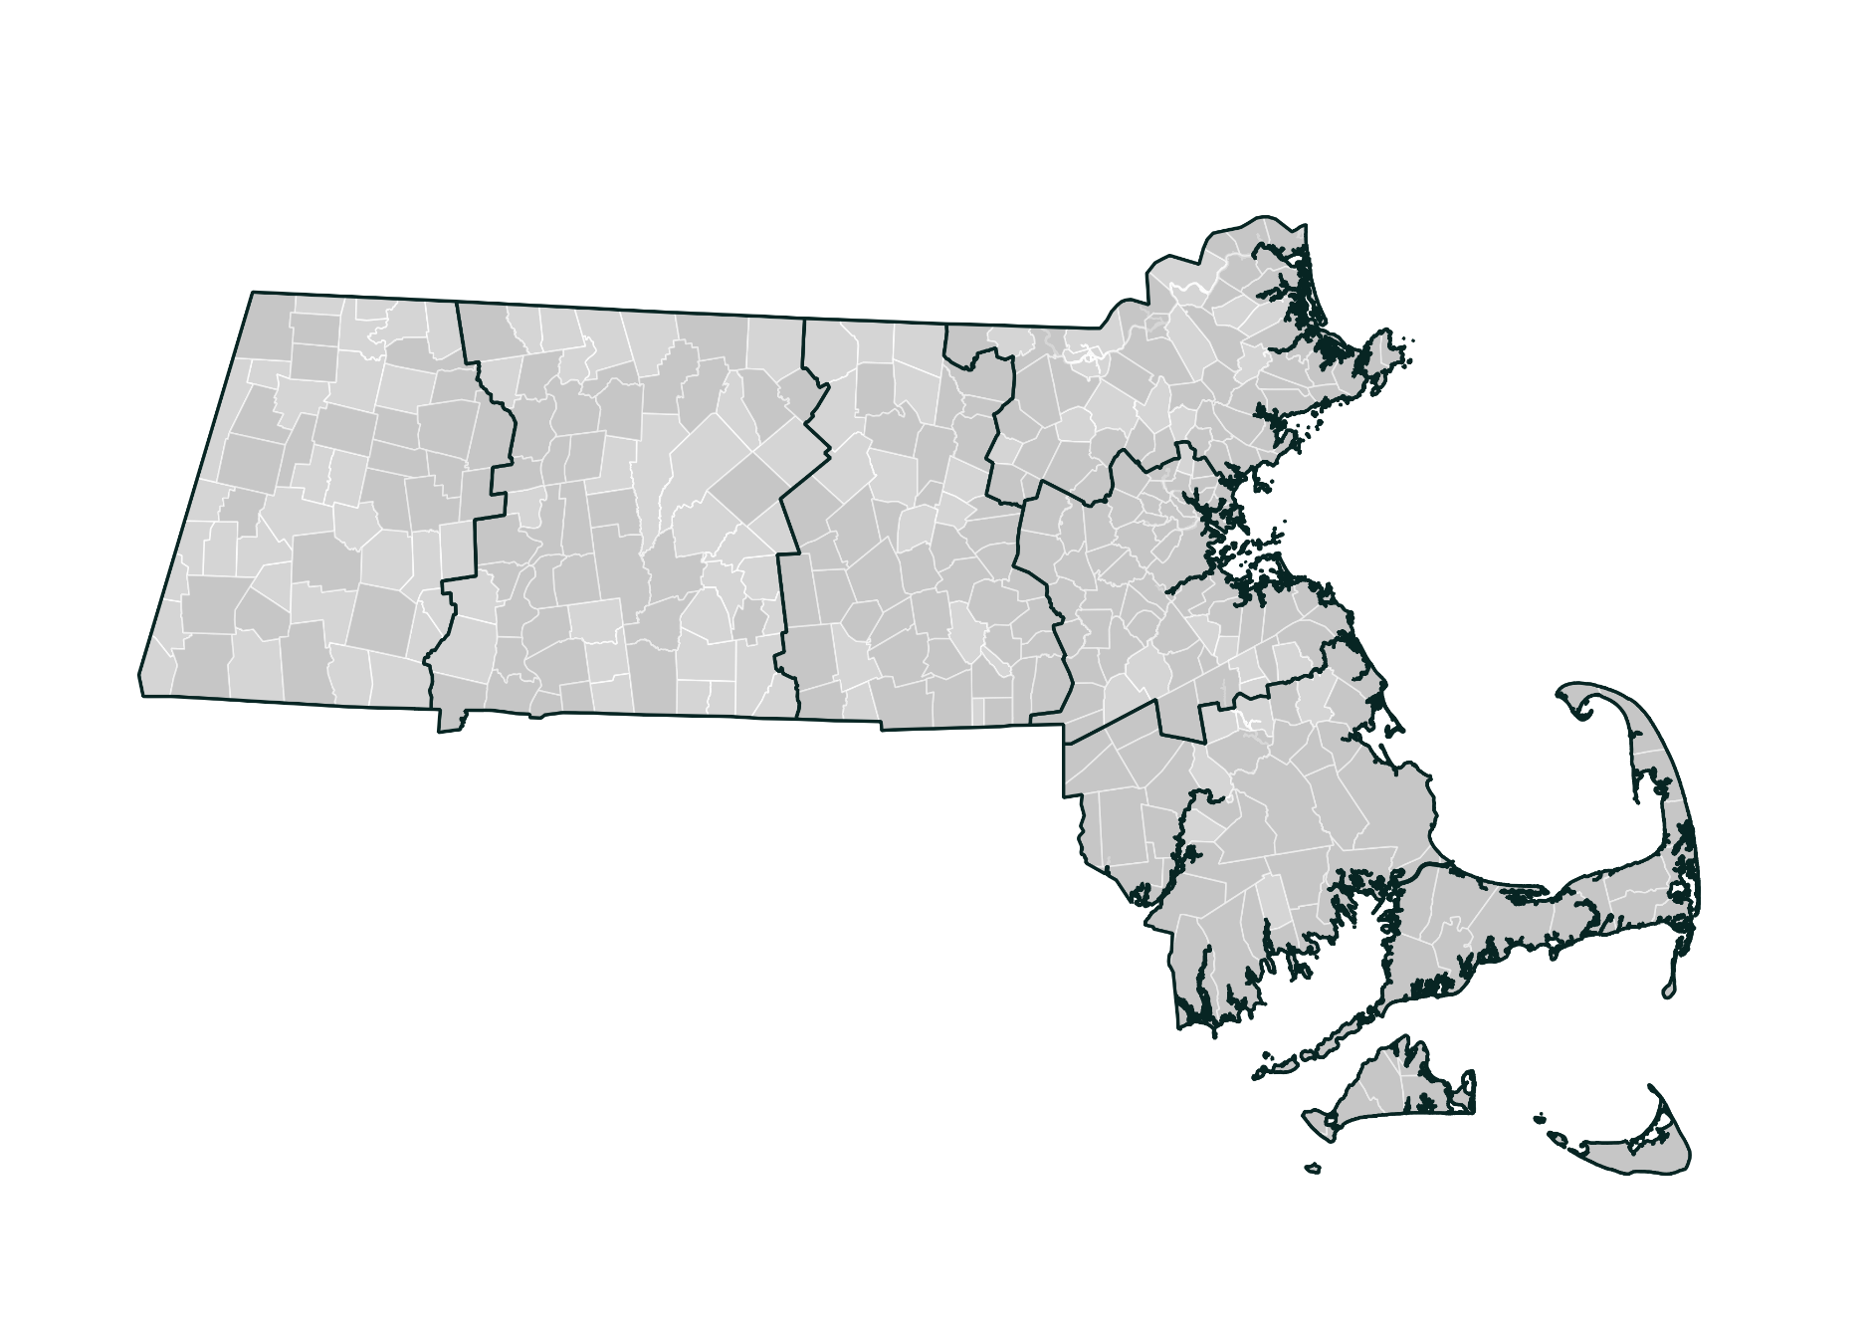
Contact Us
Regional Coordinator:
Andrew Smith andrew.b.smith@mass.gov
617-655-3874
Northeast
Regional Coordinator:
Michelle Rowden michelle.rowden@mass.gov
857-343-0097
Greater CT River Valley
Berkshires & Hilltowns
Greater Boston
Regional Coordinator:
Carolyn Norkiewicz
carolyn.m.norkiewicz@mass.gov
617-894-7128
Central
Regional Coordinator:
Emma Sass
emma.m.sass@mass.gov
857-283-7597
Regional Coordinator:
Hillary King
hillary.king@mass.gov
617-655-3913
Southeast
Find your region by municipality: https://www.mass.gov/service-details/contact-mvp-regional-coordinator
Regional Coordinator:
Courtney Rocha
courtney.rocha@mass.gov
617-877-3072
Sign up for our newsletter: Signup Form

