Slide 1


Asset Management Planning Grant Program Overview

Slide 2



Overview of the Massachusetts Clean Water Trust
The Trust was established in 1989 to finance water infrastructure projects in the Commonwealth.
The Trust and MassDEP jointly administer the Clean Water (CW) and Drinking Water (DW) State Revolving Funds (SRFs) which assist communities in complying with the Clean Water and Safe Drinking Water Acts.
To date, the Trust has financed approximately $9.6 billion in loans for nearly 300 communities, serving 97% of the Commonwealth’s population.
While loans remain the main financing option the Trust provides, the Trust also offers financial assistance through its grant programs.
IMPROVE
water quality
PROTECT
the environment
in the Commonwealth through the provision of low-cost capital financing to cities, towns, and other eligible entities
PROTECT
public health

Slide 3





Asset Management Planning (AMP) Grant Program
Launched in 2019 to assist eligible entities with completing or updating asset management plans for drinking water, wastewater, and stormwater systems.
Awards grants of $150,000 or 60% of eligible project cost, whichever is less. Eligible entities provide the remaining amount with in-kind services (IKS), a cash contribution, or an SRF loan.
Priority is given to:
  Small communities and utilities (population less than 10,000 or small systems that service fewer than 3,000 connections)
  First-time AMP grant applicants
  AMP proposals that address the 5 core components of an AMP, including an inventory and condition of current assets, level of services, criticality analysis, life cycle costs, and long-term financial planning.

Slide 4
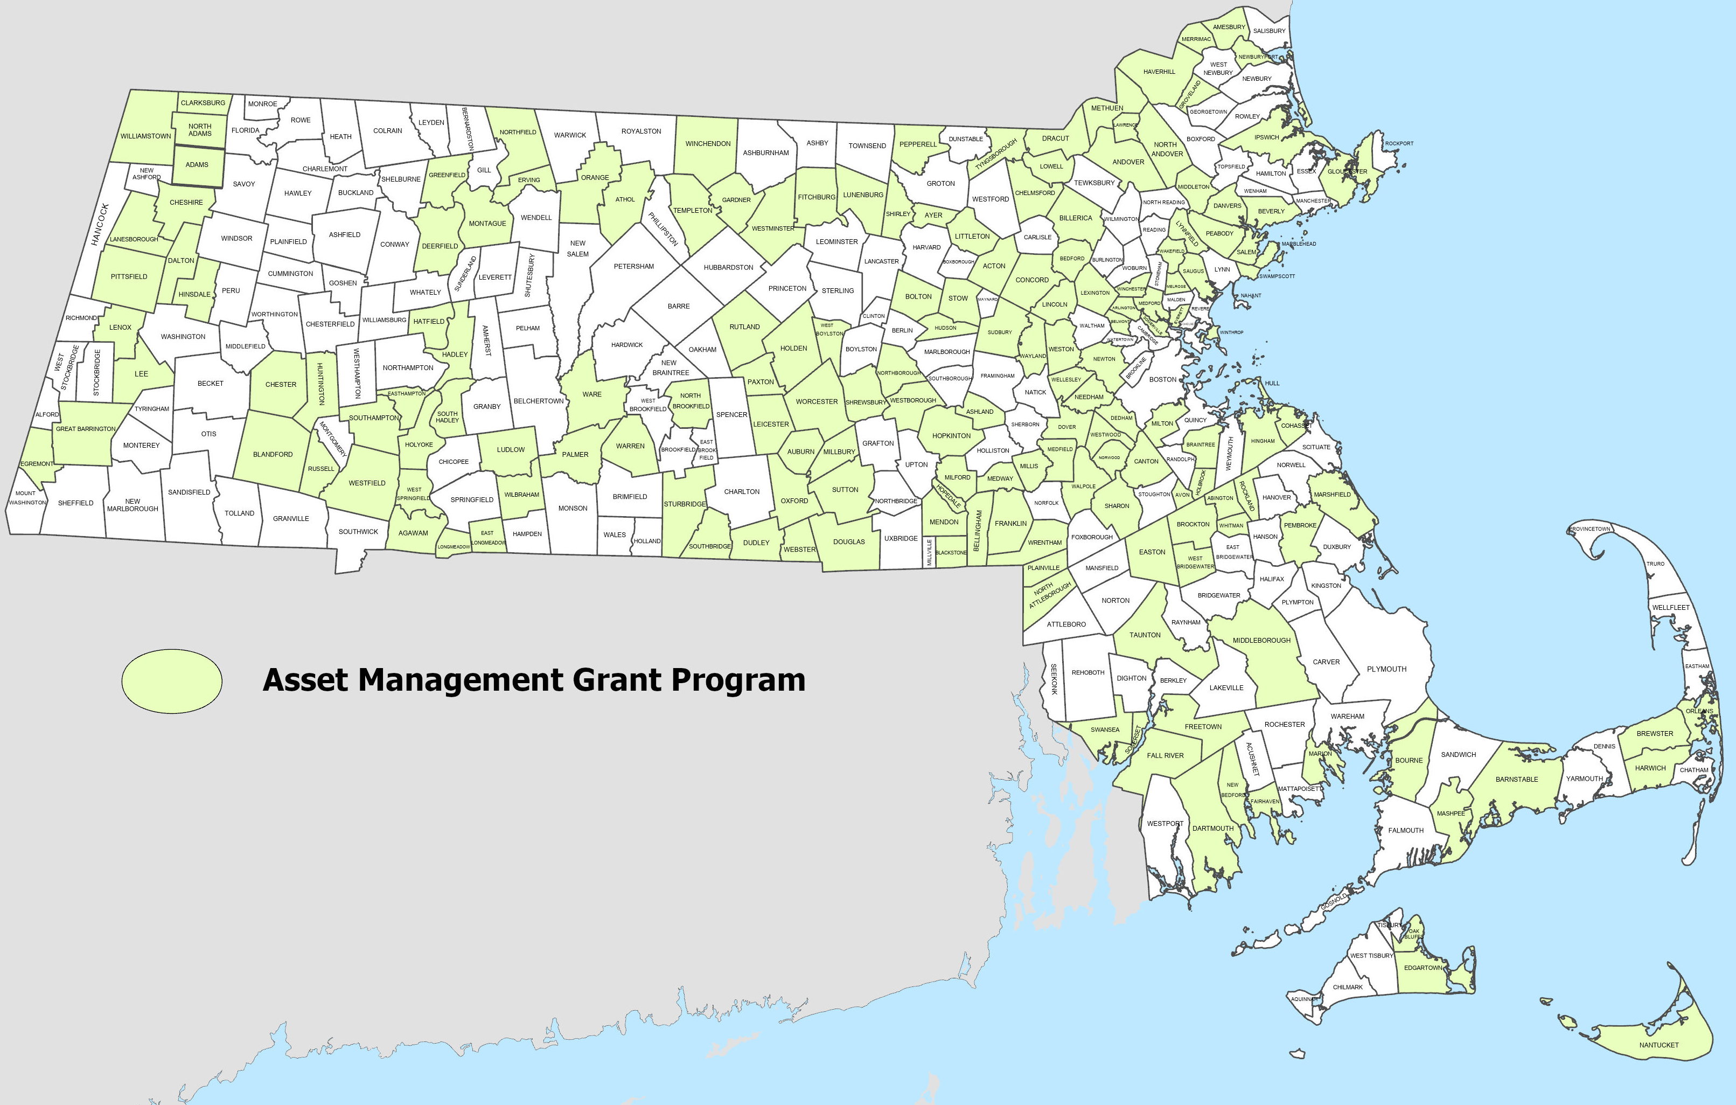
AMP Grants Across Massachusetts
Recipients 2019-2025

Slide 5
AMP Grant Program Goals
The goals of the AMP Grant Program are to:
  Improve upon existing maintenance practices to ensure the regular replacement of mechanical systems prior to failure;
  Develop and identify equipment replacement costs to establish and evaluate annual budget line items;
  Outline the annual cost effects on a rate charge system and line items in annual budgets when an asset management plan is established;
  Establish an inventory of existing equipment that will allow a replacement program to be developed;
  Provide an AMP that will ensure that the operational continuity of the water resource infrastructure systems is in place to protect public health and the environment;
  Assist with acquiring computer software and hardware for data collection, to track and organize asset management priorities more efficiently;
  Promote cybersecurity assessments to address vulnerabilities in the water systems and to protect public health and the environment.

Slide 6








Applying for an AMP Grant
Funding for AMP Grants is contingent on the availability of funds.
Some important timelines in the application calendar:
  Project solicitation occurs between May and July of each year.
  Final Intended Use Plans (IUPs) are published in the early months of the following year.
  Submission of the final scope of work and grant application is required by early October.
Applications for all SRF programs, including the AMP grant program, can be submitted to MassDEP by following the guidance at https://www.mass.gov/lists/state-revolving-fund-applications-forms.

Slide 7









AMP Grant Requirements
Eligible applicants include all municipalities and public wastewater districts that manage a stormwater system.
Applicants are limited to one grant per utility per IUP cycle.
The applicant must address all five core components and include a full report.
AMP projects are expected to be completed within two years of the date the grant was awarded.
Eligible costs for reimbursement are limited to those needed to complete the five core components of an AMP project.
2yrs

Slide 8



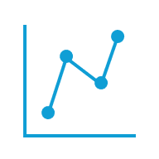


5 Core Components of an AMP Project
Asset Inventory & Condition
  Creating an inventory
  Verifying available information and documenting condition of existing assets
  Assessing remaining useful life, value, and replacement costs
  Documenting/labeling asset location
Level of Service
  Establishing Level of Service Goals (metrics might include, i.e. customer demand and regulatory requirements)
  Assessing performance data
  Communicating with staff and public
Criticality/Risk Analysis
  Determination of critical assets
  Likelihood/consequence of failure determination, including that caused by climate change
  Cybersecurity (assessment only)
  Criticality matrix
  Prioritization of asset replacement/rehabilitation

Slide 9

5 Core Components of an AMP Project (Continued)
Life Cycle Cost Analysis
  Accounting for Capital, Replacement, and Operation and Maintenance Costs
Long-term Funding Strategy
  Creation of sustainable financial structure to meet full cost of providing level of service over long term
  Review of funding options
  Review and revision of existing rate structure
  Preparation of budget/Capital Improvement Plan
Additional eligible cost: Asset Management Software
  Limited to one time per applicant
  Only for first-time purchasers, not replacement or subscription fees of existing software

Slide 10
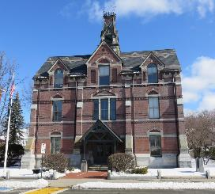
Example of AMP Project Funded
AYER CWA-21-15 | Stormwater Asset Management Plan
The Town of Ayer was awarded a $72,750 Asset Management Planning grant for its stormwater system in 2021. Total project cost was $121,250.
Examples of the activities the Town performed through the grant are:
Updating and improving the Town's existing GIS data by expanding the number of assets on record
Completing a condition assessment of the Town's stormwater infrastructure
Performing a Criticality Analysis to develop a priority list of assets and secondary list of assets to help prioritize activities in five-year cycles
Developing a Capital Improvement Plan for stormwater infrastructure to assist the DPW in proactively planning for system improvements
Ayer's DPW director, Dan Van Schalkwyk, highlighted the impact that the grant had on informing the Town on the urgency of improving its infrastructure:
“Just the sheer number of assets that we have that we need to maintain…it really was a help toward the town understanding.”
This led to the Town implementing an enterprise fund to help fund stormwater infrastructure improvements

Slide 11
Trust and MassDEP Contacts
The Trust
Sue Perez | Executive Director
617-367-9333 x816 | sperez@tre.state.ma.us
Nate Keenan | Deputy Director
617-367-9333 x508| nkeenan@tre.state.ma.us
Josh Derouen | Program Manager
617-367-9333 x515 | jderouen@tre.state.ma.us
Jonathan Maple | Senior Policy Analyst
617-367-9333 x546 | jmaple@tre.state.ma.us
Aidan O'Keefe | Program Associate
617-367-9333 x545 | aidan.k.okeefe@tre.state.ma.us
MassDEP
Robin McNamara | Acting Director of Municipal Services
857-301-0974 | robin.mcnamara@mass.gov
Michele Higgins | Program Manager
857-268-3296 | michele.higgins@mass.gov
Greg Devine | Section Chief
Northeastern and Western Regions
617-874-6456 | gregory.d.devine@mass.gov
Lilla Dick | Section Chief
Central and Southeastern Regions
857-276-3846 | lilla.dick@mass.gov

