Slide 1
TOWN OF WELLESLEY
IMPLEMENTING A
STORMWATER UTILITY:
LESSONS LEARNED
Practical Tips for Success!
Eilish Corey, PE
Senior Civil Engineer

Slide 2
Why We’re Here
Share our experience to help other municipalities
Provide practical insights from 1st year of implementation
Identify pitfalls to avoid and best practices to adopt

Slide 3


THANK YOU
To All Who Made It Happen!

Slide 4
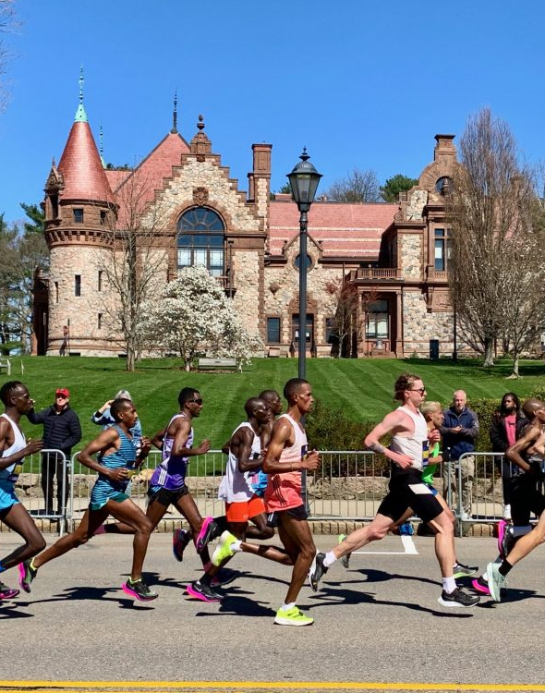
Town of Wellesley
Population: 29,550; predominantly residential with limited commercial/institutional nodes
MS4 Permit: 100% coverage in the Charles River Watershed
System Challenges: Aging drainage + stricter MS4 requirements + heavier storms

Slide 5
History of Wellesley’s Stormwater Program
  Historically, stormwater management was focused mainly on Quantity
    We maintained our drainage system and made improvements as needed.
  In 2003, the new MS4 permit shifted the focus to Quality
    The 2016 revised MS4 raised the bar again

Slide 6
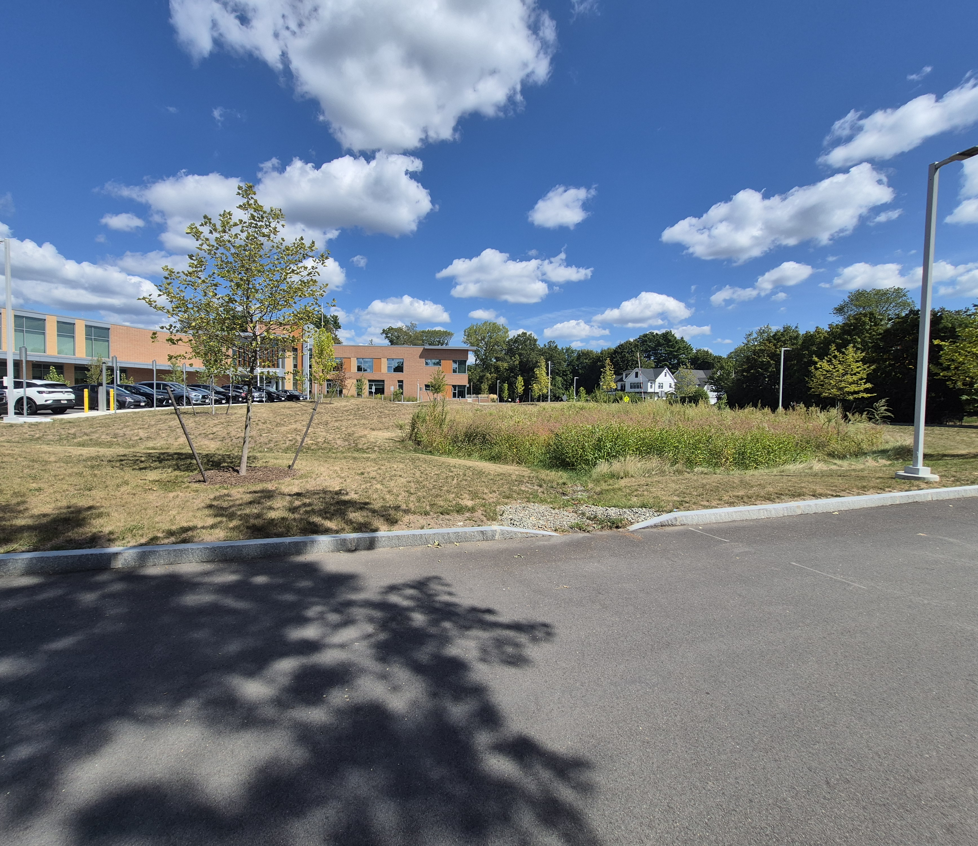
History of Wellesley’s Stormwater Program
Past practices will not:
  Satisfy future regulatory requirements,
  Improve water quality in the Charles River and local waters, or
  Meet climate change and sustainability goals.
  Future program will need to:
  Increase municipal operation & maintenance practices,
  Invest in capital projects for flood control, infrastructure resilience, and water quality, and
  Encourage public-private partnership

Slide 7

What is a Stormwater Utility?
Dedicated funding mechanism for stormwater services
  Funding had historically been through the General Fund (Tax Revenue)
Stormwater Utility Fee vs. General Fund: Multiple advantages for Wellesley’s Program
  Stable – Dedicated Revenue Source for Financial Sustainability
  Equitable & Fair - Based on Stormwater Impact vs. Property Value (Taxes). Includes tax-exempt properties.
  Flexible – Enterprise Fund can pay for all aspects of the program
  Credit Policy – Ability to provide a financial incentive for stormwater improvements on private property
We need to fund the current and future Stormwater Management Program, and this is a fairer way to share the costs.

Slide 8
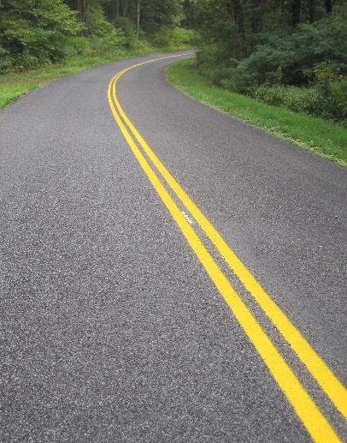
Impervious Area Billing
Equivalent Residential Unit (ERU) = 3,100 square feet
Impervious
  Roofs
  Asphalt/Concrete
  Compacted Gravel << Controversial!
  Porous Pavement
  Pools
Not Counted as Impervious
  Uncompacted gravel, including paths
  Decks – porous ground underneath
  Patios – low cost/benefit for us to monitor

Slide 9
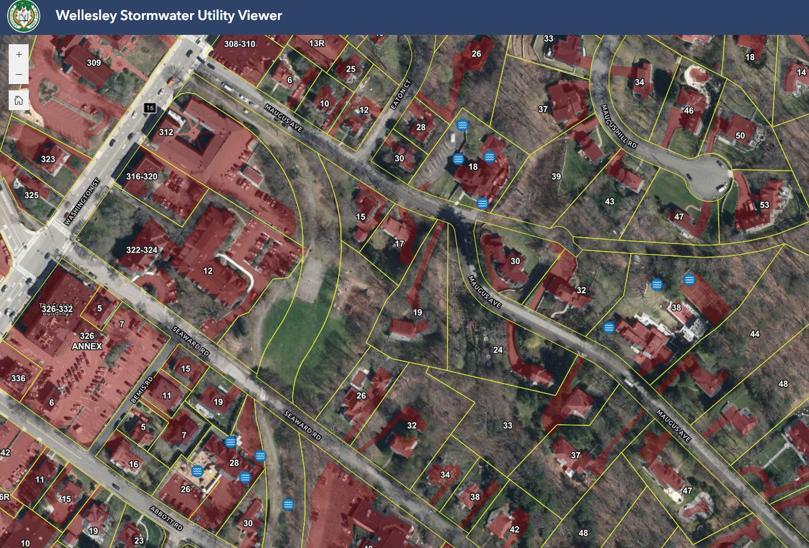
Who is Billed?
Billed
  Residential Properties
  Non-Residential Property
  State Property
  Other Municipalities
  Public Land Leased by Private Owners
Exempt
  Property owned by the Town of Wellesley
  Undeveloped Land (<300 sf impervious)
  Railroad ROW (tracks)
  Private Roads

Slide 10
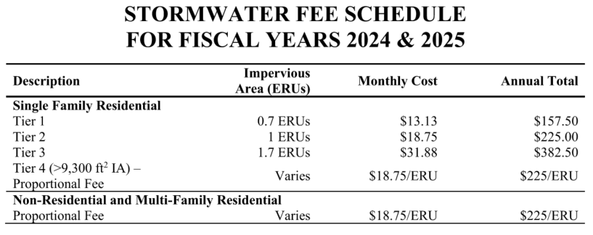
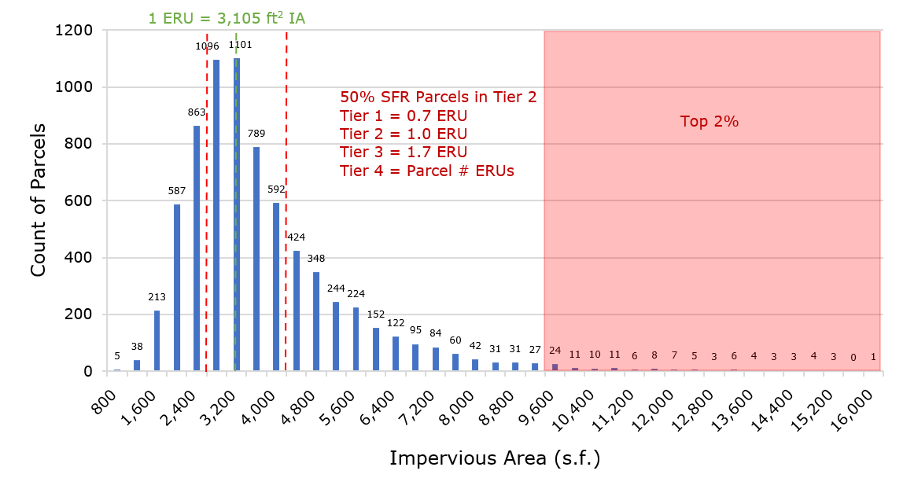
Rate Structure & Fees
Single Family Residential
1 ERU: Median Impervious Area (IA)
  3,100 sq ft
  Fee $225/ERU
  Tiers 1 - 3 with Flat Fee
  Tier 4 Proportional to Number of ERUs
Non-Single Family Residential and Multi-Family Residential
Fee Proportional to Number of ERUs

Slide 11
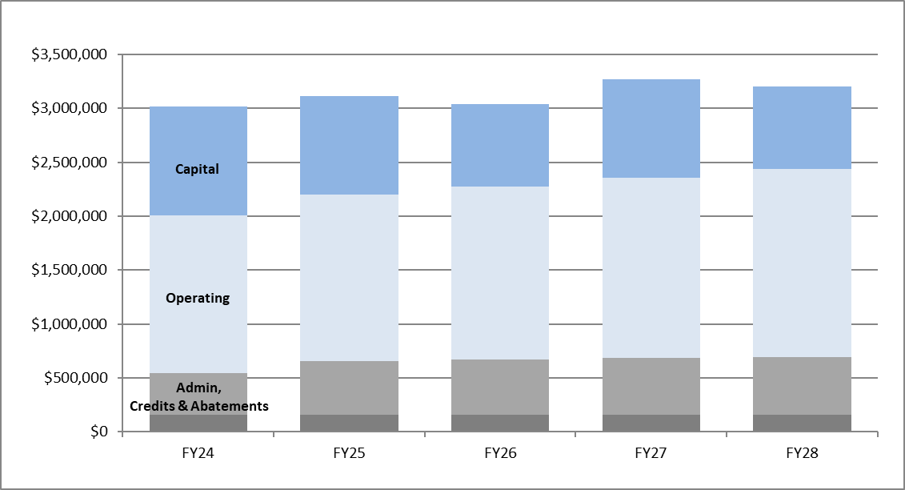
Funding
 | 5-Year Average Projected Annual Stormwater Program Expenditures
Capital | $880,000
Operating Expenses | $1,610,000
Administration | $500,000
Credits & Abatements (Est. 5% of revenue) | $160,000
Total Revenue Needs | $3,150,000
No Changes in Rates for the first 5 years

Slide 12
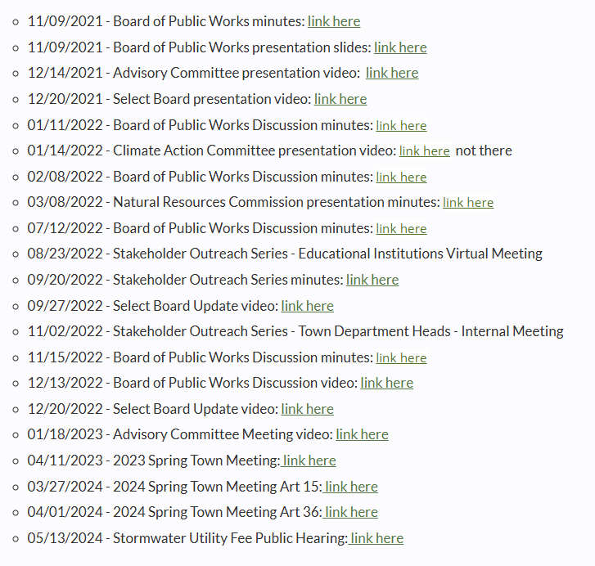
Planning Stages
Internal Buy-In
Many appreciated outreach efforts
  Opportunity for 1x1 conversations
  Interest in credits
  Spread education on many stormwater topics, not just utility
Challenges
  Overcoming educational hurdles
  Low engagement from non single-family property owners
  Opposition from some property owners
2018
MS4 Permit Update
2021
Internal Planning Begins
2022/2023
Public Outreach
2023
Spring Town Meeting Vote
Late 2022
Stormwater Engineer Hired (That’s Me!)

Slide 13
Town Meeting
(Spoiler – It Passed!)
2023 Spring Town Meeting
  2/3 vote required
Surprise Twists
  Call for amendment - failed but caused confusion
  Opposition from one major land owner
The Final Vote
  111 Yes (67%)
  52 No (31%)
  4 Abstain (2%)
May 2024 Board of Public Works Approves:
  Fee Rules & Regulations
  Schedule of Rates for FY25
  Stormwater Credit Policy

Slide 14
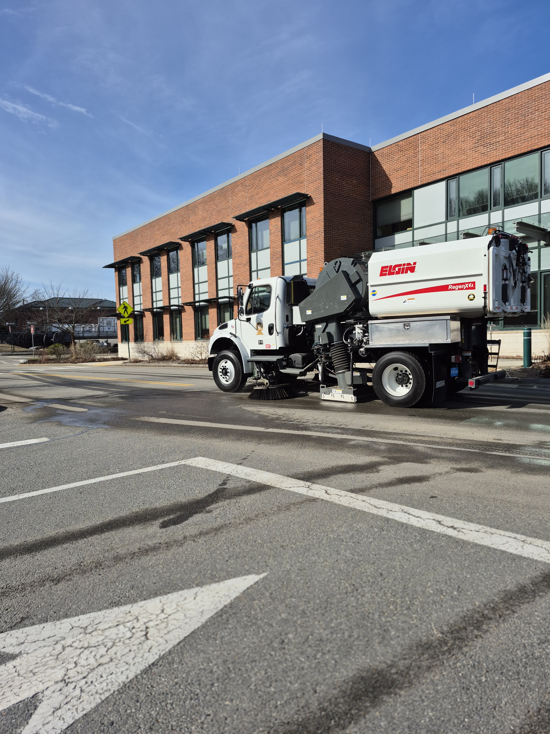
What Went Well
Mobilization
1st Year paid for with ARPA funds
  Regenerative Vacuum Street Sweeper is 1st large purchase
  Gave us Time to plan for first billing year
Finalization of Impervious Area Data
  Developed automated process for future updates
Outreach - Mailers
  Existing Billing Customers
  New Billing Customers
  BMP Owners – You’re eligible for a credit!
  Top 5% Impervious Area Customers – Do Not Do This

Slide 15
What Was a Challenge Mobilization
Billing Integration
  Rigid software not set up for stormwater billing or credits
  Difficulty aligning GIS parcel data with customer accounts
  New Customers (No existing sewer, water, or electricity accounts)
  Many Test Runs

Slide 16
What Was a Challenge Mobilization
Condos
  Identify HOA and Contacts
  Some have existing accounts, some do not
  Leave up to HOA how bill will be divvied up
Multi-Family Units
  Many do not have HOAs
  Many do not have shared bills
  1x1 conversations

Slide 17
What Was a Challenge Mobilization
Customer Response
Letter sent in existing bills a few months ahead of bills
  Many taken by surprise despite previous outreach
  Immediate inflow of enquiries
Website & FAQs
Internal Coordination

Slide 18
Common Questions
Mobilization
The rain goes into the woods behind my house – do I still need to pay the tax?
Yes, the fee is used to maintain and improve infrastructure that benefits us all.
How will condominiums be billed?
Bill is sent to Home Owners Association, who decide on an individual basis how it will be dived among individual owners.
I share a driveway or live in a duplex – how do I share a bill with my co-owner?
It is up to the owners, but we recommend setting up a shared email address to send the bill and pre-pay for the year, at the same time property bills and insurance are paid.

Slide 19
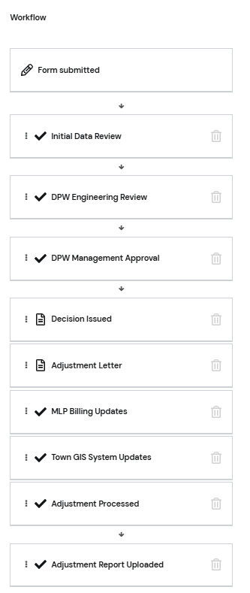
Abatements
Meant for Billing Issues
  Bill sent to wrong person
  Charged the wrong tier
  Impervious area calculated incorrectly
What Went Well
  Easy to Use Online Application
  Not here to “Nickel and Dime”
  Listening and Patience; Investing in 1x1 conversations
What Was a Challenge
  Don’t use the word “Abatement” – Residents think it is a credit

Slide 20
Commonly Asked Questions
Abatements
How do I apply?
Please use our easy-to-use online application. A response will be given within 60 days.
My pool/shed/driveway has been removed – can you adjust my bill?
Yes, following visual or photographic confirmation. Past bills will be credited the difference.
Does this count as impervious area?
Gravel Driveways = Yes
Pools = Yes
Decks/Patios = No
Porous Pavement = Yes, but can apply for credit

Slide 21

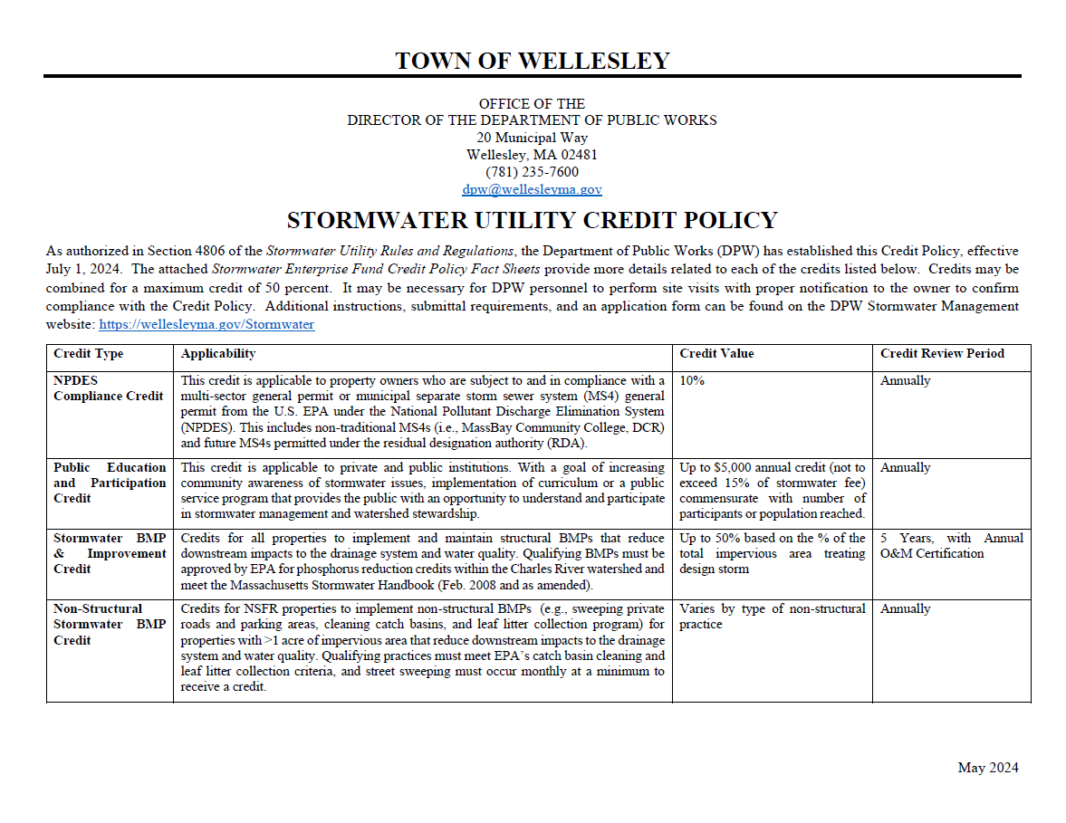
Credits
Credit Eligibility is tied to the Town’s MS4 requirements. Private investment will advance town interests

Slide 22
What Went Well
Credits
Designed the Credits to be simple to claim and maintain
  Expedited Review for Previous Permit Applicants (e.g., Wetlands, Planning)
  Application easy to find on website
Property Manager Outreach
  Usually unaware of stormwater system requirements
  But willing to partner once aware of cost savings!
Electronic Application facilitated workflow between divisions
  OpenGov Permitting Software
Investments in Staff time paid out in increased applications
Since July 2024
58 Applications Approved
  112 BMPs
  15.0 acres treated
  29.9 lbs phosphorus removed
Average Credit = 16%
Total Credits Issued = $21k

Slide 23
What Was a Challenge
Credits
Large Demand on Staff Time
  Weren’t sure how much demand there would be, hard to prepare for
  Applications came in waves following outreach materials
Inconsistent Green Infrastructure Records
  Located across several different libraries (e.g., Wetlands, Planning)
  O&M Plans inconsistent, out-of-reach, or never received
Owner Awareness of BMPs
  Eligible privately-owned BMPs now displayed on property viewer
  Need for larger awareness of green infrastructure and maintenance requirements

Slide 24
Let’s Do the Math
Capital Projects
  1lb Phosphorus Removal = $100,000 for Planning Purposes
  Does not include annual maintenance costs
Credit Program, Avg. Application:
  Treats 0.50 lbs Phosphorus
  Costs $690 in Annual Credits
  Avg. Staff Time = ~2hrs per Application or ~$250 Internal Staff Time
  No Maintenance Costs

Slide 25
Commonly Asked Questions
Credits
My contractor buried something in my backyard a few years ago – is it eligible for a credit?
Possibly. Record research or even photographs and receipts needed to confirm.
Do you offer age or income credits?
Not at this time, but will continue to monitor and re-evaluate in future years.
Are Rain Barrels eligible for credits?
Not at this time. While beneficial and encouraged, tracking use is too time-consuming.
How do I located and maintain my infiltration basins?
Look for standing water and/or sedimentation. Some systems may be maintained by owner, Other, more complicated, systems may require professional services.

Slide 26
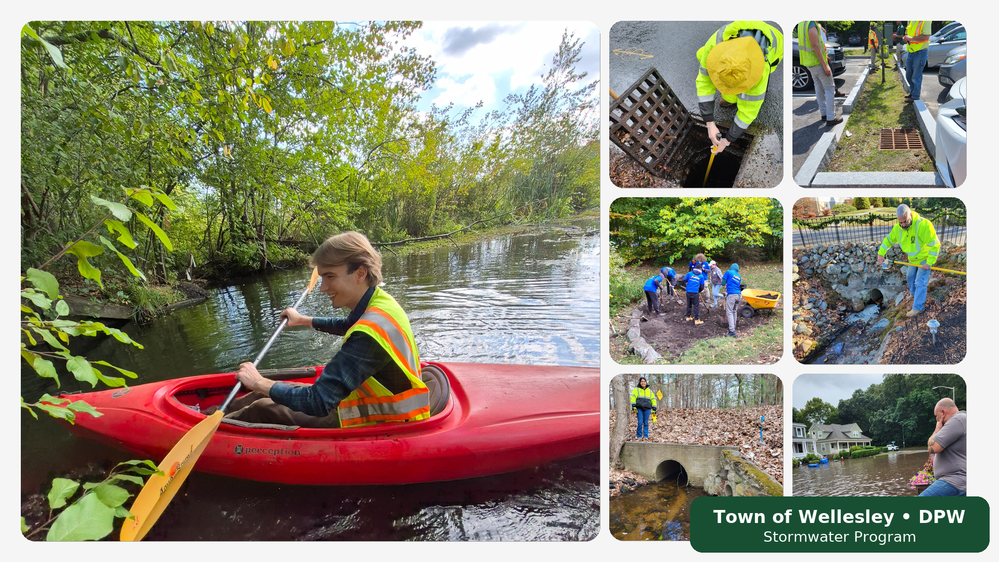
What Went Well
Administration
Invested Folks
  Management & Capital Planning = Management/Engineering
  Grey Infrastructure Maintenance = Highway
  BMP Maintenance = Parks
  Billing = Municipal Light Plant
  GIS = IT Department

Slide 27
What Was a Challenge
Administration
What does the Utility Cover?
  Straightforward: Catch Basins, Manholes, Pipes, Culverts, Green Infrastructure
  Not So Straightforward: Dams, Curbing & Driveway Aprons, Dredging
Capital Plan Prioritization
  Backlog of projects
  Forwarding and balancing multiple goals
Staffing
  Maintenance staff fall under Highway & Parks
  Additional need for Field Inspector and/or Staff Engineer

Slide 28
What Went Well
Annual Updates
Impervious Area Mapping
  Updated throughout the year by GIS Department
  Automated reporting tools
Update Bills once in early spring
  Don’t want to be “Impervious Area Police”
  Cuts down on administrative time
  Timing to plan for fiscal year budgeting

Slide 29
What Was a Challenge
Annual Updates
Subdivided or New Properties
  Not adequately captured throughout the year
  Work with Assessor in the future
Refined Impervious Area Changes
  Some properties go up a tier – will not bill for past months
  Some properties go down a tier – will refund difference in past bills
Updating Billing Software
  Too many updates to do manually – need to overwrite all billing data
  Crosswalk template for GIS Data >> Billing Software

Slide 30
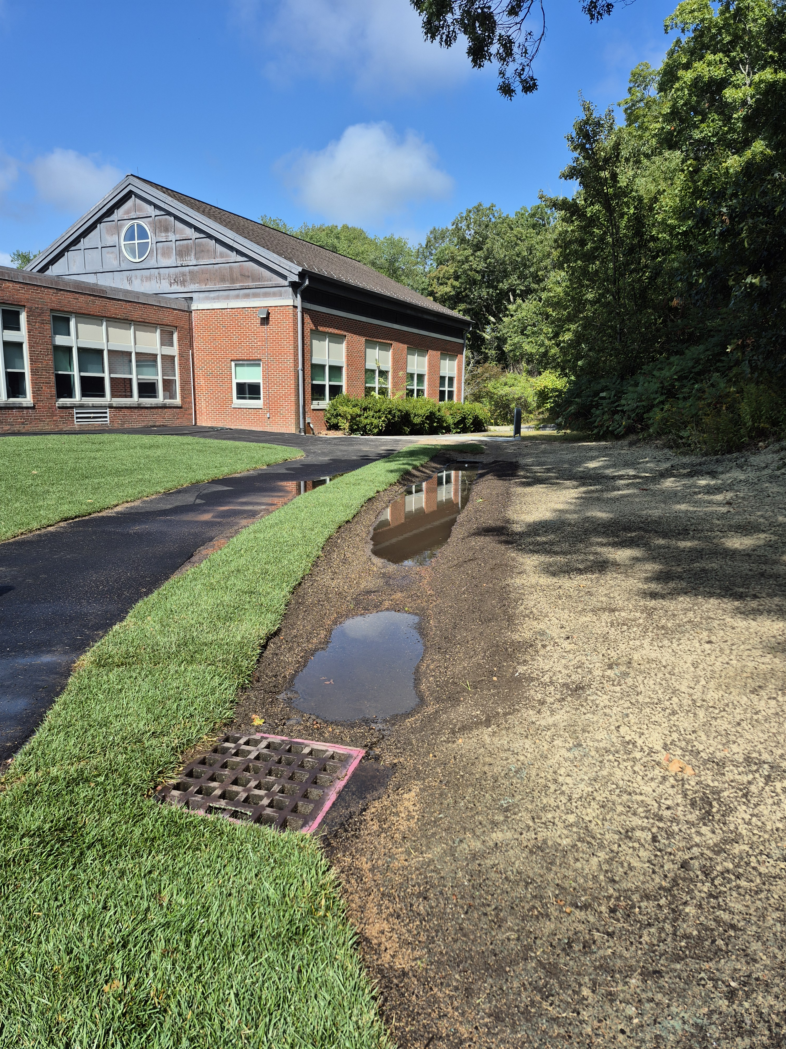
What’s Next?
Prioritization and Implementation of Capital Plan
Work with Highway & Parks Divisions to Increase Maintenance Activities
Build Out Staff Across Multiple Divisions
Streamline Management Operations
  Billing Software
  SOPs
Work with Planning & Wetlands to Expand BMP Maintenance Enforcement
Bioswale Retrofit, Built Summer 2025 -
The First of Many!

Slide 31
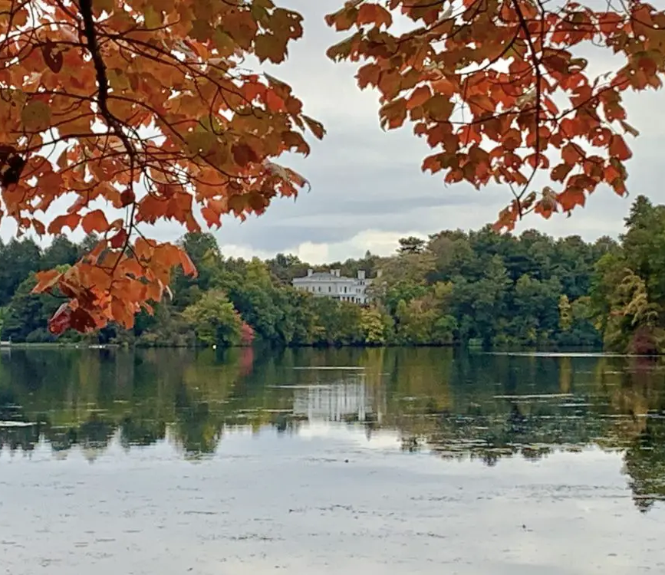
Key Takeaways
Internal Buy-In and Coordination is Essential
Keep it Simple
Plan for a Lot of Staff Time for Implementation Period
Have a Strong Consultant

Slide 32
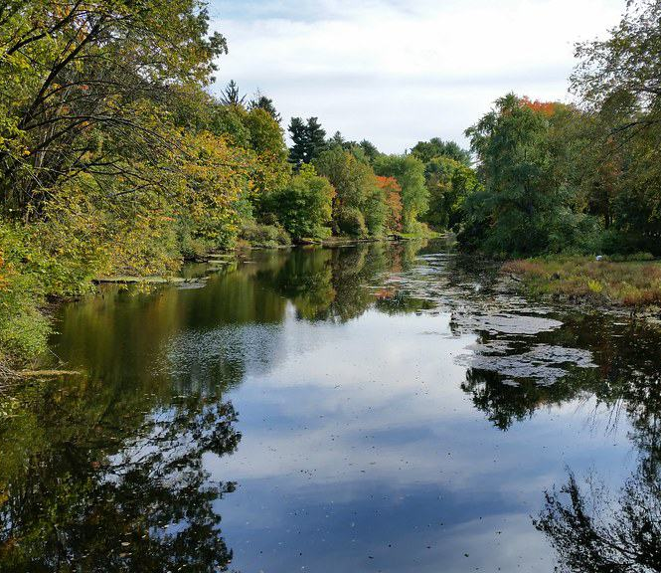
Key Takeaways
Take the Leap – it’s Doable!
Expect Challenges, but Benefits are Long-Term
Reach Out to Peers to Learn & Share

Slide 33

Thank you!
Eilish Corey, PE
Senior Civil Engineer
Town of Wellesley
781-235-7600
ecorey@wellesleyma.gov

