Slide 1
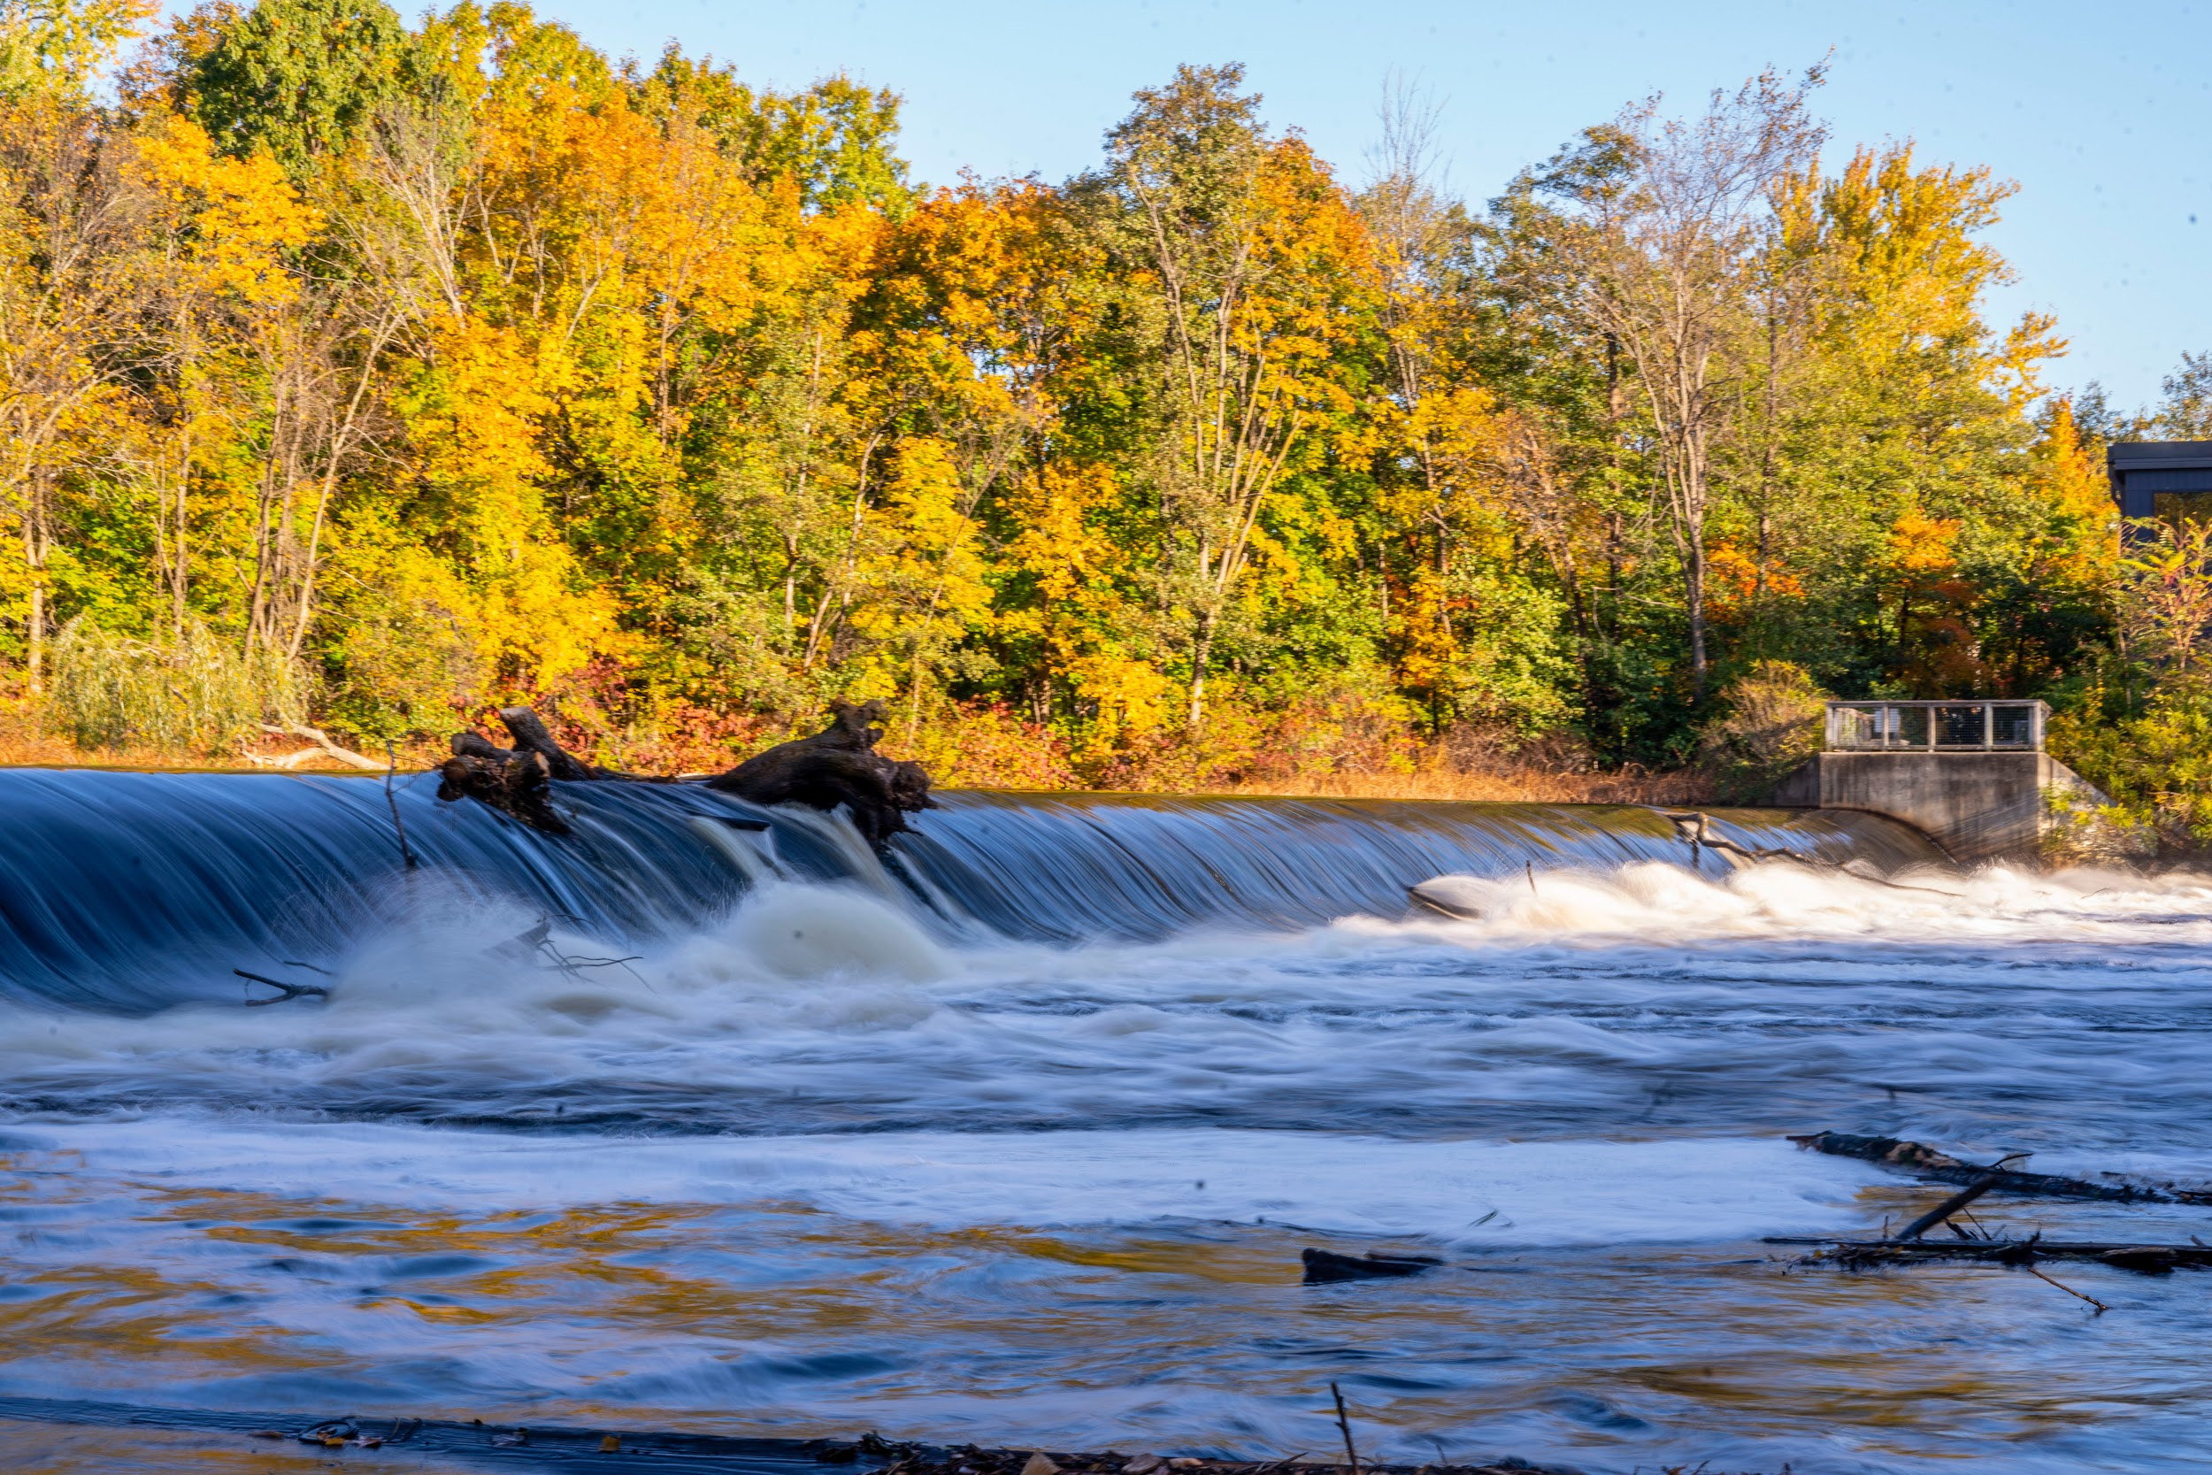

Film Viewing:
Reconnecting Rivers
May 6th, 2026
Dam Busters
Notes:
Amber

Slide 2
AGENDA
🍿
12:00 P.M. — Welcome
12:05 P.M. — Introduction
12:10 P.M. — Showing: Reconnecting Rivers
12:30 P.M. — Toolkit
12:35 P.M. — Q&A / Discussion
Notes:
Amber

Slide 3

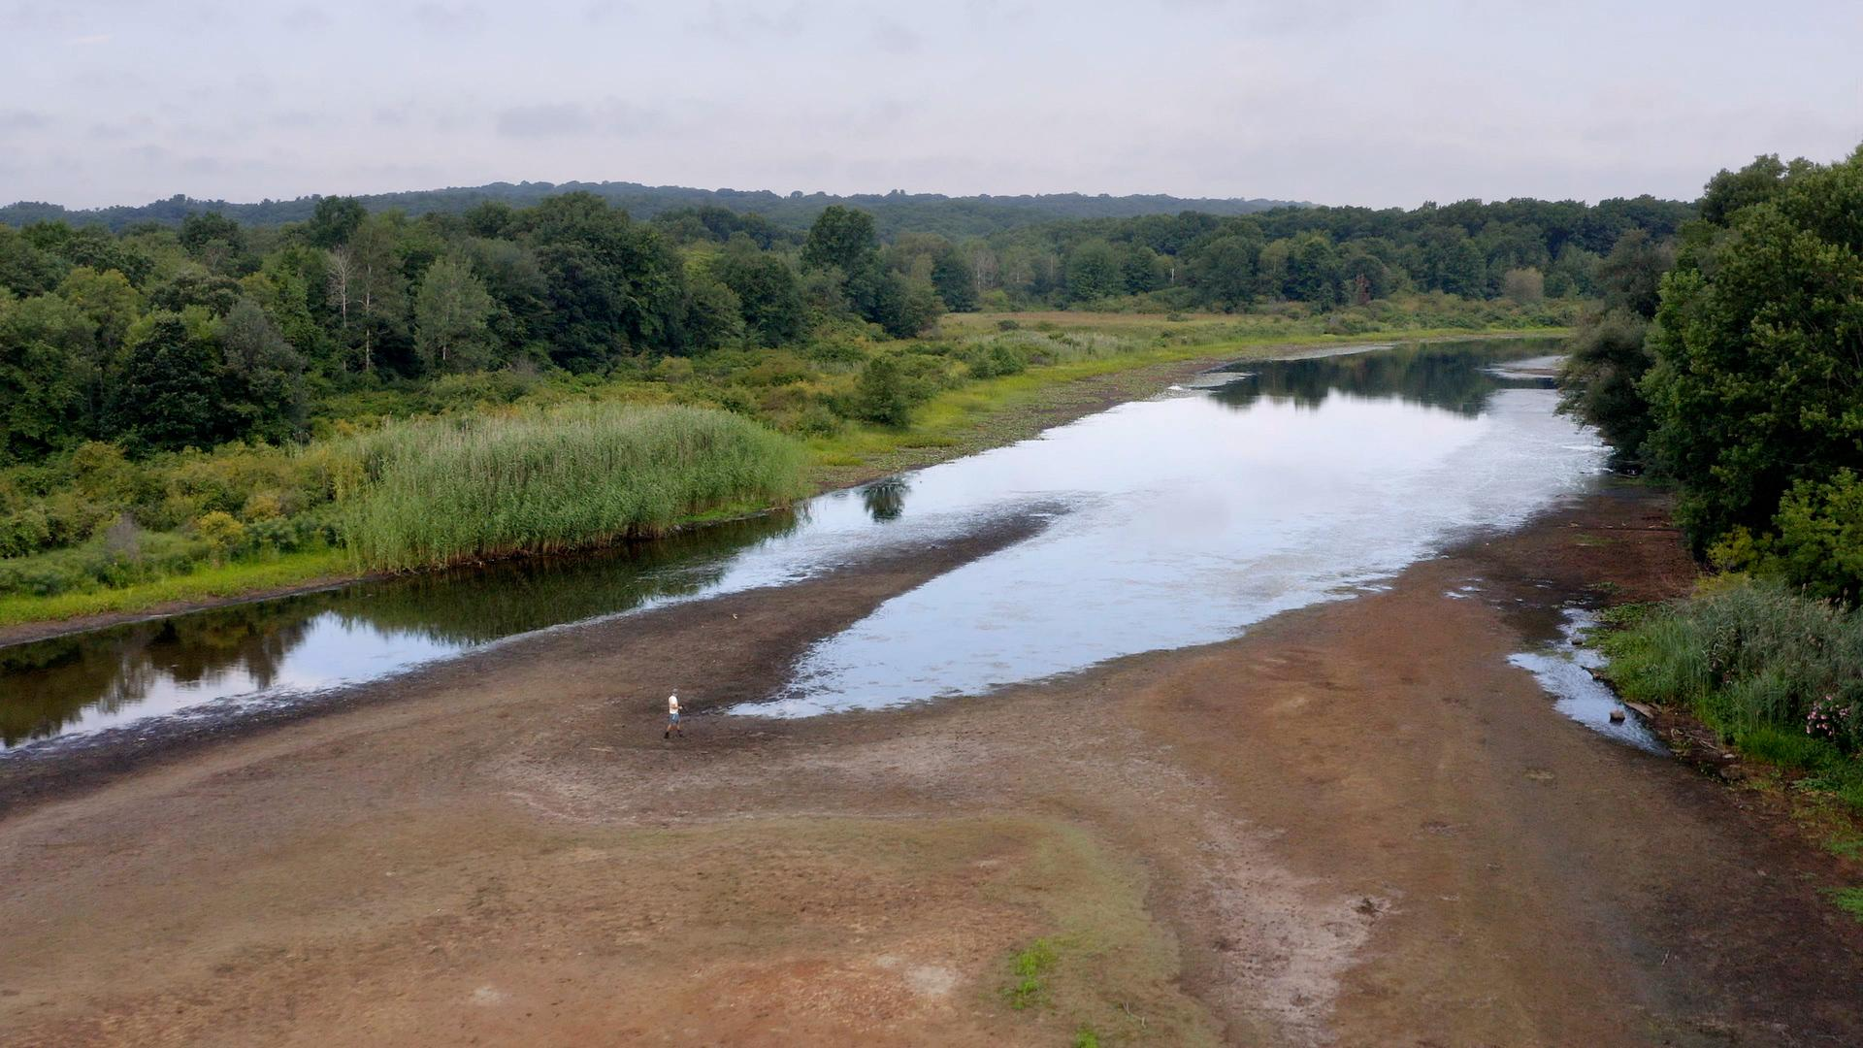
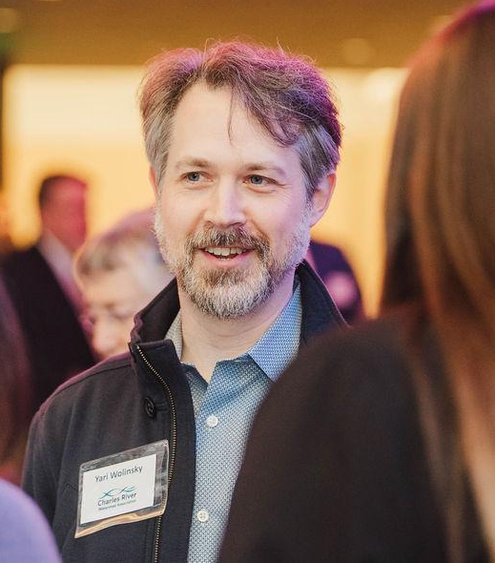
FILM INTRODUCTION
Finding Innovative Solutions to Our Changing Environment
Produced by Turnaround Films
Yari Wolinsky
Filmmaker
When in Drought, Massachusetts
2023
Notes:
Yari W

Slide 4
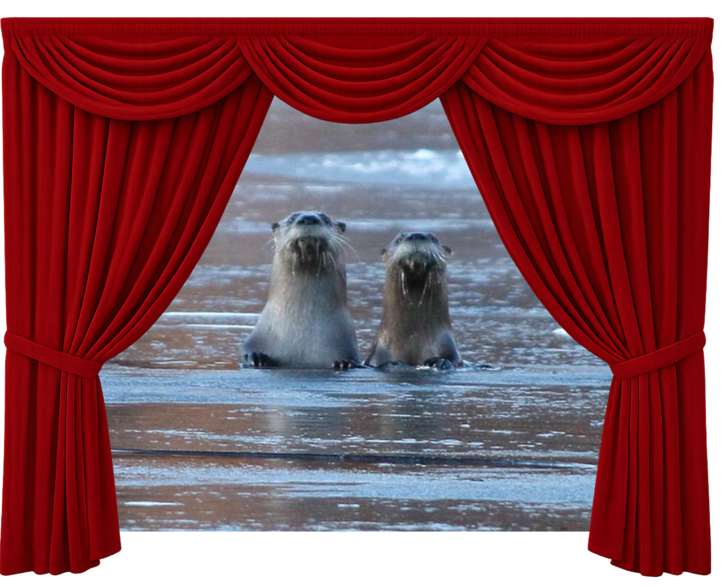
Reconnecting
Rivers
Notes:
Andrea to play
Youtube link: https://www.youtube.com/watch?v=mGYYY6GFVaU&t=1s
Vimeo link: https://vimeo.com/1111740743/88208a3497

Slide 5
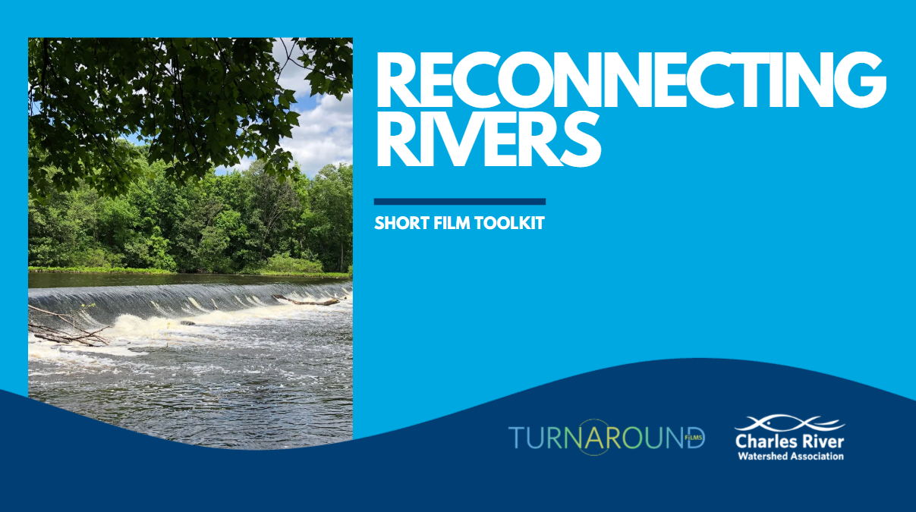
SHORT FILM TOOLKIT
Includes, for both adults & youth/educators:
Pre-screening questions
Key terms
Test your knowledge
Post-screening questions
Additional resources
Notes:
Amber

Slide 6
TOOLKIT - QUESTIONS & PROMPTS
ADULTS
YOUTH/EDUCATORS
Pre-Screening Questions
How well do you know the waterways in the your community? The history?
Do dams impact your life?
Have you ever heard of the term “Indigenous Sovereignty”?
Pre-Screening Questions
Can you name any rivers or streams in your town/city?
What are some of the reasons people build dams?
Post-Screening Questions
How can, or should, we change our thinking about rivers? Our relationship to them?
How does dam removal tie into the larger goal of restoring degraded habitat in the Commonwealth?
Post-Screening Questions
Imagine you’re a fish living in a river where there’s a dam - how would you feel if you woke up and the dam was removed?
What can you do to support a river in your community?
Notes:
Amber
Canva link: https://www.canva.com/design/DAHCdbtvFm8/eo0EvtwtH-MnD-ppLqyfrQ/edit

Slide 7
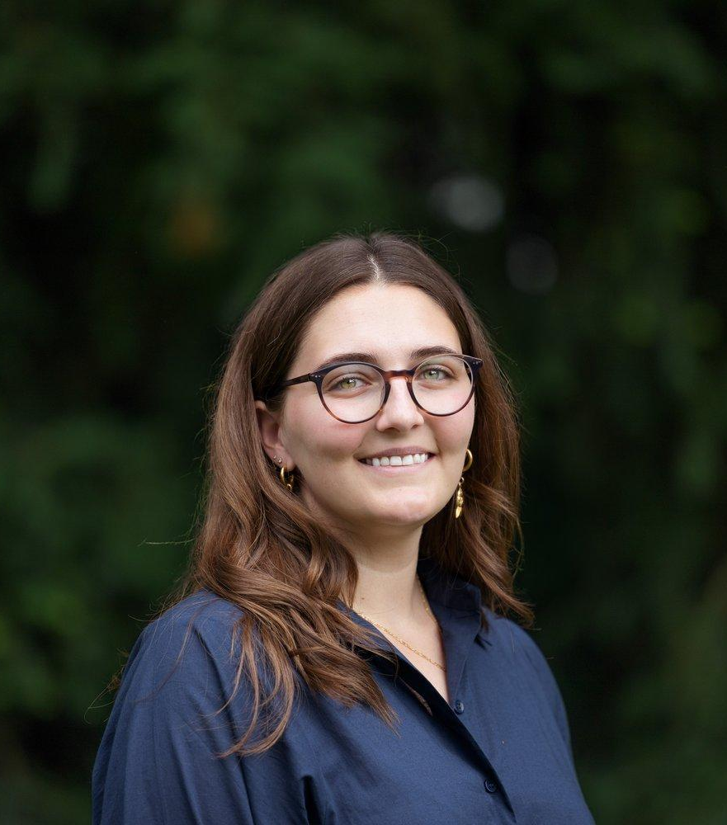
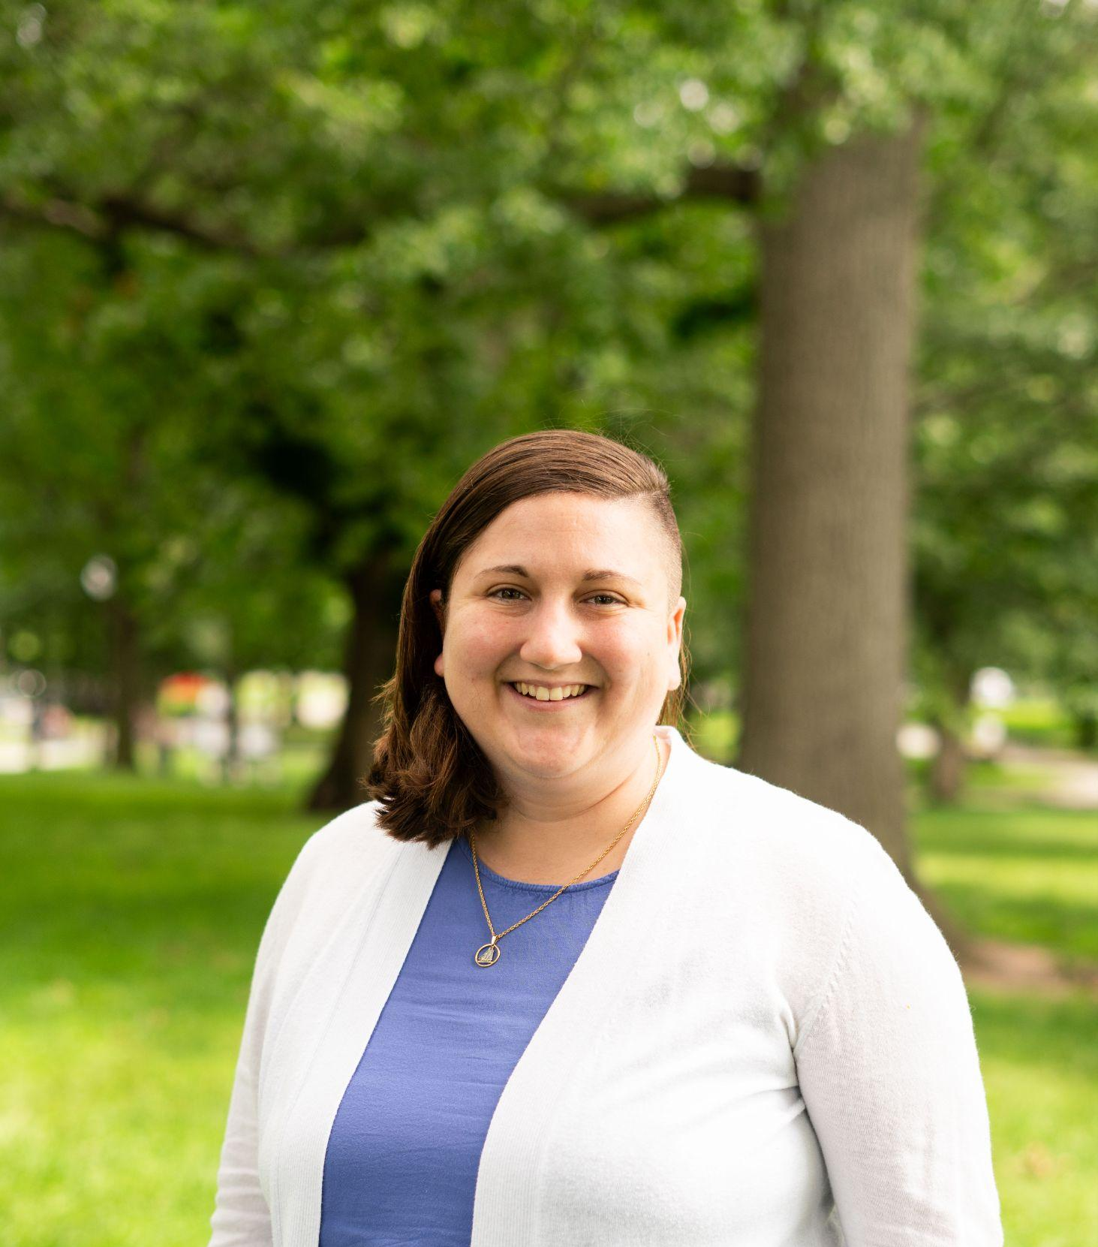
Q&A / DISCUSSION
Yari Wolinsky
Filmmaker
Turnaround Films
Amber Siegel
Sr. Restoration Manager
CRWA
Lisa Kumpf
River Restoration Director
CRWA
Notes:
Lisa moderates

