Slide 1
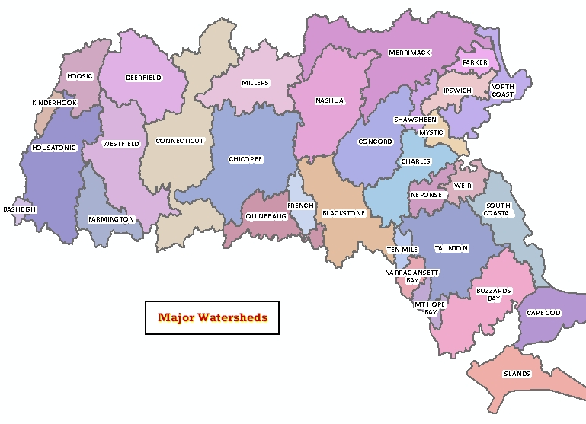

Regional Stormwater Utilities
Massachusetts Rivers Alliance
Rainwater Readiness Workshop
September 25, 2025
Major Watersheds of Massachusetts
https://www.mass.gov/files/images/massgis/datalayers/watrshds.jpg

Slide 2
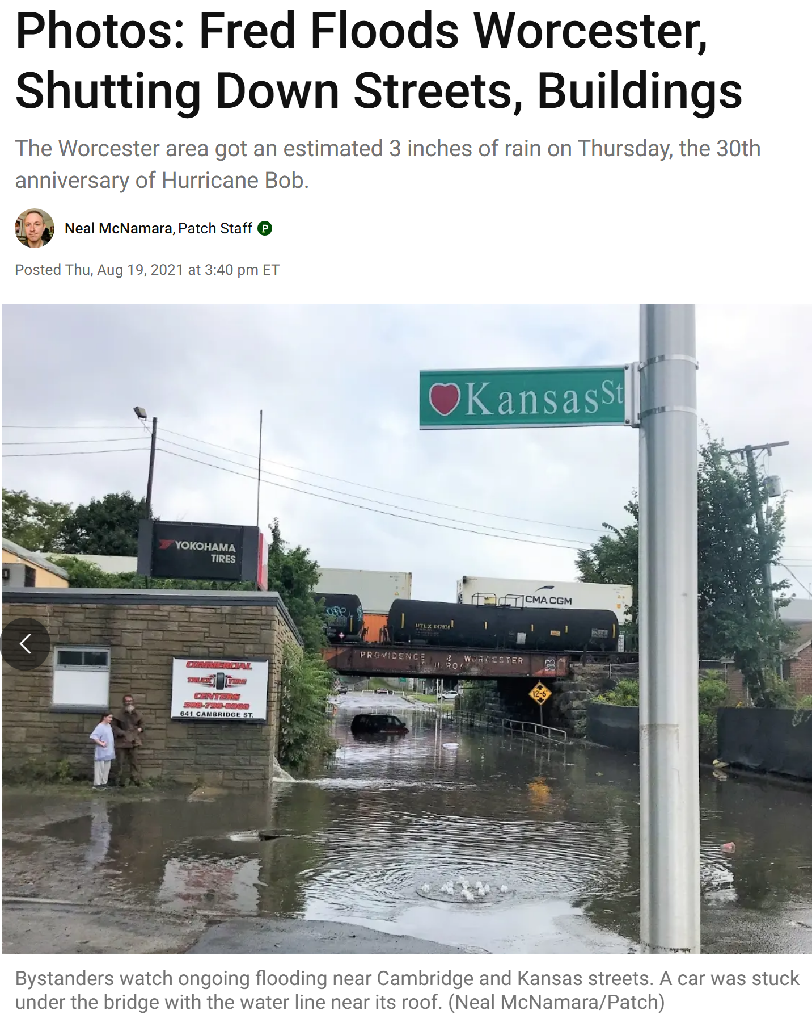
Agenda
Introductions
What is a stormwater utility?
Why regional?
Models and examples
New England context
Q&A, audience feedback
https://patch.com/massachusetts/worcester/photos-fred-floods-worcester-shutting-down-streets-buildings

Slide 3

Introductions
Mary Tchamkina
Manager at Raftelis, focusing on stormwater utilities, water affordability, and technology needed to support them.

Slide 4

75
OUR TEAM
HAS IMPLEMENTED
STORMWATER UTILITIES
AND HELPED DOZENS MORE WITH PROGRAM & FEE RESTRUCTURING
+

Slide 5

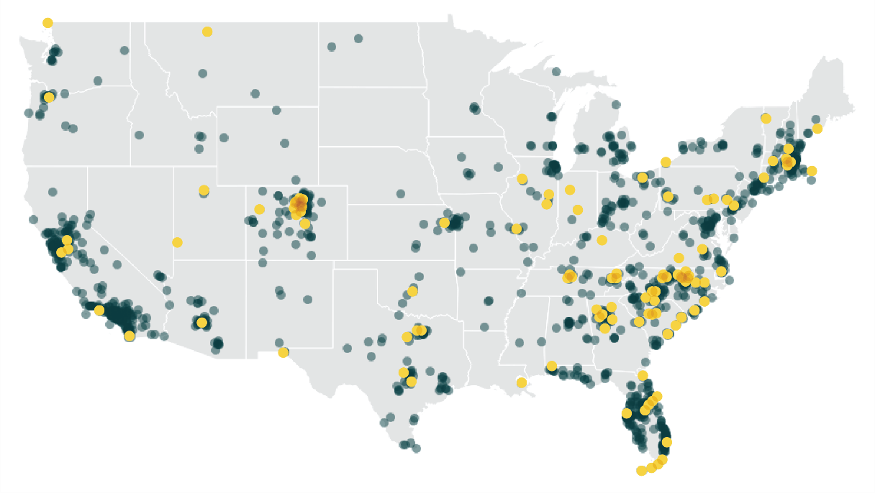
Municipal and government
Stormwater Utility
Notes:
We offer a national perspective on stormwater program design and sustainable funding for them

Slide 6
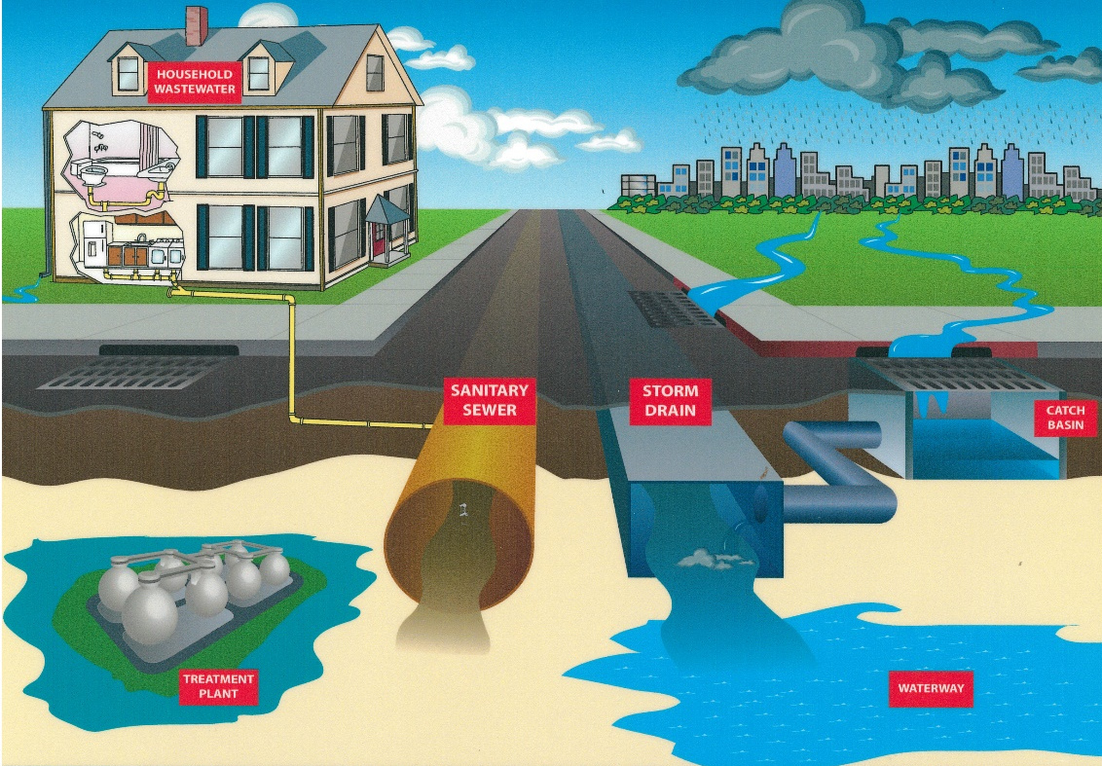
What is a Stormwater Utility?
Fee for service – a funding mechanism at its core
  Revenues support existing stormwater services and compliance activities
  Can create additional funding to enhance service delivery
User fee frequently established by ordinance
Generally, distinct from water and sewer funds and general fund (but doesn’t need to be)

Slide 7
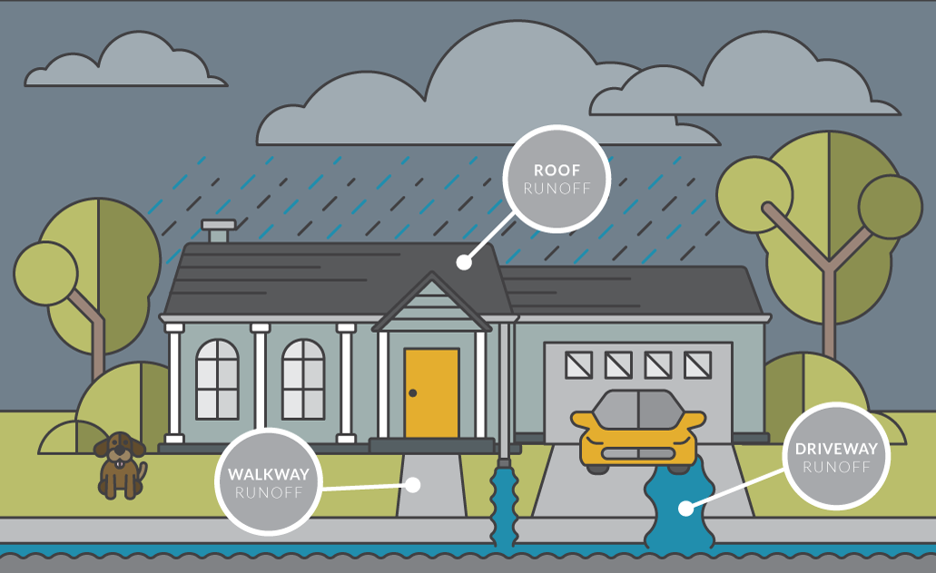
Basis for Fees
Impervious Area = Runoff = Fee
Notes:
Fees are most often based on property impervious area (IA).
A property’s IA closely correlates with how much stormwater runoff each property generates.
Properties with more IA create more runoff and place more demand on stormwater system. They would therefore pay a higher fee under a stormwater utility.
“Non-metered” fee for service, reflecting demand on stormwater system more accurately and equitably than property value.

Slide 8




Why Regional?
Water doesn’t care about municipal boundaries
Standardized
communications
Benefits of approaching stormwater management and its funding on a regional scale.
Economies
of scale
Operational efficiency & uniformity of expertise
Notes:
Water doesn’t understand municipal boundaries – efficiency of problem-solving approach
Standardization of communication
Economies of scale for capital projects
Efficiency of equipment, staffing, and processes for O&M and regulatory compliance, uniformity of expertise

Slide 9
Regional Stormwater Utility
Lowest hanging fruit for regional collaboration is utility administration and billing
Scope could be expanded to other levels of collaboration and shared services if desired

Slide 10



Options for Regional Stormwater Management
Separate Local Utilities
Shared Services / Interlocal Agreements
Centralized Entity

Slide 11
Regional Utility/Service Delivery Models
Centralized legal entity
Oversees stormwater management across multiple municipalities
Stormwater fees go directly to regional utility
Implement stormwater management program, MS4 permit compliance, infrastructure and asset management on a regional level
Regional Authority

Slide 12
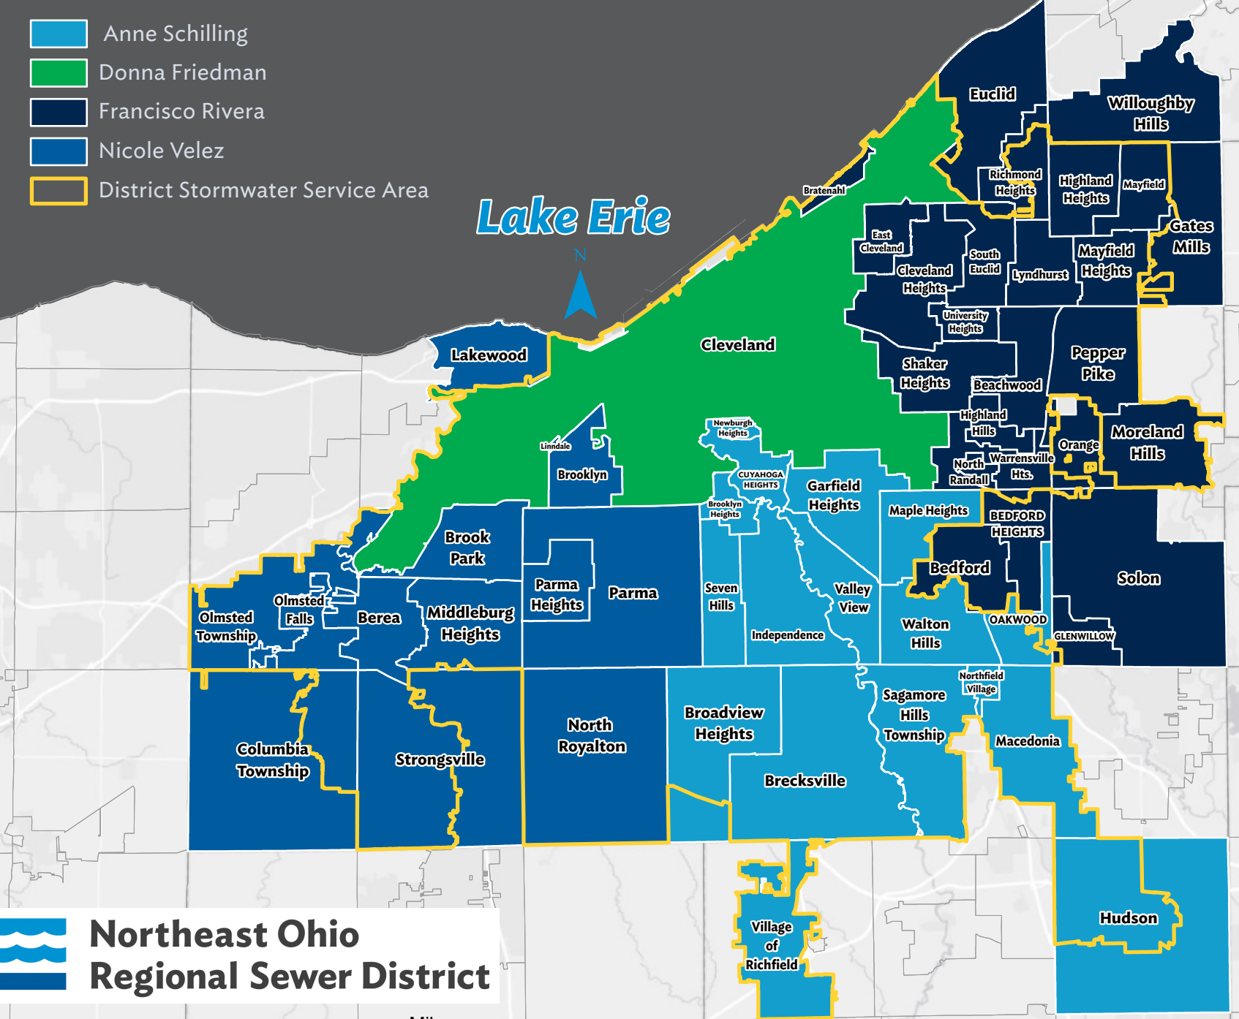
Example of Centralized Utility:
Northeast Ohio Regional Sewer District, OH
57 member communities, including City of Cleveland
District provides sewer and stormwater services
Also provides support to local projects via Community Cost Share
Fee billed on District bill; same rate for all communities
Stormwater fee generates ~$53M/year, with 25% ($13.25M) going to Community Cost Share
Notes:
Similar program: Wyoming Valley Sewer Authority, PA

Slide 13
Regional Utility/Service Delivery Models
Decentralized governance via agreements between municipalities
Opportunities for collaboration include administration and billing, service delivery, development standards, public education and outreach, and shared capital projects
Municipalities retain control over local stormwater management policies
Relies on local governments for enforcements
Inter-Local Agreements

Slide 14
Examples of Decentralized Governance:
Granville-Person Cooperative Stormwater Services, NC
Five jurisdictions: 2 rural counties, 2 towns and 1 city in one of the counties, all located in Upper Falls Lake watershed
Cost driver is watershed-specific regulations: highest nutrient reduction targets ever passed in NC (77% Phosphorus, 40% Nitrogen)
Interlocal agreements
Jurisdiction stormwater rates set specifically to their own revenue requirements
Stormwater fees billed on county tax bills
Shared billing/collections/administration and advisory services
Otherwise separate service provision

Slide 15

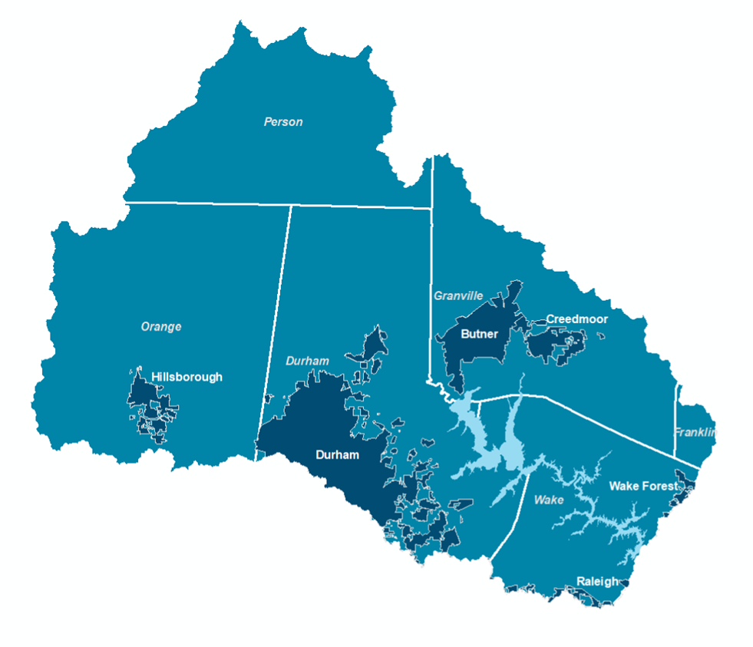
Regional Collaboration Facilitated by
Upper Neuse River Basin Authority: A regional non-profit organization that provides scientific research to understand and improve water quality and facilitates collaboration through constructive conversation among stakeholders.
Members:
Six counties
Six municipalities
One water utility
Soil and water conservation districts
Notes:
Because of the watershed-wide nature of the issue, the jurisdictions in the watershed turned to a local non-profit to facilitate regional collaboration.
The Upper Neuse River Basin Authority, or UNRBA, is focused on two things: doing water quality science and fostering collaboration among stakeholders to improve water quality in the watershed.
Its members are representatives from 6 counties, 6 municipalities, 1 water utility, and soil and water conservation districts in the watershed, as you can see in this map.
The last thing to mention here is that, while UNRBA did exist prior to 2011, it was at that time that the group really got focused and gained a defined purpose in addressing the Falls Rules.

Slide 16
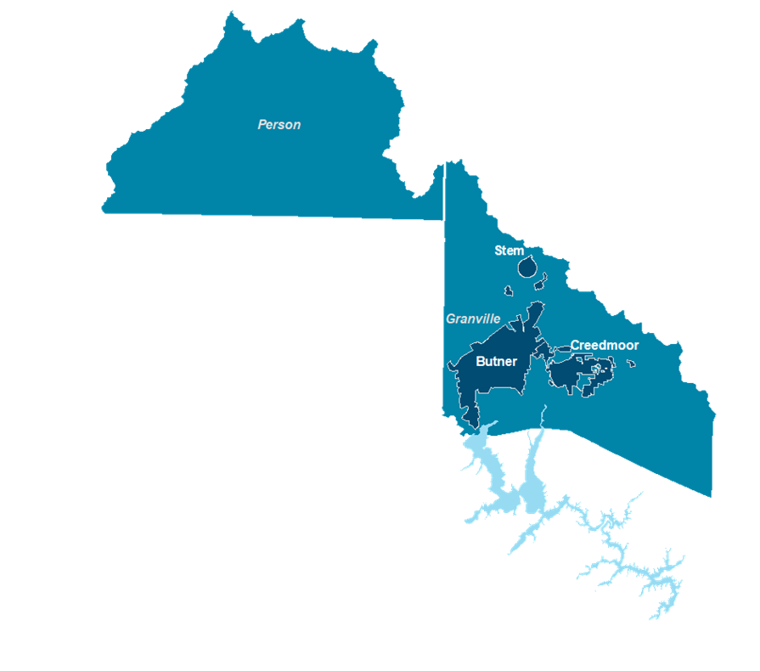
Regional Collaboration via Stormwater Utility Group
Utility administration and management
Involvement in UNRBA
Representation with regulating agencies
Shared resources
Access to expertise and broader regional perspective
Notes:
As the Falls Rules were going into effect in 2011, a subset of regulated jurisdictions (3 municipalities and 2 counties) in the region embarked on a joint effort to create stormwater utilities and begin collecting stormwater user fee revenues. These fees fund current and future program requirements, especially those related to Rules compliance.
The collaborative utility approach leverages efficiencies in utility administration and management, resource coordination, representation in interactions with regulators, and ensures a consistent approach to applying the Rules’ requirements.
All 5 jurisdictions are currently active members of UNRBA, contributing toward funding UNRBA’s work and participating in the technical and administrative decision-making processes. So there’s another layer to the collaboration there, as this tight-knit group navigates regulatory compliance and their involvement in the UNRBA’s activities.

Slide 17
Regional Collaboration in New England?

Slide 18
New England Context
  Climate change response and regulatory pressures increase costs
  Regional utilities currently being currently considered in CT
  Explored in RI/Providence region a decade ago
  Could fund new collaborations and projects as well as asset management work
  Could focus on larger shared projects that smaller towns have a hard time getting off the ground
  May be able to leverage existing relationships within watershed associations and stormwater coalitions in MA
Notes:
MS4 permit, RDA permit, and their interaction

Slide 19
QA
&
19

Slide 20
What barriers do you perceive for regional stormwater collaboration or utility creation?
Different levels of compliance and implementation
Different priorities, ability to pay
Narrow focus on regulatory requirements
Governance models in the face of regulatory compliance
What existing regional entities in MA may help facilitate the creation of a regional stormwater utility?
[Notes here]

Slide 21
Thank you!
Contact: Mary Tchamkina
917 332 7835 / mtchamkina@raftelis.com

