Slide 2
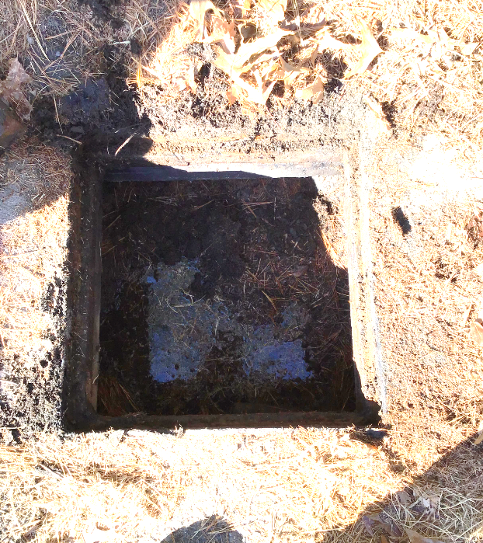
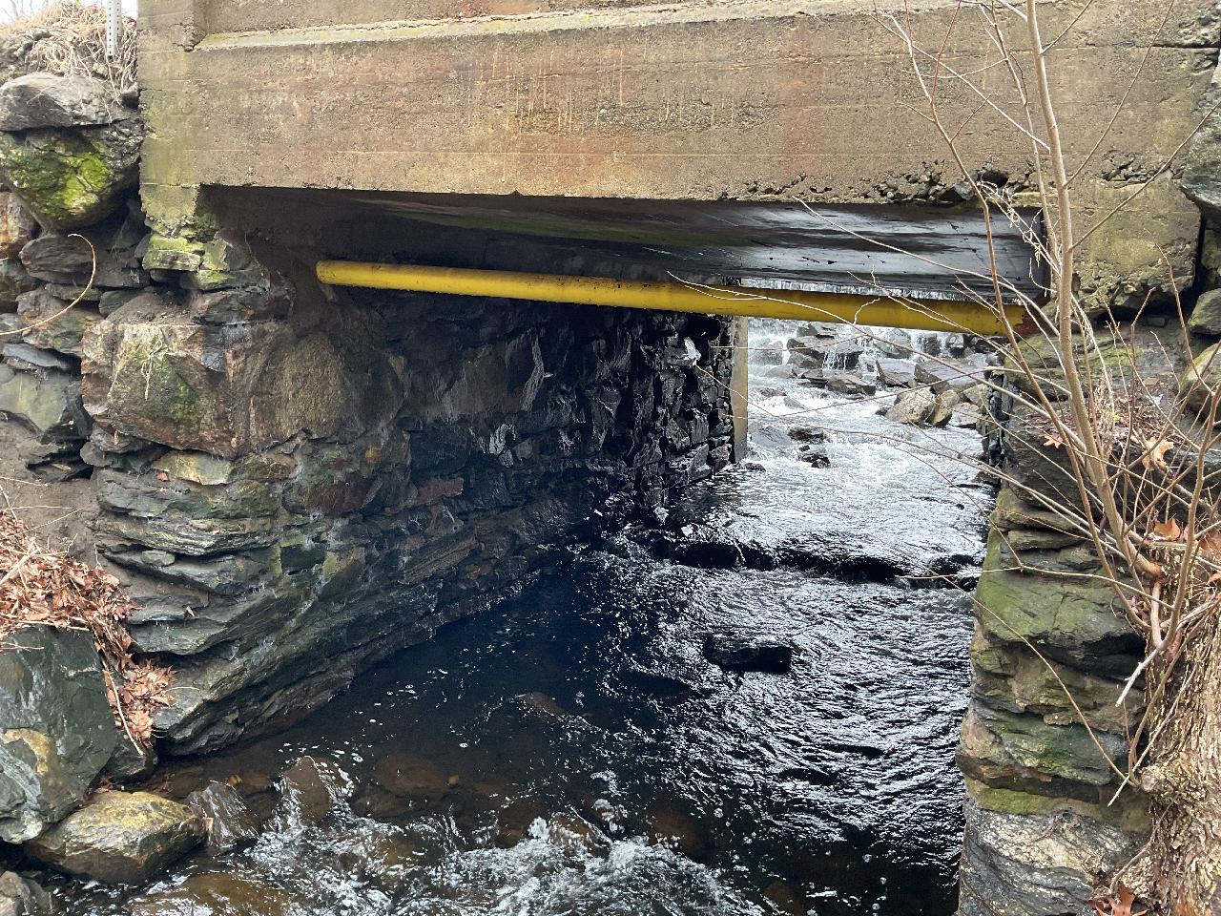
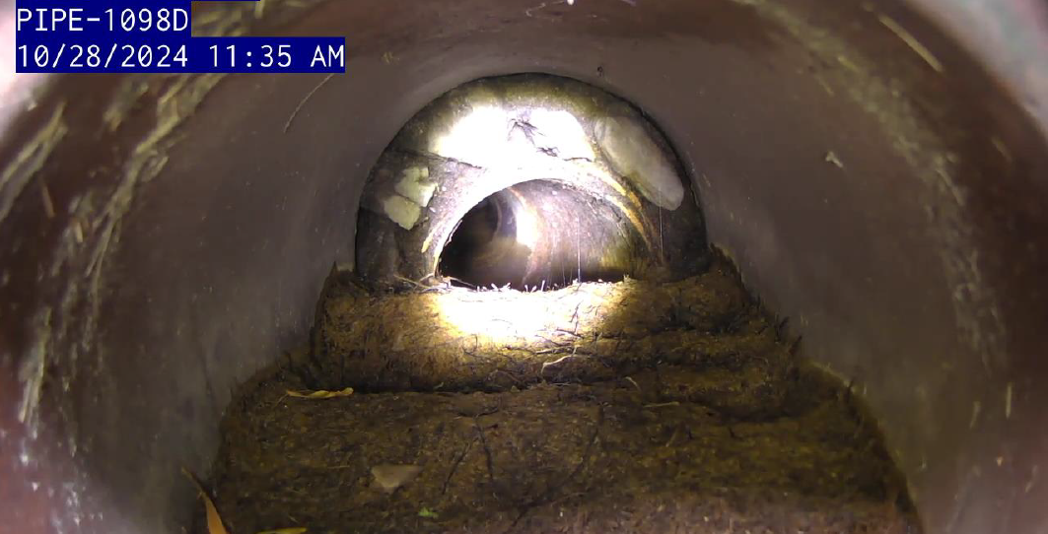

Scaling Asset Management Programs for effective community impact
Strategies for Municipal and Regional Stormwater Management
Rainwater Readiness Stormwater Workshop
September 25, 2025
Natalie Koncki – Water Resources Data Management Technical Specialist
Cassandra LaRochelle – MS4 Technical Specialist

Slide 3
Overview
Why an Asset Management Program (AMP) is worth it
Core components of an AMP
Case studies

Slide 4
What is Asset Management?
“Asset Management is about delivering a specified level of service to customers and regulators at an optimal life cycle cost and an acceptable level of risk with a strategy that ensures long-term sustainability of public assets (NHDES, 2025).”
More simply…
Stormwater Asset Management – the process of maintaining the stormwater system to ensure it’s functioning properly, lasts a long time, and provides the best value.

Slide 5
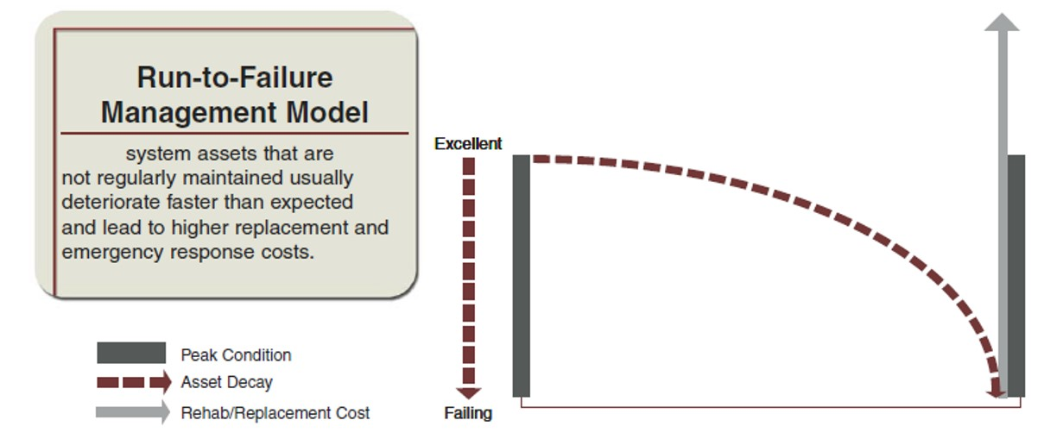
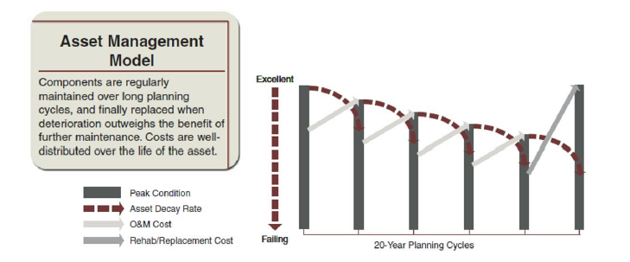
Why It’s Worth It –
Asset Management Planning
What problems are we trying to solve with an Asset Management Program (AMP)?
Reactive → Proactive
Stormwater funds are limited and competing priorities
Prioritize projects with a defensible strategy
Lack of centralized location for stormwater system management
EPA, “Fact Sheet: Asset Management for Sewer Collection Systems,” April 2002.
URL: https://www.epa.gov/sites/default/files/2015-10/documents/assetmanagement.pdf

Slide 6
5 Core Components of an AMP
Stormwater Asset Inventory and Condition
Long-Term Funding Strategy
Level of Service
Stormwater
Asset Management
Program
Life Cycle Cost Analysis
Criticality/Risk Analysis

Slide 7
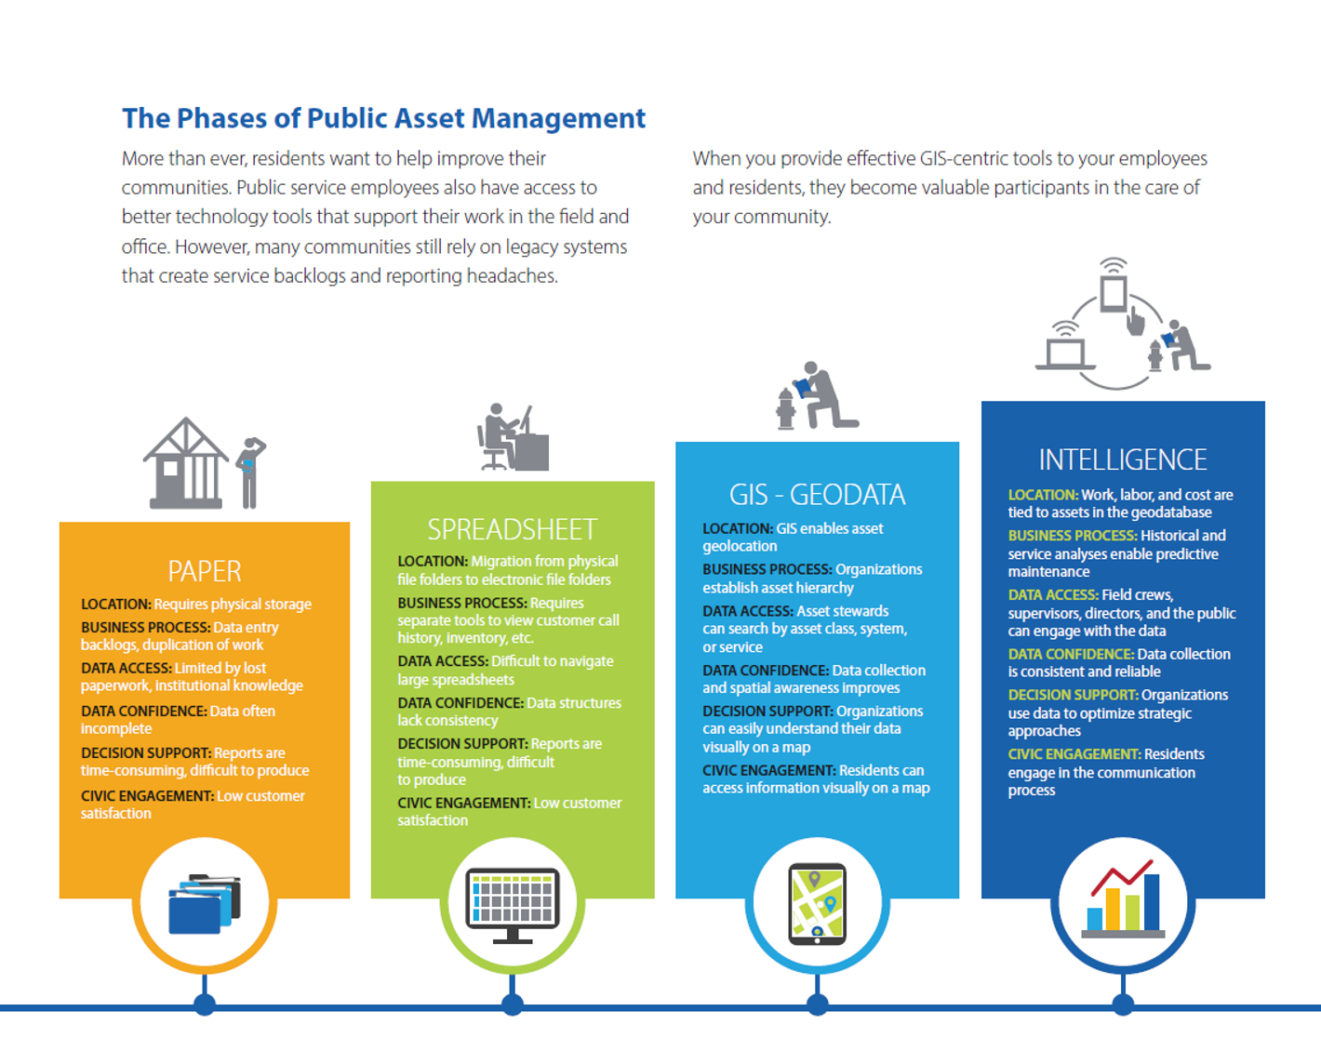
Creating an Asset Inventory
Steps to establish your stormwater inventory
What types of stormwater assets does your community have?
How many?
Where are they located?
Keep track of relevant historical information
Create an inventory and keep data in a centralized location
Establish procedures to keep the data up to date!
Source: CityWorks

Slide 8
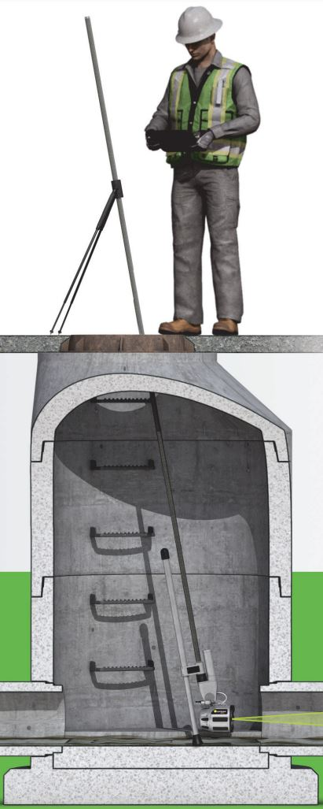
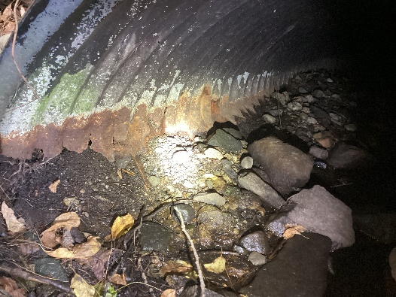
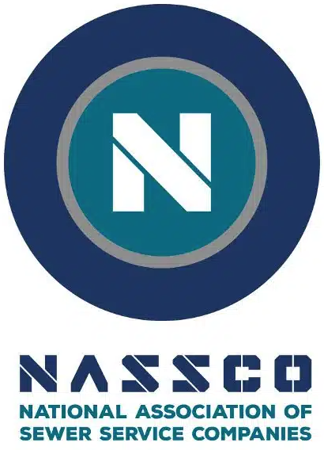

Asset Inventory and Condition
Data Management Improvements
  More efficient reporting, data collection, identification when problems arise
  Improve in-house workflows
  Dashboards and other digital tools to enhance your day-to-day operations
Condition Assessments
  NASSCO – structure and pipe assessments
  NAACC – culvert assessments
Envirosight Quickview Zoom Camera
Example of Invert Deterioration in a CMP culvert

Slide 9

Level of Service
Level of Service – How a stormwater system operates and manages its assets to meet user expectations
  Multi-department input
  Community specific concerns or
  feedback (flooding, critical customers,
  environmental concerns, etc.)
Set SMART(ER) Goals:
  Specific
  Measurable
  Attainable
  Relevant
  Time-bound
  Evaluate
  Re-do
Level of Service | Cost
Minimum Standard/Compliance
Protective
Advanced
Example: keep all catch basin sumps < 50% full
Method: annual catch basin cleaning program

Slide 10
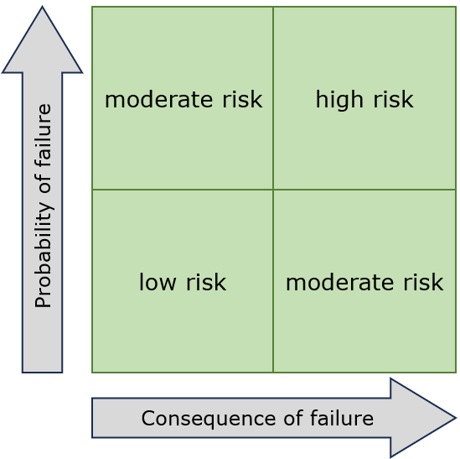
Criticality and Risk Analysis
Assign a criticality score for each asset – how critical is this asset to the overall stormwater system
Probability of Failure (PoF)
How likely is the stormwater asset to fail?
Example Factors: Condition, Age, Material, Capacity
Consequence of Failure (CoF)
What is the impact if the stormwater asset failed?
Example Factors: Severity of impact (environmental, economical, social, safety)
$$Criticality =PoF \& CoF$$

Slide 11
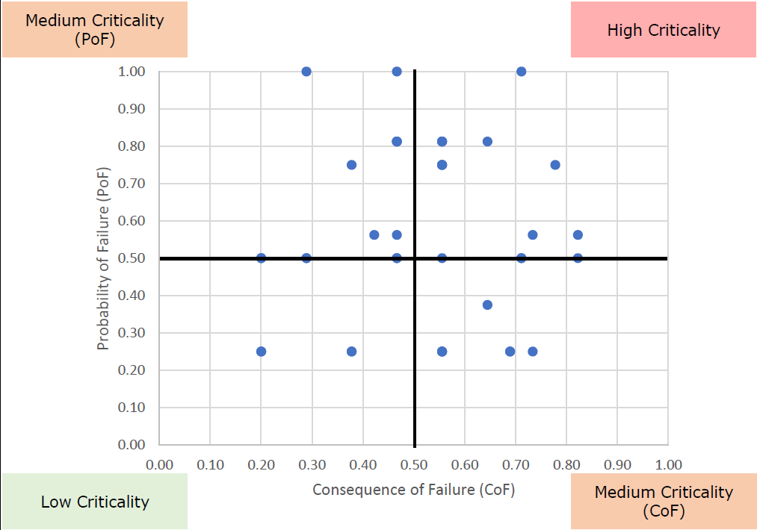
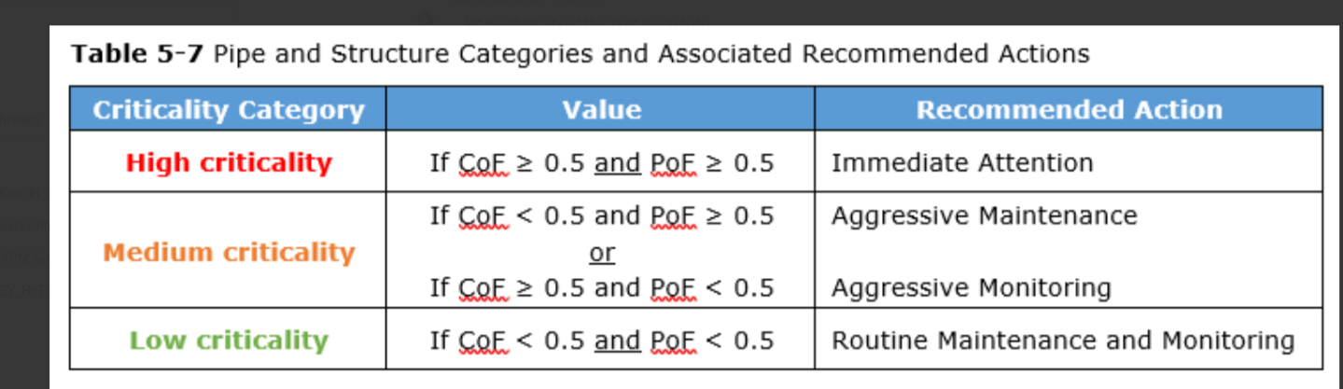
Criticality and Risk Analysis Example

Slide 12

Life Cycle Costs
What is the construction, maintenance, replacement, and rehabilitation costs to maintain your stormwater assets?
Stormwater programs are largely playing catch up – Start with an action plan for the highly critical assets first
Calculate costs for each component of the stormwater program
  Capital Improvement Projects
  Operation & Maintenance
  Staff Salaries
  Program Management and Compliance

Slide 13


Long-Term Funding Strategy
Often, NEED > AVAILABLE FUNDS
Setting up a long-term sustainable funding strategy – how to fund the stormwater system to function at the level of service agreed upon by the community
  Stormwater utility
  General Fund supplemented by grants, watershed organizations, and community support
Grant Funding Opportunities (not exhaustive!)
  MassDEP / State Revolving Fund (SRF)
  Municipal Vulnerability Preparedness (MVP) Action Grant
  MassDOT Small Bridge Program
  DER Culvert Replacement Municipal Assistance Grant

Slide 14
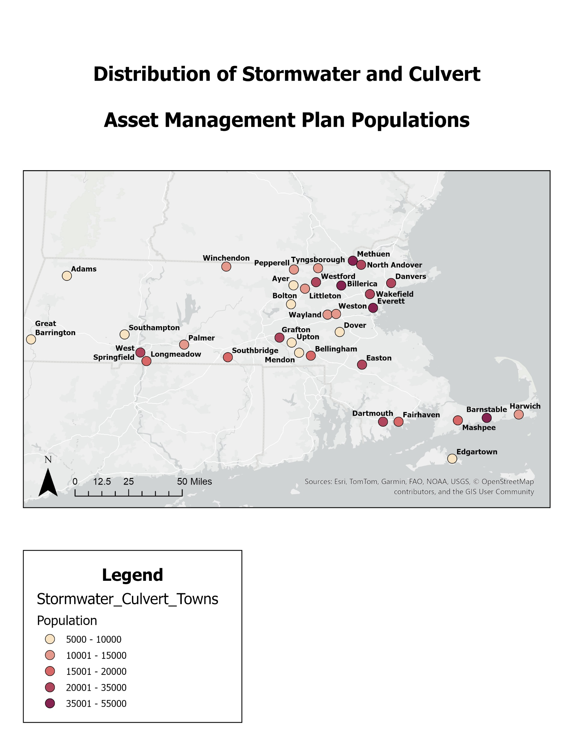
Case Studies

Slide 15
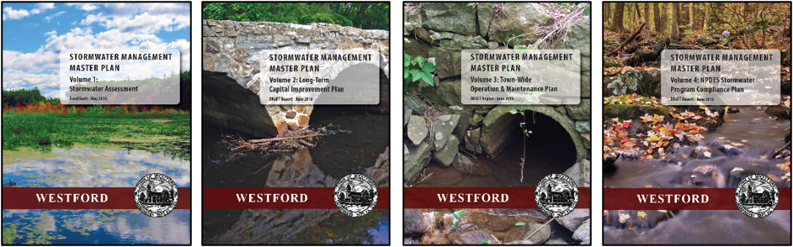
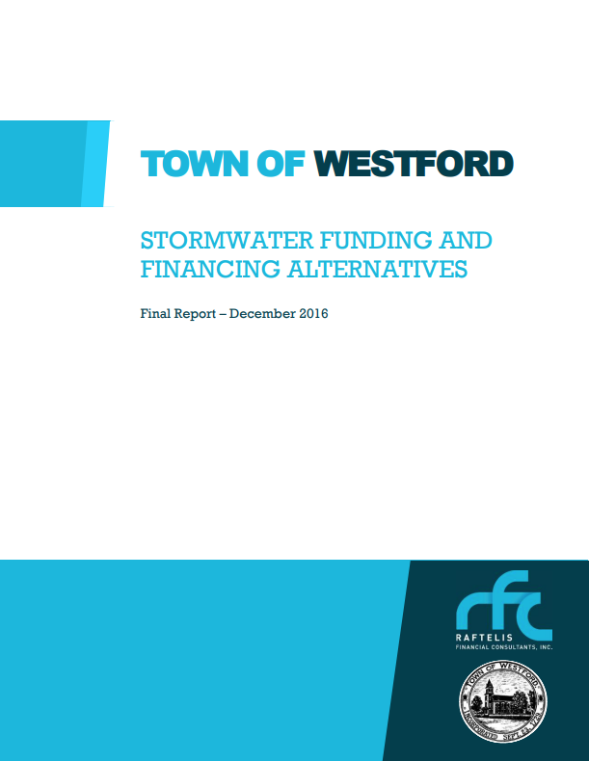

Westford
Stormwater Management Master Plan (SWMMP)
  Leveraged grants
Long-term, robust public education campaign
  Stormwater Advisory Group (SwAG)
  Local champions: Engineering Department
  and Select Board chair
Adopted stormwater utility 2019

Slide 16
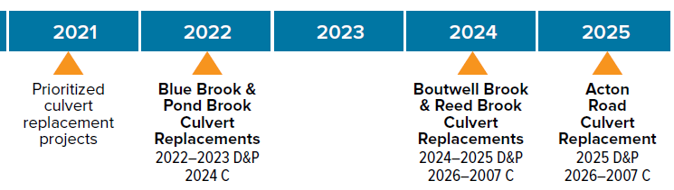
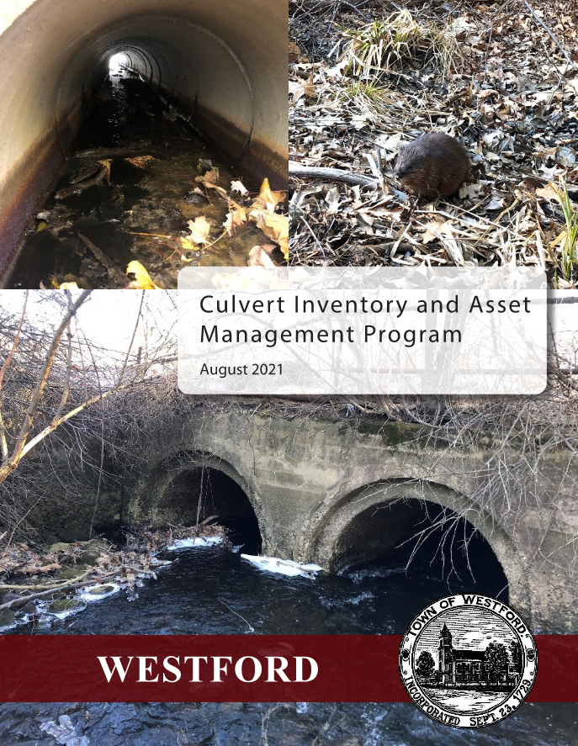
Westford
Stormwater Management Master Plan (SWMMP)
  Annual average stormwater program expenditures: $600,000
  Projected revenue needs to support program goals and capital projects: $1.5M
Culvert Inventory and Asset Management Program
  Developed culvert inventory
  Assessed nearly 200 municipal culverts
  Determined risk-based criticality ratings
  Prepared 5-year CIP for replacement, repair,
  maintenance, etc. ($500,000-$1.6M annually)
Implementation
  Culvert replacement projects
  Additional Engineering staff and DPW equipment purchases
  Improved data management
98 Old Lowell Road over Pond Brook – Opened Aug 2024
Cold Spring Road
over Boutwell Brook –
In Design
North Main Street
over Reed Brook – In Design
426 Groton Road over Blue Brook – In Construction
Forge Village Road over Boutwell Brook – In Design

Slide 17

Jeremy Downs, P.E.
Westford Assistant Town Engineer
The asset management program enables the Town to proactively plan for the repair, maintenance, and replacement of critical infrastructure, rather than waiting for failures to occur. By having a structured plan in place, the Town can better prioritize projects, allocate funding more efficiently, and reduce unexpected emergency costs. The program helps minimize risks to public safety and service disruptions, supports long-term budgeting and capital planning, and strengthens applications for state and federal grant opportunities.
Investing in an asset management program allows the town to make informed, data-driven decisions about how to invest available funds in our infrastructure. It ensures that available resources are used effectively, helps prioritize projects with the greatest benefit, and provides a clear plan for future investments. Without this program, the Town would be making decisions with limited information, risking inefficient spending and missed opportunities to plan responsibly for the future.

Slide 18
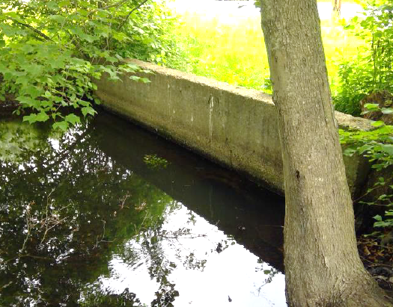
Billerica
Robust stormwater management program
  Strong Engineering and DPW support, including dedicated Stormwater Engineer
  Comprehensive GIS asset inventory and procedures
  Culverts were an unknown
2022 MassDEP Asset Management Grant
  Completed drainage system condition and water quality assessments
  Built inventory and evaluated condition for 223 municipal culverts
  Identified many submerged culverts
  Determined risk-based criticality ratings
  10-year CIP for culvert replacement, repair,
  maintenance, etc. ($630,000-$1.2M annually)

Slide 19
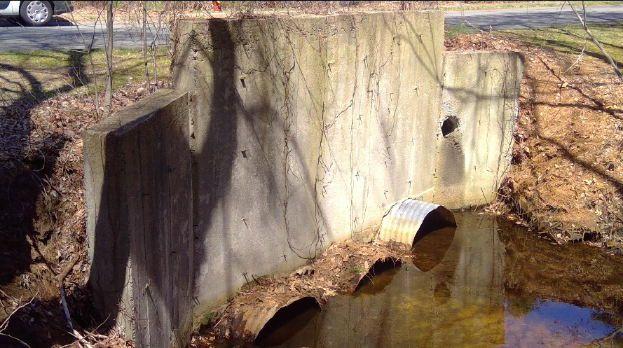
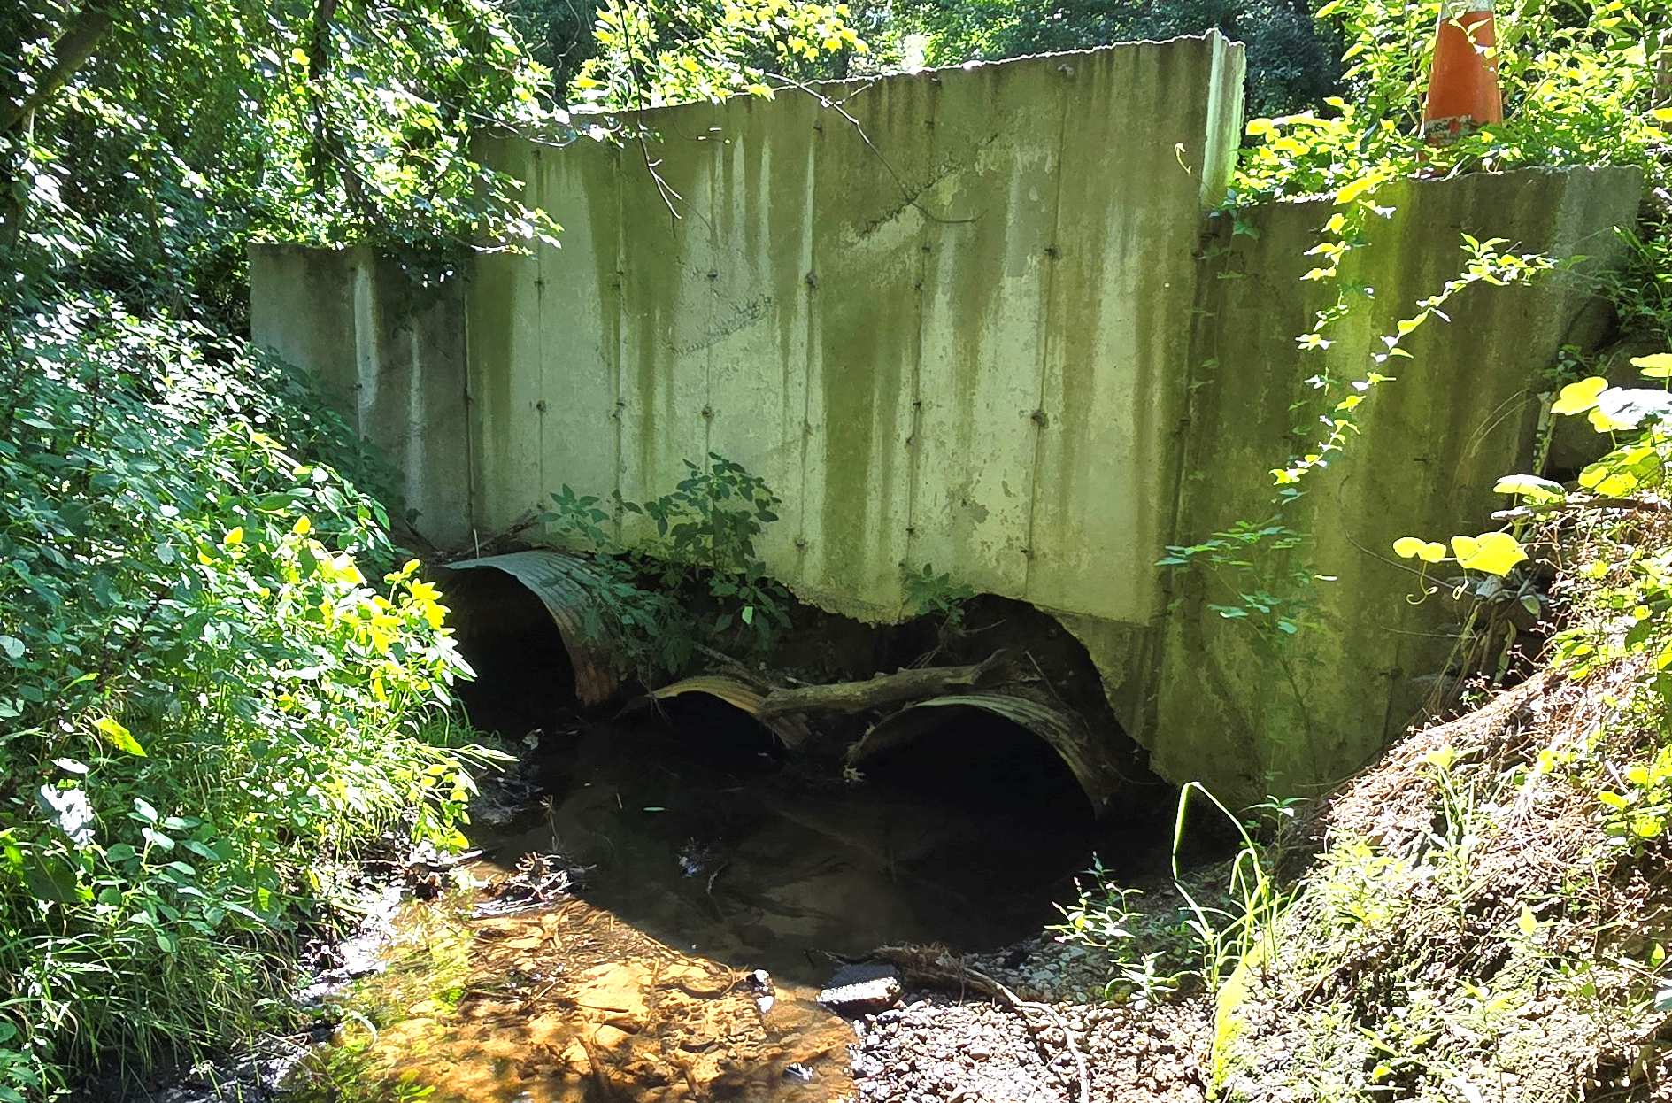
Billerica
Aug. 2023 culvert failure during AMP
Implementation
  Continuous data management updates
  Taking advantage of grants
    MVP grant for H&H of submerged culverts
    DER Culvert Replacement Municipal Assistance (CRMA) grant for preliminary design
  Updating stormwater capital plan as planning projects are completed
Culvert inlet prior to 2023 flooding
Culvert outlet with 2 failed barrels

Slide 20
Christina Papadopoulos, P.E.
Billerica Stormwater Engineer
The town benefitted from developing a formal asset management program by gaining a clearer understanding of its stormwater infrastructure, which allowed us to proactively prioritize repairs and plan for new infrastructure based on actual condition and risk rather than assumptions.
Investing in an asset management program was worth the cost because it provided long-term savings by preventing emergency repairs, improving resilience to storm events, and helping us make data-driven decisions that align with community needs and available resources.
The town uses the culvert inventory and condition information collected during the asset management program to inform capital planning, support grant applications, and coordinate maintenance efforts more efficiently across departments.

Slide 21
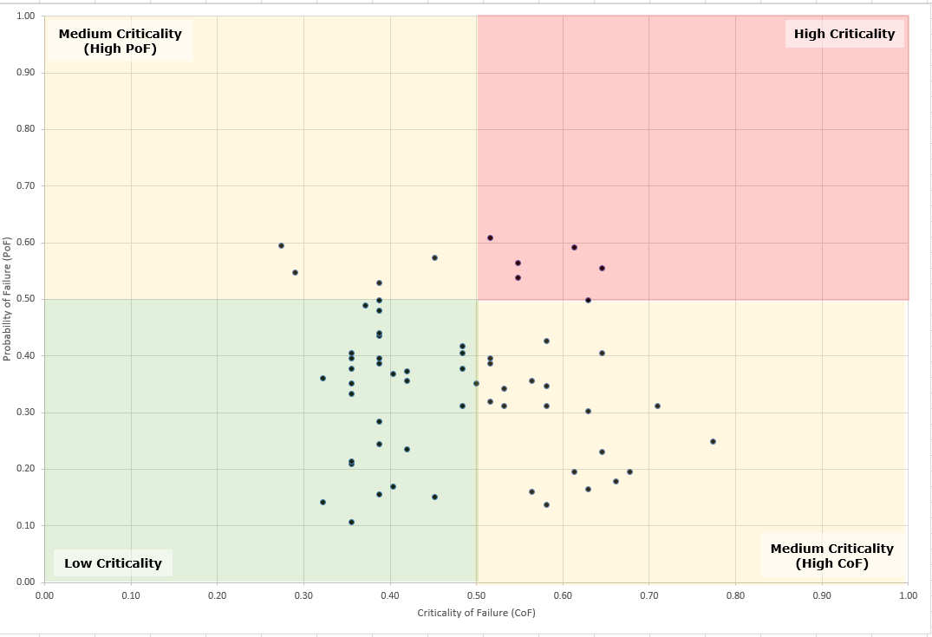
Ayer
Stormwater management program handled by Town staff with watershed collaborative support
  Stormwater enterprise fund approved in 2011, but eventually eliminated
  Through MVP process, identified need to develop a Stormwater Asset Management Plan as a High Priority
  2021 MassDEP Asset Management Grant
  Completed culvert, structure, and pipe assessments
  Built inventory and evaluated condition for 61 municipal culverts
  Determined risk-based criticality ratings
  Developed 5-year action plan: included highly critical culvert replacement, infrastructure repair, maintenance, etc. ($780,000 to $1.9M annually)

Slide 22
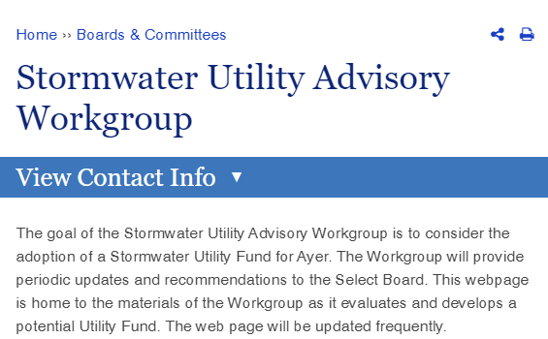
Ayer
2023 Stormwater Utility Advisory Workgroup established
Key Local Champions
AMP provided support for increased stormwater investment
Implementation
  Utility adopted 2024 & user
  fees established
  Billing started 2025

Slide 23
Dan Van Schalkwyk, P.E.
Town of Ayer Director of Public Works
Investing in an asset management program was worth the cost because the Town is now able to proactively plan work to improve its stormwater assets - we are no longer blind and reactive. Furthermore, the Town understood the importance of its stormwater system, through results of the asset management program, and has since approved a Stormwater Utility Enterprise Fund.
The town benefitted from developing a formal asset management program by simply identifying the infrastructure we have – this helps to inform and properly plan improvements, including justifying needs when requesting funding. Our stormwater system was probably our least cared for asset over the years, with reactive repairs a constant theme. The asset management program has moved us to a proactive approach, which will save money and increase resiliency in the future.

Slide 24



DER – Upton
– Grafton
Massachusetts Division of Ecological Restoration (DER) identified high priority sub-watersheds with limited existing culvert data in NAACC
  Identified two communities within Blackstone River Watershed
Partnered with local watershed association
Goal: Identify culverts with high potential for ecological restoration

Slide 25
DER – Upton
– Grafton
Scope of work:
  Built an inventory based on “potential” crossings & field confirmed
  Trained local staff on NAACC protocols
  Completed more than 300 culvert condition assessments
  Input field data into the NAACC database and GIS
  Assessed the data to prioritize culvert replacement projects
No information → complete inventory with size, material, condition, photos
Grafton – DER CRMA grant awarded to support design and permitting of highest priority culvert replacement project

Slide 26
Paul Cournoyer
Grafton DPW Director
By participating in the DER sponsored assessment program, Grafton now has the needed data to support long standing budget requests for culvert maintenance and replacement. Having town staff participate in the assessments with Tighe & Bond along with the Blackstone Watershed Collaborative gave us the ability to submit an accurate grant application, enabling us to secure funding for a much-needed replacement of a deteriorated culvert. Having accurate information also assisted in support of funding from local reserves.

Slide 27
Recap
Asset management programs can formalize current practices, support spending decisions, and help plan for the future
Establish workflows that are realistic. Keep your data up to date!
One size DOESN’T fit all
Any size community can use the resources available to them to get started
  Take advantage of grant funding
  Talk to your local watershed association
  Find your champion!

Slide 28
Thank You!
Natalie Koncki
ngkoncki@tighebond.com
508.304.6360
Cassandra LaRochelle, PE
clarochelle@tighebond.com
508.471.9644

