Slide 1





A Regional Approach to Stormwater Education

Slide 2
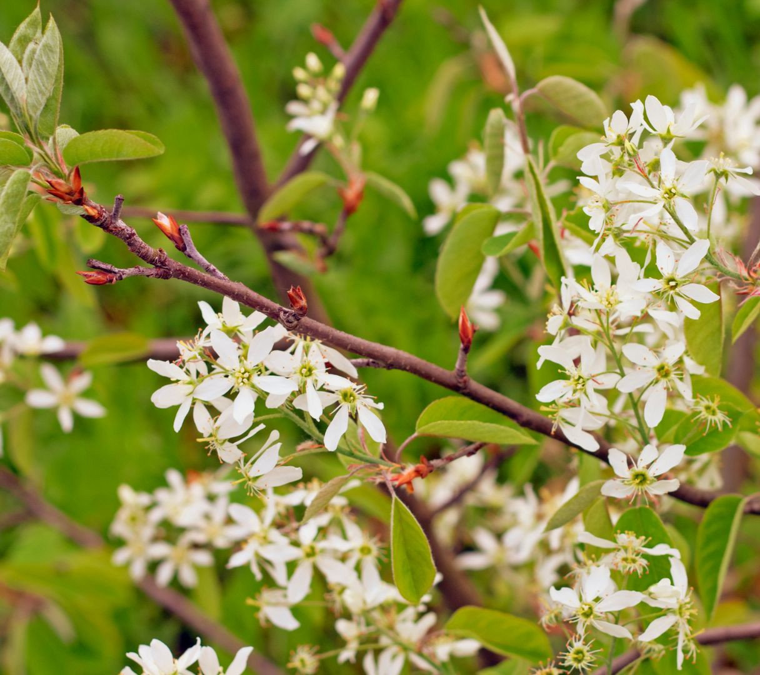
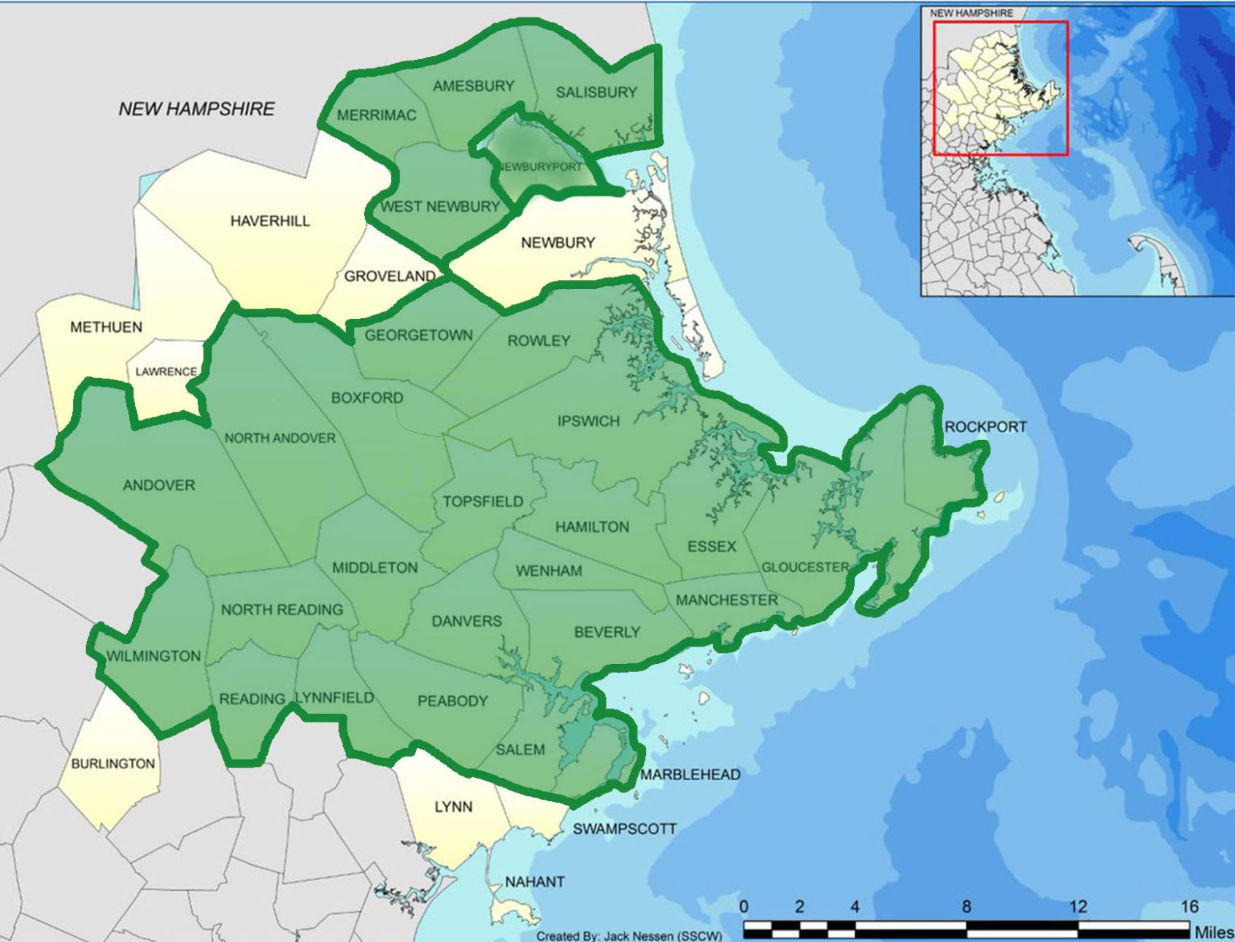
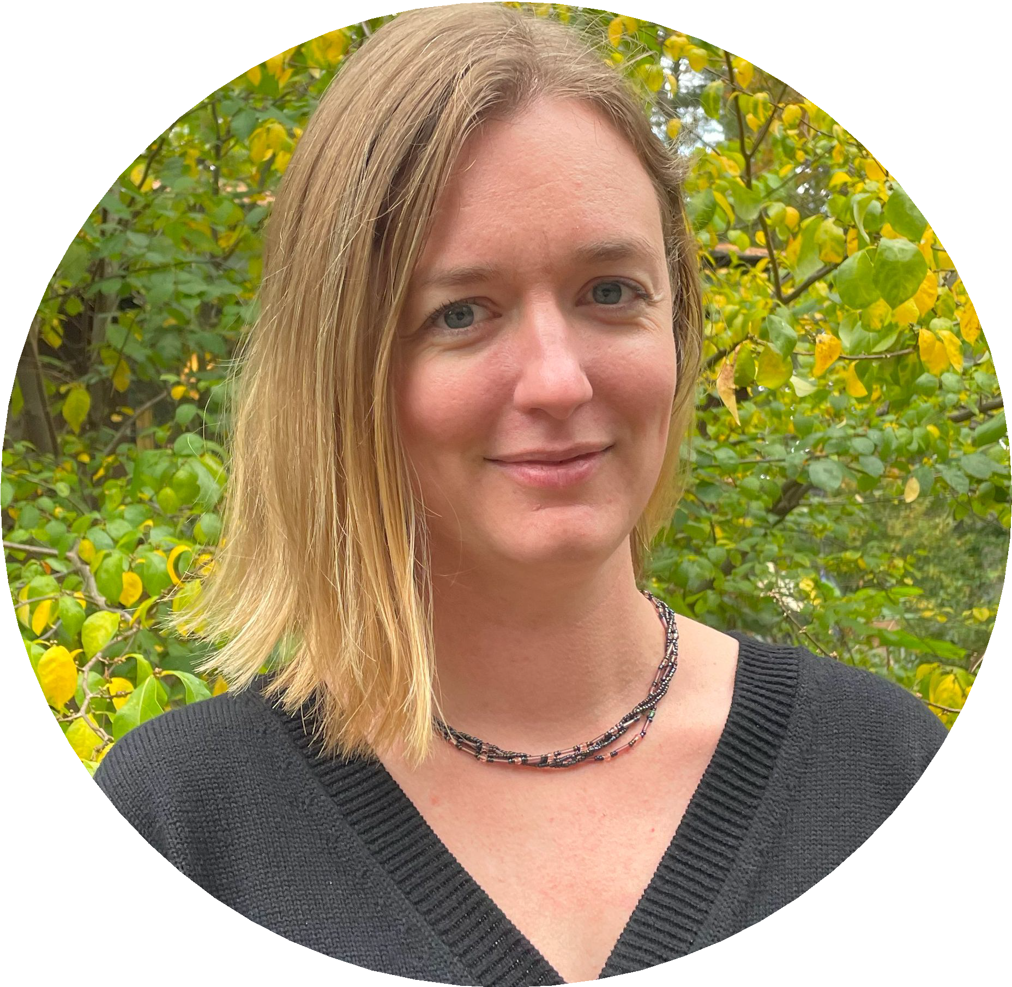
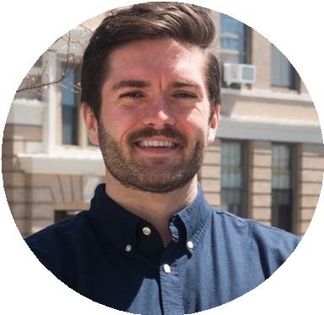
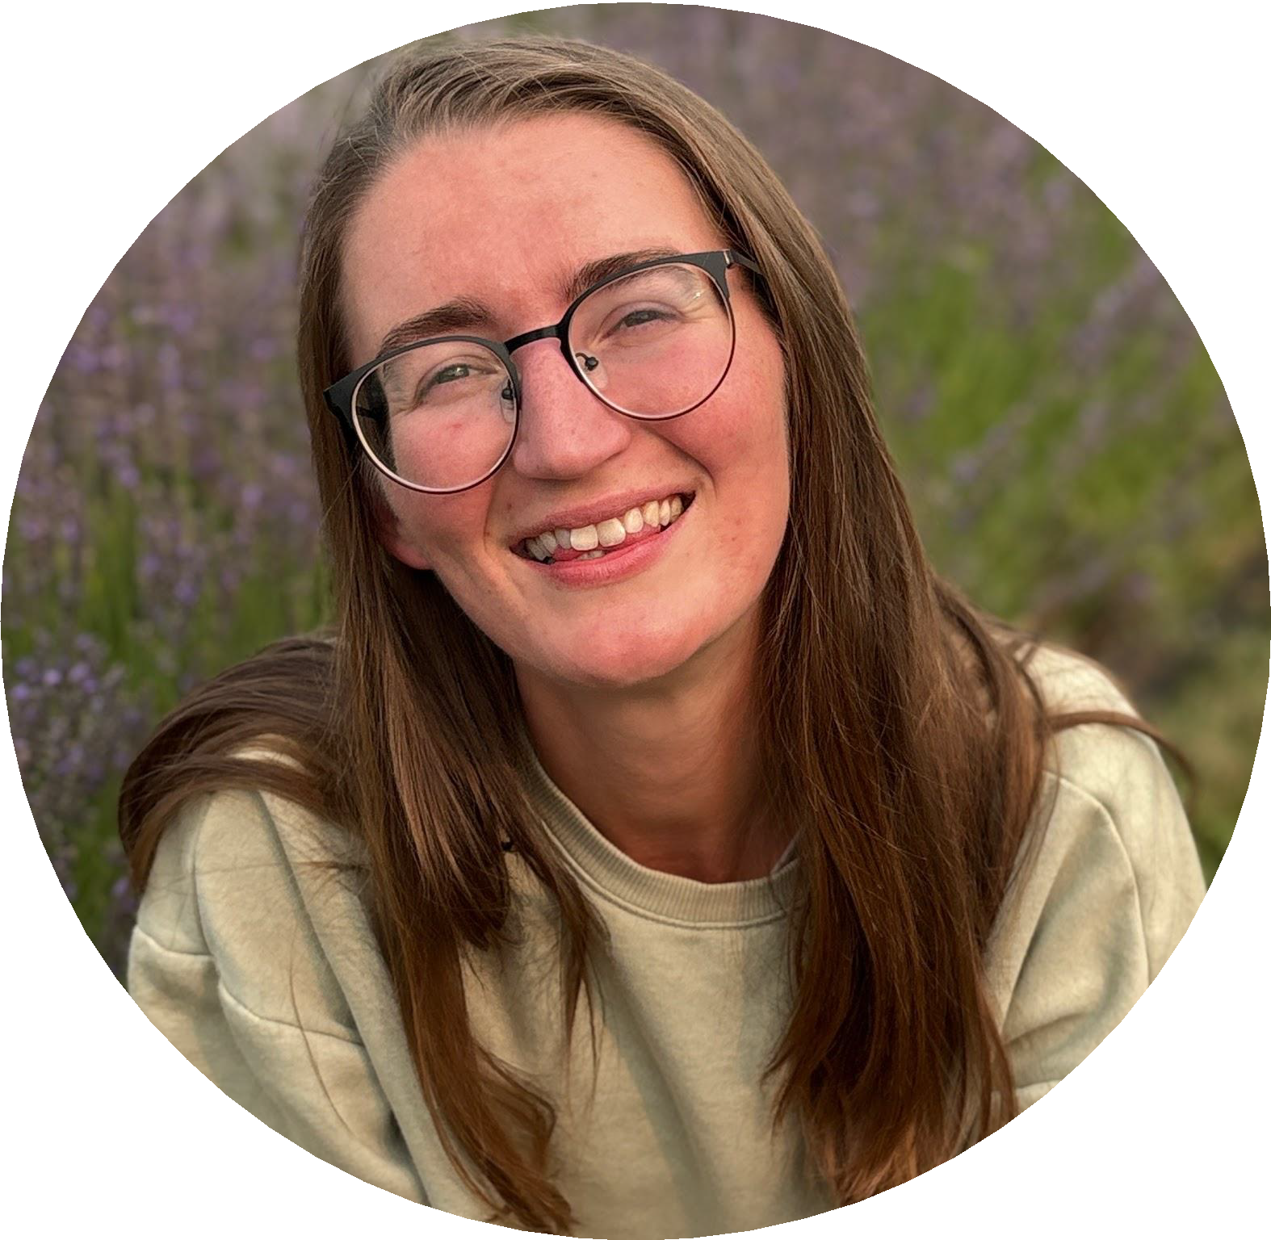
WHO WE ARE
Molly Courson she/her Resiliency Program Director IRWA
Macklen Wier he/him Environmental Planner MVPC
Emma Hughen she/they Education Program Manager IRWA
OUR COALITION

Slide 3
MISSION
GOALS
Provide outreach and education to support municipal compliance with water-related regulatory requirements, including the MS4 Stormwater and the Water Management Act permits
Empower and educate residents about water resources for better quality and quantity
Be a resource for homeowners and businesses to reduce their water bill and cut down on pollution
Promote and protect beautiful landscapes for clean and plentiful water on the North Shore of Massachusetts

Slide 4
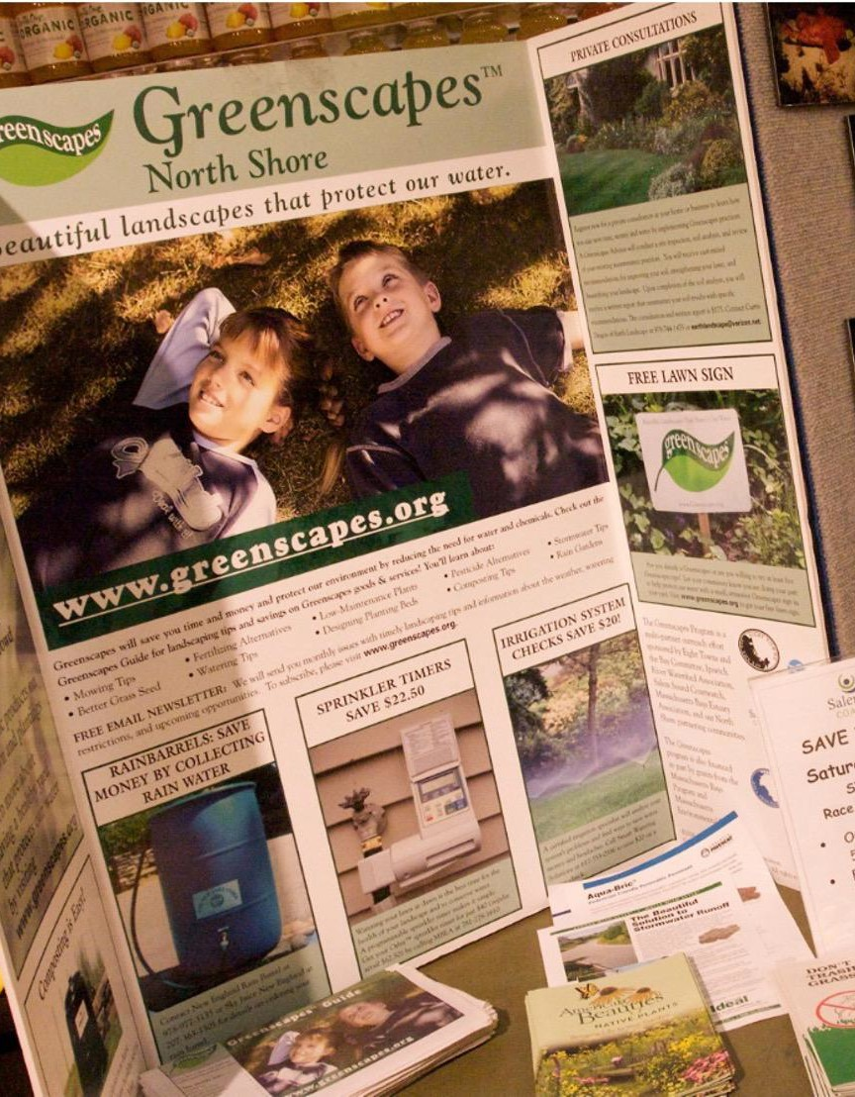

HISTORY OF GREENSCAPES
Greenscapes South Shore
North and South River Watershed Alliance (NSRWA)
Greenscapes North Shore Coalition - 2007
Goal: protect our region’s waters by teaching residents and landscape professionals how to have attractive landscapes and gardens without overusing water and chemicals
MS4 Permit - 2010
Expanded Goal: MS4 and water conservation outreach, including education to residents, developers, commercial businesses, and industrial facilities

Slide 5
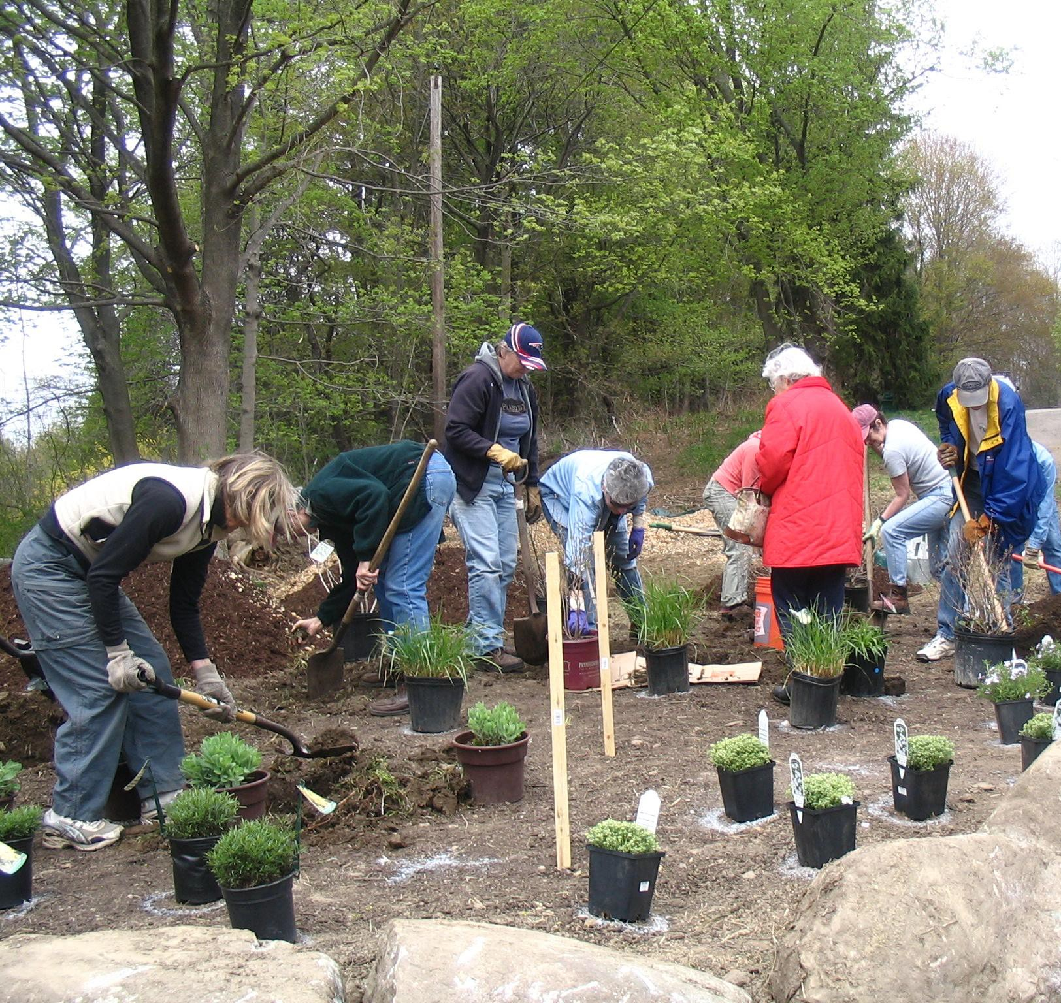
WORKING TOGETHER
Ipswich River Watershed Association Nonprofit working for the protection, conservation and sustainable management of the Ipswich River watershed since 1976. 350,000 people drink Ipswich River water.
Salem Sound Coastwatch Nonprofit coastal watershed organization working to improve the quality of Salem Sound and its watershed, home to more than 200,000 people through municipal partnerships, scientific investigation, education, and stewardship.
Merrimack Valley Planning Commission Regional Planning Agency serving 15 Towns and Cities in the Merrimack Valley working to foster cooperative efforts to resolve common, regional problems and allow our communities to plan jointly to achieve the greatest benefits.

Slide 6
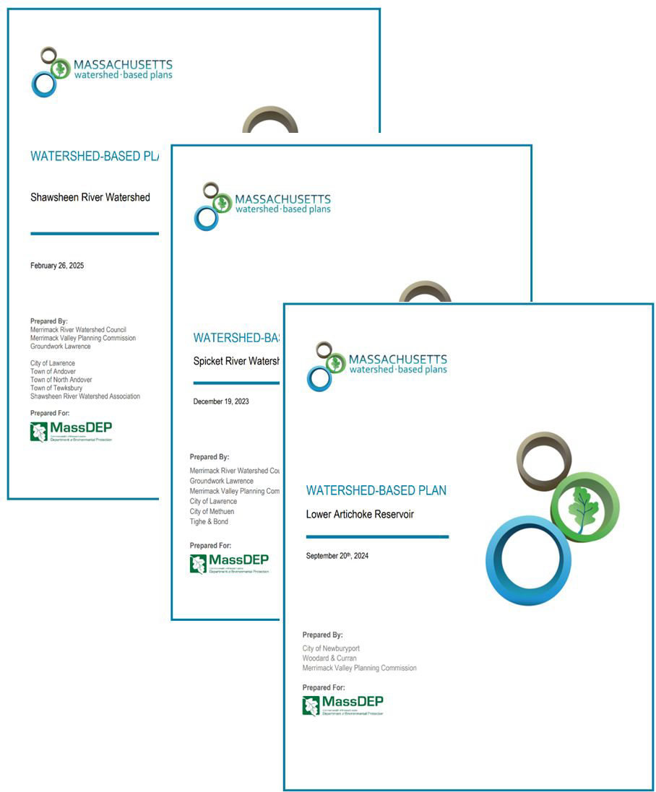
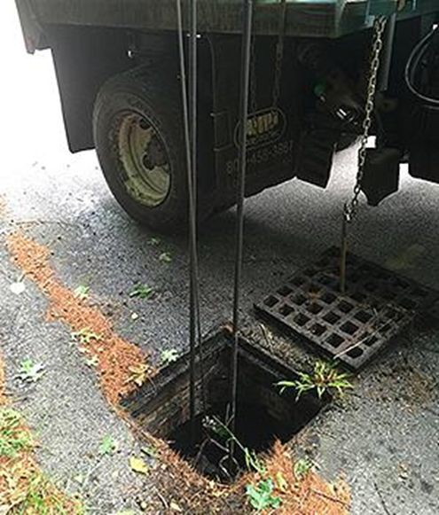
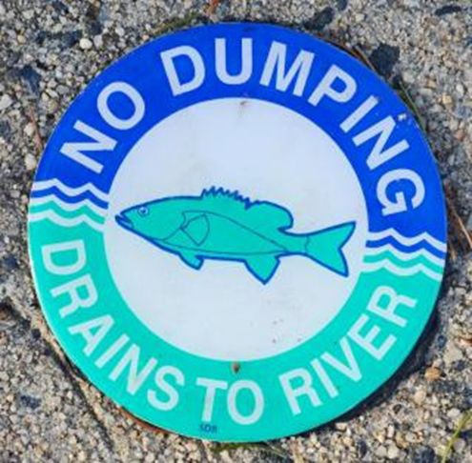
MVPC - STORMWATER COLLABORATIVE AND MORE…
Stormwater Collaborative MS4 Assistance Watershed Based Planning
Regional Stormwater Collaborative: Regional approaches to cost
-effective stormwater management
MS4 permit reporting
GIS stormwater application
Regional watershed management plans

Slide 7
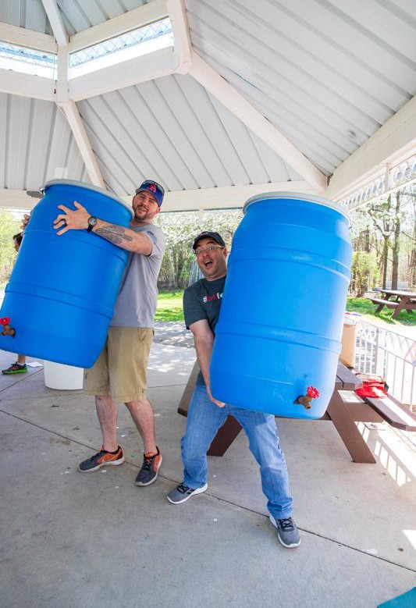
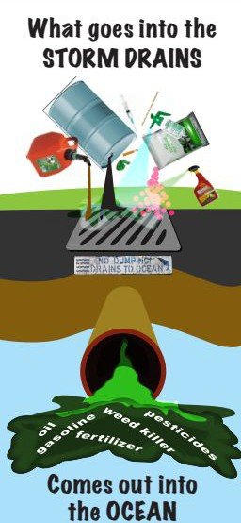
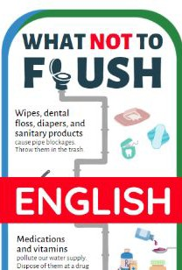
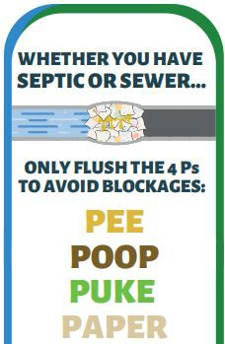
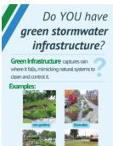
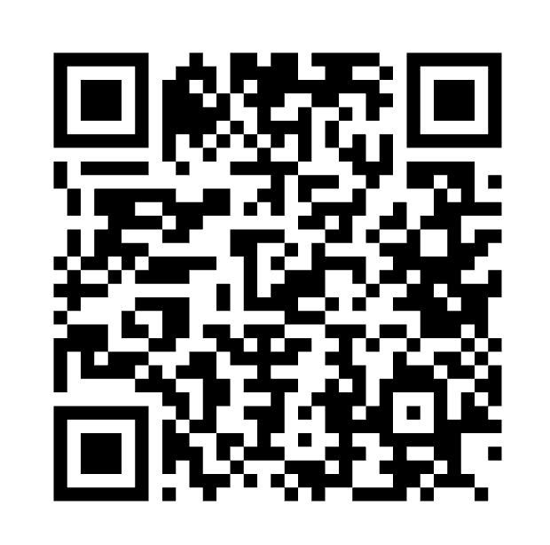
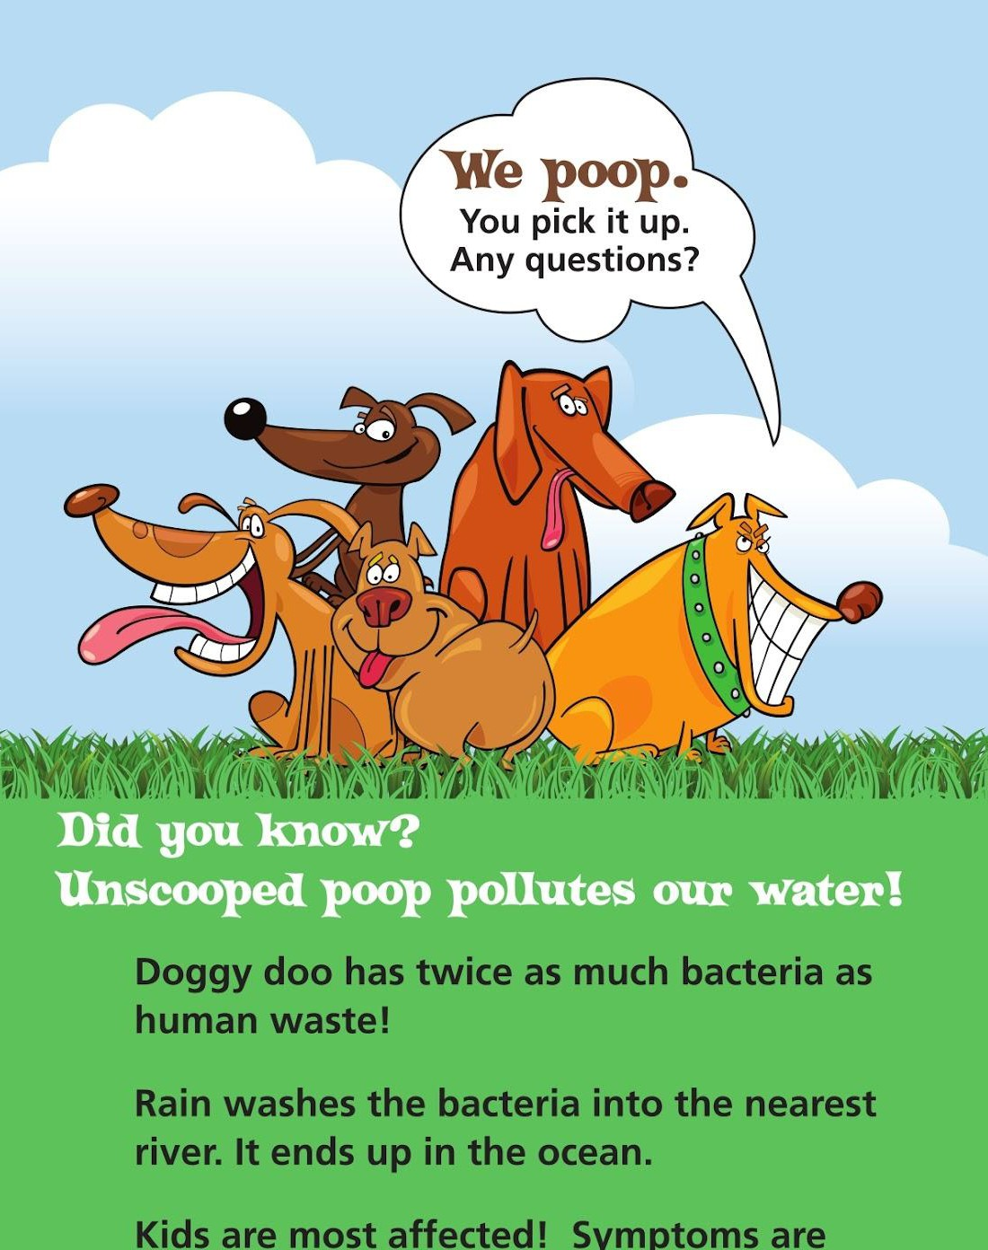
GREENSCAPES COMMUNITY SERVICES
Workshops, presentations, community events
Print and digital educational material
Social media kits for municipalities
Keeping Water Clean school program
Greenscapes Guide publication
General MS4 permit support
QR
placeholder

Slide 8

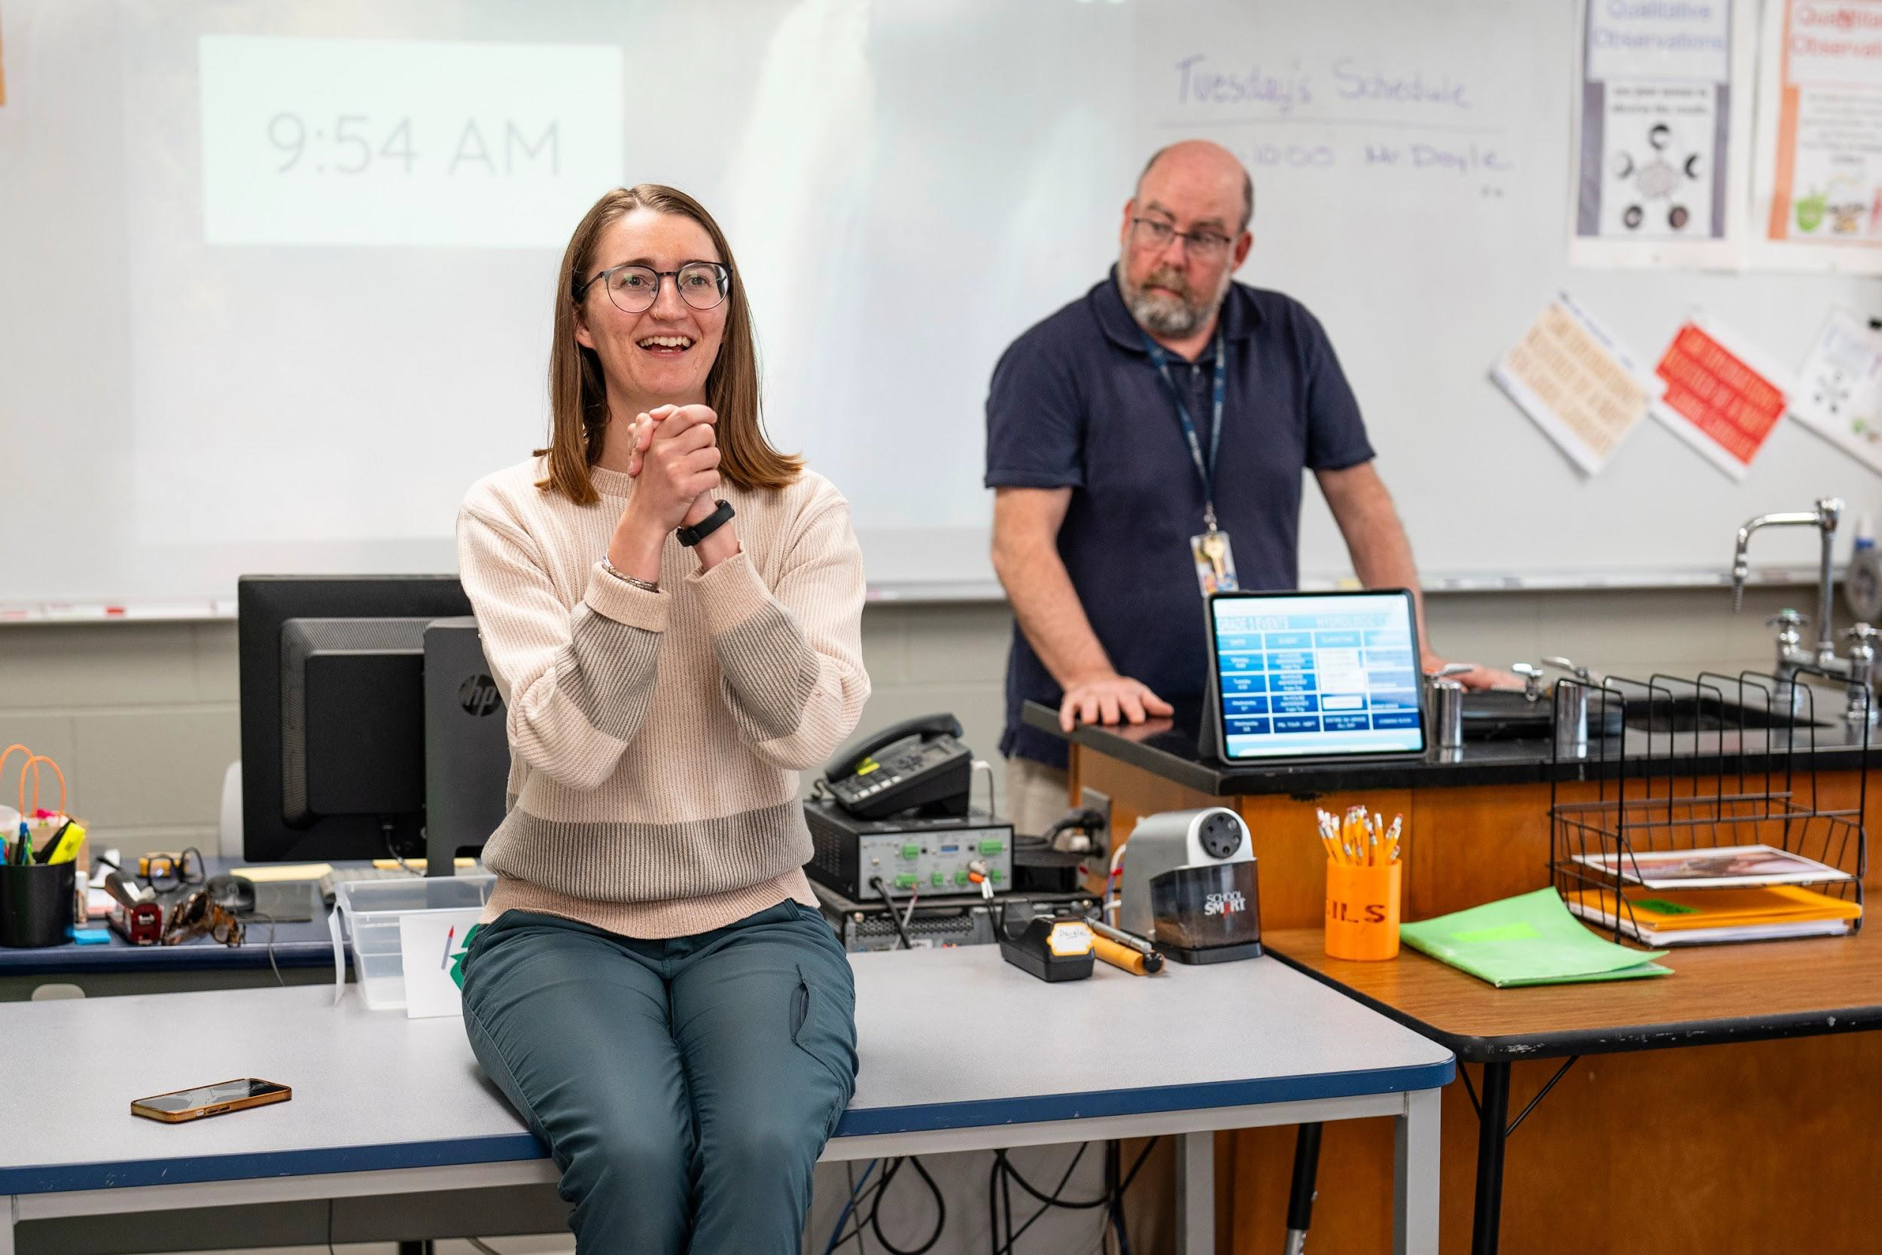
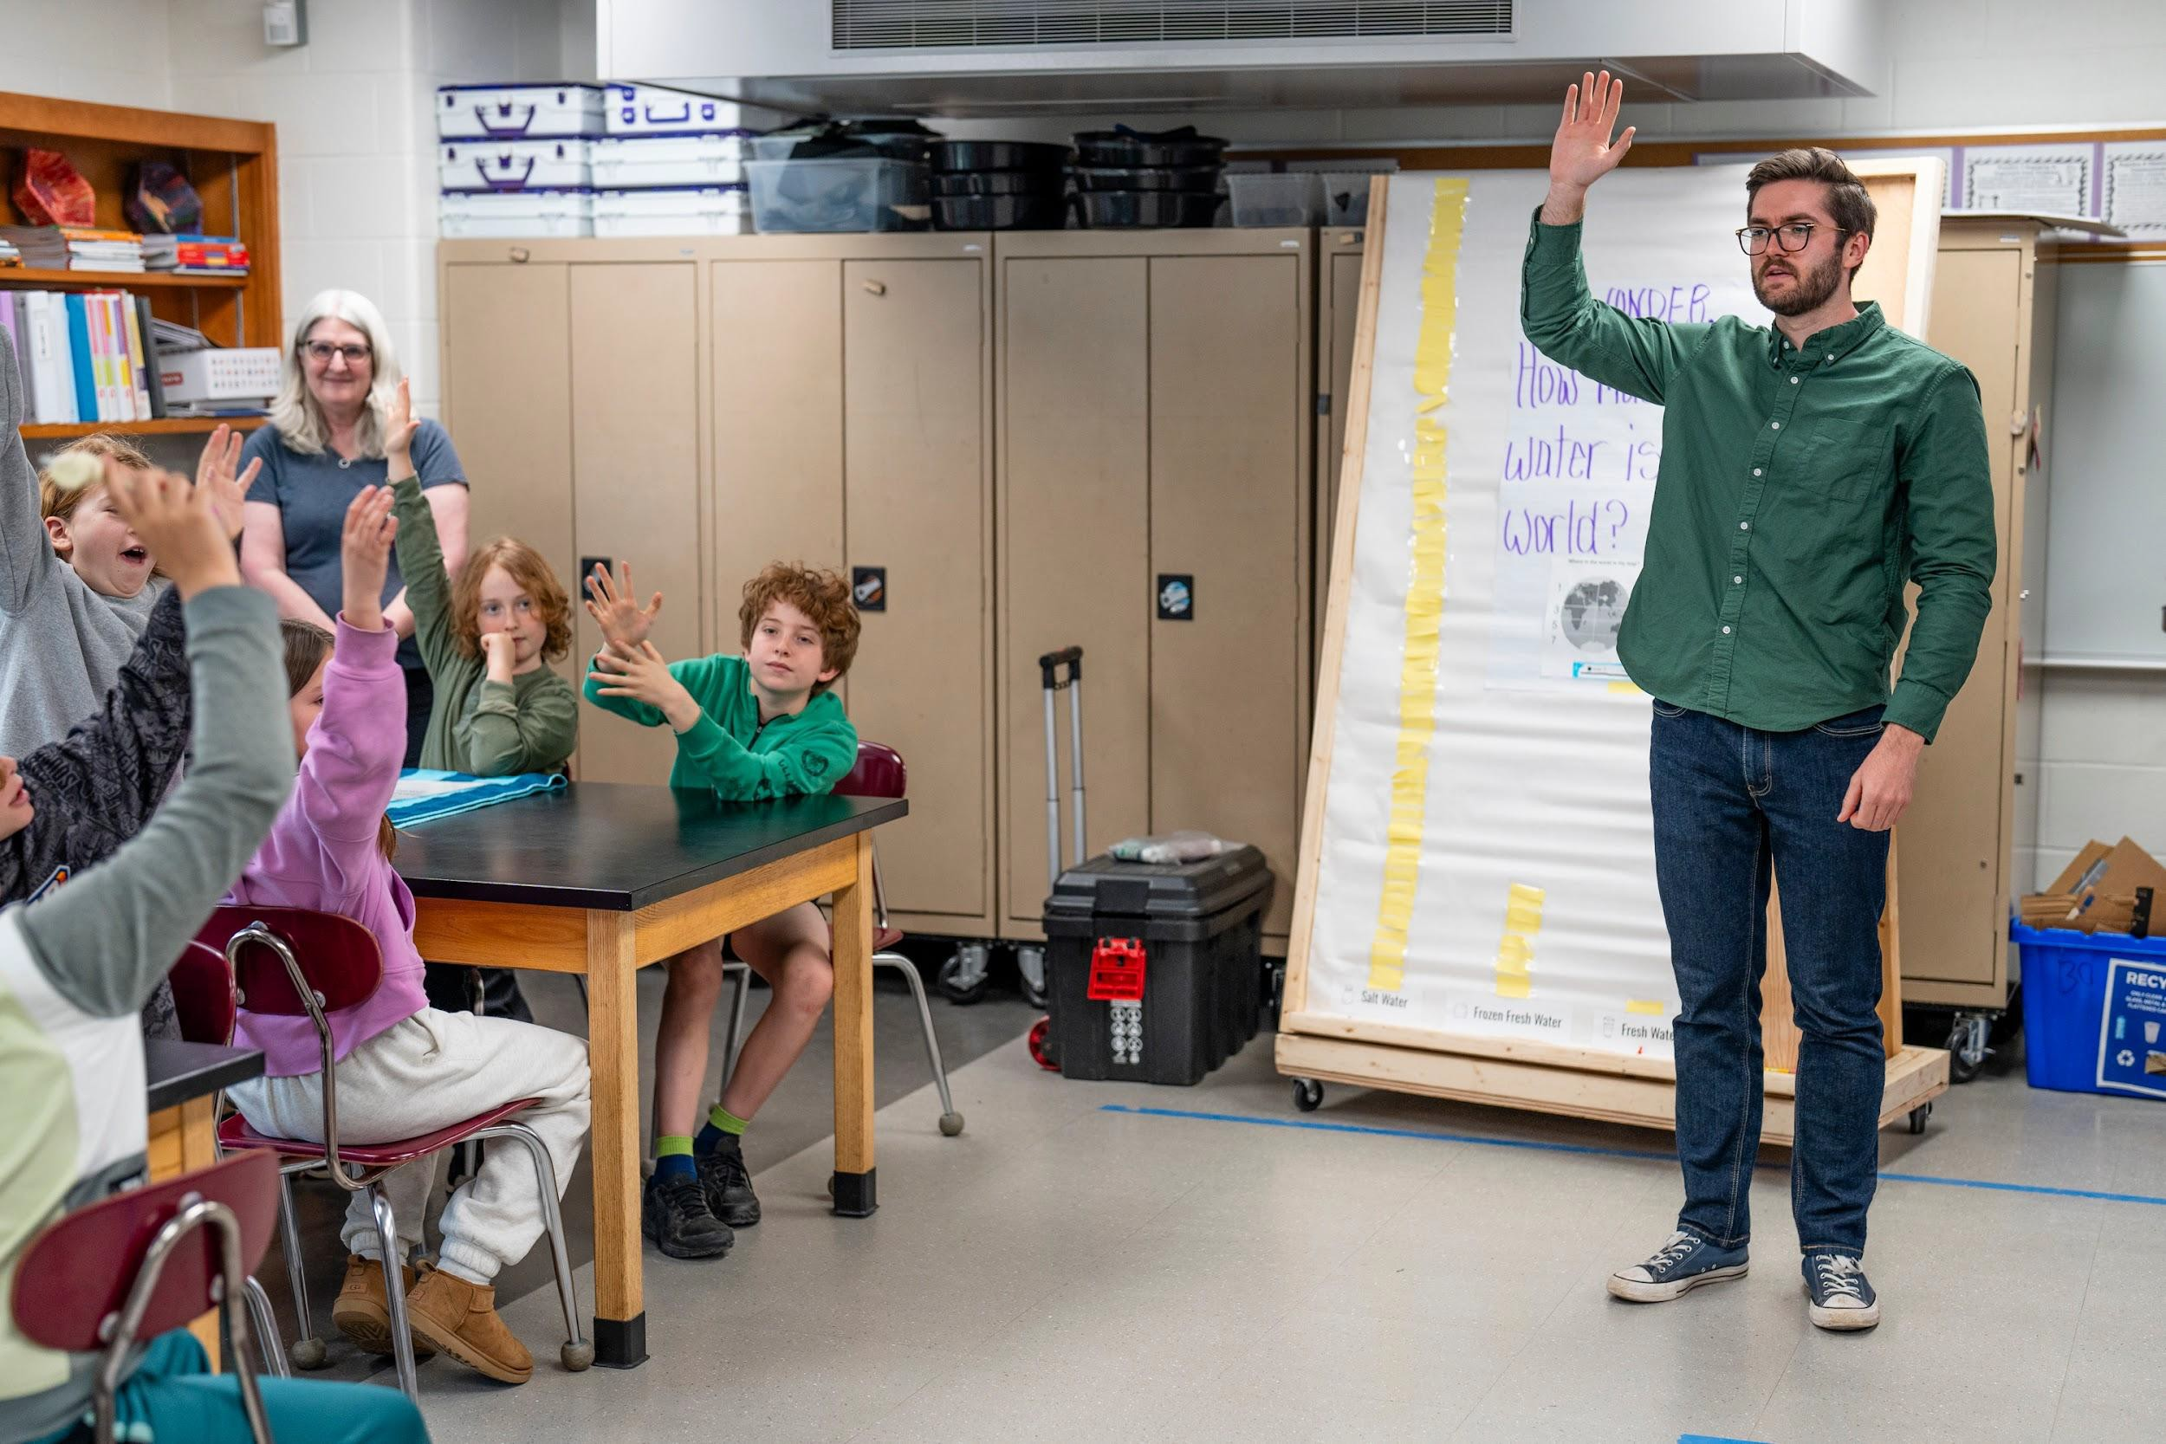
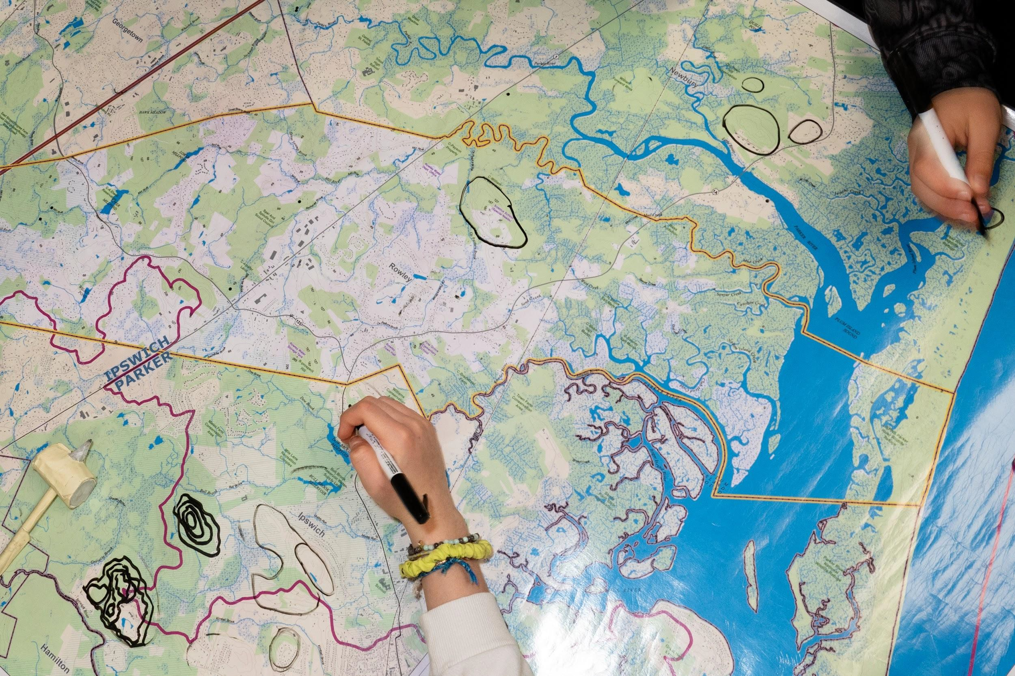
PROGRAM HIGHLIGHT: KEEPING WATER CLEAN
Engages ~3,000 5th graders & their teachers
5-15 volunteers per school
Easy to implement (one hour per class)
NGSS 5-ESS2-1 and 5-ESS3-1 (water
cycle; hydrosphere and geosphere; technology and engineering; maps)
Meets MS4 permit education requirements

Slide 9
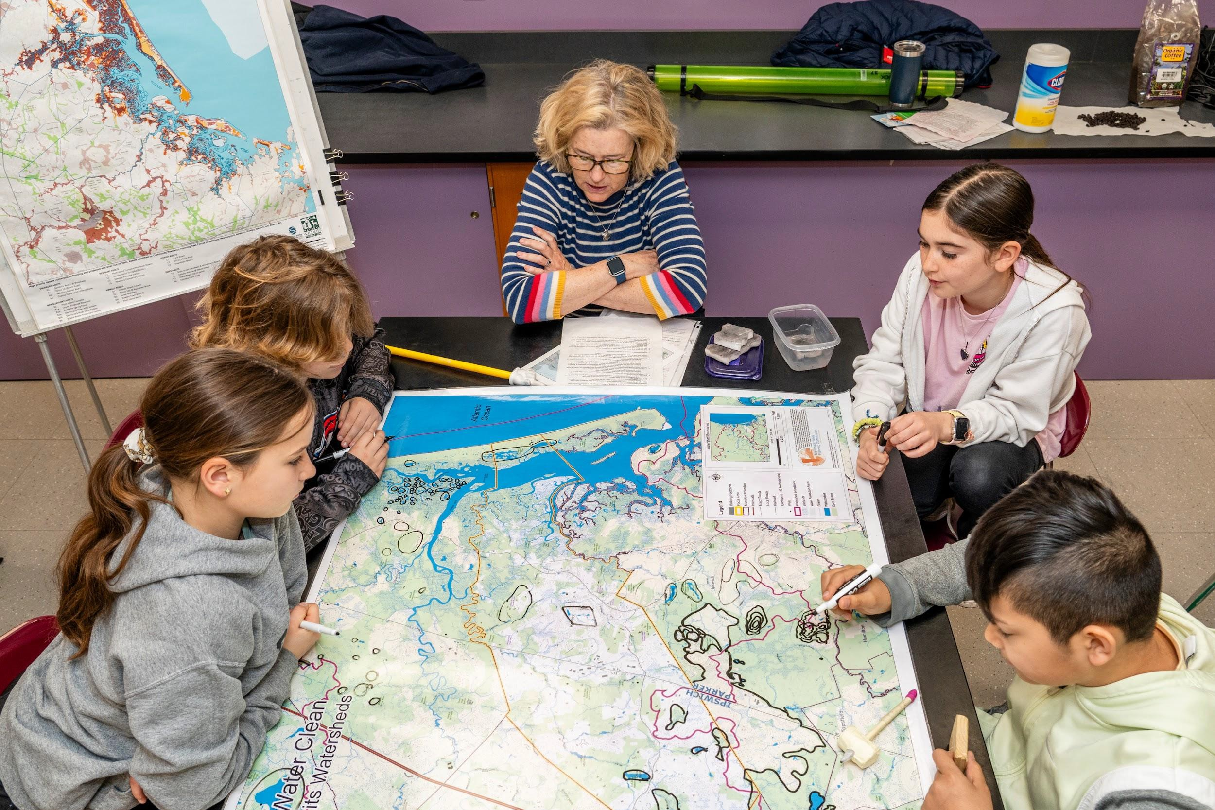
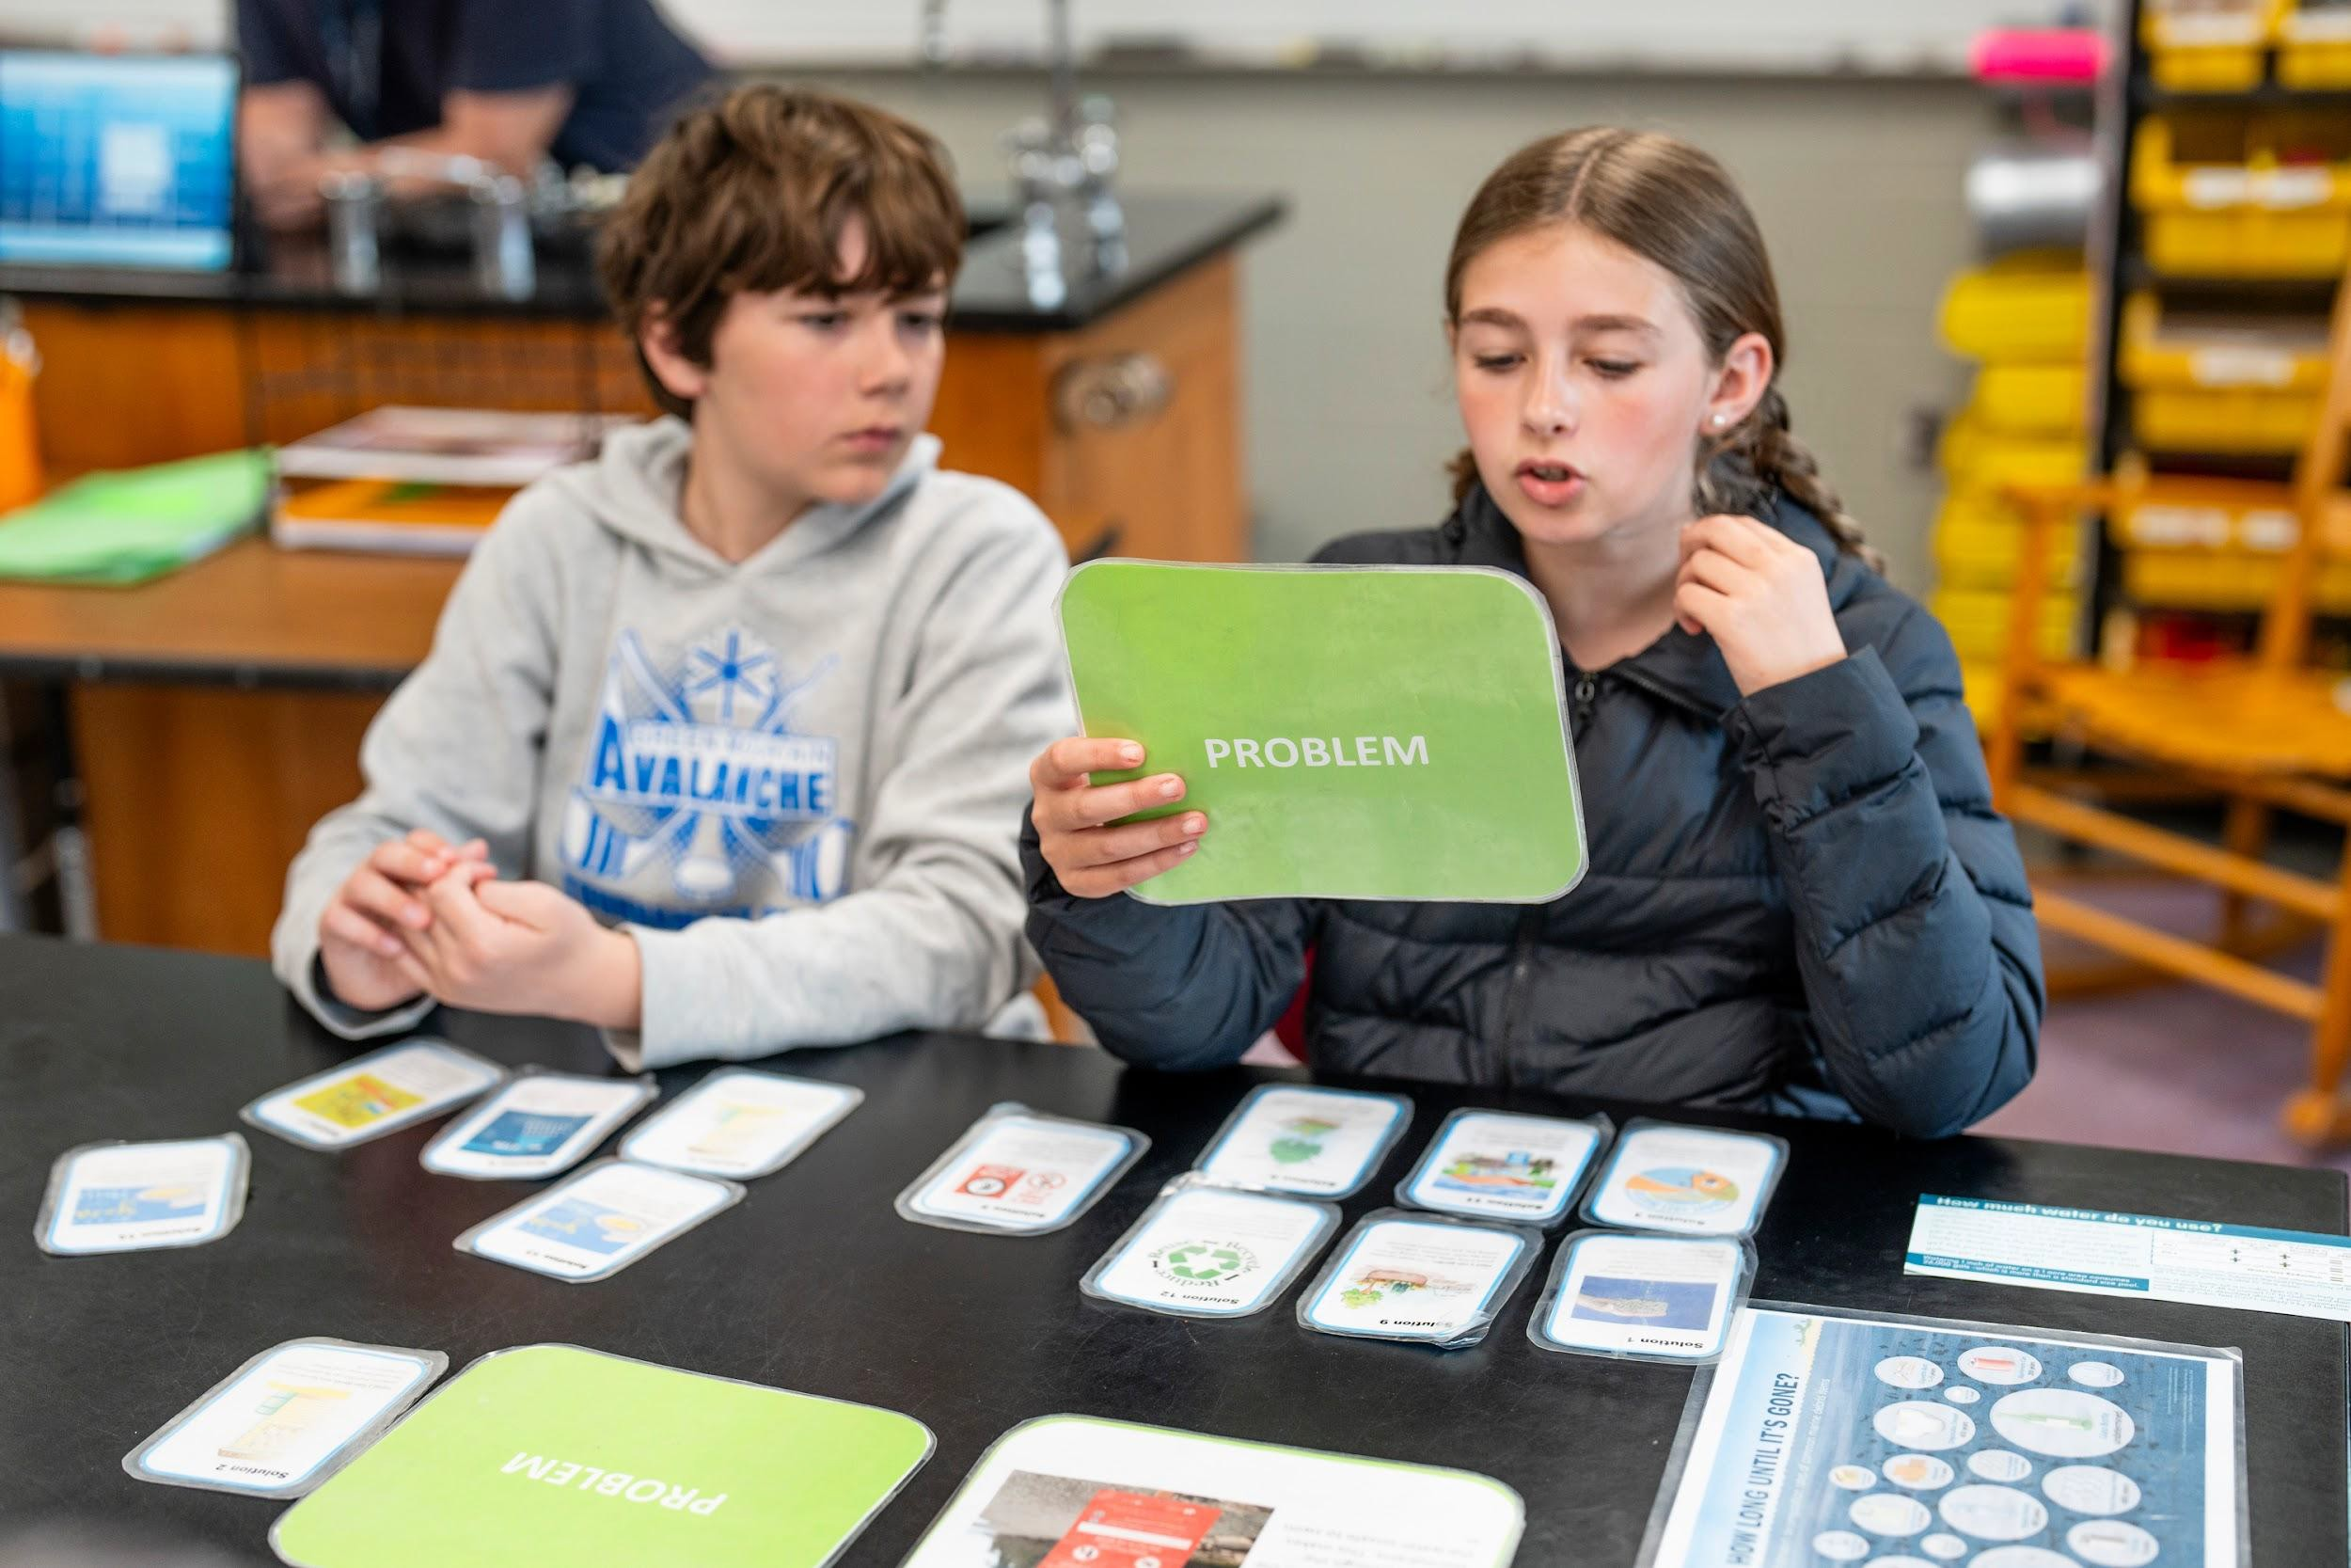
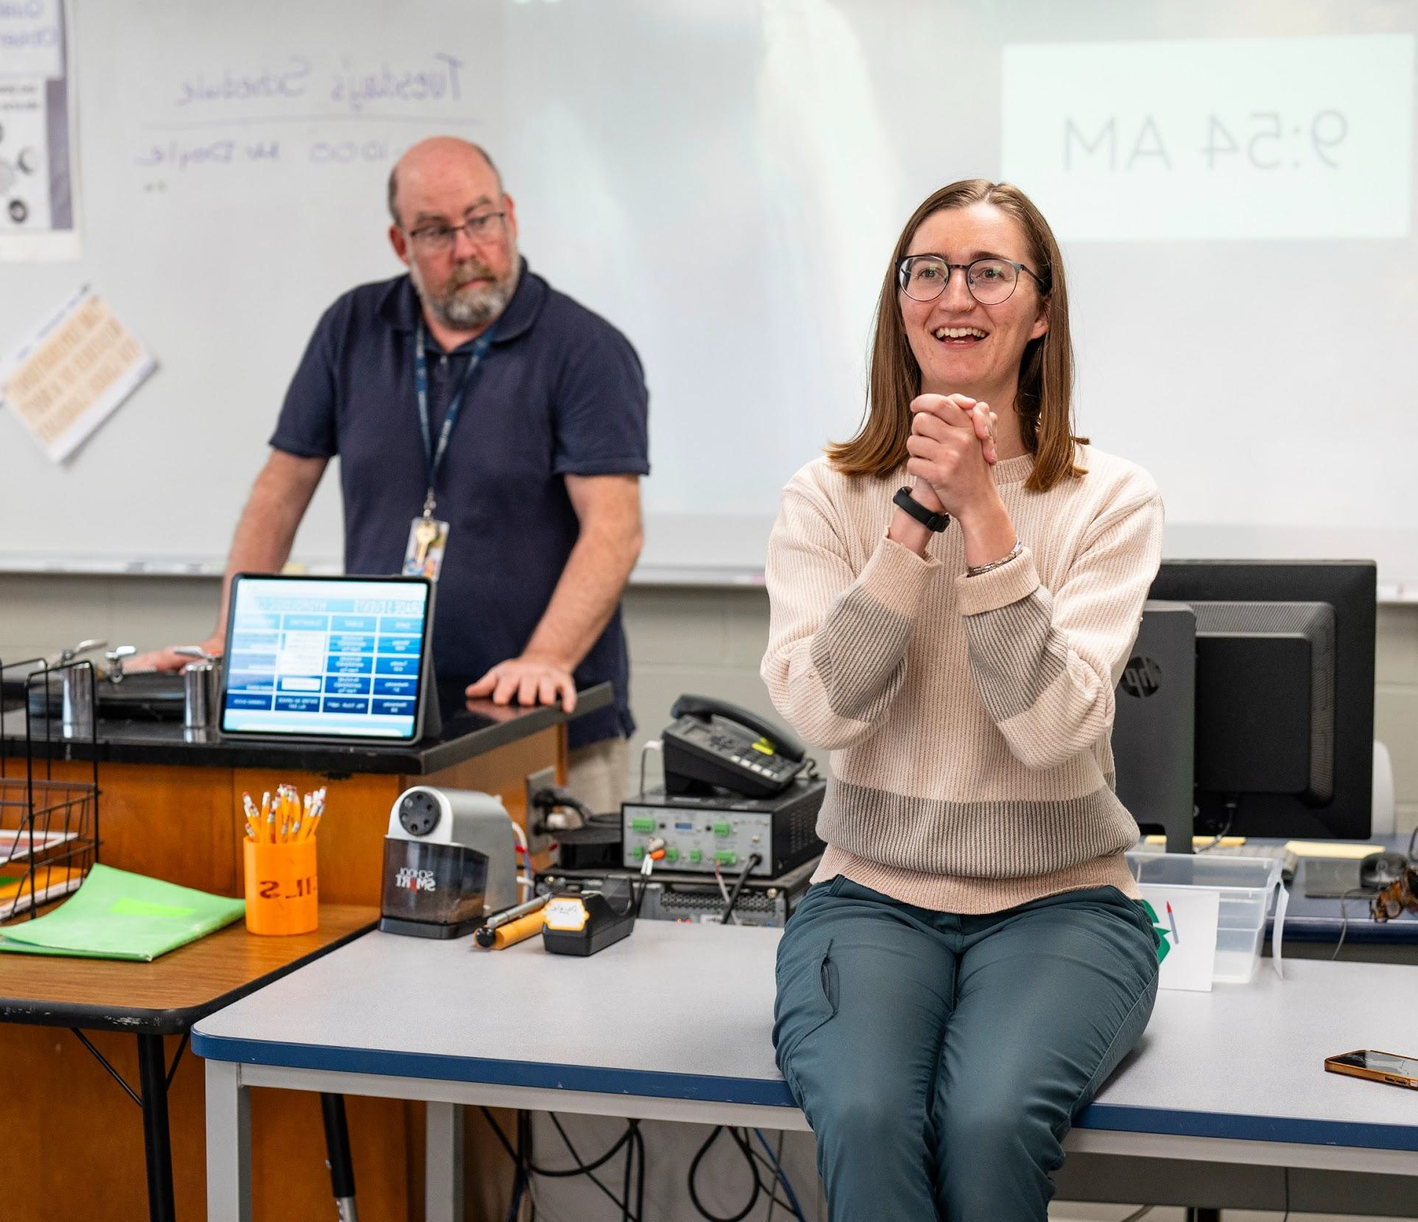
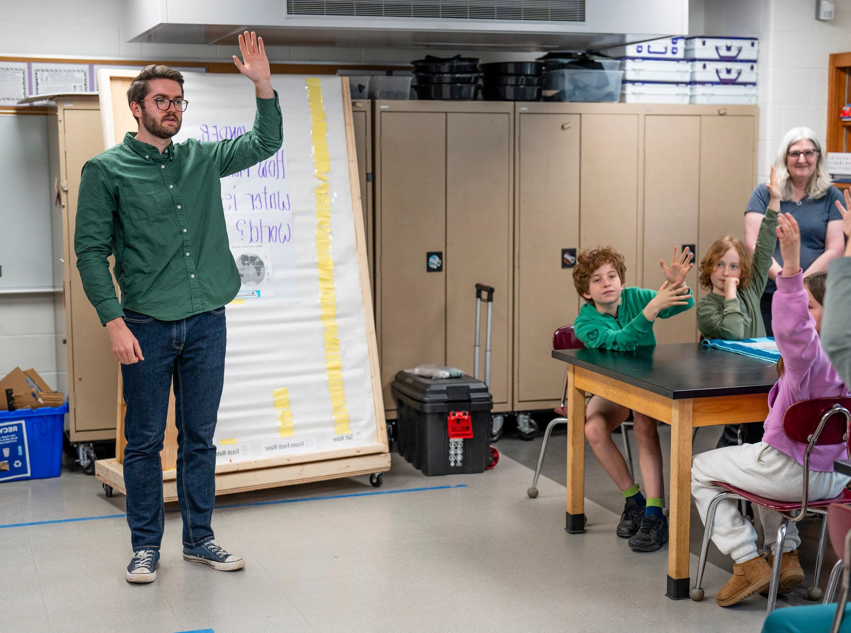
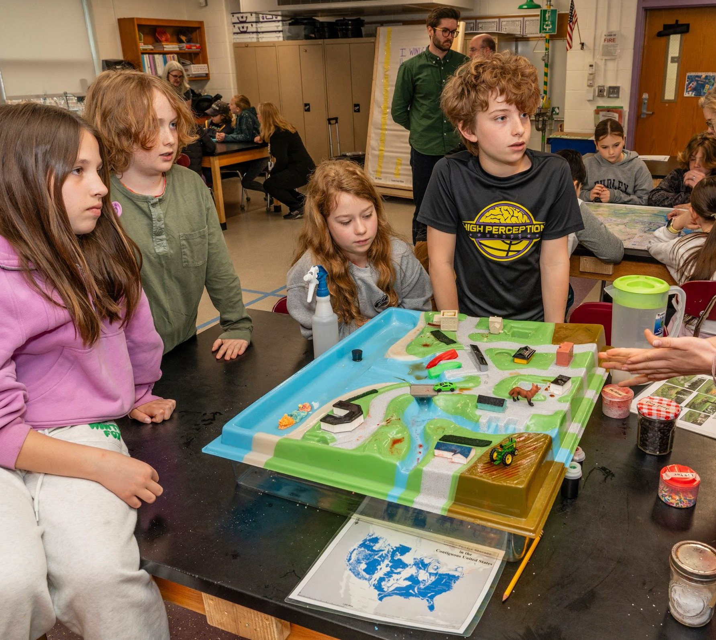
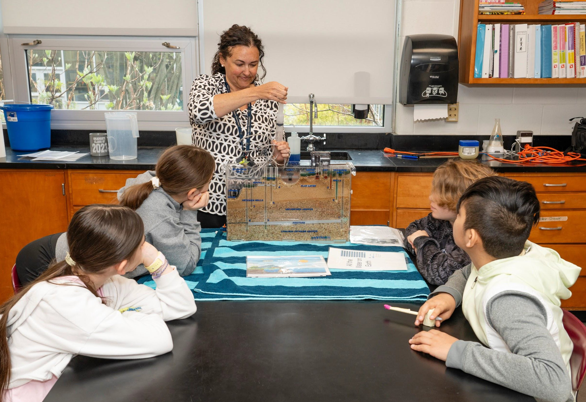
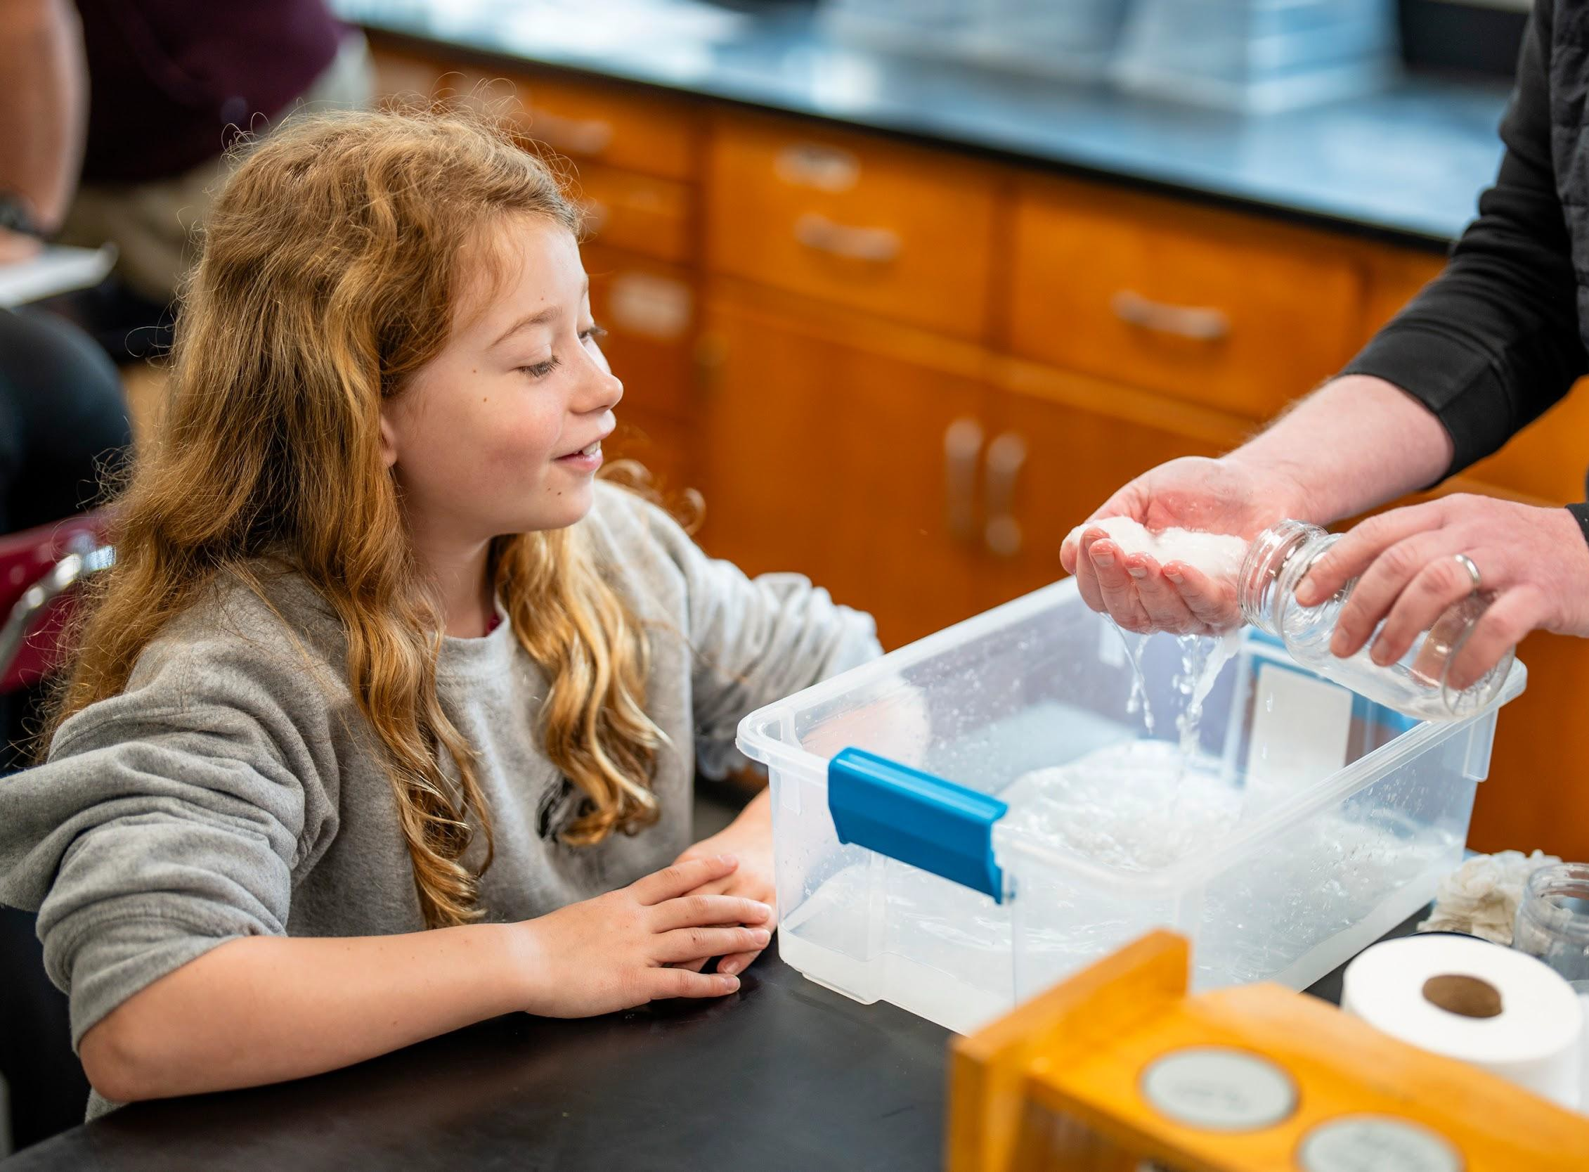
PROGRAM HIGHLIGHT: KEEPING WATER CLEAN
WATERSHED MAPPING
PROBLEM SOLVERS CARD GAME
STORMWATER RUNOFF
GROUNDWATER MODEL
WASTEWATER DEMO

Slide 10

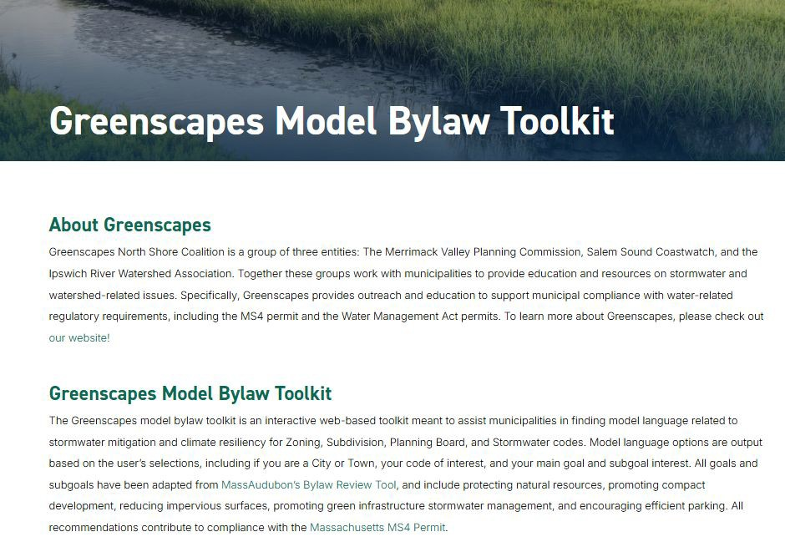
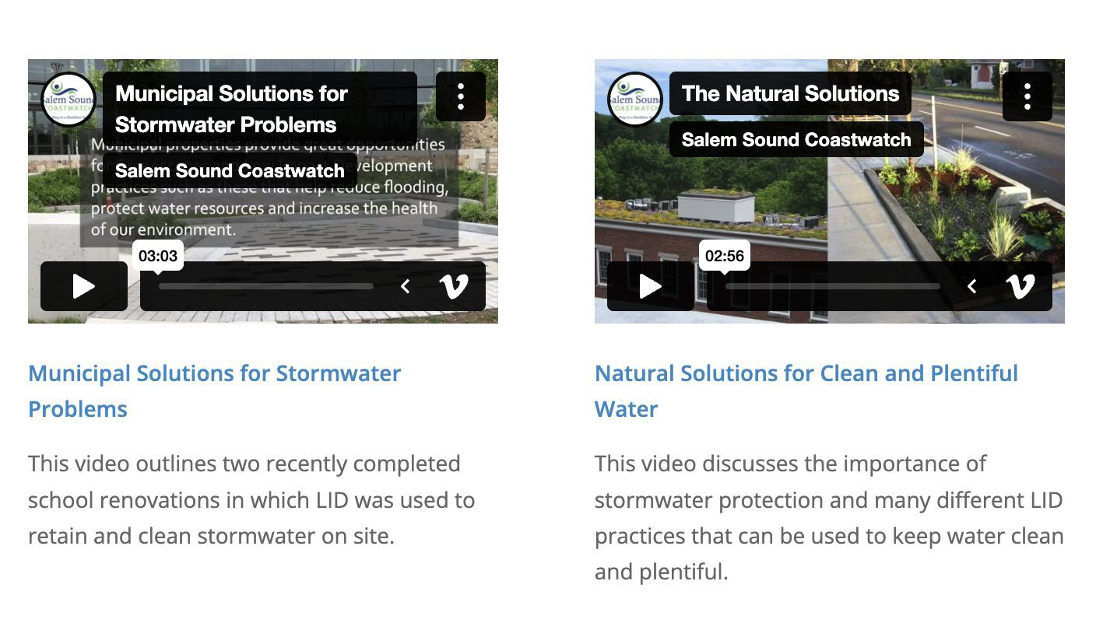

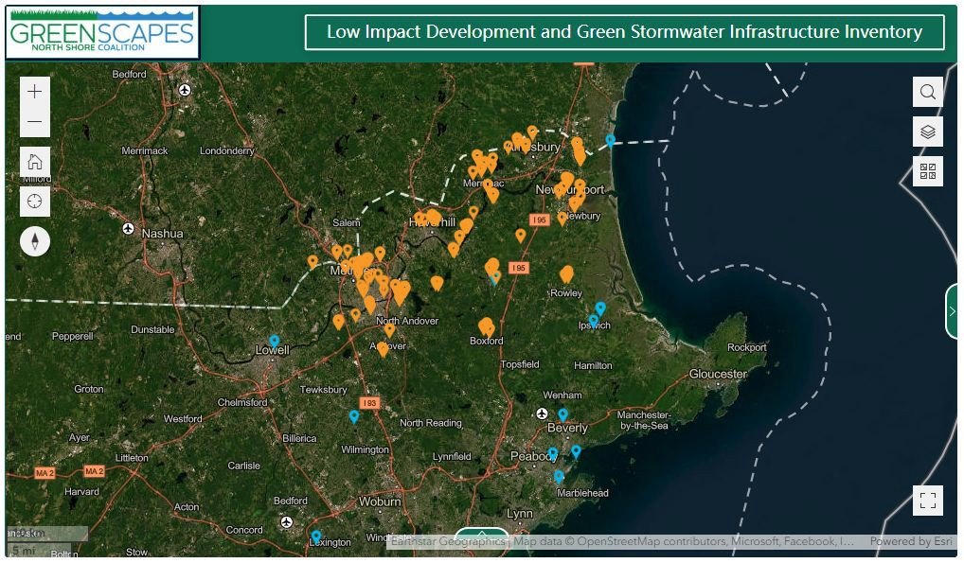
GREENSCAPES GUIDE
MODEL BYLAW TOOLKIT
RAIN GARDEN DEMO SITES
PAST PROJECTS
LID VIEWER
DOG WASTE PILOT

Slide 11
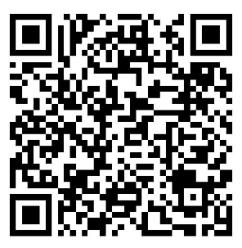
PROJECT HIGHLIGHT
QR
placeholder

Slide 12
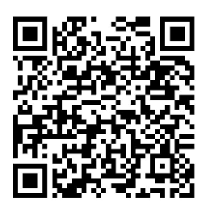
PROJECT HIGHLIGHT
QR
placeholder

Slide 13
PROJECT HIGHLIGHT
QR
placeholder

Slide 14

greenscapes.org ipswichriver.org mvpc.org salemsound.org
MANY THANKS
Questions?

