Slide 1
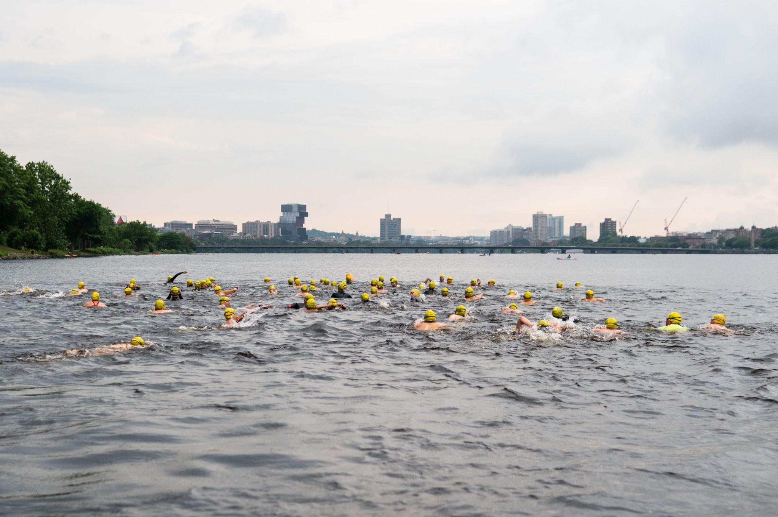
Why Does Stormwater Management Matter?
Lessons from the Charles
CHARLES RIVER WATERSHED ASSOCIATION
Rainwater Readiness Workshop
Max Rome, PhD
mrome@CRWA.org
9.25, 2025

Slide 2
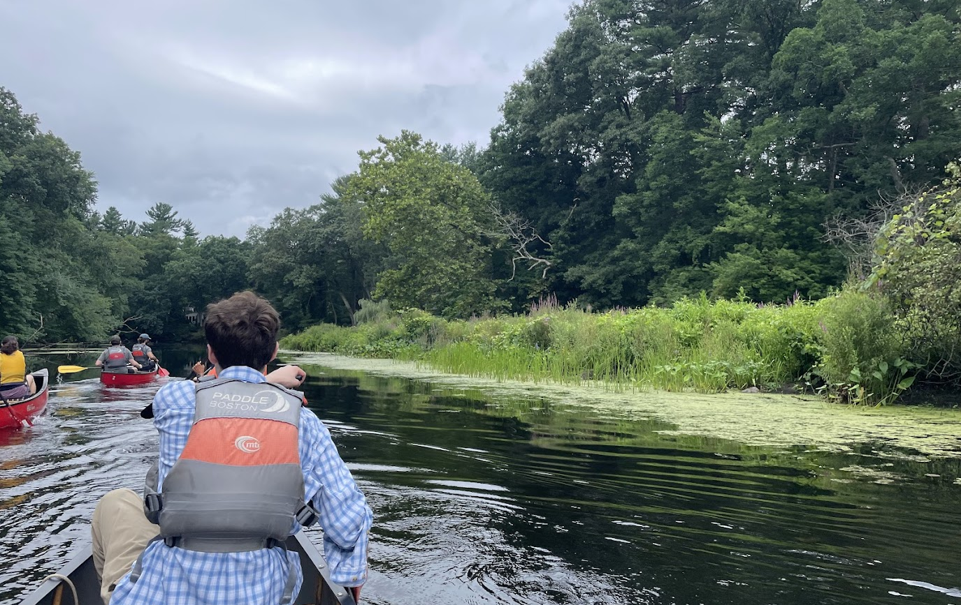
WHY DO WE CARE?

Slide 3
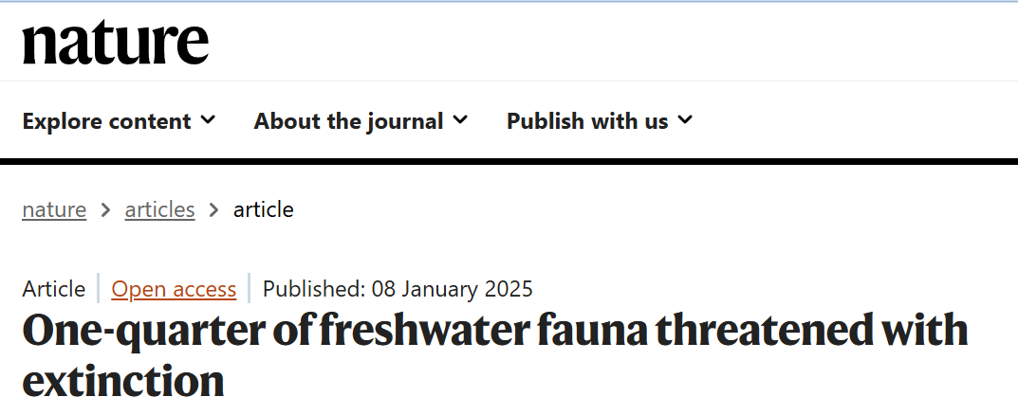
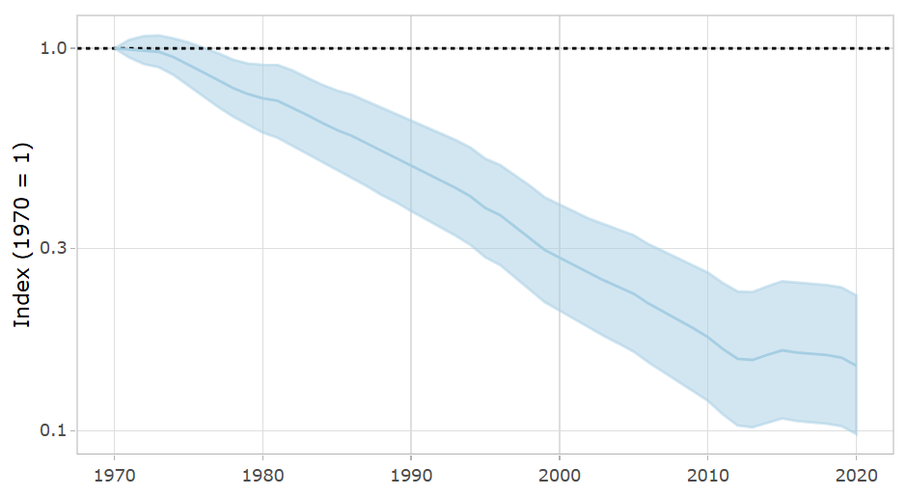
WHY DO WE CARE?
Living Planet Index for Freshwater
- 85%
Freshwaters support over 10% of all known species, including approximately one-third of vertebrates and one-half of fishes, while only covering less than 1% of the surface of the Earth1. This diversity of freshwater species provides essential ecosystem services (such as nutrient cycling, flood control and climate change mitigation2), can be used as bioindicators of wetland quality24, and supports the culture, economy and livelihoods of billions of people worldwide2.
85% decline for freshwater species since 1970
Reference:
Sayer, C.A., Fernando, E., Jimenez, R.R. et al. One-quarter of freshwater fauna threatened with extinction. Nature 638, 138–145 (2025). https://doi.org/10.1038/s41586-024-08375-z
WWF (2024) Living Planet Report 2024 - A System in Peril. WWF, Gland, Switzerland.

Slide 4
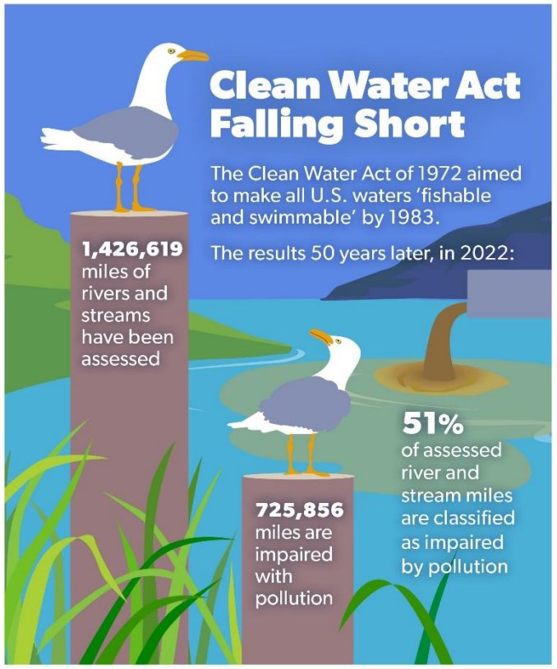
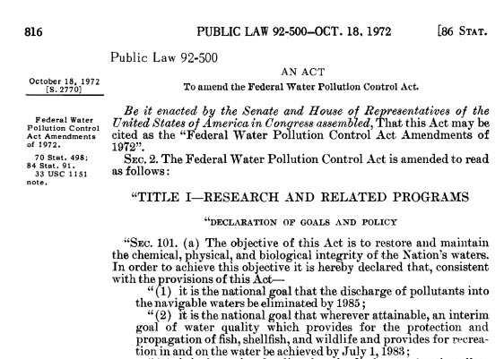
IT’S THE LAW!
1972 Clean Water Act
Eliminate Discharge of pollutants by 1985
“Fishable and swimmable” by 1983
Reference:
Environmental Integrity Project. The Clean Water Act at 50: promises half kept at the half-century mark. 2022 https://environmentalintegrity.org/wp-content/uploads/2022/03/CWA-report-3.22.22.pdf

Slide 5
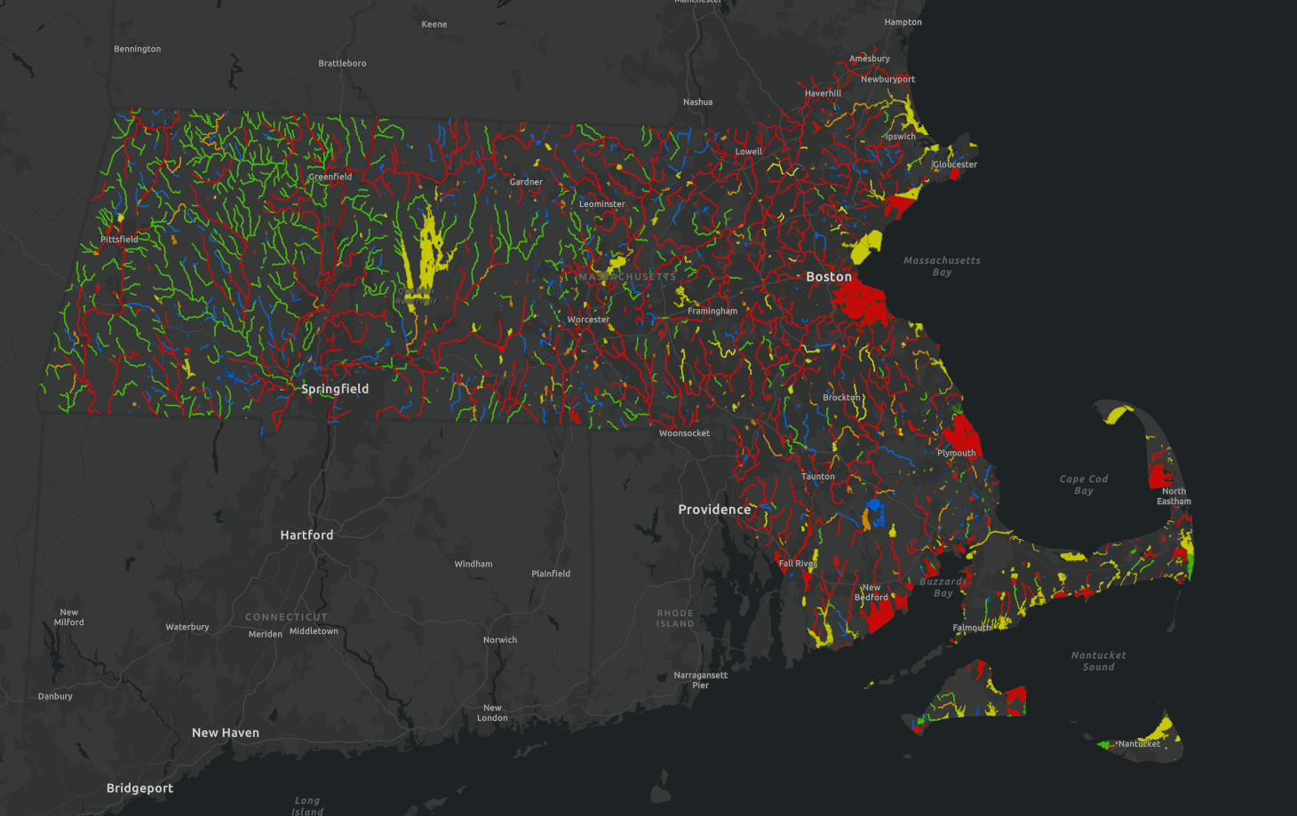
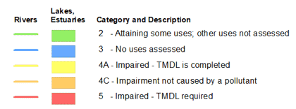
IMPAIRMENTS IN MASSACHUSETTS
MassDEP 2022 Integrated List of Waters

Slide 6
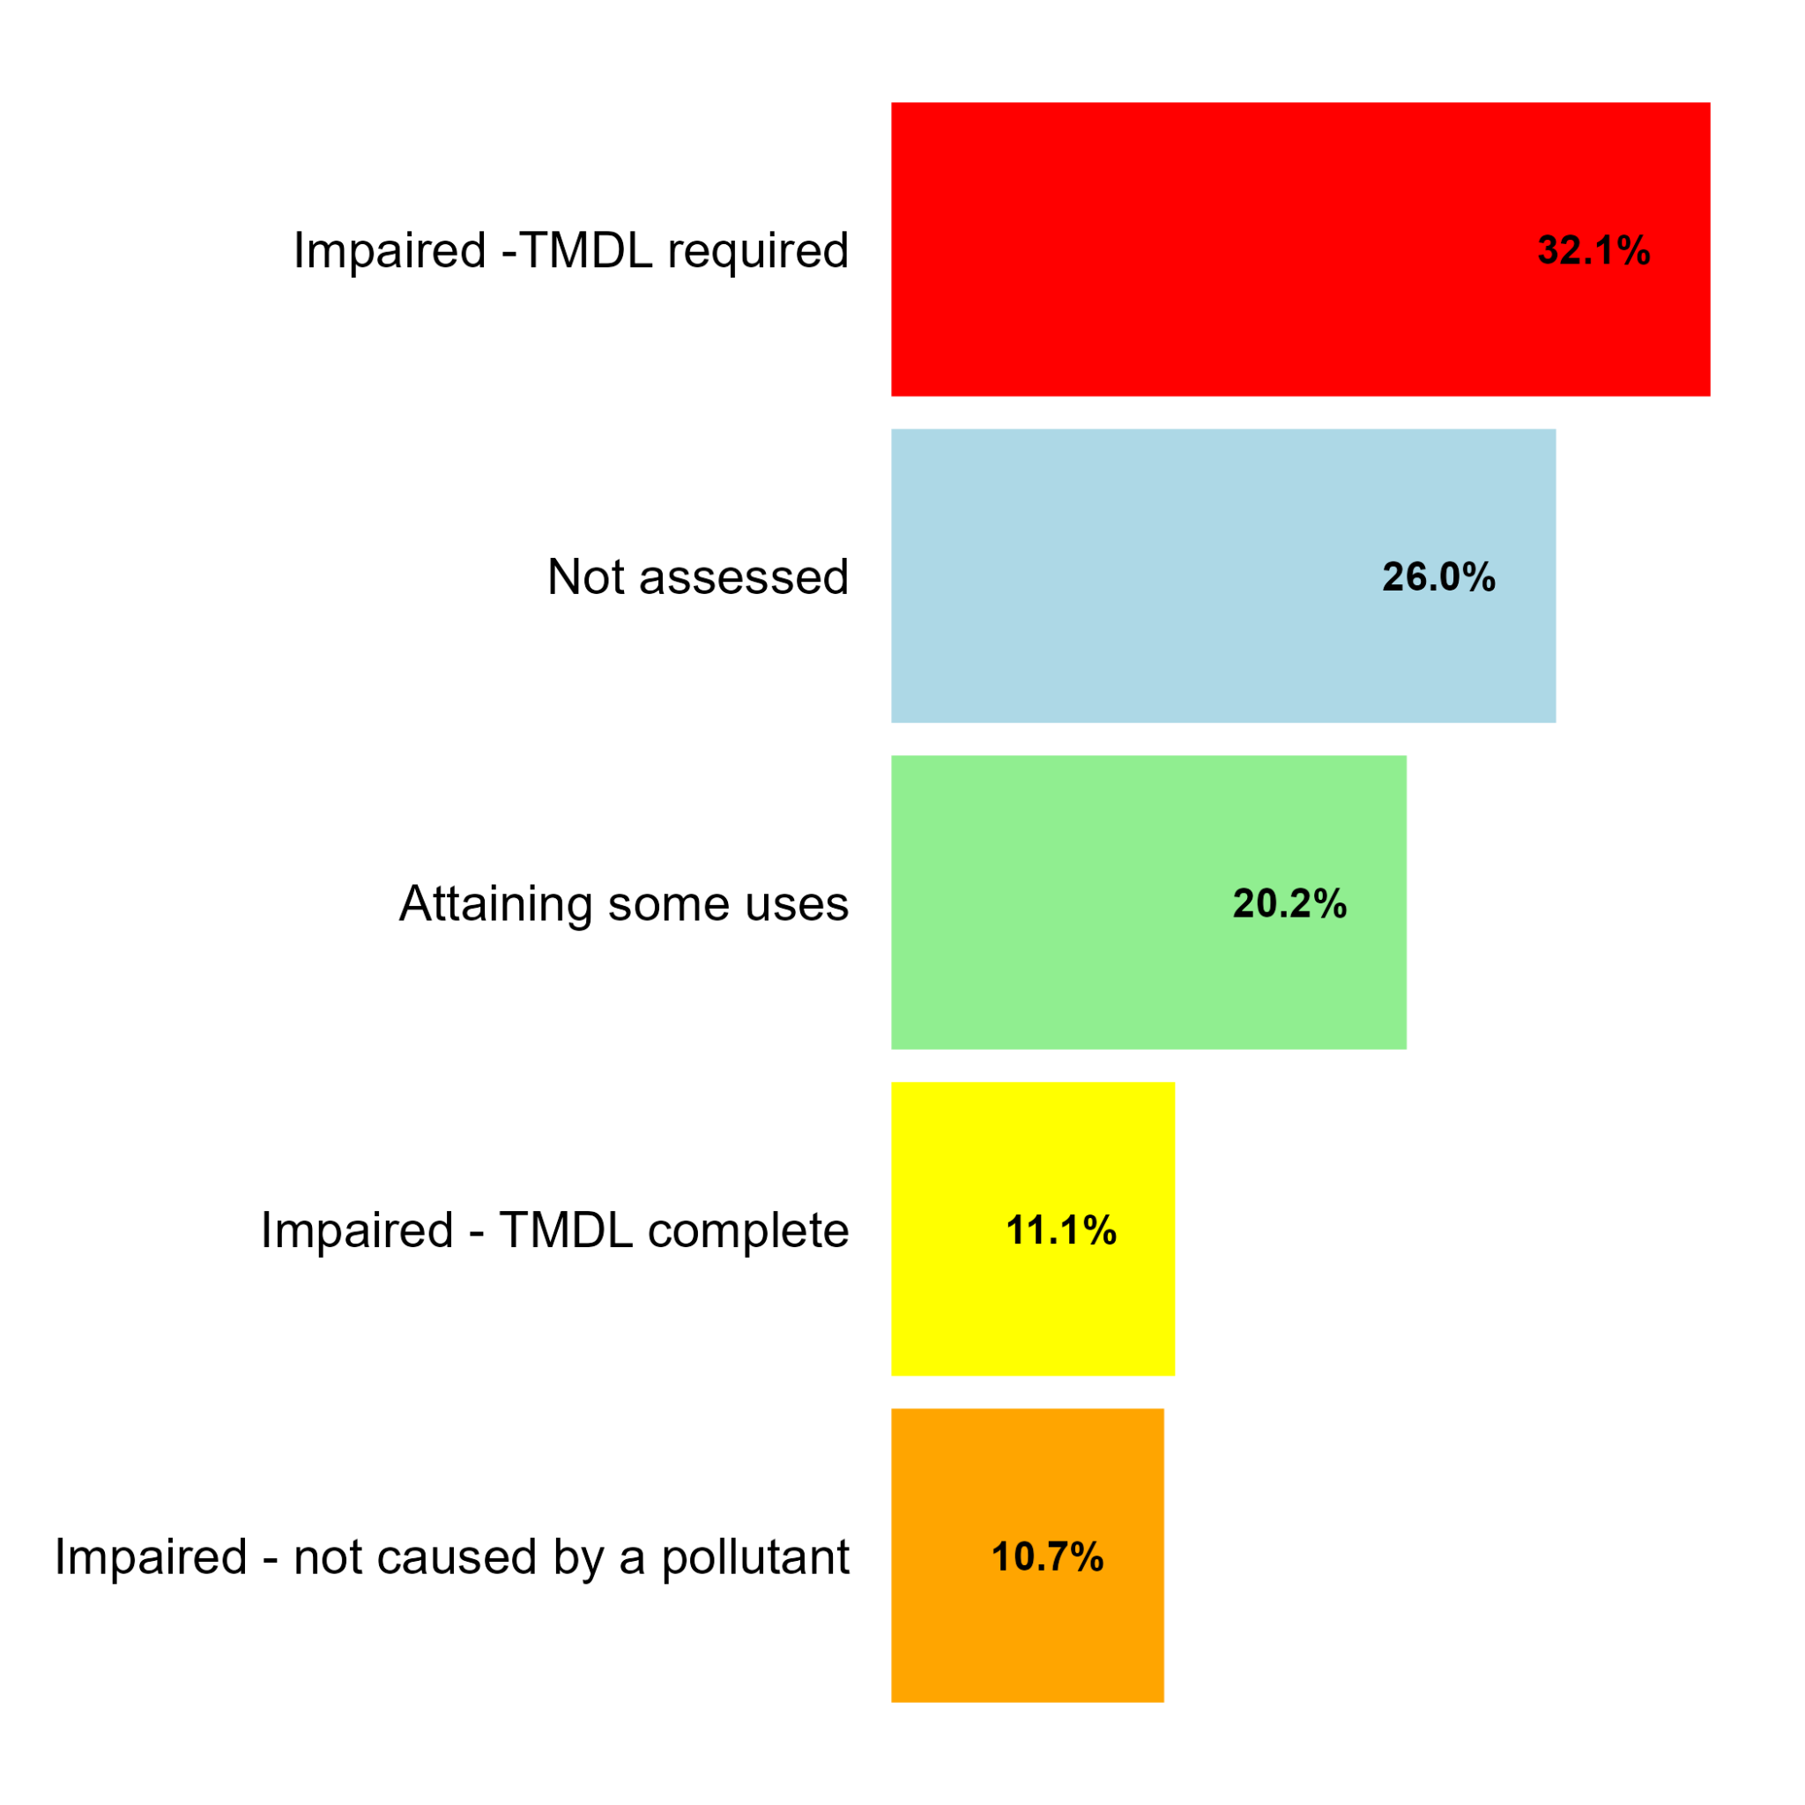
TMDL
required
TMDL
complete
Not caused by pollutant
2,549 Assessed water body “Units” (AU)
54% (1,372) of water bodies are Impaired
Of those, 17% (238) are caused by excess phosphorus
30% (417) identify stormwater as a driver of impairment
Impaired
Not Assessed
Attaining some uses

Slide 7
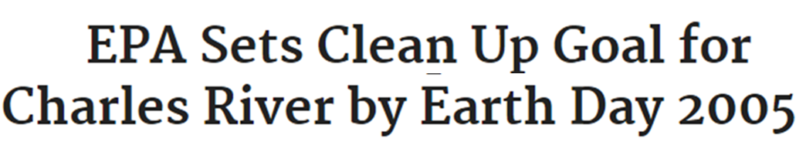
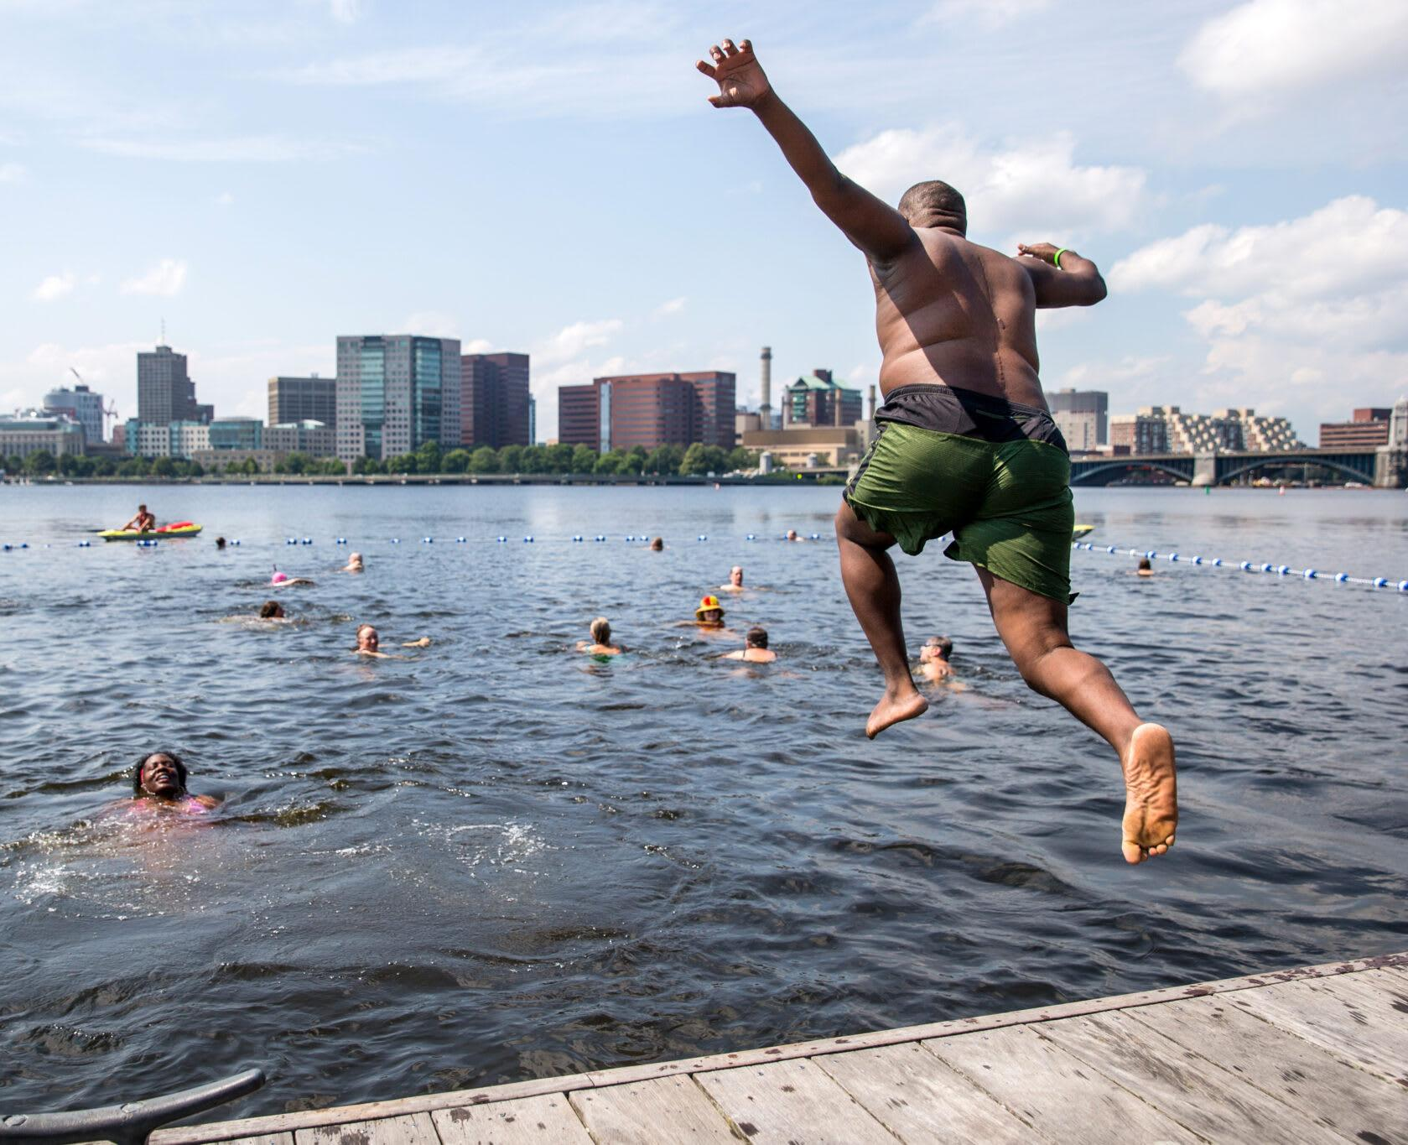
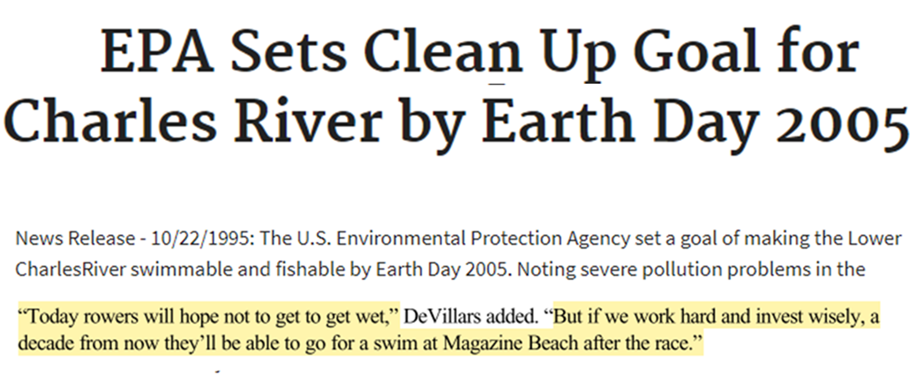
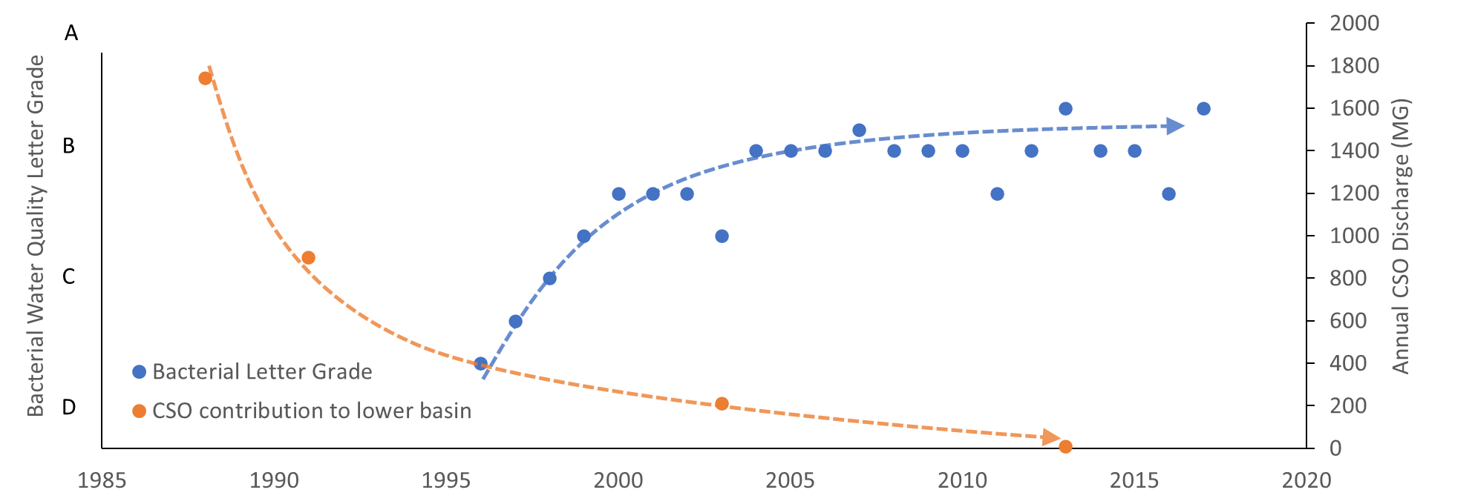
PROGRESS IN THE CHARLES
City Splash, Image courtesy of Charles River Conservancy

Slide 8
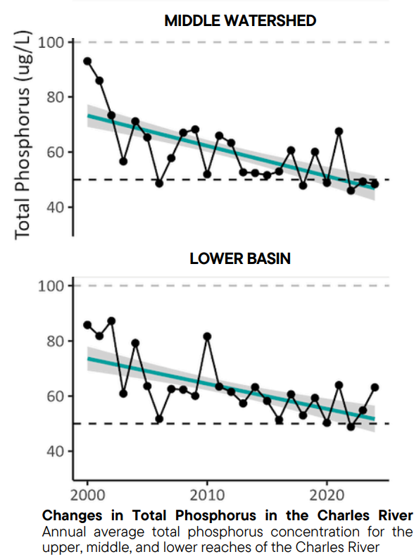
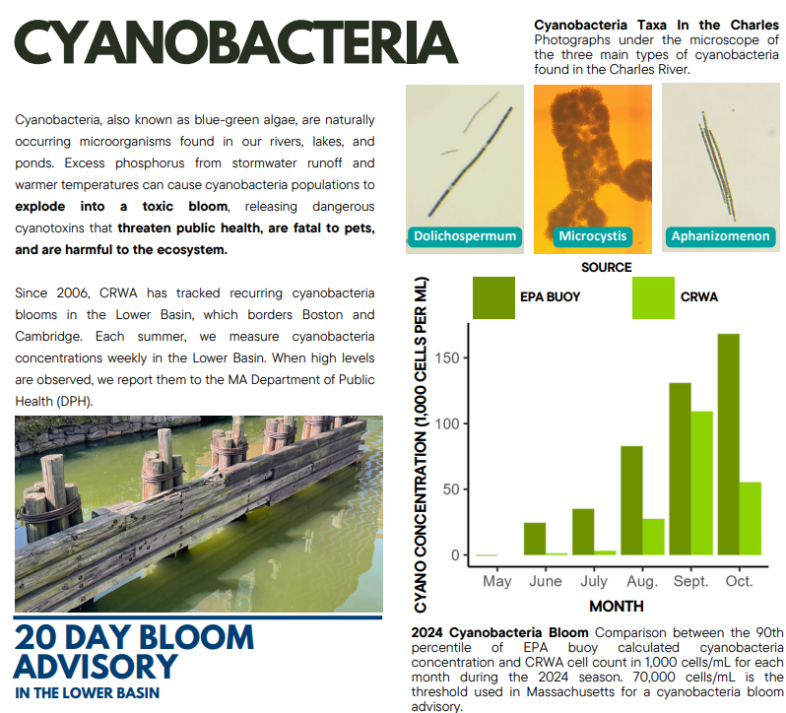
PROGRESS IN THE CHARLES

Slide 9
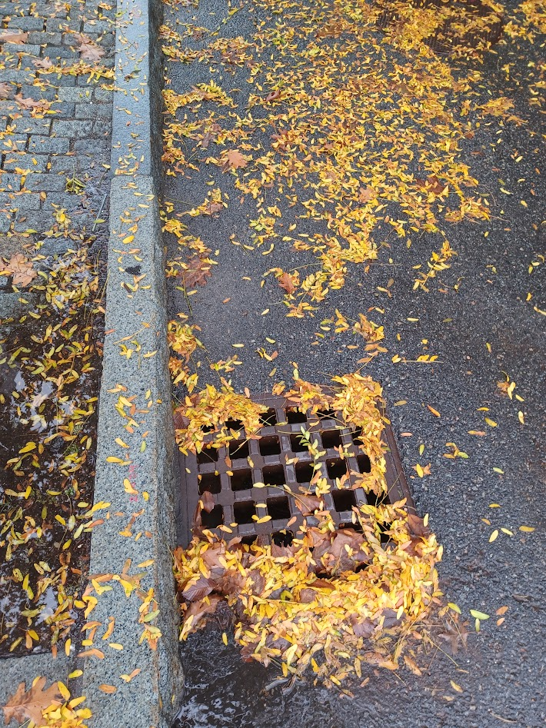
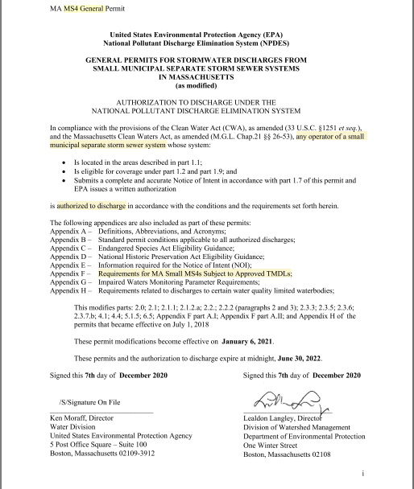
FOCUS ON STORMWATER
2007 TMDL
MS4 General Permit
The pollutant of concern for this TMDL study is phosphorus because it is directly causing or contributing to the excessive algal biomass in the Lower Charles River. Since there are no numeric criteria available for phosphorus in the Lower Charles, it was necessary to calculate a numerical endpoint to address the excessive algal biomass due to excessive nutrient input to the Lower Charles River. A surrogate water quality target had to be determined in order to calculate pollutant load reductions to the river. Chlorophyll a was chosen as the surrogate water quality

Slide 10
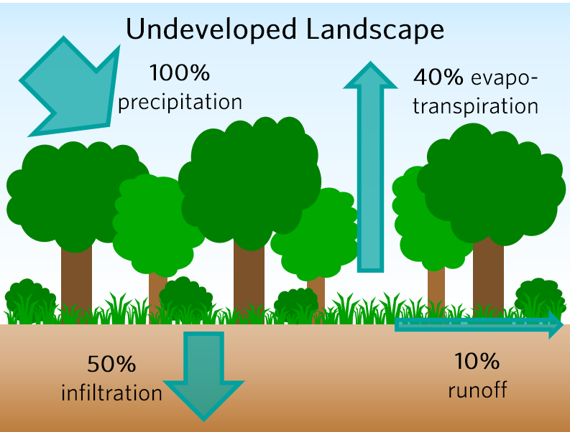
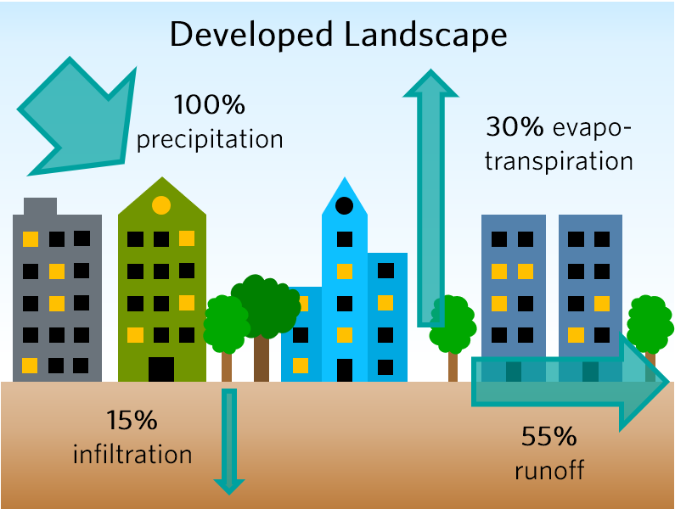
STORMWATER 101
Changes to Hydrology
Notes:
Jeff
A major focus of our work necessarily involves water. As we develop our communities and build hard surfaces, we interfere with the natural water cycle. What should generally be considered a resource can become a nuisance when water falling to the ground has nowhere to go and can’t naturally soak into the ground. It runs off of these hard surfaces and can cause significant problems–property damage, public safety hazards and public health issues, to name a few

Slide 11
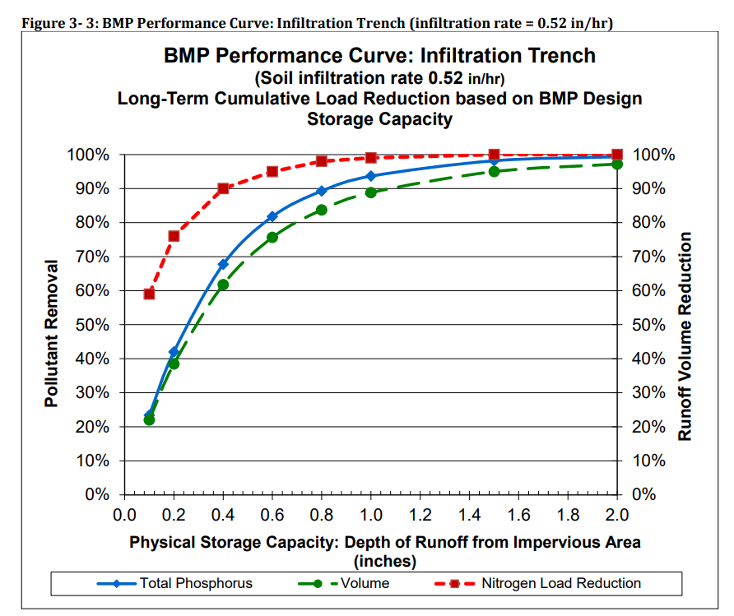
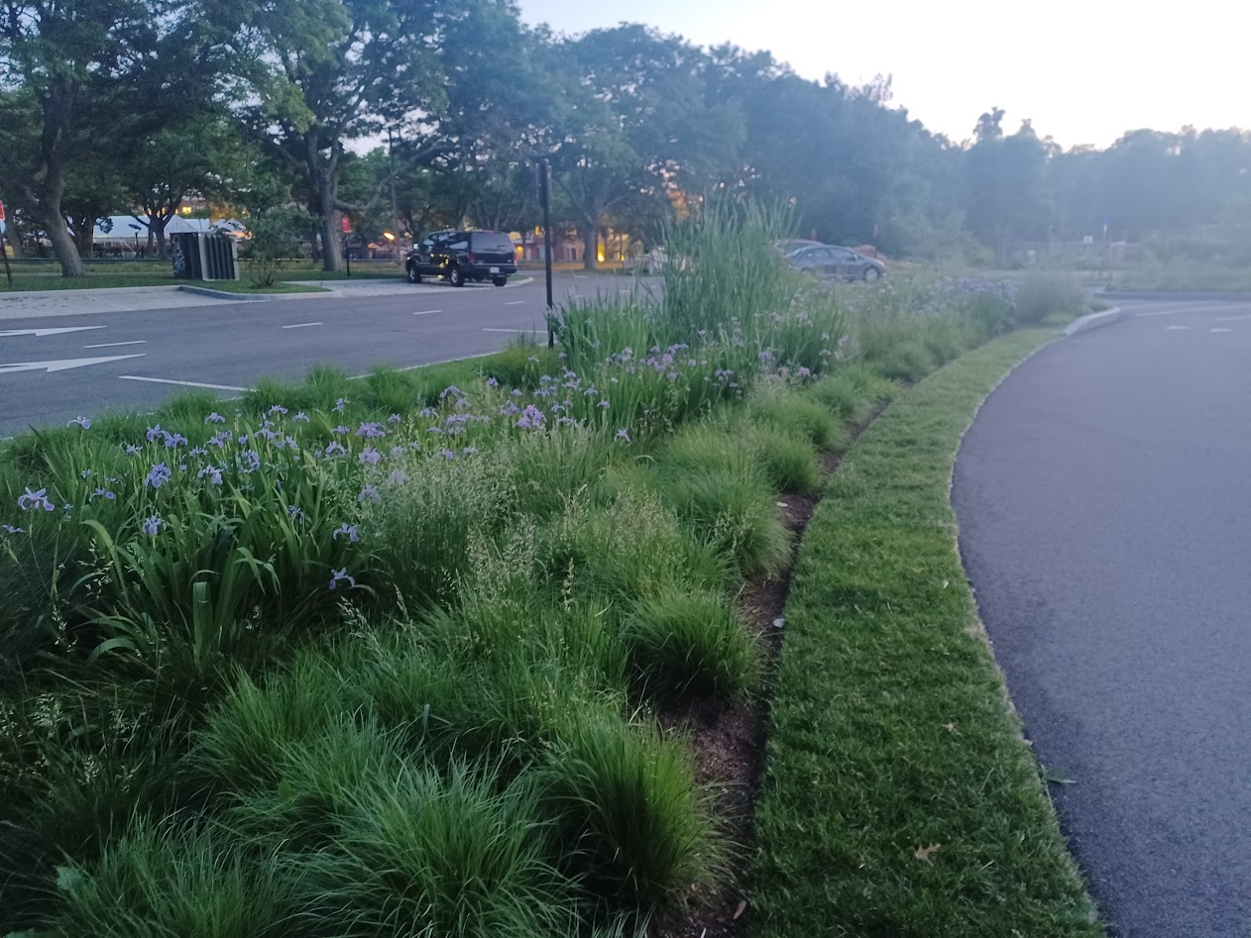
STORMWATER SOLUTIONS

Slide 12
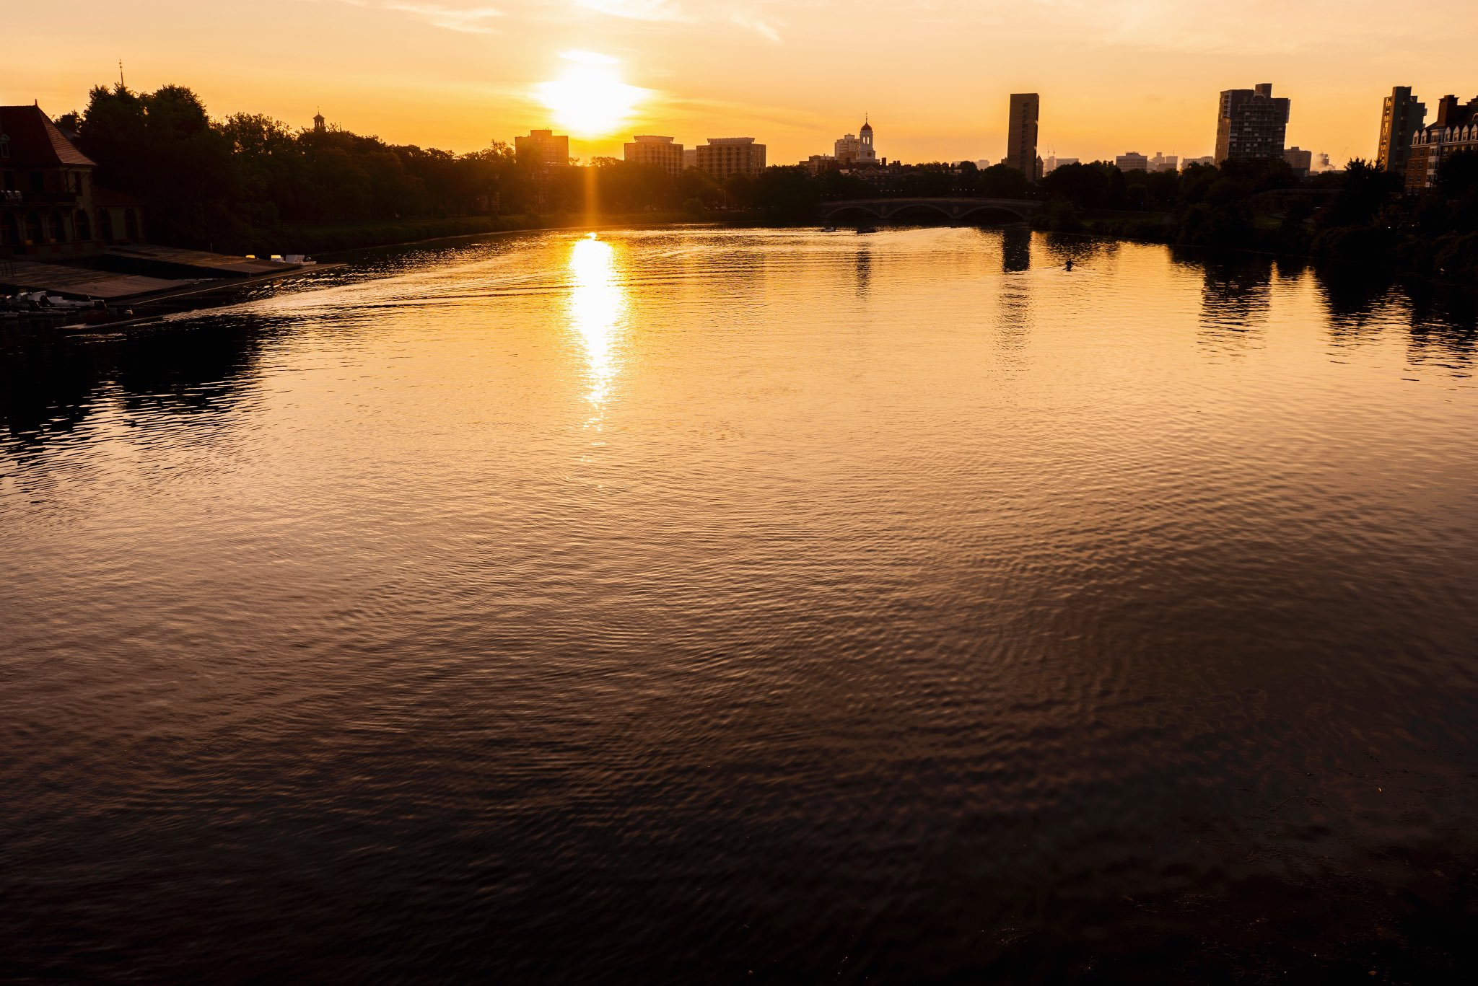
THANK YOU!

