Slide 1
Notes:
This document is part of a comprehensive curriculum program, Building Climate Resilience Through Local Regulations, developed by Mass Audubon in collaboration with other nonprofit organizations and federal, state and regional agencies. The curriculum contains 8 modules, each of which guides the user through different components of improving community resilience through local regulations that support green designs and nature-based climate solutions. Each module includes a participant guide (e.g., this document) and a PowerPoint presentation.
The full curriculum, supplemental resources and additional information on bylaw review and best practices are available through the Mass Rivers Alliance and Mass Audubon websites (https://www.massriversalliance.org/climate-resilience-planning & https://www.massaudubon.org/our-conservation-work/policy-advocacy/local-climate-resilient-communities). The SNEP Network’s website provides additional resources including an interactive virtual storymap and webinar recordings (https://snepnetwork.org/bylaw-review/).

Slide 2
Notes:
Many people and organizations contributed to this curriculum.
This bylaw curriculum has been developed by SNEP Network Partners Mass Audubon, Cape Cod Commission, the Southeast Regional Planning and Economic Development District, and the Blackstone Watershed Collaborative in partnership with the Massachusetts Rivers Alliance and Citizen Planner Training Collaborative, and financial support from the SNEP Network. The Barrett Planning Group, LLC assisted with planning content.
The Southeast New England Program (SNEP) Network brings together local environmental organizations, academic institutions, regional planners, and consultants who collaborate to provide municipalities, tribes and organizations in Rhode Island and Southeast Massachusetts access to free training and technical assistance to advance stormwater management, ecological restoration, and sustainable financing goals across the region. The SNEP Network is administered through EPA’s partnership with the New England Environmental Finance Center, a non-profit technical assistance provider for EPA Region.
The SNEP Network supports this bylaw review curriculum as a key resource for communities to update their local regulations for improved nature-based climate solution implementation. Find out more about the SNEP Network at www.snepnetwork.org.
This product has been funded wholly or in part by the United States Environmental Protection Agency under Assistance Agreement SE- 00A00655-0 to the recipient. The contents of this document do not necessarily reflect the views and policies of the U.S. Environmental Protection Agency, nor does the U.S. EPA endorses trade names or recommends the use of any products, services or enterprises mentioned in this document.
This project also received funding from the Lookout Foundation.

Slide 3
Notes:
In this first section, we’ll be addressing the value and benefits of our natural environment, as well as the losses that we’re experiencing because of climate change.

Slide 4
Notes:
Each of these modules will run for about 30 minutes.

Slide 6
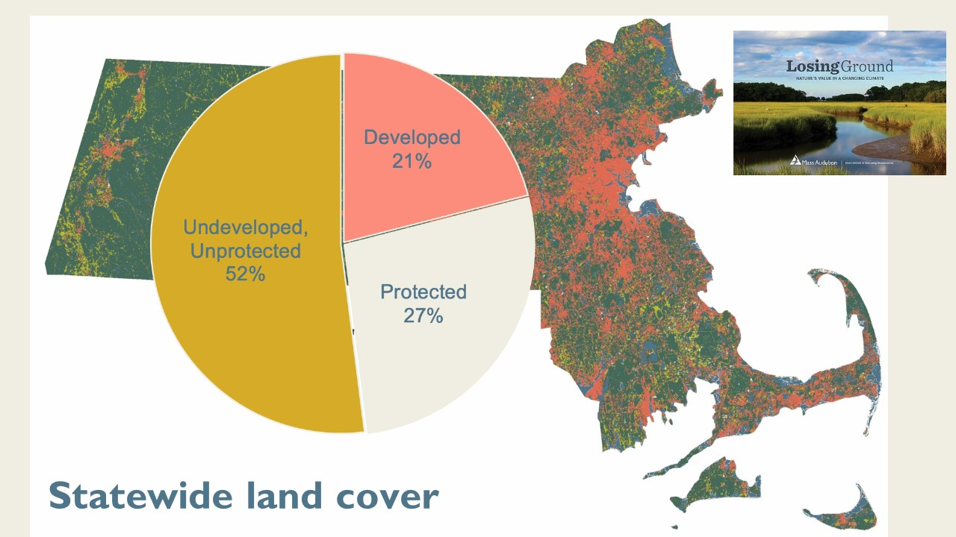
Notes:
Mass Audubon analyzed land cover using satellite data in partnership with BU. (You can read more in our publication Losing Ground, and the most recent edition is pictured here in the upper right-hand corner.)
The areas shown in pink are developed land. As we expect, the areas with the most pink are urban centers or more densely-populated regions.
These areas in pink are those most likely to have experienced disruption or loss of natural ecosystems, and consequently, their benefits.
[click to show chart]
As of 2017, about 21% of the state is developed, 27% protected, and 52% neither protected nor developed.
64% forest, 21% developed

Slide 7
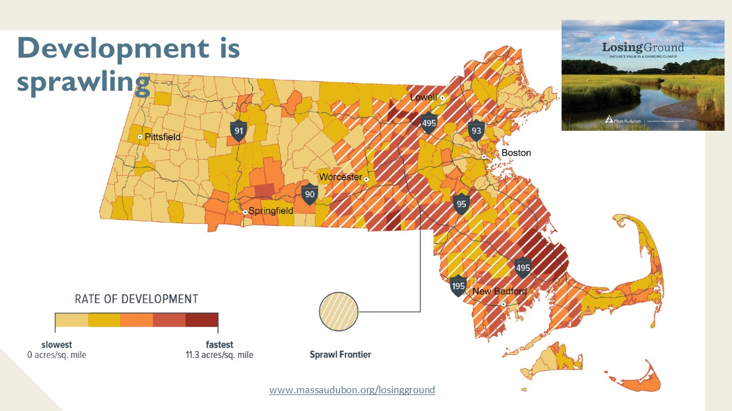
Notes:
We continue to see development concentrated around and beyond the Rt 495 belt and along transportation corridors, notably the Mass Pike and Route 2. We call these areas of most intense development pressure the Sprawl Frontier. The Sprawl Frontier, a band of towns seeing relatively rapid development, remains prominent along and outside of Interstate 495.
As we see this rapid development, it’s important to note that disrupting the natural environment in favor of a built environment can result in a loss of many of the natural systems and benefits that contribute to climate resilience. As a result, many of these communities are working to conserve land strategically, and land conservation and protection between 2012 and 2017 reached a pace of 55 acres/day (which represents an increase of nearly 40% over the pace from 2005 to 2013.)
Land conservation is one of the three actions that we introduced in the previous module. Seventy-six percent of newly protected land was within the Green Infrastructure Network, and this indicates that conservation efforts are largely focused on the most important lands. We will talk later on about initiatives state and regional initiatives that can help to support those efforts.
But what about the areas that are or are in the process of being developed? When we can’t conserve the land, how do we integrate sustainable practices into development? What happens if we don’t?

Slide 8
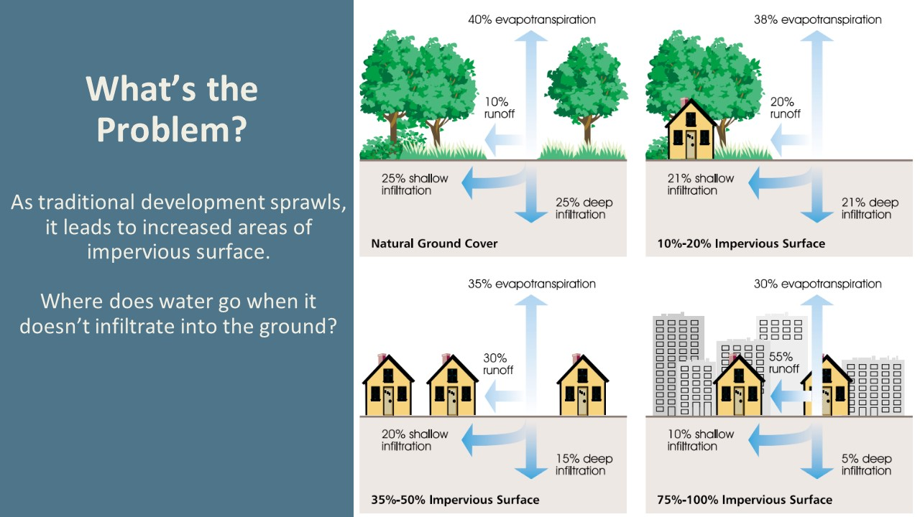
Notes:
In areas with natural ground cover, about 50 percent of precipitation infiltrates into the ground, 40 percent undergoes evapotranspiration (water use by plants that is re-released into the atmosphere, along with oxygen produced in plant processes), and 10 percent becomes runoff.
When we develop a site, trees and vegetation are often cleared, which reduces water uptake by those plants. Instead of filtering through the soil and being taken up by plant roots, water pools and runs off impervious surfaces. On a site half developed with impervious surfaces, up to 30 percent of precipitation volumes become stormwater runoff, and when a lot totally covered with impervious surface, up to 55 percent becomes stormwater.
The other services that trees and plants provide, like air and water filtration and mitigation of urban heat island effects, are also lost.

Slide 9
Notes:
[4 clicks to walk through consequences]
Traditional development means there will be more impervious surfaces. Water that lands on a roof or on road doesn’t infiltrate through those surfaces – they create runoff. Even cleared land has more runoff than vegetated land does – water uptake from trees can diminish problems with runoff, in addition to offering benefits or water filtration and flood buffering as we just talked about in Let Nature Do the Work!
Water quality impairments: from road sediments to lawn treatment chemicals, there are pollutants making their way to stormwater systems. The majority of Massachusetts’ urban waterways are impaired—meaning they don’t meet state water quality standards and are not providing ideal habitat for fish and wildlife, and may also be leading to beach closures and other negative economic effects. Pollution from stormwater runoff from impervious surfaces contributes to 55% of the water quality impairments in MA.
Public health risks: Trees and vegetation reduce the urban heat island effect, reducing smog that contributes to asthma and other respiratory diseases. Managing stormwater through soils and vegetation reduces the need for retention ponds and catch basins, avoiding creation of mosquito habitat. More than $11 million is spent annually on mosquito control in Massachusetts
Infrastructure impacts: While grey infrastructure (traditional, as opposed to GI) is typically designed to reduce flooding risk, but often does not adequately protect water quality and habitat. Implementing GI practices can reduce the amount of grey infrastructure needed to manage flooding and combined sewer overflows and avoid expensive capacity expansions (EPA Maintenance of Low Impact Development Fact Sheet from the EPA’s Barrier Buster series)

Slide 10
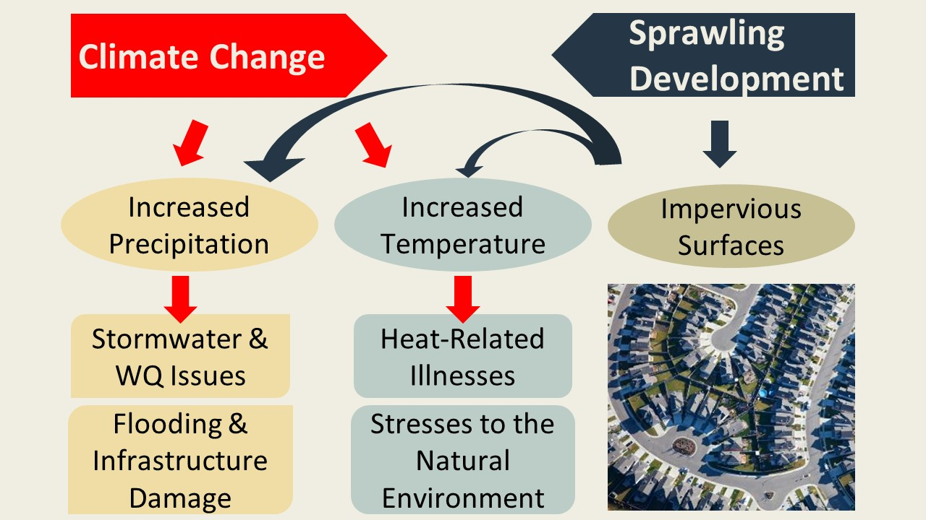
Notes:
Climate change is driving increased precipitation both on average and during individual storm events,
Which creates [click] stormwater management and water quality issues and can lead to flooding and infrastructure damage
Climate change is also driving [click] temperature increases, which in turn increase the incidence of [click] heat-related illnesses and puts added stress on our natural environments.
Add to all this the threat of sprawling development [click], and what do we get?
[click] Increased hard or impervious surfaces, which exacerbate [click] the issues we are already facing because of increased. precipitation and also [click] contribute to the urban heat island effect, leading to more heat-related illness and ecosystem stress.
Developmental sprawl and climate change make sense as related ideas: they represent a “dual threat”
If climate change is increasing temperatures, precipitation, and storms – and increasing conventional development leads to increases in runoff, urban heat islands.
(defined by the EPA as “Heat islands are urbanized areas that experience higher temperatures than outlying areas. Structures such as buildings, roads, and other infrastructure absorb and re-emit the sun’s heat more than natural landscapes such as forests and water bodies. Urban areas, where these structures are highly concentrated and greenery is limited, become “islands” of higher temperatures relative to outlying areas. Daytime temperatures in urban areas are about 1–7°F higher than temperatures in outlying areas and nighttime temperatures are about 2-5°F higher.”)
These problems compound one another.

Slide 11
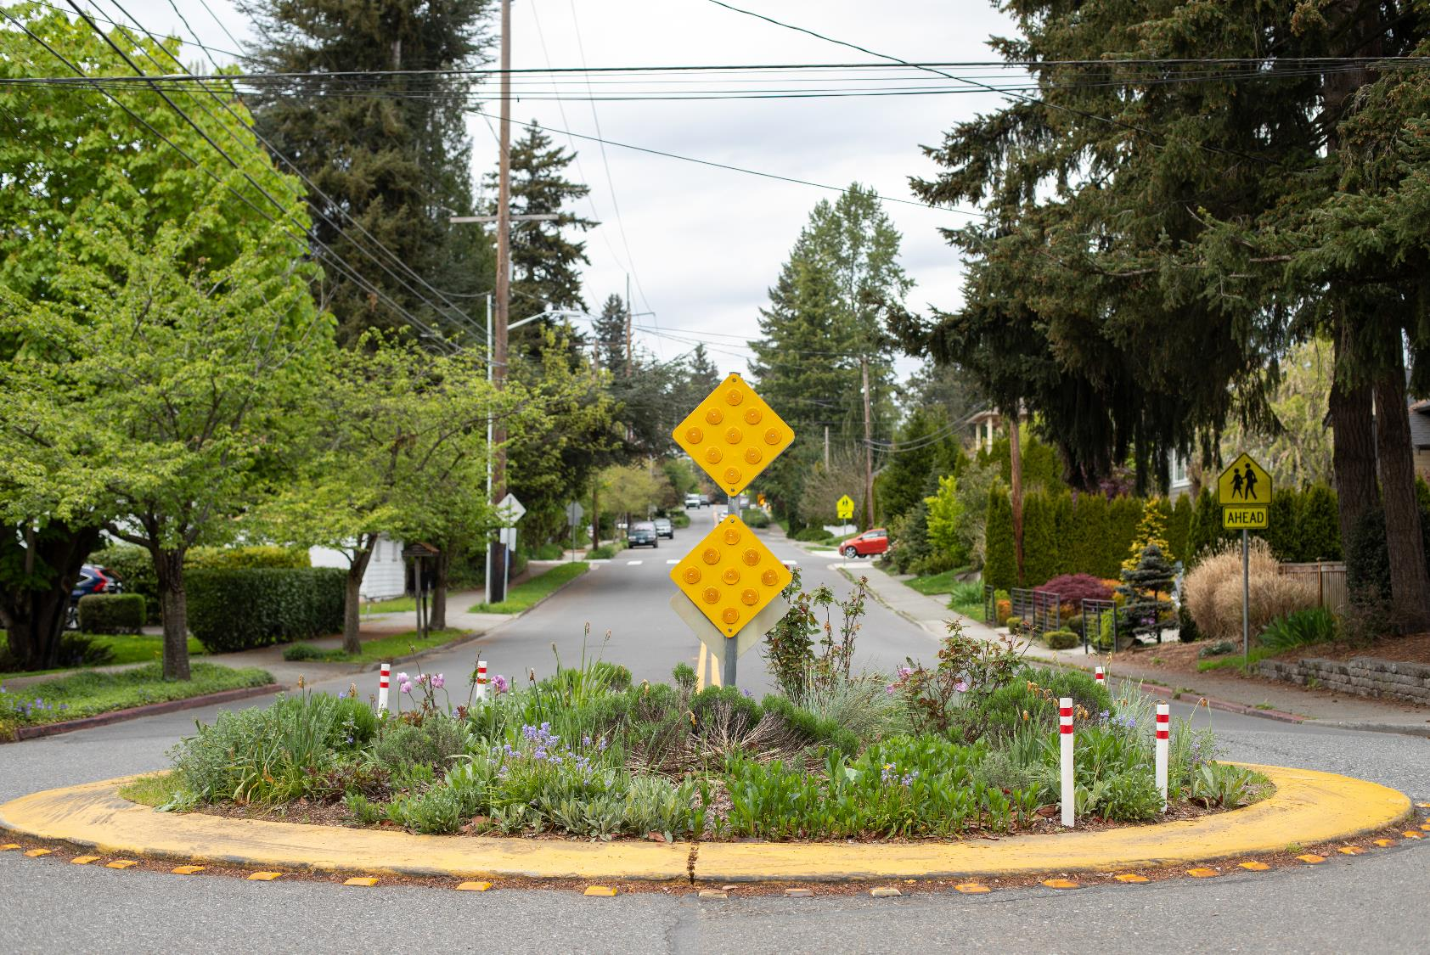
Low Impact Development (LID)
Treats water as a resource, not just a waste product
Manages stormwater as close to its source as possible
Preserves natural landscape by recreating natural features
Notes:
We introduced green infrastructure and nature-based solutions in the previous section. Low impact development (LID) a nature-based solution focused on development design standards that utilize plants and soils in capturing and filtering water while minimizing imperviousness. – Examples of LID techniques include: rain gardens & bioswales; rain barrels & cisterns; green roofs; permeable pavement; paving reductions through narrower roads, alternative cul-de-sac designs, and shared driveways; conservation development; bylaws relating to stormwater regulation or wetland protection
Not only can nature keep our water clean, it can also ensure that we have enough of it
When stormwater infiltrates into the ground instead of running across it, our groundwater resources are replenished
This groundwater recharge is especially important given climate change - increase in droughts. An ample groundwater supply can help ensure that we do not run out of water when there is not much rain.
A great thing about low impact development is its diversity – it can really be done at any scale from the most rural communities to urban

Slide 12
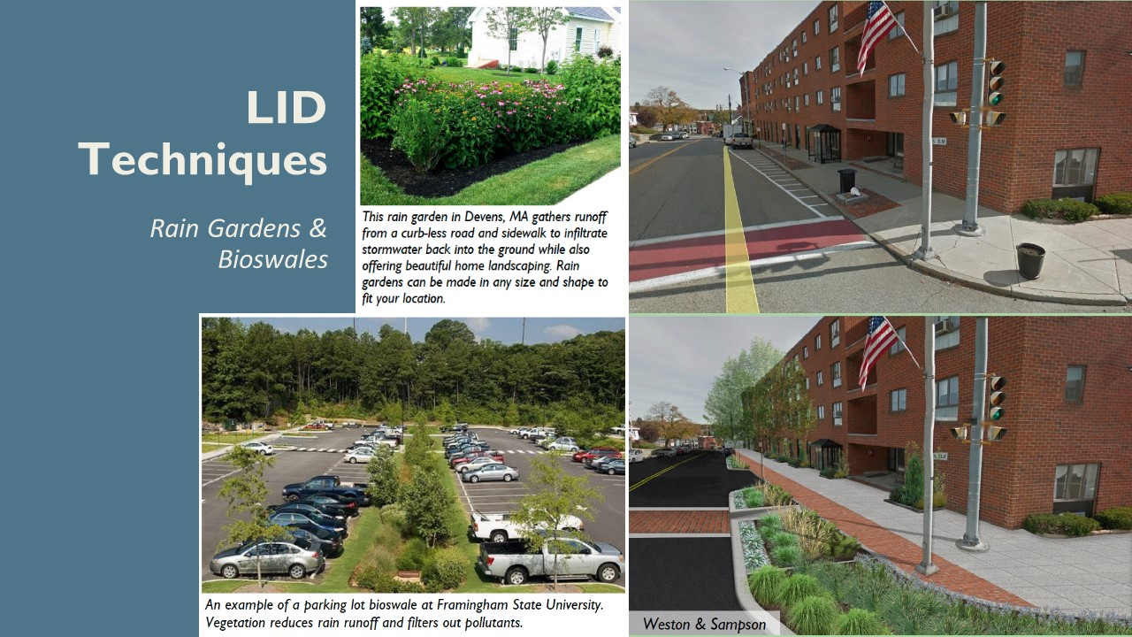
Notes:
Rain gardens and bioswales often look like regular gardens and vegetated areas, and they are examples of bioretention areas. Bioretention is a generic term that applies to any engineered, vegetated depression in the ground constructed to retain water. Rain gardens, like this one in Devens, help absorb and filter stormwater. You have probably seen rain gardens along roads or in road medians, and they are often also located on residential properties near downspouts.
Bioswales [shown here at Framingham State University] are a lot like rain gardens, but they tend to be situated in particularly flood-prone areas or large stretches of impervious surface (such as parking lots), so they are often bigger and deeper than rain gardens. Bioswales serve to collect and filter rainwater, particularly during rain and flood events, and because the water has somewhere to go that is removed from roads and sidewalks, they can improve road- and pedestrian- safety. Water infiltrates slowly into the ground or slows as it makes its way to the sewer system.
The costs of installation and maintenance of bioretention areas are modest, ($2-12/sq ft to install, and about $200/yr in labor for maintenance), and they can potentially save money on stormwater filtration as well as avoid damages to the built environment and property from flooding. If bioretention areas are incorporated in initial site design, then large areas of impervious surface can be broken up strategically with rain gardens and bioswales throughout to capture stormwater runoff and promote the safety of pedestrians as well as property, or as part of retrofits, these bioretention areas tend to be bigger and less numerous.
Cost: Costs about $2-12/ft2 to install, and about $200/yr in labor for maintenance 6, 7
Runoff: Reduces runoff by 90%.
Additional benefits: improves aesthetics; reduces pollutants, including Nitrogen, Phosphorus, metals, and TSS by 65-90%
But what about... Ownership and maintenance can be held by the individual residential property owners, homeowners’ associations, or by local public works. If outside entities need to be on private property to maintain bioretention such as rain gardens, be sure to include this in deeds so that homeowners understand what is their responsibility and what is the municipality’s.
On the right, the top picture is a typical Main Street intersection in a Massachusetts mill town. The top image shows what the street looks like in 2016.
The bottom image is the redesigned Main Street intersection that incorporates bioretention bump-out areas and street trees to capture and filter stormwater and enhance aesthetics. These also improved pedestrian safety by reducing the walking distance and improving sight lines, without altering existing parking or bus stops.
Local bylaws can sometimes stand in the way of this kind of feature – we will be coming back to this idea when we talk about bylaw review.

Slide 13
Notes:
Roads aren’t the only impervious surfaces. Rooftops also create runoff. Incorporating vegetation into a living or green roof can also capture precipitation and mitigate runoff volumes. For many of us, our first introductions to green roofing were on buildings with large footprints and flat roof structures, such as schools, universities, and museums (and IKEA locations). They can also offer additional insulation, and therefore reduce heating costs, because of the heat-retention qualities of the planting medium and vegetation layer. They also protect the roof structures from the environment because they include additional waterproofing and barriers, so they can extend the longevity of a roof.
As long as they are planted with hardy, native perennial plants, maintenance of green roofing is largely limited to weeding and pruning, and they are otherwise relatively self-sustaining because rainwater contains nutrients necessary for sustaining plant life.
What is it? Planting vegetation on a roof so that rain can be taken up by plants instead of running off. There are many types of green roofs and they can serve as additional recreation space or simply a stormwater storage area.
Cost: $10-30/ft2 to install; Becomes up to 50% cheaper by the square foot as the square footage exceeds 10,000 feet
Runoff: Reduces runoff by 30-86%. 4
Additional benefits:
A 5,000 ft2 green roof sequesters 170 lbs of carbon/yr
Reduces heating and cooling costs for buildings by $6-8/ft2
Can extend life expectancies of roofs by more than double
But what about... Maintenance on green roofs entails general weeding and debris removal, but since they’re watered by stormwater, which has nutrients, they usually don’t need any fertilizer or irrigation.

Slide 14
Notes:
So far in this training, we have discussed pavement as a barrier to groundwater infiltration because it is most often impervious to water, but there are pavement types that are water permeable. As long as they are well-maintained, permeable pavement and concrete, as well as pavers, can facilitate groundwater recharge because they have pores through which water can infiltrate. As a result, this type of pavement can serve to reduce puddling and flooding, which are public safety hazards. In the colder months, permeable pavement can provide some mitigation of pollutants because it requires significantly less salt treatment to prevent freezing and icing.
When communities embrace these LID strategies over conventional development and paving, they can also significantly reduce flood damages to buildings and infrastructure, and in some cases they have even been shown to diminish the extent of floodplains, which can increase property values and reduce the costs associated with insuring properties.
What is it? Permeable, or porous, pavement or concrete allows water to infiltrate the driving surface to reduce stormwater runoff, eliminate puddles, and increase groundwater recharge.
Cost: Costs range from $10-12ft2 installed.
Runoff: Can infiltrate as much as 70-80% of annual rainfall.
Additional benefits
Reduces the amount of land needed for stormwater management
Reduced flood risk may increase property value by 2-5%
Massachusetts communities typically spend over $100,000 annually on salting. 9 Areas with permeable pavement can reduce salt use by as much as 75%, leading to enormous cost savings 10 and reduced salt pollution
But what about... Winter weather is no trouble for permeable pavement. In fact, studies at the University of NH Stormwater Center have found that before icing, precipitation melts into the ground and unsalted porous pavement offers a shorter stopping distance than salted traditional pavement. This improves safety and can reduce salting by 75%, saving money as well.
[click for a better view of permeable grass pavers]

Slide 15
Notes:
Paving is expensive. For many of our communities, cost is a critical factor in the poor or deteriorating condition of our roads. Regardless of whether a community uses permeable or traditional paving, decreasing its overall area saves money. Narrower roads, shared driveways, and alternative cul-de-sac layouts all serve to reduced the paved area in communities.
The standard widths of the roads in many of our neighborhoods exceed requirements, at 28’ wide or more. Narrowing roads from 28 feet to 20 feet in a small neighborhood with only one centerline mile of roadway saves a quarter-million dollars at installation, and there will be additional savings in maintenance (plowing, salting, sweeping, etc.) throughout the life of the road. Indirect savings can also come from reducing road surface area because stormwater runoff reductions mean mitigating flood damages and improving water quality.
Narrower roads:
What is it & benefits: Designing and installing 10’ or 12’ lanes on neighborhood roads reduces the amount of impervious surface and enhances the land’s ability to infiltrate water and pollutants.
But what about... Safety should always be a top concern, which is why narrow roads are a smart idea. Studies have shown that 10’ lanes are as safe as – if not safer than – wider lanes.11 When roads are narrower, drivers go slower, pay closer attention to the road, and have fewer accidents. Street-lined trees that provide a shaded lane and homes closer to the roadways also enhance these safety benefits.
Shared driveways:
What is it & benefits: Instead of each home having a separate driveway from the street, shared driveways that then split to each home offer access to homeowners while still reducing impervious surfaces and increasing stormwater infiltration.
But what about... Marketable homes with shared driveways don’t deter potential buyers. In fact, homes in Concord and Plymouth with shared driveways and parking still brought high value and sold quickly – including during the 2008 recession.
Alternative cul-de-sac designs:
What is it & benefits: Instead of having a wide road with a large paved circle at the end, the circle can be vegetated to increase infiltration. Alternatively, the road could make a loop and be enclosed with vegetated area that’s perfect for community spaces.
But what about... Emergency vehicles and plow trucks need space to turn around, which narrower roads and alternative cul-de-sac options still provide. National Fire Protection Association requires a 20’ wide passage for fire trucks.12 However, communities have met this requirement in innovative ways. Some homes in Devens, MA have rear garages on 12’ of pavement bordered by 8’ of grass pavers on the side. This structure is still heavy weight bearing and the combined 20’ roadway was accepted by the local fire department.

Slide 16
Notes:
When we started talking about reducing roof runoff, many of you probably thought of rain barrels first. They are among the most intuitive of the strategies we’re talking about here today, and they can collect up to 100% of roof runoff by way of existing gutters and downspouts (although heavy rains in extreme storms may overflow gutter systems, and larger cisterns have more capacity than rain barrels.)
While you might not save on your water bills because you can’t drink collected rainwater, it can save your lawn and plantings in the hot summer months, when your community may have watering restrictions in place.
What is it? A structure to store rooftop runoff and reuse it for landscaping and other non-potable uses. There are many different styles, including an above ground 50 gallon barrel or a below ground several hundred- or thousand- gallon cistern.
Cost
Average 50 gallon rain barrel costs around $100
Cisterns can be more expensive, depending on the size
Runoff: At scale, cisterns can store 100% of rooftop runoff except in extreme storms.
Additional benefits
A one-inch rainstorm generates 623 gallons of stormwater per 1,000 square foot of roof that can be collected
Water can be used to landscape in hot summer months, saving water costs
But what about... Installation is a cinch – simply attach a downspout elbow to divert rainwater from your lawn or driveway into the barrel. When you’re ready to harvest the water, just attach a hose and go! Above ground cisterns can be just as easy, though below-ground cisterns require more work for siting and installation.

Slide 17
Notes:
Here is an undeveloped site illustration from the Rhode Island Department of Environmental Management.
[click to show conventional development pattern]
This is a conventional subdivision layout. According to the specifications on the books in many of our communities, there are large lot sizes, rigid setback and frontage requirements, and the result is a sprawling neighborhood. The natural areas are fragmented, and the character of the area is changed entirely.
[click to show conservation development]
There is an alternative. Conservation Development reimagines the neighborhood layout and allows a community to guide growth to the most appropriate areas within a parcel. By clustering our neighborhoods and subdivisions around a village-center model, reducing lot sizes, conserving critical resource areas and half the land area, and implementing LID BMPs, we can build resilient communities that honor community character and retain the natural ecosystem services of our land. With appropriate planning and thoughtful site-specific design, these sustainable neighborhoods can maintain natural wildlife corridors, preserve and utilize green infrastructure, and minimize stormwater impacts while creating the same number of units possible with traditional development patterns.
Key features of conservation development
Important natural, cultural, and recreational resources are identified for permanent protection.
Development is flexibly designed from the context of the site, neighborhood, and community.
Development is guided to the areas of the site that are the most appropriate.
Preserved Open Space is carefully planned for links to adjacent parcels to form continuous open space corridors.
(The Rhode Island Conservation Development Manual, Rhode Island Department of Environmental Management, 2003.)
Because conservation design and development represent a holistic approach to retaining green infrastructure and ecosystem services, it has been shown to reduce stormwater runoff more than any of the other techniques we’ve discussed. It means letting nature do the work! Conservation subdivisions are less expensive to build than conventional subdivisions because they don’t require as much clearing, grading, or paving. Once they are built, property values in these conservation subdivisions can be even greater than those in traditional subdivisions even despite smaller lot sizes because of the desirability of conserved natural land and recreation space, neighborhood walkability, and the community in the neighborhood. Energy bills in these communities tend to be reduced because of the natural protections that trees provide to homes, including reducing wind that causes heat loss in cooler months as well as natural cooling effects in the summer.
(Geosyntec Consultants. 2010. “Effectiveness of Environmentally Sensitive Site Design and Low-Impact Development on Storm Water Runoff Patterns at Partridgeberry Place LID Subdivision in Ipswich, MA.” Department of Conservation and Recreation: Massachusetts Executive Office of Energy and Environmental Affairs. Boston, MA.)

Slide 18
Notes:
[4 clicks to walk through consequences]
Sustainable development aims to minimize impervious surfaces. By recapturing as much water as possible and increasing groundwater infiltration through LID techniques – runoff and its effects are lessened for better water quality and less strain on our infrastructure from flooding and erosion.

Slide 19
Notes:
Here on the left we have a potential site for redevelopment.
The rendering for traditional development shows one way that a site like this might be redeveloped. You can see that there are large lot sizes, as required by many communities’ zoning bylaws. While some of the vegetation is retained, there are considerable losses in areas, some of which would be cleared for construction, yard space, and particularly for the road itself.
[click]
Redeveloping this site using LID principles preserves much more of the existing vegetation and features considerably less paved surface area. The homes are on smaller lots, arranged around a clustered village center, and the wetland area is undisturbed.

Slide 20
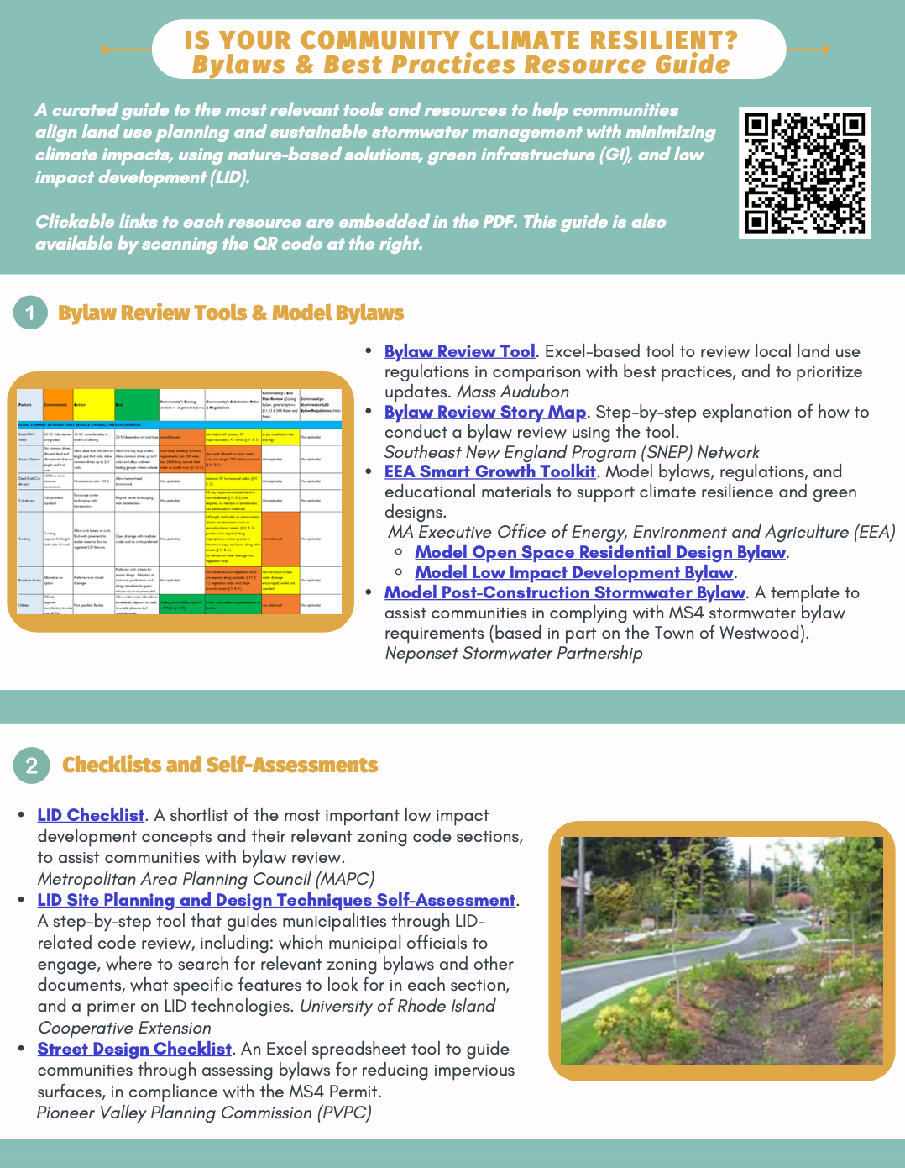
Resources
Mass Audubon LID fact sheets and bylaw tool: massaudubon.org/lidcost
Mass Audubon Losing Ground and Value of Nature factsheets: www.massaudubon.org/valueofnature
EEA Smart Growth Toolkit: mass.gov/smart-growth-smart-energy-toolkit-information-and-resources
MAPC’s Climate Resilience: Toolkit mapc.org/resource-library/climate-resilient-land-use-strategies/
Citizen Planner Training Collaborative: masscptc.org/
Massachusetts Association of Conservation Commissions Electronic Resource Library: maccweb.org/page/ElecResLibrary
EEA Planning Assistance Grants: mass.gov/service-details/planning-assistance-grants
MVP Action Grants mass.gov/service-details/mvp-action-grant
MA Office of the Attorney General Municipal Law Unit: mass.gov/municipal-law-review
UNH Stormwater Center: unh.edu/unhsc/
URI NEMO Program: uri.edu/nemo/
RI Green Infrastructure Coalition: greeninfrastructureri.org
SNEP Network: snepnetwork.org
Find more info in our Resource Guide!

Slide 21
Notes:
Let’s pause here. Are there any questions?

