Slide 1
Notes:
This document is part of a comprehensive curriculum program, Building Climate Resilience Through Local Regulations, developed by Mass Audubon in collaboration with other nonprofit organizations and federal, state and regional agencies. The curriculum contains 8 modules, each of which guides the user through different components of improving community resilience through local regulations that support green designs and nature-based climate solutions. Each module includes a participant guide (e.g., this document) and a PowerPoint presentation.
The full curriculum, supplemental resources and additional information on bylaw review and best practices are available through the Mass Rivers Alliance and Mass Audubon websites (https://www.massriversalliance.org/climate-resilience-planning & https://www.massaudubon.org/our-conservation-work/policy-advocacy/local-climate-resilient-communities). The SNEP Network’s website provides additional resources including an interactive virtual storymap and webinar recordings (https://snepnetwork.org/bylaw-review/).

Slide 2
Notes:
Many people and organizations contributed to this curriculum.
This bylaw curriculum has been developed by SNEP Network Partners Mass Audubon, Cape Cod Commission, the Southeast Regional Planning and Economic Development District, and the Blackstone Watershed Collaborative in partnership with the Massachusetts Rivers Alliance and Citizen Planner Training Collaborative, and financial support from the SNEP Network. The Barrett Planning Group, LLC assisted with planning content.
The Southeast New England Program (SNEP) Network brings together local environmental organizations, academic institutions, regional planners, and consultants who collaborate to provide municipalities, tribes and organizations in Rhode Island and Southeast Massachusetts access to free training and technical assistance to advance stormwater management, ecological restoration, and sustainable financing goals across the region. The SNEP Network is administered through EPA’s partnership with the New England Environmental Finance Center, a non-profit technical assistance provider for EPA Region.
The SNEP Network supports this bylaw review curriculum as a key resource for communities to update their local regulations for improved nature-based climate solution implementation. Find out more about the SNEP Network at www.snepnetwork.org.
This product has been funded wholly or in part by the United States Environmental Protection Agency under Assistance Agreement SE- 00A00655-0 to the recipient. The contents of this document do not necessarily reflect the views and policies of the U.S. Environmental Protection Agency, nor does the U.S. EPA endorses trade names or recommends the use of any products, services or enterprises mentioned in this document.
This project also received funding from the Lookout Foundation.

Slide 6
Notes:
As you’ll recall from the introductory module, both natural and built green infrastructure provide many valuable functions including capturing, filtering, and infiltrating stormwater.
Integrating nature and natural functions of plants and soils into our built environment is what we refer to as “low impact development.” A great thing about low impact development is its diversity – it can really be done at any scale, from the most rural communities to urban.
Communities often come up across barriers when trying to encourage more widespread adoption of these techniques, however, because their local zoning and subdivision regulations reflect the conventional development practices and discourage or, oftentimes, prohibit LID techniques, and we will be discussing those barriers later on.
Restoring ecosystems where they have been lost introduces natural resilience back into communities.

Slide 7
Notes:
Reviewing and updating your local bylaws and regulations can be a daunting task. But there are many resources available to assist you, including state grant programs.
Protecting our most important natural green infrastructure like forests, farmlands, wetlands and buffer zones is accomplished through many measures like acquisition through state grants or the Community Preservation Act. But it’s important to keep in mind that Zoning and other land use regulations can also play a key role in protecting these most precious features on parcels that do get developed.
Open Space Design, Natural Resource Protection Zoning or similar approaches by other names such as Conservation Subdivision can be powerful tools for protecting important natural assets when development takes place.
Other local regulations such as stormwater bylaws or general LID bylaws should be designed to work in concert with zoning and subdivision rules.
The Executive Office of Energy and Environmental Affairs (EEA) provides a set of model bylaws as a part of its Smart Growth/Smart Energy Toolkit, many of which relate to LID principles such as OSRD. Some of the examples we will discuss in this module make use of these models, and we recommend looking at these models as a starting point when developing regulations for your community.

Slide 8
Notes:
Open Space Residential Design is an alternative to traditional subdivision design that seeks to reduce the environmental impacts of development while providing cost-saving incentives to developers.
OSRD clusters development into only a small portion of a site, leaving more open space undisturbed while also reducing the amount of impervious roadway needed to serve the same number of units.
State guidelines recommend adopting OSRD as the standard form of subdivision development, or at least allowing it as a by-right alternative. Many communities already have some form of cluster development in their bylaws, but it often requires a special permit process that does not adequately offset the added time and expense so, developers do not end up taking advantage of it.
Sherborn Example:
The Town of Sherborn established OSRD as a “preferred alternative” to conventional subdivision design, allowing it by right in all three of their residential districts. Sherborn’s requirement that “developed areas and protected open space shall be placed within the parcel in a manner that best fits the characteristics of the land and the purposes of this bylaw, in particular the protection of clean groundwater resources and environmental resiliency” is a good illustration of OSRD to tailor development to the natural resources of a specific location.

Slide 9
Notes:
One of the main aspect of local land use regulation where LID comes into play is through stormwater management.
There are several locations in your municipality’s General Bylaws where LID regulations might be found, such as a wetlands bylaw or stormwater management bylaw.
For example, a wetlands bylaw might “permit the use of low impact stormwater structures within the buffer zone of wetland resource areas” as long as this does not conflict with any other regulations. Similarly, stormwater management bylaws may encourage or require any number of LID stormwater techniques .
Westwood Example:
The Town of Westwood’s stormwater management bylaw “stipulates land disturbance review processes for nearly all new development consistent with LID stormwater standards for best practice. The bylaw mandates compliance with performance and design guidelines emphasizing LID techniques and conservation, with permit requirements for development disturbing more than one-half acre of land and administrative review stipulated for all projects disturbing at least 5,000 square feet”

Slide 10
Notes:
There is another section of a municipality’s bylaws where LID regulations might be located: a dedicated Low Impact Development Bylaw. This is the route taken by the Town of Westminster back in 2006, with updates through 2020. As stated in the introduction of Westminster’s LID bylaw:
“the Town of Westminster enacts this Low Impact Development bylaw to provide guidance that will prevent harmful impacts from land development activities”
However, as we’ll see later, it is important that other aspects of your local land use rules also align with a bylaw like this. Consistency across the regulatory scheme is important to ensure LID is actually employed fully.

Slide 11
Notes:
The dimensional regulations found in Zoning Bylaws can either limit or encourage the use of LID principles in a community’s development patterns and site design.
For example, flexibility in terms of allowable frontage and setbacks allow for more creative design that can push development away from environmentally sensitive areas. Stormwater systems such as rain gardens or bioretention areas might be permitted within required setbacks, or the extent of lawns might be limited.
There are many opportunities in a ZBL to limit the amount of impervious area in a municipality. For example, parking requirements should be minimized to require the least possible amount of impervious pavement while ensuring safe and adequate parking. Permeable paving could also be added as a permissible material for parking areas.
Framingham Example:
The City of Framingham includes a robust set of special regulations in its zoning bylaw to minimize land disturbance, including tree protection. The bylaw states that: “the removal of trees shall not be permitted within the side/rear setbacks… unless identified by the Town’s Tree Warden to be hazardous and/or diseased.” Applicants are also required to retain trees above a certain size in their front setback and replace any removed trees of significant size, or if that is infeasible, to contribute to a local tree planting program.

Slide 12
Notes:
A major responsibility of the planning board in carrying out the Subdivision Control Act is to regulate the design of a subdivision’s roads and ways. Opportunities to incorporate LID in this area include reducing street length and minimizing total paved area. Beyond roadway requirements, planning boards should consider limiting clearing, reducing lawn size, and requiring retention or planting of native vegetation.
Northampton Example:
The City of Northampton’s subdivision rules and regulations heavily incorporate a suite of LID concepts, including definitions and illustrations of ideas such as green roofs, rain gardens, and shared streets. Developers are encouraged to include LID techniques in their subdivision plans (for example, “Developers should consider ‘green alley’ and ‘shared streets’ options”), otherwise they must “show that LID techniques are not feasible from a design perspective,” based on specific standards.

Slide 13
Notes:
Site Plan Review is found in the zoning bylaw and can be applied to projects that reach a certain size threshold or can be applied to certain uses regardless of size. Subdivision Rules and Regulations and Site Plan Review can incorporate LID principles in very similar ways: both are reviews of a site design carried out by the planning board in which a board may require developers to follow certain standards in landscaping, construction of roads, and site layout.
Franklin Example:
The Town of Franklin created a “Best Development Practices Guidebook” that serves as a set of standards for Site Plan Review, as well as subdivision review and a host of other projects.
To meet these goals, Franklin’s guidebook provides criteria for site plans to:
“Preserve views and vistas both into and out of the site”
“Minimize cut and fill”
“Conserve energy by orienting buildings to the sun and wind for maximum efficiency”

Slide 14
Notes:
Pollution from stormwater runoff is the single largest contributor to the high levels of water quality impairment in Massachusetts. The EPA requires many communities to address this problem by undertaking a series of measures through the MS4 permit.
There are 6 main components the MS4 permit.
1. addresses runoff from municipal operations such as DPW yards
2. Illicit discharges are non-stormwater discharges to the storm drain system, typically containing bacteria and other pollutants
3. ongoing stormwater management after construction is completed, and monitoring
4. The federal Construction General Permit already requires owners/operators to file a Notice Of Intent for construction activity disturbing more than one acre of land. Towns may wish to adopt stricter local rules.
5. Towns are encouraged to form partnerships to distribute educational materials to diverse local audiences
6. EPA suggests that communities give the public the opportunity to play an active role in developing and implementing the MS4 program.
(from: https://www.mass.gov/guides/municipal-compliance-fact-sheet-stormwater)
The EPA MS4 permit for Massachusetts includes requirements for communities to review and update their local land use bylaws and regulations in several respects. The bylaw review tool includes several of those elements, so undertaking a review using the tool will help your community with its MS4 compliance efforts.

Slide 15
Notes:
This module helps inform you about where LID may be incorporated into local land use rules. Subsequent modules will examine more about how to review existing local rules in relation to best practices, and using the bylaw review tool to identify priorities for updates and to ensure consistency across all regulations.

Slide 16
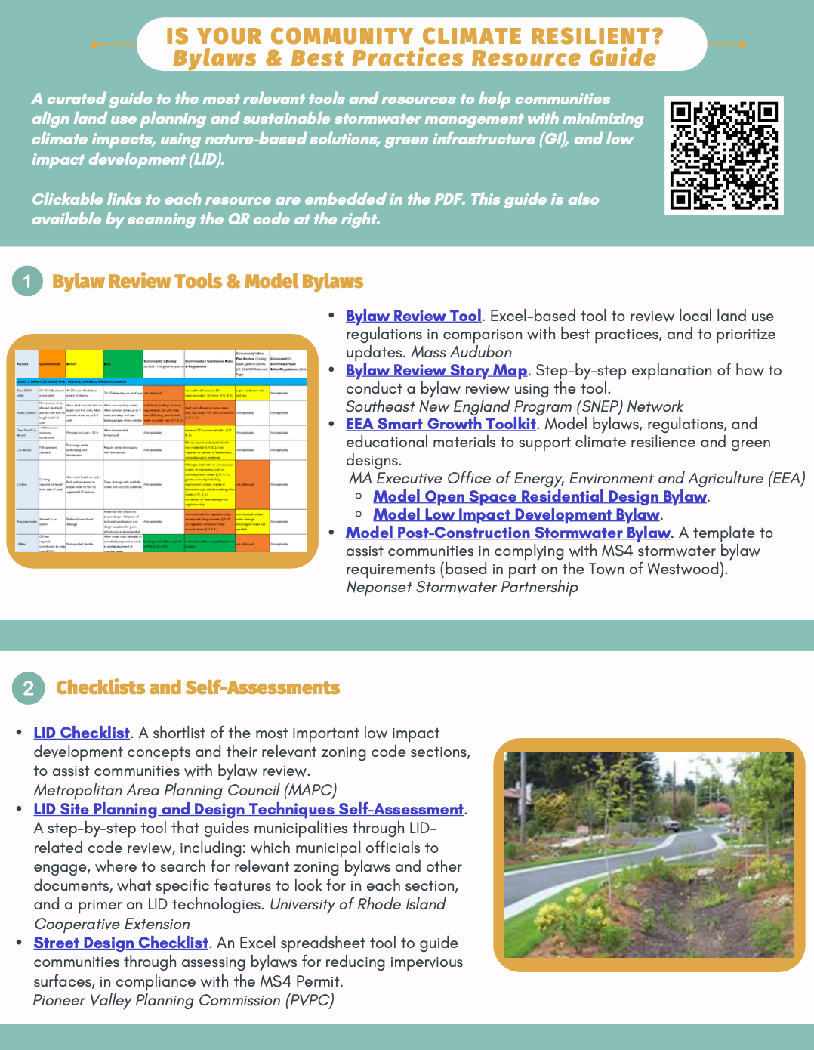
Resources
Mass Audubon LID fact sheets and bylaw tool: massaudubon.org/lidcost
Mass Audubon Losing Ground and Value of Nature factsheets: www.massaudubon.org/valueofnature
EEA Smart Growth Toolkit: mass.gov/smart-growth-smart-energy-toolkit-information-and-resources
MAPC’s Climate Resilience: Toolkit mapc.org/resource-library/climate-resilient-land-use-strategies/
Citizen Planner Training Collaborative: masscptc.org/
Massachusetts Association of Conservation Commissions Electronic Resource Library: maccweb.org/page/ElecResLibrary
EEA Planning Assistance Grants: mass.gov/service-details/planning-assistance-grants
MVP Action Grants mass.gov/service-details/mvp-action-grant
MA Office of the Attorney General Municipal Law Unit: mass.gov/municipal-law-review
UNH Stormwater Center: unh.edu/unhsc/
URI NEMO Program: uri.edu/nemo/
RI Green Infrastructure Coalition: greeninfrastructureri.org
SNEP Network: snepnetwork.org
Find more info in our Resource Guide!

Slide 17
Notes:
Let’s pause here. Are there any questions?
Are there aspects of LID in local bylaws that you would want more clarification on?
Did you find any of the examples in this module relevant to your own town?

