Slide 1
Notes:
This document is part of a comprehensive curriculum program, Building Climate Resilience Through Local Regulations, developed by Mass Audubon in collaboration with other nonprofit organizations and federal, state and regional agencies. The curriculum contains 8 modules, each of which guides the user through different components of improving community resilience through local regulations that support green designs and nature-based climate solutions. Each module includes a participant guide (e.g., this document) and a PowerPoint presentation.
The full curriculum, supplemental resources and additional information on bylaw review and best practices are available through the Mass Rivers Alliance and Mass Audubon websites (https://www.massriversalliance.org/climate-resilience-planning & https://www.massaudubon.org/our-conservation-work/policy-advocacy/local-climate-resilient-communities). The SNEP Network’s website provides additional resources including an interactive virtual storymap and webinar recordings (https://snepnetwork.org/bylaw-review/).

Slide 2
Notes:
Many people and organizations contributed to this curriculum.
This bylaw curriculum has been developed by SNEP Network Partners Mass Audubon, Cape Cod Commission, the Southeast Regional Planning and Economic Development District, and the Blackstone Watershed Collaborative in partnership with the Massachusetts Rivers Alliance and Citizen Planner Training Collaborative, and financial support from the SNEP Network. The Barrett Planning Group, LLC assisted with planning content.
The Southeast New England Program (SNEP) Network brings together local environmental organizations, academic institutions, regional planners, and consultants who collaborate to provide municipalities, tribes and organizations in Rhode Island and Southeast Massachusetts access to free training and technical assistance to advance stormwater management, ecological restoration, and sustainable financing goals across the region. The SNEP Network is administered through EPA’s partnership with the New England Environmental Finance Center, a non-profit technical assistance provider for EPA Region.
The SNEP Network supports this bylaw review curriculum as a key resource for communities to update their local regulations for improved nature-based climate solution implementation. Find out more about the SNEP Network at www.snepnetwork.org.
This product has been funded wholly or in part by the United States Environmental Protection Agency under Assistance Agreement SE- 00A00655-0 to the recipient. The contents of this document do not necessarily reflect the views and policies of the U.S. Environmental Protection Agency, nor does the U.S. EPA endorses trade names or recommends the use of any products, services or enterprises mentioned in this document.
This project also received funding from the Lookout Foundation.

Slide 6
Where Do We Start?
Image: Urban flooding in Florence, MA
Photo source: Dodson & Flinker, 2021
Notes:
Where do we start?
This training has equipped you with the tools and resources you will need to begin a bylaw review and update, but what are the first steps?
As you begin to undertake this process, you will need to build community support for the successful adoption and implementation of LID updates. As we have discussed throughout this training, LID measures work best when they are in place and well-maintained throughout a community, so community outreach and education will be critical to the success of your new initiatives.
Whether the primary concerns in your community are flooding (as in many coastal, low-lying, or densely developed communities), water quality protection (as in many vulnerable watersheds or environmentally-sensitive communities), or natural area conservation, you can tailor your primary message to community context and concerns.
Leverage these community priorities to get people involved and interested!

Slide 7
Notes:
Whenever undertaking an effort to support positive change in a community’s approach to development, the first step is to gather information and assess current conditions. Look for opportunities to leverage existing plans, leadership and community interests into next steps toward implementation.
There are lots of opportunities and choices when it comes to climate-smart development. There is no one-size-fits all approach, so conversations should focus on what is the best fit for YOUR community (or the community you’re working in if you are providing technical assistance).
You can use the Bylaw Review tool and public engagement processes to determine local priorities if those aren’t already apparent.
Look at the municipality’s existing planning documents and any related efforts, to see if sustainability and climate resilience objectives have already been identified. Master Plans, Open Space and Recreation Plans, Municipal Vulnerability Preparedness Plans, and Hazard Management Plans are some of the documents that can provide additional insight into the needs and priorities identified through past public engagement efforts.
Are there formal Sustainability Committees or other official groups working on related topics? Are there informal community groups or local leaders who you can connect with?

Slide 8
Notes:
You can use the Bylaw Review tool and public engagement processes to determine local priorities if those aren’t already apparent, or to refine potential areas for action if local plans identify general goals.
Bylaw Review and update is an opportunity to ensure zoning and other regulations accurately reflect the vision and priorities for growth, development, and redevelopment in your community. Engaging people in the process of utilizing the tool can help build a base of support for actions to implement priorities the tool identifies.
Your Bylaw Review may offer clear indications of the actions that may make the biggest difference and have the greatest impact on your community. The image on this slide shows a Bylaw Review workbook in a community that found its cluster development bylaws to be even more restrictive than conventional development standards. This may make these bylaws difficult or impossible to utilize, so updating this family of bylaws could be an area of opportunity for this community.
Alternatively, you may focus your initial efforts bylaws and regulations that shape a greater proportion of development. The actions with greatest impact vary based on the current conditions of your regulatory framework and the development context of your community. The scale of these updates can vary between communities, in part because of the types of regulations that may represent barriers to LID.

Slide 9
Notes:
You’ve identified changes that will make a difference. You’ve prioritized the biggest issues, concerns, and challenges in your community.
Now, what is the process required to actually align local land use rules with best practices based on the priority updates identified in the tool?
Regulations that are updated through administrative processes (such as subdivision rules and regs) can be “low-hanging fruit,” or easier changes to accomplish, because they don’t require a Town Meeting vote. Winning over your Planning Board and other local officials to support Low Impact Development (LID) standards can mean that some important updates are adopted and effective on a relatively short time scale. This can then also form the basis for tackling updates to zoning and other rules that require broader community support.

Slide 10
Notes:
Building community understanding and support for updates is important, whether or not a vote of Town Meeting or the City Council is required.
This requires outreach and education, as well as gathering input on what is most important to your community. You will need to get the community on the same page. Voters who understand how changes to land use rules will benefit to the residents, businesses, and the environment will be much more likely to support proposed updates. You want to be clear in introducing these new ideas and what they will mean for your city or town. One of the biggest mistakes you can make is assuming that your audience already knows what you mean while you introduce new policy ideas and options.
Change is always difficult. People will naturally want to know why the systems they’ve relied on for many years need to be revised, and why it is in their best interest.
For many communities, one of the most effective early steps they can take is partnering with and engaging local stakeholders to get them to understand, promote, and invest in these techniques. Low Impact Development (LID) solutions are cost-effective stormwater best management practices (BMPs), and a key part of bringing these techniques to your community will be outreach and education, for industry professionals and residents alike!
Public participation in the regulatory update process may yield insight into the skepticism or concerns that exist within your community, but engaging the public means having the opportunity to address those questions. If possible, it can be in your interest to anticipate these issues so that you have a well-considered (or perhaps well-researched!) answer or solution ready, but hearing and acknowledging the viewpoints of stakeholders can help to build better bylaws and to earn public support. There be many different perspectives on development in your community, but all of your neighbors each have a vested interest in seeing their hometown thrive.
Members of your community can also be key resources when you are met with resistance. If you have developers, builders, and other industry professionals who have engineered or installed LID features in their recent work, their hands-on experience can make them valuable partners, trainers, and advocates. Similarly, garden clubs, horticulture organizations, and outdoor enthusiasts may have planted or maintained rain gardens and bioswales, and they can attest to the simplicity of caring for these landscape features. Building a base of support can take different forms between community contexts, and these examples aren’t the only people whose voices may amplify the message. The efficacy and cost-effectiveness of LID measures are being felt in more and more communities, particularly because so many cities and towns throughout the Commonwealth are subject to MS4 requirements (Module 3), so potential allies to LID adoption may be even nearer and more numerous than you realize.
Benefits like protecting water quality, avoiding flood damage, and reducing municipal cost burdens can be motivating factors for change. The resources guide at the end of this presentation has links to many resources on the benefits of green infrastructure and LID.

Slide 11
Notes:
An Bylaw Review team may look different from community to community. A team may be primarily made up of municipal staff and local officials from various departments. If resources are available and the review is complex, you may wish to populate a working group with a coalition of public- and private- sector partners and stakeholders as well as community members at-large. You want your community to see that your updates and efforts are inclusive and transparent.
Modules 3 and 4 introduced the types of bylaws and ordinances that you may wish to consider, as well as the processes you’re your team will undertake to get them adopted. If you are drafting a zoning bylaw or a zoning amendment, the Planning Board will be holding a hearing to discuss the bylaw, so it will be in your interest to get the Planning Board involved sooner rather than later to ensure that your initiative has its support. The Planning Board will decide whether your zoning update will go to Town Meeting. In the case of general bylaws, local officials can be a tremendous resource, and their support can be invaluable to winning over voters at Town Meeting, but they do not necessarily have to be as involved in the drafting process, and resident signatures can get your bylaw on the Town Meeting warrant (Module 3).

Slide 12
Notes:
Once you’ve built a solid base of support, you can bring changes to your Town Meeting or City Council.
In general, it is better and more effective to work collaboratively with local officials and staff on land use regulatory updates, rather than to propose revisions by citizen petition. There may be situations where the latter is necessary, but a cooperative approach led by local officials is more likely to be successful, and to minimize any divisiveness.
If you are a citizen seeking improvements in local land use and find that your officials are not receptive to considering updates even when presented with evidence that the current rules do not meet state-recommended best standards, then you may need to take a step back. Consider other steps like running for a seat on the Planning or Select Board or convening a local citizens groups to discuss where the town’s development trends are headed and build support for a more sustainable future.
Mass Audubon’s Guide to Citizen Involvement has many tips on effective local advocacy.
https://www.massaudubon.org/our-conservation-work/policy-advocacy/local-climate-resilient-communities/guidebook-to-involvement-in-your-community
supportive. Make sure voters know where your updates are in the Town Meeting warrant.
Feel free to be creative in driving out the vote!
From yard signs to social media pages, and from bumper stickers to t-shirts, think of the techniques that you have seen succeed in your community in the past or may strike a chord with residents.
Think of past campaigns that yielded results:
What did they have in common?
What made them compelling?
Are there local businesses or other partners that share your interest in getting the word out?
Make sure that voters also know the stakes! Adopting LID is about climate resilience and sustainable growth, as well as tax dollars saved in costs avoided from inaction. Planning for climate resilience has implications across the community.

Slide 13
Notes:
How many of you are feeling better equipped to bring LlD techniques to your communities?

Slide 14
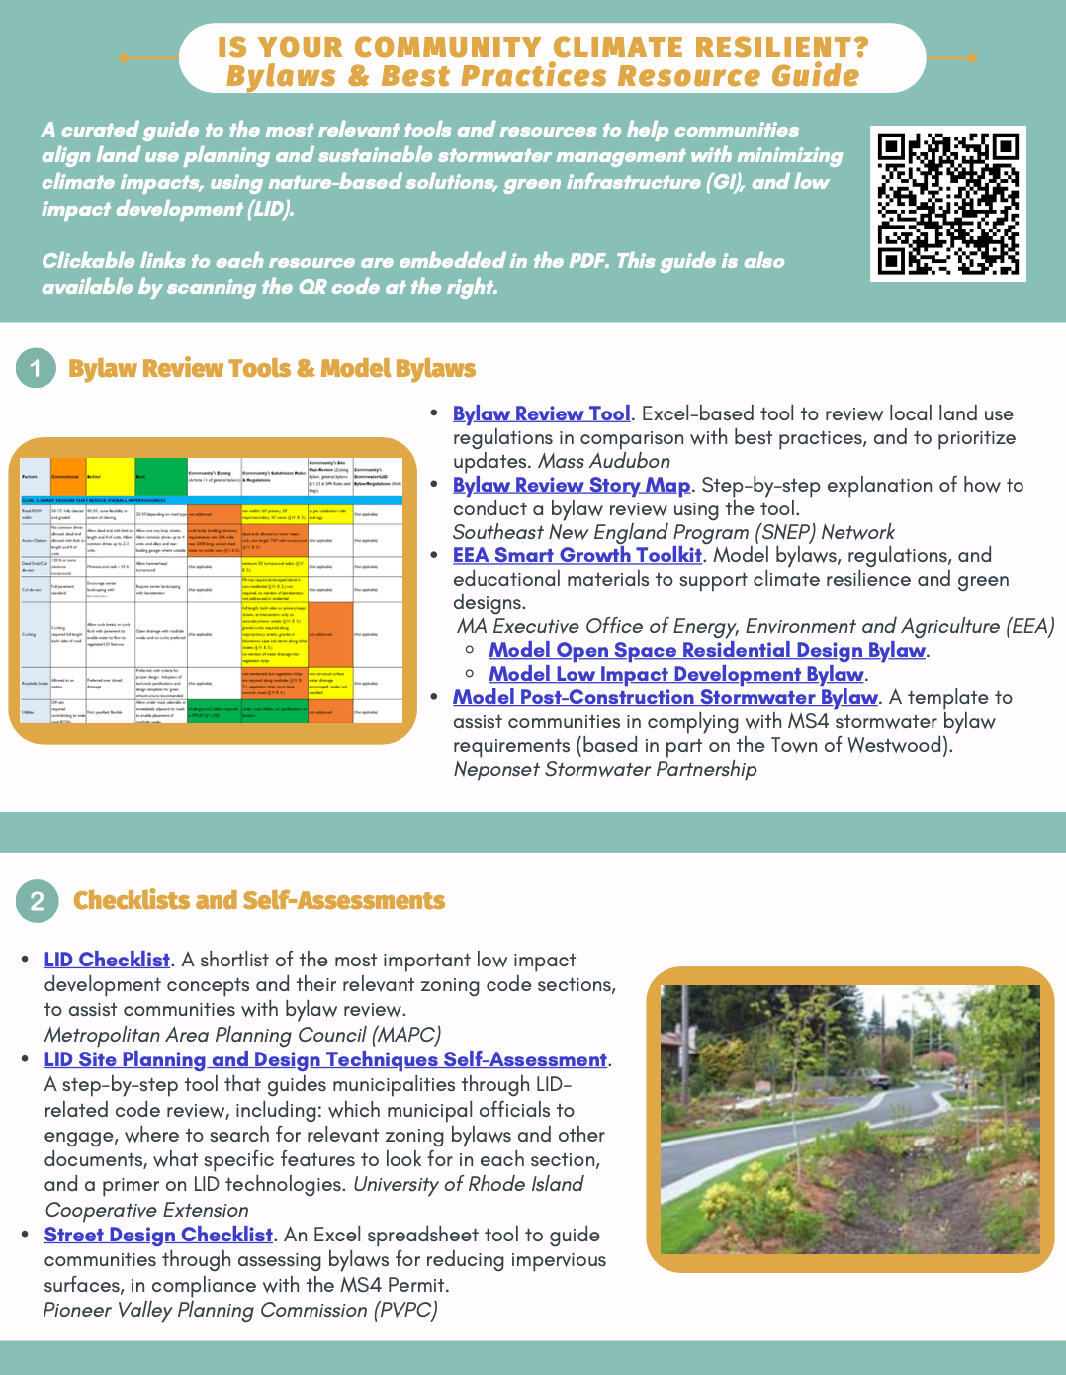
Resources
Mass Audubon LID fact sheets and bylaw tool: massaudubon.org/lidcost
Mass Audubon Losing Ground and Value of Nature factsheets: www.massaudubon.org/valueofnature
EEA Smart Growth Toolkit: mass.gov/smart-growth-smart-energy-toolkit-information-and-resources
MAPC’s Climate Resilience: Toolkit mapc.org/resource-library/climate-resilient-land-use-strategies/
Citizen Planner Training Collaborative: masscptc.org/
Massachusetts Association of Conservation Commissions Electronic Resource Library: maccweb.org/page/ElecResLibrary
EEA Planning Assistance Grants: mass.gov/service-details/planning-assistance-grants
MVP Action Grants mass.gov/service-details/mvp-action-grant
MA Office of the Attorney General Municipal Law Unit: mass.gov/municipal-law-review
UNH Stormwater Center: unh.edu/unhsc/
URI NEMO Program: uri.edu/nemo/
RI Green Infrastructure Coalition: greeninfrastructureri.org
SNEP Network: snepnetwork.org
Find more info in our Resource Guide!

