Slide 1
Notes:
This document is part of a comprehensive curriculum program, Building Climate Resilience Through Local Regulations, developed by Mass Audubon in collaboration with other nonprofit organizations and federal, state and regional agencies. The curriculum contains 8 modules, each of which guides the user through different components of improving community resilience through local regulations that support green designs and nature-based climate solutions. Each module includes a participant guide (e.g., this document) and a PowerPoint presentation.
The full curriculum, supplemental resources and additional information on bylaw review and best practices are available through the Mass Rivers Alliance and Mass Audubon websites (https://www.massriversalliance.org/climate-resilience-planning & https://www.massaudubon.org/our-conservation-work/policy-advocacy/local-climate-resilient-communities). The SNEP Network’s website provides additional resources including an interactive virtual storymap and webinar recordings (https://snepnetwork.org/bylaw-review/).

Slide 2
Notes:
Many people and organizations contributed to this curriculum.
This bylaw curriculum has been developed by SNEP Network Partners Mass Audubon, Cape Cod Commission, the Southeast Regional Planning and Economic Development District, and the Blackstone Watershed Collaborative in partnership with the Massachusetts Rivers Alliance and Citizen Planner Training Collaborative, and financial support from the SNEP Network. The Barrett Planning Group, LLC assisted with planning content.
The Southeast New England Program (SNEP) Network brings together local environmental organizations, academic institutions, regional planners, and consultants who collaborate to provide municipalities, tribes and organizations in Rhode Island and Southeast Massachusetts access to free training and technical assistance to advance stormwater management, ecological restoration, and sustainable financing goals across the region. The SNEP Network is administered through EPA’s partnership with the New England Environmental Finance Center, a non-profit technical assistance provider for EPA Region.
The SNEP Network supports this bylaw review curriculum as a key resource for communities to update their local regulations for improved nature-based climate solution implementation. Find out more about the SNEP Network at www.snepnetwork.org.
This product has been funded wholly or in part by the United States Environmental Protection Agency under Assistance Agreement SE- 00A00655-0 to the recipient. The contents of this document do not necessarily reflect the views and policies of the U.S. Environmental Protection Agency, nor does the U.S. EPA endorses trade names or recommends the use of any products, services or enterprises mentioned in this document.
This project also received funding from the Lookout Foundation.

Slide 3
Notes:
In this first section, we’ll be addressing the value and benefits of our natural environment, as well as the losses that we’re experiencing because of climate change.

Slide 4
Notes:
Each of these modules will run for about 30 minutes.

Slide 6
Notes:
Let’s start with infrastructure. You’ve heard of built, or “gray,” infrastructure, but how many of you are familiar with green infrastructure?

Slide 7
Notes:
Gray infrastructure, or conventional infrastructure of a built environment, refers to systems engineered and constructed by humans, such as dams, seawalls, roads, pipes, or water treatment plants.
Green infrastructure has several definitions, including Mass Audubon’s given here: a network of waterways, wetlands, woodlands, wildlife habitats, and other natural areas that support native species, maintain natural ecological processes, sustain air and water resources, and contribute to health and quality of life
Others references to GI often include designed landscape features like rain gardens that employ natural mechanisms to provide additional benefits for human well-being, such as flood protection and climate regulation.

Slide 8
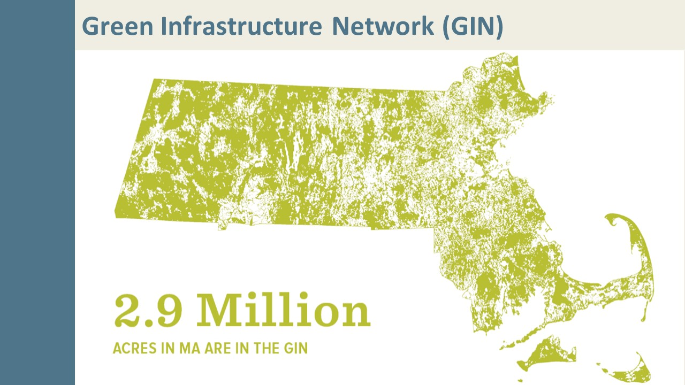
Notes:
Green Infrastructure Network
Plymouth-based environmental organization Manomet developed a model to map GI and the GI Network using GIS. Key inputs include Resilient Landscapes, BioMap2 Core & Critical Natural Landscape areas, riparian buffers, and areas vulnerable to coastal or inland flooding. Mass Audubon then applied this methodology statewide in its report Losing Ground, Nature’s Value in a Changing Climate (2020). www.massaudubon.org/losingground
The statewide Green Infrastructure Network (GIN) encompasses 2.9 million acres. As of 2012, 1.037 million acres (36%) of the GIN had already been protected, leaving 1.8 million acres of high-priority land for conservation unprotected in Massachusetts.
Between 2012 and 2017, just over 9,300 acres of the GIN were lost to new development, largely within the Sprawl Frontier. This represents 38% of all new development, suggesting that there is an urgent need for improved development planning to avoid impacting our most valuable lands.
Just over 82,200 acres of GIN land were conserved between 2012 and 2017, or 76% of all newly protected land.
In the context of our changing climate, our GIN is critical to resilience to environmental stressors in our communities. The next slides will discuss some of the effects of climate change that have already caused changes.

Slide 9
Notes:
Massachusetts communities are already seeing the effects of greenhouse gas emissions on our climate.
[click]
Since 1895, 2.9 F increase in Massachusetts temp. For context, during the maximum extent of the last ice age, when a mile of ice covered most of Massachusetts, temperatures were 9° F cooler than today.
Think of this change between the start of the 20th century and today as 10 more days over 90 degrees F in MA.
Since 1960, increase of 4 days over 90 degrees per year
[click]
These changes affect the seasons! Our growing season has gotten 11 days longer
[click]
Changes in temperature and precipitation patterns are yielding more frequent droughts and intense storm events.
55% stronger storms mean more storm damage
[click]
Accelerating sea level rise threatens development and ecosystems particularly in coastal and wetland areas.
- The sea level in Boston Harbor has risen 11” since 1922

Slide 10
Notes:
The changes we’re seeing in our environment are have consequences, but if we stay on the course we’re on, the effects of climate change will continue to increase. Projections indicate that more extreme increases in temperature, growing season duration, sea level rise, and strong storms are forthcoming, and these effects will profoundly reshape our communities.

Slide 11
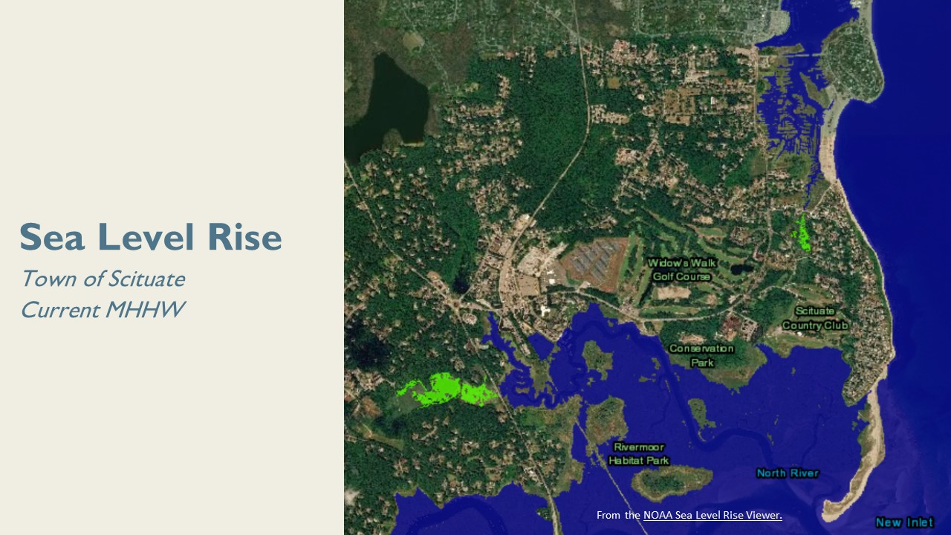
Notes:
This is an image of Scituate (on the South Shore of Boston) at the mouth of the North River. This image was generated from satellite imaging by the NOAA Sea Level Rise Viewer. Of course, the tides are always changing, so the MHHW, which stands for “mean higher high water,” is the average height of the highest tide observed each day over a time interval. That means that the sea level you’re seeing here approximates the current highest-tide level.
Like much of the South Shore, Scituate is already seeing erosion here, and the Town is taking action to protect its shoreline because sea level rise will exacerbate these issues. The areas shown in green are low-lying, and according to NOAA’s data, may also flood if mitigation measures are not present or installed in the future.
Click to see 3’ sea level rise and again to see 7’ sea level rise. These are levels we are likely to see by the year 2100
As you can see, Scituate looks dramatically different today than it does with these changes in the sea level.

Slide 12
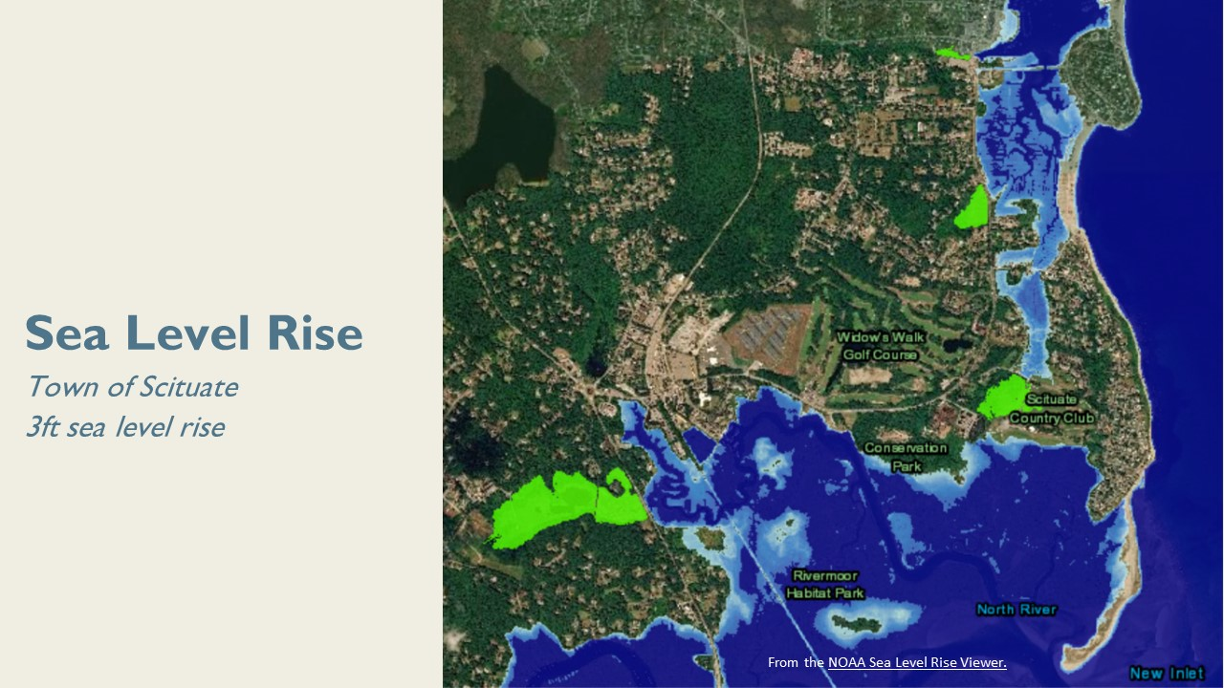
Notes:
This map illustrates a 3’ sea level rise

Slide 13
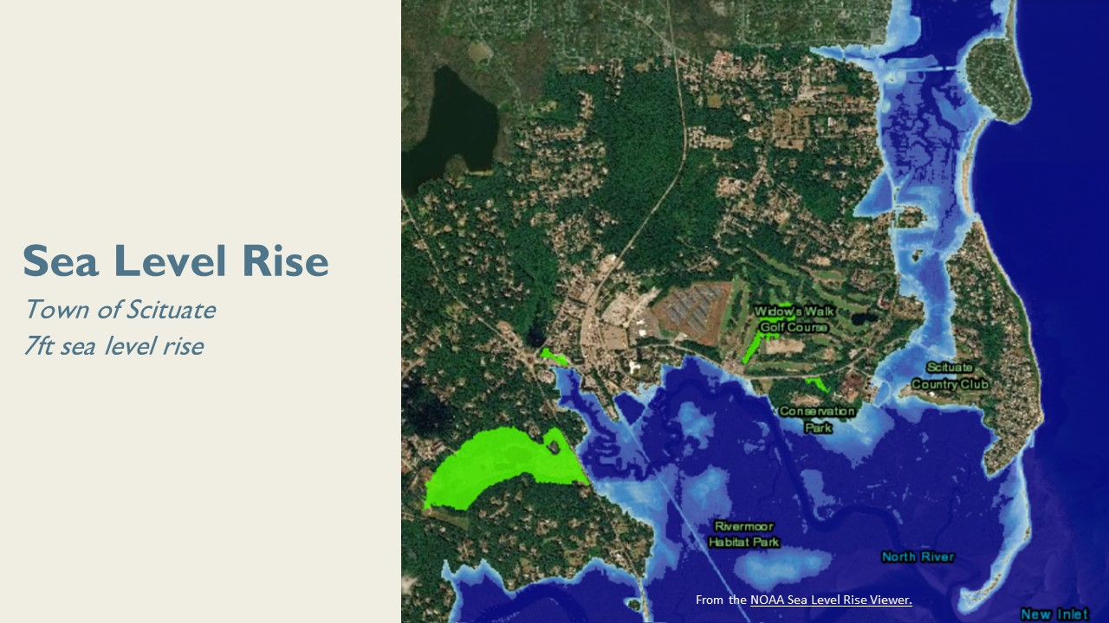
Notes:
7’ sea level rise.
You’ll notice significant losses in land area between these images, and other coastal communities can expect to see similarly dire projections. These images show that action is necessary for protecting our natural resources as well as our built environment.

Slide 14
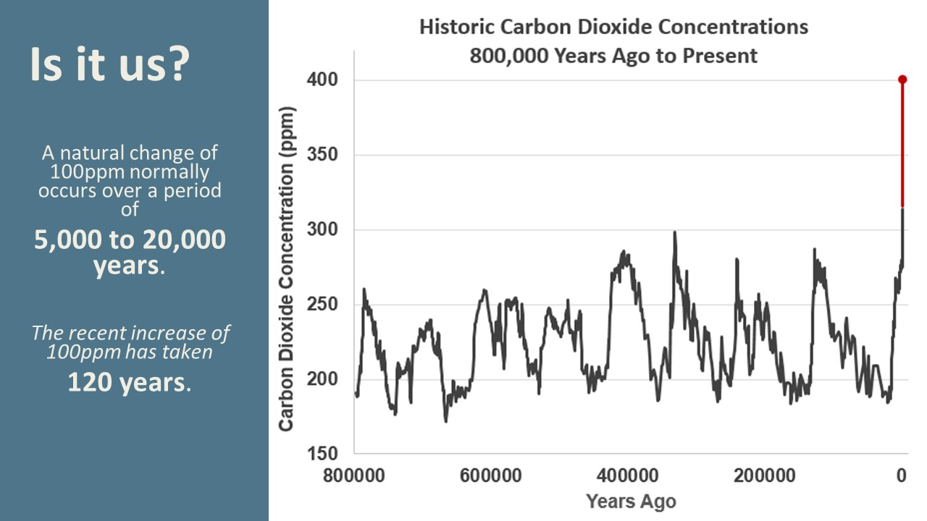
Notes:
While the climate change conversation can sometimes stall when it comes to the impact of human activity versus natural cycles, this graph shows atmospheric carbon dioxide concentrations over time, and it comes from the National Oceanic and Atmospheric Administration’s website, climate.gov. Atmospheric carbon dioxide levels are part of what we mean when we talk about ”greenhouse gases,” which trap heat from the sun inside the Earth’s atmosphere.
Takeaway: yes, it’s us.

Slide 15
Notes:
We know that climate change is real; it’s bad; it’s due to human activity.
[If you would like to learn more about the way climate change is affecting Massachusetts communities, Mass Audubon and the MA DEP have many resources available.]
[click to reveal]
Sometimes the problem can seem so massive that it’s overwhelming (particularly in coastal communities, as we just saw), but there are solutions for mitigating these effects, and they represent local contributions to and protections from a global problem.

Slide 16
Notes:
While the frequency and severity of storms, flooding, erosion, and drought are due to climate change, these “symptoms” are not new. Nature is resilient to these effects, as long as we preserve and protect it. Nature-based solutions conserve, enhance, or restore nature to address climate issues (like flooding, erosion, drought, and extreme heat). Our natural environment is our best resource for mitigating the effects of global climate change, as well as preventing these effects in the future.
Let’s walk through some of these strategies and how they work in nature.

Slide 17
Notes:
Sources for these and other stats: www.massaudubon.org/valueofnature
Carbon sequestration is the process of capturing and storing atmospheric carbon dioxide. It is one method of reducing the amount of carbon dioxide in the atmosphere – one of the “greenhouse gases” that trap heat from in the sun in the Earth’s atmosphere – and the ultimate goal is reducing global climate change.
Forests:
3 million acres of forest, or about 60 percent of the land area of Massachusetts, store an average of 103 tons of carbon per acre, and absorb about 7 percent of the Commonwealth’s annual carbon emissions. (Chu, H., et al. 2018. Global Warming Solutions Act: 10-Year Progress Report. The Commonwealth of Massachusetts. 77 pp)
Wetlands:
Wetlands hold 20 to 30 percent of global soil carbon while making up only 5 to 8 percent of global land area. The wetlands of the Eastern Mountains and Upper Midwest (includes New England) account for nearly half of the carbon stored in US wetlands.
Coasts:
The annual carbon sequestration rate of vegetated coastal ecosystems (salt marshes, seagrasses, and mangroves) is 10 times greater than that of terrestrial forest systems. Salt marshes are among the most productive ecosystems in the world.

Slide 18
Notes:
Forests:
Forests in New England annually remove an estimated 760,000 tons of pollutants that cause smog and ground-level ozone.
Urban Green Space:
Trees also can serve to reduce urban heat island effects by casting shade and releasing water vapor and filtering particulate matter in the air. A study of roadside street trees indicates that neighboring houses saw a 50 percent reduction in indoor coarse particulate matter concentrations in the air. Another study found that a single tree lowered concentrations in its vicinity by 15 percent.

Slide 19
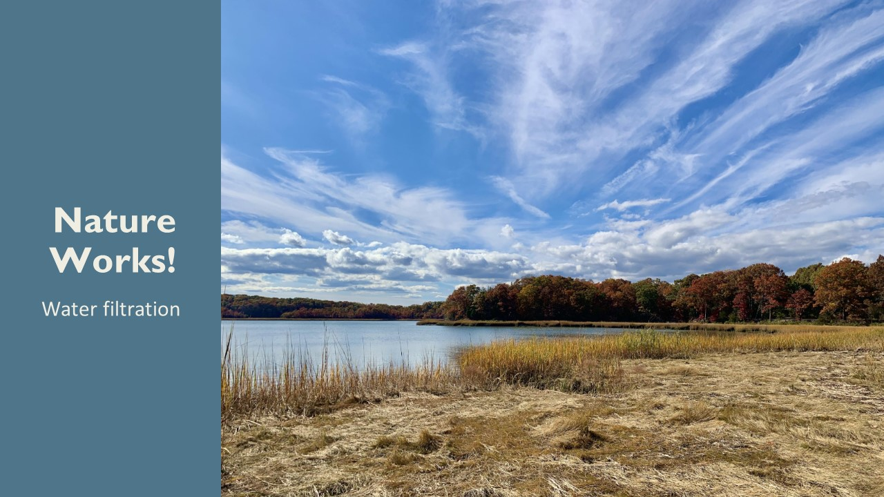
Notes:
Forests:
Forests are natural water filtration systems. Each forested acre that drains into public water source filters 543,000 gallons of drinking water per year. Meeting the annual needs of 19 people, this filtration has an annual value of $2,500.
Wetlands:
Every $1 investment in source water protection yields a savings of $27 in water treatment costs. New England communities save $157 million annually in water filtration costs because of the region’s wetlands and forests.
Coasts:
Vegetated coastal wetlands such as seagrass beds act as a mechanism of water filtration by removing nutrients from sediment and the water column.

Slide 20
Notes:
When a site loses its vegetation, less water is used onsite in plant processes (evapotranspiration), and less water infiltrates into the ground. This generates runoff, or stormwater, and as stormwater travels, it picks up chemicals and pollutants from the surfaces it runs across. Instead of undergoing onsite filtration and recharging groundwater, stormwater brings unwanted contaminants to our waterways.
Stormwater pollution is responsible for more than half of the water quality impairments across the Commonwealth. The Clean Water Act regulates these impaired waters as well as MS4 (Municipal Separate Storm Sewer System) permit areas. This image highlights in red and yellow the impaired water bodies across Massachusetts and illustrates the water quality issues that many of our communities are facing, often but not always corresponding with areas with storm sewer systems.

Slide 21
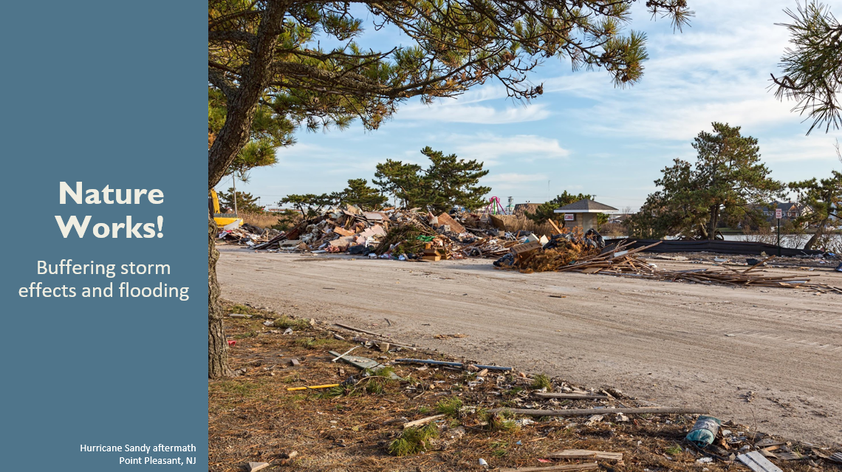
Notes:
Wetlands:
Wetlands function like sponges in that they store and slowly release water. Over 1 million gallons of water can be stored in 1 acre of wetland, and the slow release of water facilitates groundwater recharge.
Coasts:
High tides threaten more than 89,000 Massachusetts homes. By buffering wave height and impact, salt marshes and wetlands reduce annual flood losses in the northeast by 16 percent annually, and in major storm events, savings potential is even higher. When Hurricane Sandy hit, coastal wetlands in the northeastern US saved $625 million in flooding damages. (Narayan, S., et al. 2017. The value of coastal wetlands for flood damage reduction in the Northeastern USA. Scientific Reports 7, 9463 (2017).)
Forests:
Strategic planting and protection of forested floodplains can help to control erosion, buffer flooding, and decrease potential flood heights in towns downstream by up to 20 percent.

Slide 22
Notes:
So what do these strategies look like in practice?
Natural resource and open space preservation is about conserving the natural resources that exist in your community. The ecosystems in these areas provide the services we’ve talked about at minimal or no additional cost.
Integrating these natural strategies into our built environment is what we refer to as “low impact development.” A great thing about low impact development is its diversity – it can really be done at any scale, from the most rural communities to urban. Our work with towns largely focuses on this central idea – integrating LID into development wherever possible. Towns often come up across barriers when trying to encourage more widespread adoption of these techniques, however, because their local zoning and subdivision regulations reflect the conventional development practices and discourage or, oftentimes, prohibit LID techniques, and we will be discussing those barriers later on.
Restoring ecosystems where they have been lost introduces natural resilience back into communities.

Slide 23
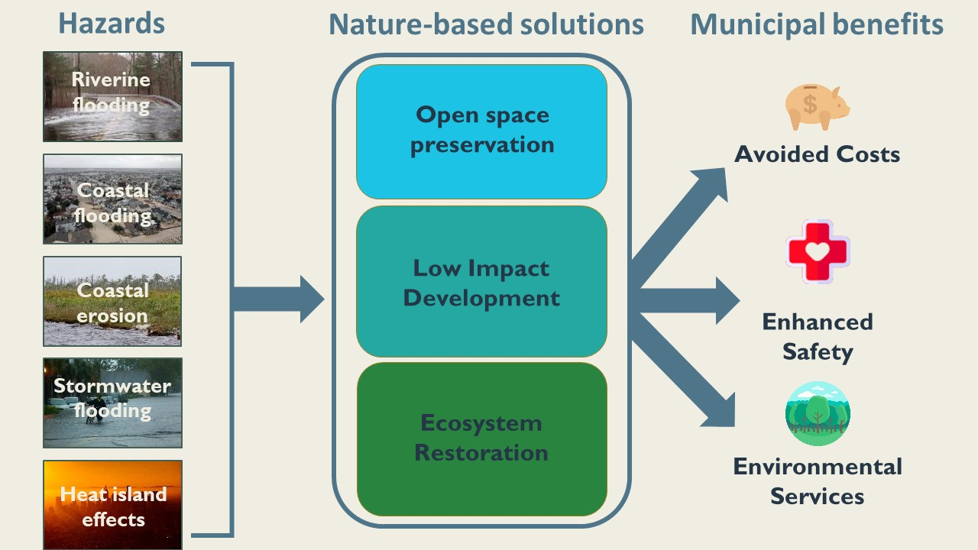
Notes:
Here you’ll see the three types of nature-based solutions: they work together to combat the natural hazards that our communities are facing:
Coastal and inland flooding
Storm effects and erosion
Urban heat islands
The benefits of implementing nature-based solutions take many forms, including cost savings from prevented damage, health and safety benefits such as healthier habits, and increased resilience.
In action words, we refer to this three-step approach as conserve, integrate, restore

Slide 24
Notes:
I hope this module has illustrated that nature works! The natural functions of our environment are valuable, and we can work to conserve what already exists, integrate natural solutions into development, and restore ecosystem services to protect our communities into the future. In the next section, we will explore Low Impact Development (LID), which utilizes nature-based solutions and green infrastructure to offset the local environmental effects of new development, particularly related to surface and groundwater.

Slide 25
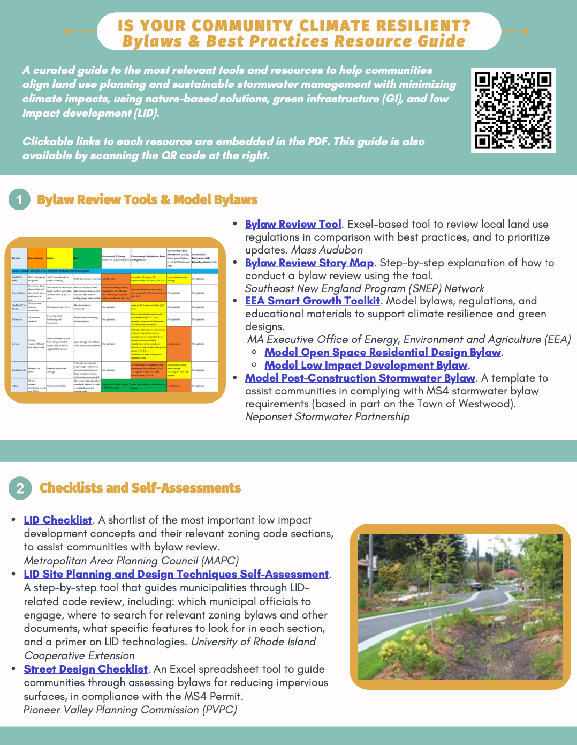
Resources
Mass Audubon LID fact sheets and bylaw tool: massaudubon.org/lidcost
Mass Audubon Losing Ground and Value of Nature factsheets: www.massaudubon.org/valueofnature
EEA Smart Growth Toolkit: mass.gov/smart-growth-smart-energy-toolkit-information-and-resources
MAPC’s Climate Resilience: Toolkit mapc.org/resource-library/climate-resilient-land-use-strategies/
Citizen Planner Training Collaborative: masscptc.org/
Massachusetts Association of Conservation Commissions Electronic Resource Library: maccweb.org/page/ElecResLibrary
EEA Planning Assistance Grants: mass.gov/service-details/planning-assistance-grants
MVP Action Grants mass.gov/service-details/mvp-action-grant
MA Office of the Attorney General Municipal Law Unit: mass.gov/municipal-law-review
UNH Stormwater Center: unh.edu/unhsc/
URI NEMO Program: uri.edu/nemo/
RI Green Infrastructure Coalition: greeninfrastructureri.org
SNEP Network: snepnetwork.org
Find more info in our Resource Guide!

Slide 26
Notes:
Let’s pause here. Are there any questions?

