Slide 1
Notes:
This document is part of a comprehensive curriculum program, Building Climate Resilience Through Local Regulations, developed by Mass Audubon in collaboration with other nonprofit organizations and federal, state and regional agencies. The curriculum contains 8 modules, each of which guides the user through different components of improving community resilience through local regulations that support green designs and nature-based climate solutions. Each module includes a participant guide (e.g., this document) and a PowerPoint presentation.
The full curriculum, supplemental resources and additional information on bylaw review and best practices are available through the Mass Rivers Alliance and Mass Audubon websites (https://www.massriversalliance.org/climate-resilience-planning & https://www.massaudubon.org/our-conservation-work/policy-advocacy/local-climate-resilient-communities). The SNEP Network’s website provides additional resources including an interactive virtual storymap and webinar recordings (https://snepnetwork.org/bylaw-review/).

Slide 2
Notes:
Many people and organizations contributed to this curriculum.
This bylaw curriculum has been developed by SNEP Network Partners Mass Audubon, Cape Cod Commission, the Southeast Regional Planning and Economic Development District, and the Blackstone Watershed Collaborative in partnership with the Massachusetts Rivers Alliance and Citizen Planner Training Collaborative, and financial support from the SNEP Network. The Barrett Planning Group, LLC assisted with planning content.
The Southeast New England Program (SNEP) Network brings together local environmental organizations, academic institutions, regional planners, and consultants who collaborate to provide municipalities, tribes and organizations in Rhode Island and Southeast Massachusetts access to free training and technical assistance to advance stormwater management, ecological restoration, and sustainable financing goals across the region. The SNEP Network is administered through EPA’s partnership with the New England Environmental Finance Center, a non-profit technical assistance provider for EPA Region.
The SNEP Network supports this bylaw review curriculum as a key resource for communities to update their local regulations for improved nature-based climate solution implementation. Find out more about the SNEP Network at www.snepnetwork.org.
This product has been funded wholly or in part by the United States Environmental Protection Agency under Assistance Agreement SE- 00A00655-0 to the recipient. The contents of this document do not necessarily reflect the views and policies of the U.S. Environmental Protection Agency, nor does the U.S. EPA endorses trade names or recommends the use of any products, services or enterprises mentioned in this document.
This project also received funding from the Lookout Foundation.

Slide 6
Notes:
In this module, we will be talking about some of the resources that will be available to you. You will notice that in the corner of most of the slides, there will be one of more of the icons that are given on this slide. This is intended to offer some guidance regarding the primary benefits of the resource, but that isn’t to say that their utility is necessarily restricted to one of these four categories.
Assessment Tools
Municipal Vulnerability Preparedness (MVP) Program
Environmental Protection Agency (EPA) Water Quality Scorecard
Center for Watershed Protection’s Code & Ordinance Worksheet (COW)
Regional Partners
Your local RPA
EPA’s Southeast New England Program (SNEP) and SNEP Network
Toolkits, guides, and model bylaw language
Massachusetts Executive Office of Energy and Environmental Affairs’ (EEA) Smart Growth/Smart Energy Toolkit
Metropolitan Area Planning Council (MAPC) Climate Resilience Land Use Strategies
Metropolitan Area Planning Council (MAPC) LID Toolkit
Center for Watershed Protection’s Better Site Design Handbook
American Planning Association – Massachusetts Chapter (APA-MA) Neighborhood Road Design Guidebook
Massachusetts Stormwater Handbook and Stormwater Standards
Funding
Grants, taxes, public-private partnerships… There is a list of potential grant opportunities in the participant handbook

Slide 7
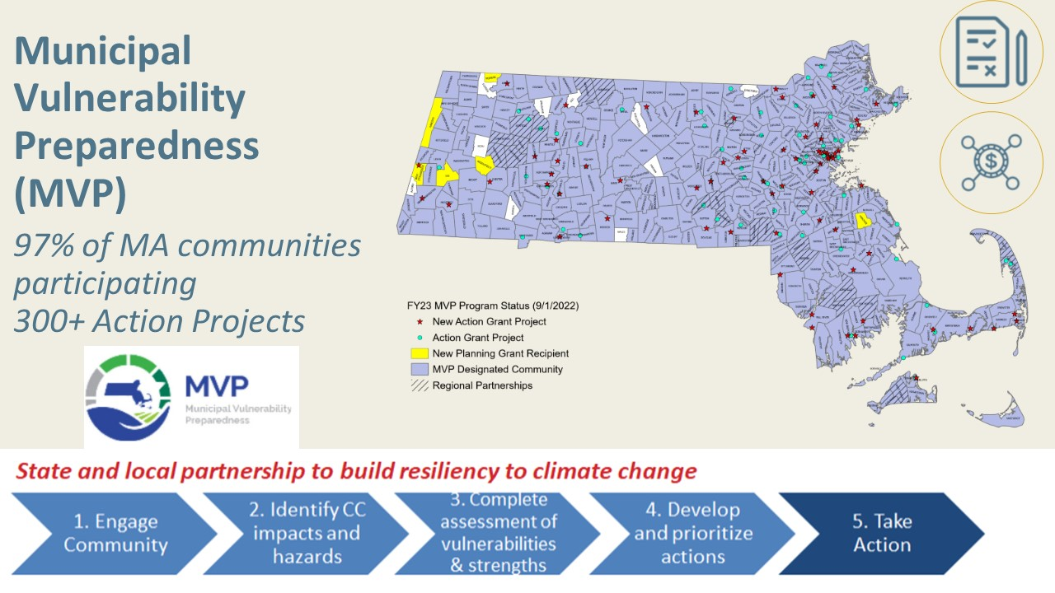
Notes:
Program run by EEA, designed in partnership with The Nature Conservancy and MAS to help communities plan for climate resilience
The process is community-driven, drawing on local knowledge to identify climate change impacts and hazards into the future, evaluate local vulnerabilities and strengths, develop and prioritize actions for adaptation, and then make them happen!
The program was launched in early 2017, and 97% of municipalities were participating in the program as of January, 2023, with over 300 Action Project Grants awarded – huge success!

Slide 8
Notes:
So how do we incorporate NBS into our communities so that we can get all of these benefits? MA’s MVP program provides funding for communities to prepare for the impacts of climate change – and the program prioritizes projects that use NBS

Slide 9
Notes:
A critical first step in community planning for resilience is identifying lands that are the most important natural Green Infrastructure. These include key areas of forests, farmlands and wetlands that are of highest functional value for ecosystem services like water supply, prevention of flooding, carbon storage, biodiversity, and more. UMass has compiled many of the mapping tools and associated educational and planning resources available to assist with Land Conservation Planning. Mass Audubon offers many resources for local climate resilience planning. The Losing Ground report series analyzes changes to land use patterns in Massachusetts and provides policy background. It includes a map of a statewide natural Green Infrastructure Network. The Value of Nature fact sheets make information on the financial and other benefits of natural areas accessible to general audiences. The Massachusetts Land Trust Coalition also has a set of educational resources on the Value of Land Conservation.
The BioMap produced by MassWildlife has a wealth of information and an interactive mapping tool to identify lands of greatest importance for biodiversity at both the statewide and local levels.

Slide 10
Notes:
This next resource also includes community spotlight examples, but covers the value and benefits of GI on a bigger scale, and not just LID
we performed a large literature review and pulled facts and figures into a set of 5 fact sheets to help build the case for GI – website
They are…
-Services we cover are relatively constant across…
-primarily benefits of nature for people
-intended to be used individually or as a set to tailor your communications (which ecosystems are most relevant to them? you can also pull info across the fact sheets on one service, like economic and health - Which services/co-benefit(s) might audience care about the most? Think back to Rishya talking about finding an object of care (water quality, cooling?)
-each fact sheet also has a few blurbs on the impacts that climate change and development are having on these ecosystems
Trying to stress co-benefits, or multiple benefits, of nature, which is crucial for strengthening the case for its prioritization
-Sustainability is made up of ecological, economic and social dimensions that are all connected
-These components deliver more benefits as a whole than the sum of the individual parts
-Thinking back on that bioswale from a few slides ago, not only did it manage stormwater, but unlike grey infrastructure it can provide habitat for pollinators, reduce maintenance costs in the long term, and improve urban livability and public health

Slide 11
Notes:
Your RPA can be a tremendous partner in your planning efforts. Communities in an RPA’s service area enjoy assistance in regional initiatives and cooperation across town, county, and sometimes even state lines. RPAs can offer or facilitate communication, planning, policymaking, coordination, advocacy, and technical assistance, with an objective of building partnerships and programs that reflect the regional community’s needs and priorities.
In Module 5, we discussed some of the work of the Cape Cod Commission regarding LID initiatives, and later in this module, we’ll talk about some of the work that MAPC has done to streamline climate-resilience and LID initiatives, so these examples demonstrate the range of services that RPAs can provide

Slide 12
Notes:
The Southeast New England Program Network is a collaborative group of 16 partner organizations with expertise in financing and implementing stormwater and watershed management efforts. The mission of the SNEP Network is to empower communities to achieve healthy watersheds, sustainable financing and long-term climate resilience through management of stormwater and restoration projects. A project of the New England Environmental Finance Center, The Network provides free training and technical assistance to strengthen the capacity of municipalities, organizations, and tribes within Rhode Island and Southeastern Massachusetts. The Network is currently working on a multitude of projects and regional initiatives that have a broad application throughout the region. To learn more about or request network services, SNEP communities can visit the SNEP Network Website.
While this regional network only serves a portion of Massachusetts communities, they produce a wealth of resources that can be useful across the Commonwealth. These partners also assisted in the development of the Mass Audubon Bylaw Review Tool.

Slide 13
Notes:
The EEA Smart Growth/Smart Energy Toolkit includes 19 modules, ranging in topic from Business Improvement Districts to Transit-Oriented Development. The modules that are relevant to the topics we have discussed today are:
Low Impact Development (LID)
Open Space Design (OSD)/Natural Resource Protection Zoning (NRPZ)
Smart Parking
Traditional Neighborhood Development (TND)
Some of the Toolkit’s modules PowerPoint presentations designed for a general audiences, as well as a more technical presentations aimed toward Planning Boards and developers. They also employ case studies and examples from urban, suburban, and rural communities as well as model bylaws that can be tailored to suit community needs.
The Outreach and Education module of the EEA Toolkit includes guidance and case studies for successful public engagement in bylaw update and revision projects. These resources can be instructive for bolstering community support of new or revised policies, which can be imperative for their adoption. We will discuss this resource at greater length in the next module
Case studies are also available here

Slide 14
Notes:
MAPC’s most recent development (”latest and greatest”) in LID adoption and implementation is its Climate Resilient Land Use Strategies Toolkit, which builds on their existing work in the LID Toolkit. MAPC has compiled existing examples of policies adopted throughout its service area and across the Commonwealth related to climate resilience, which as we have discussed, is deeply interconnected with Low Impact Development. This toolkit is laid out similarly to this training, with relevant background and introductory information, outlines of the federal and state guidelines that relate to climate resilience, and includes policy examples.
The small image on the right of this slide is also in your participant guide, and it’s a screenshot from one of the many featured “Language Examples.”
There are also examples of model language and bylaws in these topics:
The Language Examples section of the Toolkit serves as a repository of existing bylaws in Massachusetts communities that address a specific need or concern:
Floodplain Overlay Districts
Floodplain Zoning Relief
Other Zoning Districts
Stormwater Regulations
Local Wetlands Bylaws and Ordinances
Site Plan Review
Water Conservation Regulations
Tree Protection Regulations
Design Standards and Guidelines
A major concern shared by many communities is that policy changes often represent departures from the tried-and-true patterns of the community, and they want to see what has and hasn’t worked in other communities. This resource represents a clearinghouse of climate-action checklists, climate-resilient policies, where they reside in communities’ regulatory frameworks, and ultimately, provide the opportunity to find partner communities with like concerns.
The LID-specific Toolkit is an earlier iteration of this training, but it contains additional useful resources. It includes introductory and presentation materials, a checklist for regulatory review, as well as a model Stormwater Bylaw for communities that have not yet adopted one.

Slide 15
Notes:
The Water Quality Scorecard from the EPA offers a way for communities to quantify the strengths and needs of local regulatory specifications for protecting water quality in communities of any size. Among the factors highlighted in this Scorecard are:
Protect natural resources (including trees) and open space
Promote efficient, compact development patterns and infill
Design complete, smart streets that reduce overall imperviousness
Encourage efficient provision of parking
Adopt green infrastructure stormwater management provisions
This guidance document is intended for use by local governments in identifying areas of opportunity and strengthening the regulations that protect the health of their communities.

Slide 16
Notes:
The Better Site Design Handbook, which has served communities in the Mid-Atlantic region since 1998, promotes “environmentally sensitive, economically viable, and locally appropriate development” through twenty-two model development principles for better site design. The Code and Ordinance Worksheet from 2017 asks 94 questions grouped into categories for addressing these 22 principles, plus an additional 3 principles for runoff reduction, and provides scores for the answers to these questions. The topics addressed are listed below:
Residential streets and parking lots (including 10 principles on this topic)
Lot development (6 principles)
Natural areas (6 principles)
Runoff reduction
The regulatory documents that are reviewed in the COW are comprehensive, and the approach taken in this tool acknowledges and provides accommodations for communities of different sizes and contexts, ranging from “rural” to “highly urban.”
Once a community completes the worksheet and tallies its score, the COW suggests that if a municipality scores under 80% of the total possible points, it is appropriate to systematically review and update its regulations – particularly those that fail to advance low impact development and redevelopment in a community.

Slide 17
Notes:
The Neighborhood Road Design Guidebook was a collaborative effort between planners and builders, and the result is a guidance document that focuses on residential road design that supports and fosters sustainable and Low Impact Development, particularly in the context of subdivision roadways. This guidebook suggests narrow roads for less environmental impact from stormwater runoff, as well as encouraging lower speeds on neighborhood roads. The guidebook also considers multi-modal transportation and other issues related to road layout and design.

Slide 18
Notes:
The Massachusetts Stormwater Handbook is in the process of being updated, but in its current iteration, it’s a three-volume guidance document from the Massachusetts Department of Environmental Protection (MassDEP) on state regulations governing the management of stormwater pollution. Check the state website for the most current information.
The Stormwater Handbook is outlined in Volumes.
Volume 1 comprises the Stormwater Management Standards (Chapter 1 of Volume 1 is reproduced in Module 4 of this guide) and lays out the legal and regulatory framework for the Handbook.
Volume 2 has 5 chapters and an appendix, describing the components of stormwater management and best managment practices including LID.
Many communities are also subject to the EPA Municipal Separate Storm Sewer (MS4) permit, which includes requirements for municipalities to update their bylaws and ordinances. The Bylaw Review Tool includes provisions that can assist communities in prioritizing local bylaw and regulatory updates to achieve compliance. EPA also has many other resources on stormwater and LID.

Slide 19
Notes:
Funding for LID initiatives can come from a variety of sources.
Stormwater utility:
Newton, MA and Reading, MA both have stormwater utilities:
Reading: Single- and two-family properties are assessed a flat fee (i.e., $10/quarter or $40/year) and other properties are charged fees based on the total amount of impervious cover on their property (MAPC 2010). Undeveloped properties are not assessed a stormwater fee. Residential and nonresidential properties that install and maintain infiltration systems or other means to reduce runoff are eligible for a fee reduction of up to 50 percent of their total stormwater fee assessment (Town of Reading 2014).
Newton: Newton’s stormwater fee is a set charge based on whether a property is residential or nonresidential, with a discounted fee for senior residents. All residential properties with a domestic water meter are charged $6.25/quarter; the elderly discount fee is $4.38/quarter. All nonresidential properties are charged $37.50/quarter (City of Newton 2014).
Grants:
You will find that in your participant guide, there is a list of federal and state grants for which your community may be eligible, including:
MVP Program
Massachusetts Green Infrastructure for Coastal Resilience Pilot Grants Program: provides financial and technical assistance to advance the use of natural approaches to mitigating flooding problems and coastal erosion. Grants support the planning, feasibility assessment, design, permitting, construction, and monitoring/evaluation of green infrastructure projects that implement natural approaches. The 78 municipalities located within Massachusetts’ coastal zone and certified 501(c)(3) non-profit organizations that have coastal property available to the public are eligible to apply for the grants.
MS4 Municipal Grant Assistance Program
Local funding
Probably worth spending some time on funding mechanisms for implementing LID and enforcing regs specifically (setting up local funding streams vs grants to fund individual projects).

Slide 20
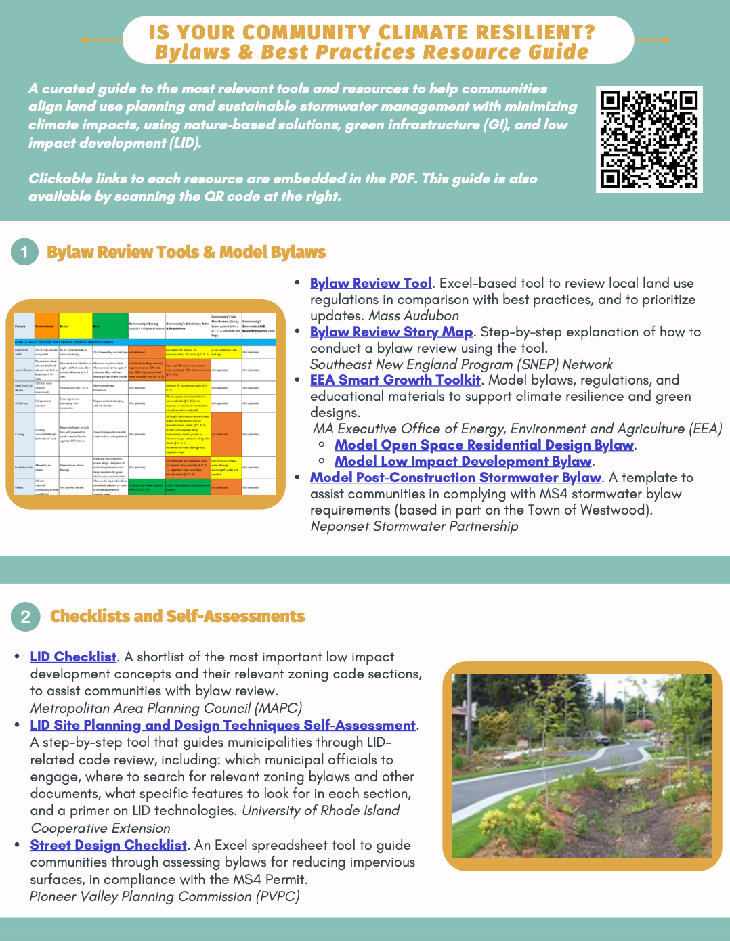
Resources
Mass Audubon LID fact sheets and bylaw tool: massaudubon.org/lidcost
Mass Audubon Losing Ground and Value of Nature factsheets: www.massaudubon.org/valueofnature
EEA Smart Growth Toolkit: mass.gov/smart-growth-smart-energy-toolkit-information-and-resources
MAPC’s Climate Resilience: Toolkit mapc.org/resource-library/climate-resilient-land-use-strategies/
Citizen Planner Training Collaborative: masscptc.org/
Massachusetts Association of Conservation Commissions Electronic Resource Library: maccweb.org/page/ElecResLibrary
EEA Planning Assistance Grants: mass.gov/service-details/planning-assistance-grants
MVP Action Grants mass.gov/service-details/mvp-action-grant
MA Office of the Attorney General Municipal Law Unit: mass.gov/municipal-law-review
UNH Stormwater Center: unh.edu/unhsc/
URI NEMO Program: uri.edu/nemo/
RI Green Infrastructure Coalition: greeninfrastructureri.org
SNEP Network: snepnetwork.org
Find more info in our Resource Guide!

