Slide 1
Notes:
This document is part of a comprehensive curriculum program, Building Climate Resilience Through Local Regulations, developed by Mass Audubon in collaboration with other nonprofit organizations and federal, state and regional agencies. The curriculum contains 8 modules, each of which guides the user through different components of improving community resilience through local regulations that support green designs and nature-based climate solutions. Each module includes a participant guide (e.g., this document) and a PowerPoint presentation.
The full curriculum, supplemental resources and additional information on bylaw review and best practices are available through the Mass Rivers Alliance and Mass Audubon websites (https://www.massriversalliance.org/climate-resilience-planning & https://www.massaudubon.org/our-conservation-work/policy-advocacy/local-climate-resilient-communities). The SNEP Network’s website provides additional resources including an interactive virtual storymap and webinar recordings (https://snepnetwork.org/bylaw-review/).

Slide 2
Notes:
Many people and organizations contributed to this curriculum.
This bylaw curriculum has been developed by SNEP Network Partners Mass Audubon, Cape Cod Commission, the Southeast Regional Planning and Economic Development District, and the Blackstone Watershed Collaborative in partnership with the Massachusetts Rivers Alliance and Citizen Planner Training Collaborative, and financial support from the SNEP Network. The Barrett Planning Group, LLC assisted with planning content.
The Southeast New England Program (SNEP) Network brings together local environmental organizations, academic institutions, regional planners, and consultants who collaborate to provide municipalities, tribes and organizations in Rhode Island and Southeast Massachusetts access to free training and technical assistance to advance stormwater management, ecological restoration, and sustainable financing goals across the region. The SNEP Network is administered through EPA’s partnership with the New England Environmental Finance Center, a non-profit technical assistance provider for EPA Region.
The SNEP Network supports this bylaw review curriculum as a key resource for communities to update their local regulations for improved nature-based climate solution implementation. Find out more about the SNEP Network at www.snepnetwork.org.
This product has been funded wholly or in part by the United States Environmental Protection Agency under Assistance Agreement SE- 00A00655-0 to the recipient. The contents of this document do not necessarily reflect the views and policies of the U.S. Environmental Protection Agency, nor does the U.S. EPA endorses trade names or recommends the use of any products, services or enterprises mentioned in this document.
This project also received funding from the Lookout Foundation.

Slide 4
Notes:
This is module 6 out of 8

Slide 6
Notes:
As you’ll recall from the earlier modules, both natural and built green infrastructure provide many valuable functions including capturing, filtering, and infiltrating stormwater.
Integrating nature and natural functions of plants and soils into our built environment is what we refer to as “low impact development.” A great thing about low impact development is its diversity – it can really be done at any scale, from the most rural communities to urban.
Communities often come up across barriers when trying to encourage more widespread adoption of these techniques, however, because their local zoning and subdivision regulations reflect the conventional development practices and discourage or, oftentimes, prohibit LID techniques, and we will be discussing those barriers later on.
Restoring ecosystems where they have been lost introduces natural resilience back into communities.

Slide 7
Notes:
As explained in Module 4, many different components of local land use rules can affect whether and to what degree LID is incorporate in development and redevelopment. This includes Zoning, General (non-zoning) Bylaws, stand-alone Stormwater Bylaws, Site Plan Review requirements, and Subdivision Regulations.
The Bylaw Review Tool helps communities examine all of these local rules in relation to LID best practices, and identify priorities for updates as well as inconsistencies across different parts of the local regulations.

Slide 8
Notes:
Towns often come up across barriers when trying to encourage more widespread adoption of these techniques,, because their local land use regulations reflect the conventional development practices and discourage or, oftentimes, prohibit LID techniques
What can we do? We can review our bylaws
Making sure that your bylaws and land use regulations are consistent with your overall goals is key to encouraging development where you want it and discouraging it where you don’t, and encouraging the KIND of development you want to see, like LID or conservation design.
The tool we have developed assesses whether your community’s bylaws, regulations, and plans reflect conventional, better, or best practices, as I’ll show you on the next slide.
*Changing bylaws and regulations can help support the use of LID techniques as the preferred, most easily permitted methods for development, redevelopment, and stormwater management.
A major advantage of this process is that it can help you identify “low-hanging fruit” – positive changes that can be made administratively rather than having to go through Town Meeting or City Council.
----
The categories covered by the Bylaw Review Tool include Zoning, subdivision rules and regs, LID/stormwater bylaw, cluster/OSRD/NRPZ, MP and Site Plan Review

Slide 9
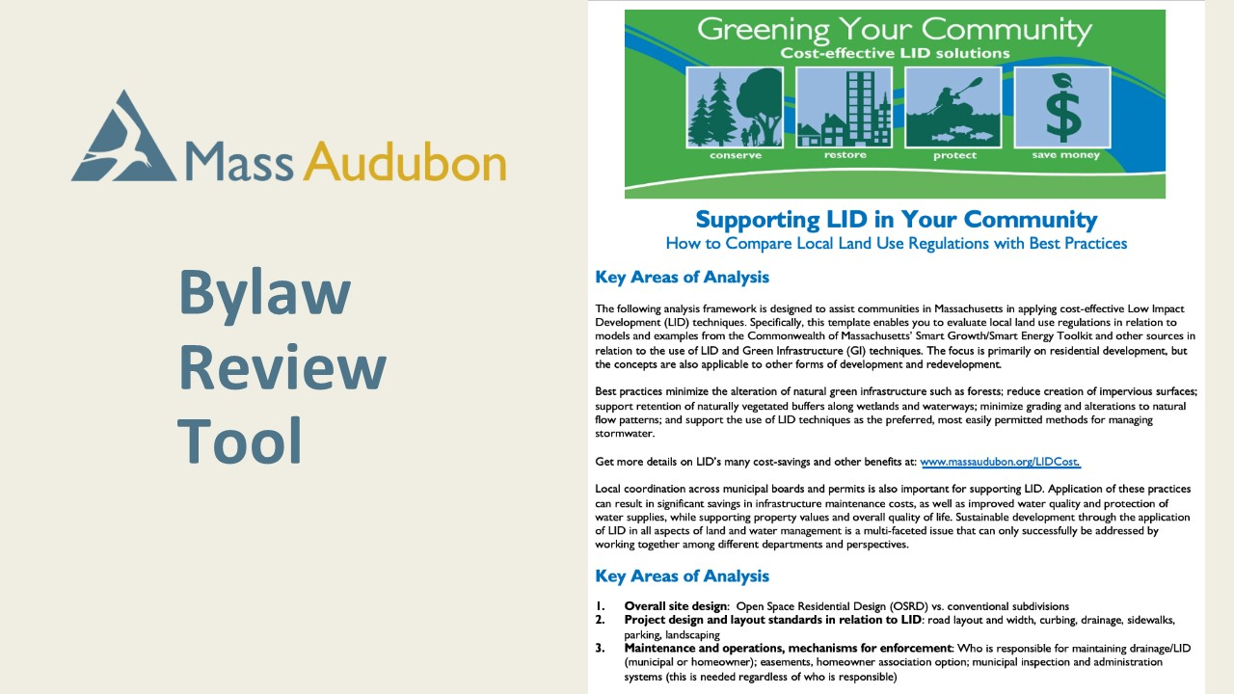
Notes:
The Mass Audubon Bylaw Review Tool is an Excel-based resource that helps to equip community leaders to identify the greatest areas of opportunity in their bylaws and regulations. The image you see when you open the document is the first sheet and Introduction, and it describes the objectives of bylaw review: including LID best practices in your local regulatory framework to reduce barriers to implementing Low Impact Development in your community.

Slide 10
Notes:
At the bottom of the Excel window, you will see all of the “sheets” that make up this Excel workbook. There may be minor variations in the appearance of this bar depending on your operating system, but there are no functional differences.
[click to zoom in on the tabs for sheets 1-4]
Sheets 1 through 4 are color-coded purple. These sheets contain helpful context and resources for the bylaw review process, and there is no work for you to do on these pages.
[click to see the text of sheet 2]
Sheet 2: The OSRD Overview provides some helpful context for evaluating an open space residential design bylaw or natural resource protection zoning. Because this type of bylaws already focus on reducing disturbances associated with development, these bylaws tend to be relatively straightforward to evaluate for their “friendliness” to LID techniques. Open space zoning or natural resource protection zoning protects much of the critical natural Green Infrastructure within a development site at no cost.

Slide 11
Notes:
Sheet 3: The Zoning, Subdivision (Rules and Regulations), Site Plan Review, and Stormwater (Bylaw) Overview sheet identifies goals across 5 categories to guide your analysis:
[next slide]

Slide 12
Notes:
Goal 1: Protect Natural Resources and Open Space
Goal 2: Promote Efficient, Compact Development Patterns and Infill
Goal 3: Smart Designs that Reduce Overall Imperviousness
Goal 4: Adopt Green Infrastructure Stormwater Management Provisions
Goal 5: Encourage Efficient Parking
These goals can help you to construct a framework to determine local priorities and make sure zoning and other land use regulations accurately reflect those priorities.
There are lots of opportunities and choices when it comes to climate-smart development
Not every type of bylaw or regulation may address each goal. That’s okay. We’ll talk about that a little more in the next slides. The overview in this sheet helps to frame the issues that may be considered in effort to meet these goals throughout your community’s regulations.

Slide 13
Notes:
Sheet 4: Additional Notes and Recommendations
This information sheet provides references for ensuring stormwater regulations are calculated based on updated storm intensity data from the Northeast Regional Climate Center, as well as guidance for landscaping and tree regulations that require native rather than invasive species.
There are also Additional Considerations that you and your community will need to consider as you update your regulations, including:
Funding and maintenance
Training, demonstration projects, and public education (which we will discuss in greater depth in Module 8)
Uses of clean, nonpotable stormwater

Slide 14
Notes:
The worksheets that will facilitate the bulk of your analysis are sheets 5 and 6. The tabs for these sheets are color-coded green.
These sheets offer:
“conventional” regulation language (orange), which may fail to address, impede, or prohibit LID
“better” regulatory specifications (yellow), which may allow or even encourage LID; and
“best practices” (green), which require LID and incorporate its practices and principles into the fabric of the community.
Sheet 5: OSRD Analysis
The image on this slide shows all of the columns and the first 9 rows of Sheet 5: OSRD Analysis. You will be able to edit the 5th column [next slide] to reflect the current text of your OSRD, and you can color-code it to provide visual cues that show areas of opportunity to make LID updates.

Slide 15
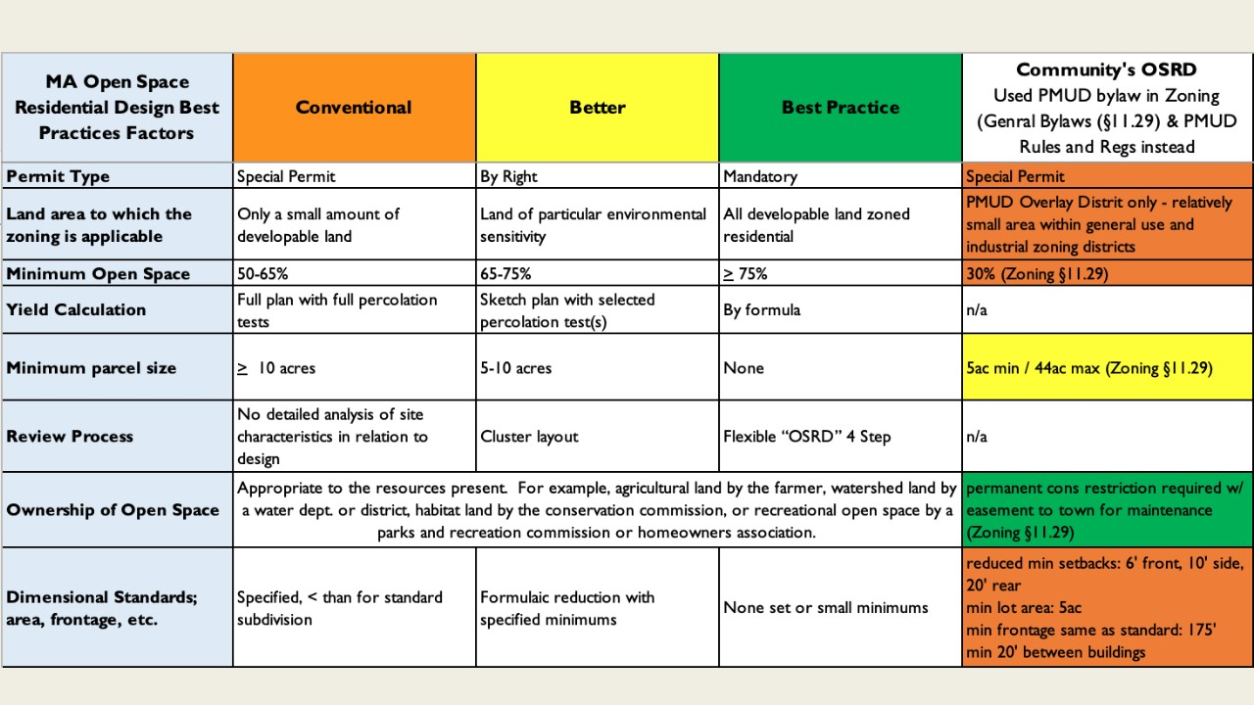
Notes:
This is an example of one Town’s review of their Planned Mixed-Use Development (PMUD) Bylaw according to Open Space Residential Design Standards. In a relatively small community, districts and overlays such as these may serve multiple purposes, so it is okay if the bylaw’s name or purpose isn’t specifically in alignment with the Mass Audubon model, as in this example.

Slide 16
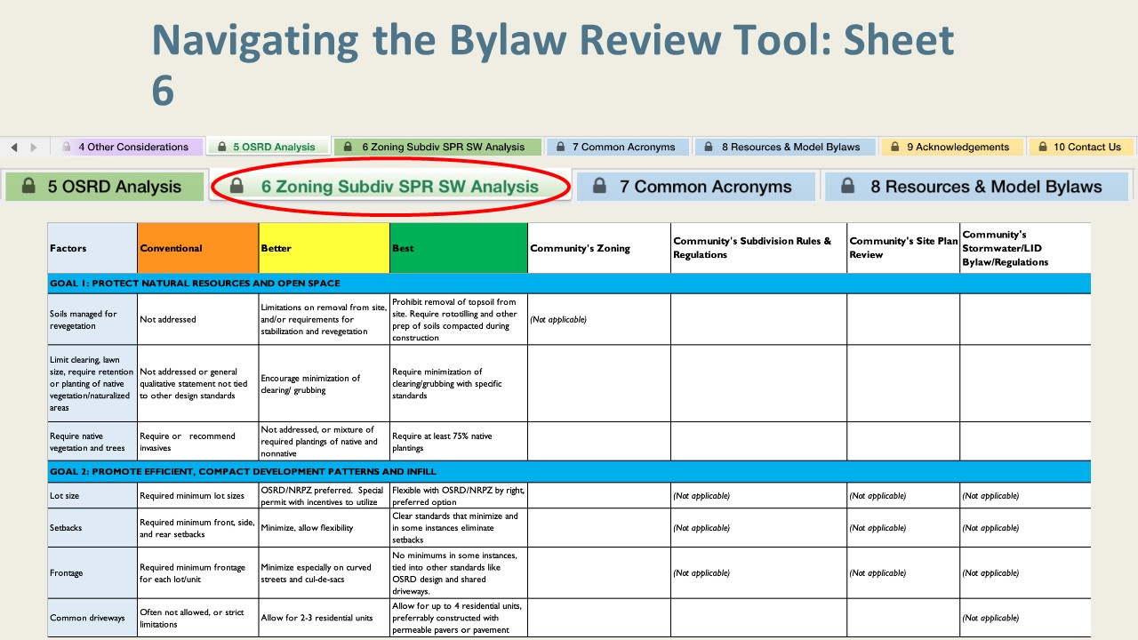
Notes:
Sheet 6: Zoning, Subdivision Rules and Regulations, Site Plan Review, Stormwater Bylaw Analysis
Much like the OSRD sheet that we just went over, this sheet is set up with “conventional,” “better,” and “best” practices for LID in your community’s regulations.
Unlike the previous sheet, however, you will notice that considerations are grouped according to the five goals listed in sheet 3. These goals group the factors and specifications being evaluated into like categories. You will also notice that in this sheet, there are notes in some of the columns that indicate that those factors are not applicable to that regulation type.

Slide 17
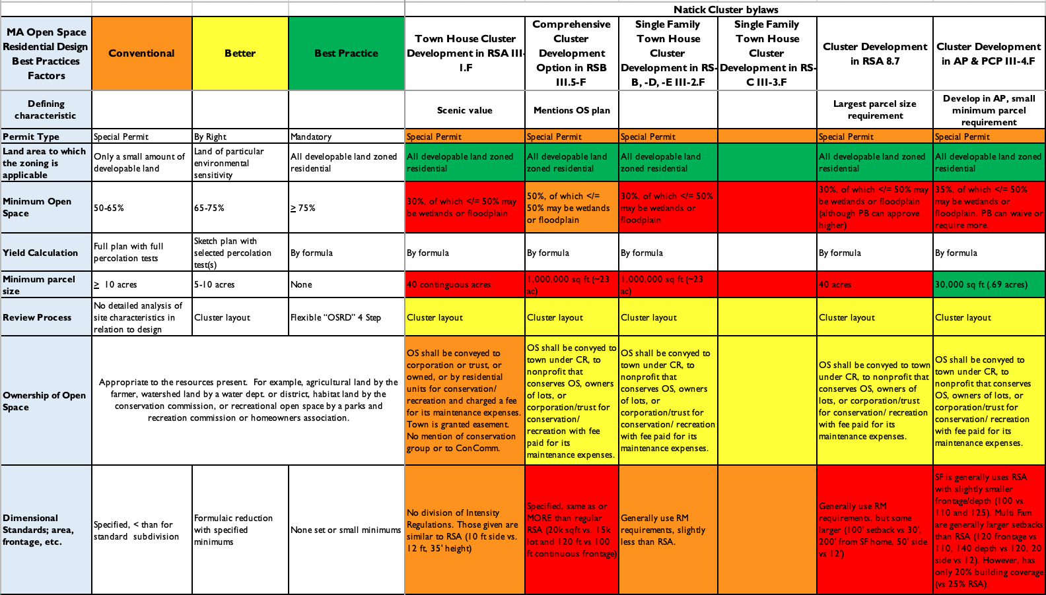
Notes:
In some cases, there may be more than one relevant bylaw or group of bylaws. It can be useful to present them side-by-side for comparison or, as in this example, to examine and sort them according to the defining characteristic or objective.
You will also note the use of red in this example: in this case it indicates practices that are even more restrictive of LID practices than conventional development standards. Depending on who will be reading your bylaw review, this additional color-coding may help in highlighting areas of opportunity, or it may be perceived unfavorably. As I’m sure you’ve experienced in your community, perceived critical judgments can stall conversation in the context of contentious issues.

Slide 18
Notes:
Sheets 7 and 8 provide references and resources. If you need a reminder about some of the common acronyms that will come up in this process, sheet 7 is a helpful reference. If you get stuck during the bylaw review process, or if you need a frame of reference when beginning to draft a bylaw to address some of the barriers included in your existing bylaws, sheet 8 provides several links and resources.

Slide 19
Notes:
Sheets 9 and 10 acknowledge the cooperation between the partners and grants that contributed to the Bylaw Review Tool as well as provide contact information for Mass Audubon for any inquiries about the tool.

Slide 21
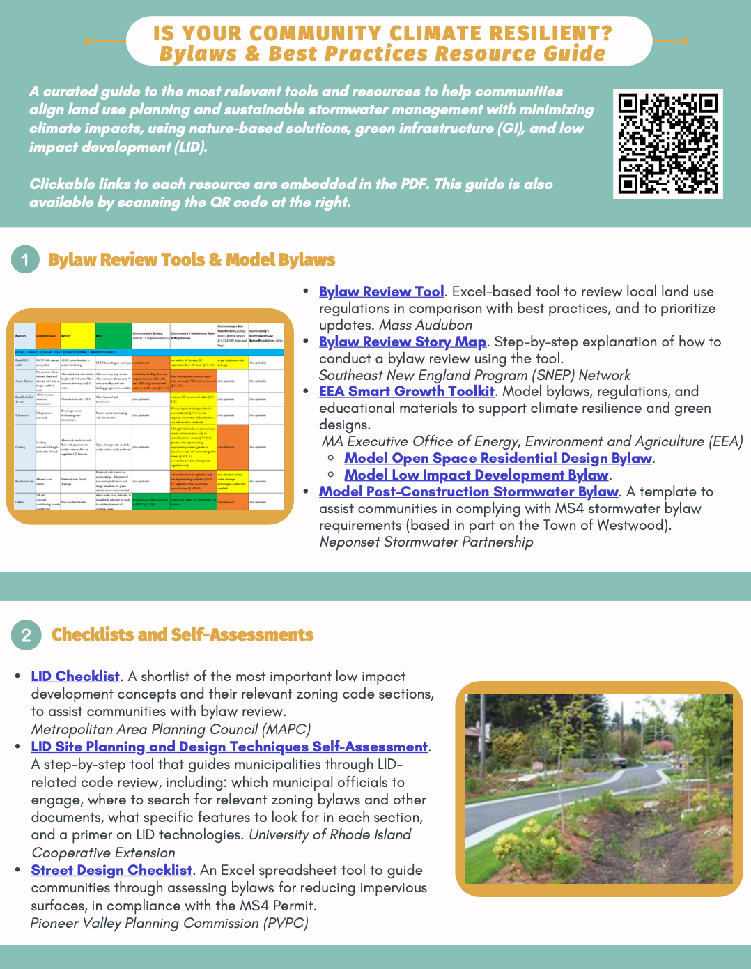
Resources
Mass Audubon LID fact sheets and bylaw tool: massaudubon.org/lidcost
Mass Audubon Losing Ground and Value of Nature factsheets: www.massaudubon.org/valueofnature
EEA Smart Growth Toolkit: mass.gov/smart-growth-smart-energy-toolkit-information-and-resources
MAPC’s Climate Resilience: Toolkit mapc.org/resource-library/climate-resilient-land-use-strategies/
Citizen Planner Training Collaborative: masscptc.org/
Massachusetts Association of Conservation Commissions Electronic Resource Library: maccweb.org/page/ElecResLibrary
EEA Planning Assistance Grants: mass.gov/service-details/planning-assistance-grants
MVP Action Grants mass.gov/service-details/mvp-action-grant
MA Office of the Attorney General Municipal Law Unit: mass.gov/municipal-law-review
UNH Stormwater Center: unh.edu/unhsc/
URI NEMO Program: uri.edu/nemo/
RI Green Infrastructure Coalition: greeninfrastructureri.org
SNEP Network: snepnetwork.org
Find more info in our Resource Guide!

