Slide 1
Notes:
This document is part of a comprehensive curriculum program, Building Climate Resilience Through Local Regulations, developed by Mass Audubon in collaboration with other nonprofit organizations and federal, state and regional agencies. The curriculum contains 8 modules, each of which guides the user through different components of improving community resilience through local regulations that support green designs and nature-based climate solutions. Each module includes a participant guide (e.g., this document) and a PowerPoint presentation.
The full curriculum, supplemental resources and additional information on bylaw review and best practices are available through the Mass Rivers Alliance and Mass Audubon websites (https://www.massriversalliance.org/climate-resilience-planning & https://www.massaudubon.org/our-conservation-work/policy-advocacy/local-climate-resilient-communities). The SNEP Network’s website provides additional resources including an interactive virtual storymap and webinar recordings (https://snepnetwork.org/bylaw-review/).

Slide 2
Notes:
Many people and organizations contributed to this curriculum.
This bylaw curriculum has been developed by SNEP Network Partners Mass Audubon, Cape Cod Commission, the Southeast Regional Planning and Economic Development District, and the Blackstone Watershed Collaborative in partnership with the Massachusetts Rivers Alliance and Citizen Planner Training Collaborative, and financial support from the SNEP Network. The Barrett Planning Group, LLC assisted with planning content.
The Southeast New England Program (SNEP) Network brings together local environmental organizations, academic institutions, regional planners, and consultants who collaborate to provide municipalities, tribes and organizations in Rhode Island and Southeast Massachusetts access to free training and technical assistance to advance stormwater management, ecological restoration, and sustainable financing goals across the region. The SNEP Network is administered through EPA’s partnership with the New England Environmental Finance Center, a non-profit technical assistance provider for EPA Region.
The SNEP Network supports this bylaw review curriculum as a key resource for communities to update their local regulations for improved nature-based climate solution implementation. Find out more about the SNEP Network at www.snepnetwork.org.
This product has been funded wholly or in part by the United States Environmental Protection Agency under Assistance Agreement SE- 00A00655-0 to the recipient. The contents of this document do not necessarily reflect the views and policies of the U.S. Environmental Protection Agency, nor does the U.S. EPA endorses trade names or recommends the use of any products, services or enterprises mentioned in this document.
This project also received funding from the Lookout Foundation.

Slide 6
Notes:
Implementing LID in a community that has not yet codified these techniques in its bylaws and regulations isn’t impossible. It can be done (often by special permit), but it requires a private developer’s motivation to make it happen in many cases.
The Pinehills development in Plymouth won a number of accolades in the early- to mid- 2000s including Best Master-Planned Community and Best Smart Growth Community. The Pinehills example is provided in the State’s Smart Growth/Smart Energy Toolkit LID module. The development has been an overwhelming success, and it’s now Plymouth’s single-largest generator of tax revenue… and it was developed in a community that has LID in its Storm Drainage Guidelines rather than enshrined in a bylaw.
In order to make the development allowable, Town Meeting passed a floating Open Space Mixed Use Designation within its Rural Residential zone. This allowed for reduced frontage requirements, flexible road width requirements and shared driveways (pictured in Module 2), and other stormwater best management practices (BMPs). Throughout the design of the Pinehills neighborhoods, this project emphasizes retention of the native trees and other vegetation and minimization of land clearing and grading through designs that work with the natural sloped land features.
If any of you have ever visited the Pinehills, you may be wondering when we’re going to talk about golf. The Pinehills development is situated on more than 3000 acres, and is home to more than 3000 housing units and a mix of housing types, but it is also the site of four (4) 18-hole golf courses. Golf courses have a reputation for adverse environmental impacts, so the inclusion of this development as an example may be a surprise. The golf courses are part of the story here. There are vegetated swales for runoff pre-treatment, a robust wastewater treatment system utilizes several BMPs, and treated wastewater reuse irrigates the golf courses. When we talked about rain barrels in Module 2, we talked about the nutrients that can be in rainwater that make it non-potable, but the Pinehills irrigation system replicates these systems on a much larger scale and uses those nutrients to mitigate the need for fertilizers. More than 2000 acres of the property are dedicated to active and passive recreation, and the Eel River watershed, where Pinehills is located, suffers no net loss of water.
Are you thinking: but I thought you said Plymouth didn’t have a regulation to guide future development? The OSMUD (open space mixed-use development) requires at least 3000 acres. This was a one-shot regulation, and all roads and water and sewer facilities are privately owned. Regarding surface water drainage and wastewater disposal, the regulation states “It is intended that an OSMUD permitted under this bylaw shall not pollute the groundwater.” without comment on Low Impact Development techniques.

Slide 7
Notes:
So is that the end of the Plymouth example? It’s not!
The team that was behind Redbrook are both a fixture of local industry (the world’s largest cranberry growers) and real estate developers.
Redbrook is on a 1400-acre site, so it was not eligible for OSMUD designation. About 1000 acres is conserved, and there will be about 1200 housing units at full build-out.
Plymouth adopted a similar floating designation called Traditional Rural Village Development (TRVD). From the Plymouth zoning bylaw, “TRVD consists of the following four Use Areas:
Conservancy Area (CA). Locations for permanently protected Open Space and recreation areas, including greens, commons, fields, meadows, water bodies, wetlands, forests, trails, pathways and other parcels used for agriculture, nurseries, or tree farms, located and integrated throughout the TRVD.
Residential Area (RA). Locations for a variety of housing types, including Single family detached and attached Dwellings, sited beyond walking distance from the Village Mixed-Use Area.
Village Residential Area (VRA). Locations for a variety of housing types, including single-family attached, Townhouses, and Multi-family Dwellings, sited within walking distance from the Village Mixed-Use Area.
Village Mixed-Use Area (VMA). Locations for limited retail, service, office, and community meeting facilities customarily associated with traditional neighborhoods and villages, which may also incorporate locations for a variety of housing types including Townhouses, Multi-Family and second-floor residential Uses.”
There is an emphasis on walkability, so that commercial and residential areas are within close proximity, and there are provisions that allow for smaller lot sizes, reduced frontage and setbacks, and encourage shared driveways and LID stormwater BMPs. This low-impact site design is a critical component of managing the stormwater impacts of new development, as we have discussed throughout this training. Redbrook’s private wastewater treatment facility aims to satisfy the “no net nitrogen standard,” and the development’s land stewardship initiatives (rain barrel installations, native plantings, etc) assist homeowners in reducing the “nitrogen footprint” of their properties. Redbrook homes are also built and equipped for energy efficiency, and on average, they are 40 percent more efficient than standard new-construction homes in 2015.
The takeaway between the development of Pinehills and Redbrook was the overwhelming popularity. Plymouth made changes to its zoning to make Redbrook possible because authorizing Pinehills was such a difficult undertaking and extensive community process (more than 200 meetings), but TRVD is much more open to future use in Plymouth, although it still is a special permit designation

Slide 8
Notes:
Natick undertook the Bylaw Review process (which we will talk more about in the next module) as part of a technical assistance grant from the MetroWest Foundation. The project, Empowering MetroWest Communities to Manage Land and Water Resources for a Sustainable Future, also included bylaw reviews for Framingham, Dover, Sherborn, and Wellesley.
The findings of the bylaw review indicated that there were a number of barriers to LID in the Town’s bylaws. The Stormwater Bylaw, adopted in 2006, did not address several of the factors analyzed as part of this review process, and it was found to not regulate the stormwater in 90% of private properties in Natick.
As a result of this review, Natick worked with various experts under and Municipal Vulnerability Preparedness (MVP) grant to update their stormwater bylaw. Natick is an MS4 (municipal separate storm sewer systems) community and 6 of its local waterbodies are impaired. The image on this slide is one of the slides from the presentation to Town Meeting in 2019, when these updates were adopted.
Mass Audubon reviewed Natick’s updated Stormwater Bylaw and found that it represented significant improvements in applicability and promoting LID.
The Town reports that the review process and the resulting bylaw updates were ”the spark that’s created a fire in us that’s growing,” and there are more sustainability and climate resilience initiatives currently in the planning process.

Slide 9
Notes:
Previously, Natick regulated parcels >40,000 sq ft. and did not regulate parcels <40,000 sq ft (90%)
This slide provides the new permit thresholds under the updated stormwater bylaw.

Slide 10
Notes:
Natick’s updated provisions allow many LID features that are not allowed in many community’s outdated land use regulations. For example, many communities require continuous vertical curbing along all roads. LID regulations allow and encourage curb breaks and other designs to enable runoff from small areas to be directed into many different LID features for treatment rather than being collected in a centralized system of pipes, catch basins, and large retention ponds or infiltration features.

Slide 11
Notes:
In 2016, the Town of Mendon worked with Mass Audubon and the Central Massachusetts Regional Planning Commission (CMRPC) as part of a Blackstone Valley regional technical assistance project, Nutrient Reduction through Innovative Land Use Techniques: Overcoming Municipal Implementation Barriers. The Bylaw Review process indicated that Mendon had a strong start:
OSRD allowed by-right
Stormwater Bylaw that supports LID as the preferred design method.
Recommendations included strengthening these existing regulations and adding more references to LID throughout the Town’s Zoning Bylaw and Subdivision Rules and Regulations.
Mendon’s primary difficulties were in its capacity to implement these recommendations. Through an MVP grant, Mendon got technical assistance from CMRPC to implement the recommendations. Every step of the way, it was necessary for the small municipality with limited staff capacity to seek outside technical assistance.
The first important internal discussion the proponents of the amendments had was whether to adopt a separate LID bylaw or to integrate LID elements in their appropriate individual locations throughout the Town’s bylaws and regulations. Ultimately, in Mendon, it made the most sense to leave the LID regulations where they were. It was decided that a separate LID bylaw might be more easily forgotten or ignored and could increase the likelihood of inconsistencies.
Mendon adopted the changes at Town Meeting in 2020. Proponents got Town boards and committees involved and on board early and to kept the public informed as part of a transparent and inclusive process. This allowed the implementation team to anticipate the public’s concerns and address them in the final product, so by the time a Town Meeting vote came around everyone already knew what they would be voting on.
While the 2020 zoning amendments are too new to fully evaluate, it is safe to call Mendon’s OSRD regulations have a success, with several developers undertaking OSRD subdivision projects without showing much interest in pursuing a Special Permit for a conventional subdivision development.

Slide 12
Notes:
The development rate map on this slides is from the fifth edition of Mass Audubon publication Losing Ground: Planning for Resilience (2014). From 2005 to 2013, Ayer had the “dubious distinction” (as stated on the front page of the Boston Globe) of experiencing the highest rate of development in the Sprawl Frontier. In the 6th edition, Losing Ground: Nature’s Value in a Changing Climate (2020), Ayer is highlighted as “a model of smart local planning.”
What changed?
The Town took the situation seriously, and responded effectively. The progress is attributable to several regulatory updates, including adoption of mandatory open space residential design (OSRD) by right, transit-oriented development updates to zoning, and updated requirements in the stormwater bylaw.
Ayer’s zoning allows OSRD without a minimum parcel size or number of lots. If the site is served by public sewer, then 50 percent of open space must be conserved, and if the site does not have access to public sewer, 40 percent must be conserved. In 2018, Ayer took the requirement a step further: the Town amended the bylaw to consider the quality of the open space being preserved: the bylaw offers this example, “if jurisdictional wetlands and steep slopes comprise 25% of the parent parcel, then up to 25% of the required protected open space can contain such jurisdictional wetlands and steep slopes.”
The Town says that since the adoption of these and other zoning updates, the quality of proposed development projects has improved, and there haven’t been any applications to waive the OSRD requirements in any of the four subdivisions that have gone through the permitting process since then. Ayer updated its Open Space and Recreation Plan in 2019 with the help of the Nashua River Watershed Association and conducted a study with the Montachusett Regional Planning Commission to identify Priority Preservation Areas (PPAs), so there has been a strong emphasis on conservation in the time between these two images on this slide.
Stormwater management in Ayer is regulated under the Town’s Stormwater Bylaw, which was updated with the assistance of the Central Massachusetts Regional Stormwater Coalition and adopted at Town Meeting in 2021, which requires the use of LID site planning and design strategies to the maximum extent feasible. Ayer’s Conservation Agent ensures that the order of conditions covers maintenance of LID BMPs for each new proposed project.

Slide 13
Notes:
“The Pleasant Bay Alliance is a municipal organization formed by the Towns of Orleans, Chatham, Harwich and Brewster to coordinate the resource management plan for the Pleasant Bay ACEC and watershed. The Alliance’s projects, programs and studies promote healthy natural resources and safe public access throughout Pleasant Bay.
Alliance programs encompass technical research, policy analysis, and public outreach in the areas of coastal processes, watershed planning, navigation, fisheries, wetlands protection, and water quality monitoring.” Mission statement from the Pleasant Bay Alliance website
In 2021, under a grant from the Southeast New England Program (SNEP) within the US EPA, the Pleasant Bay Alliance commissioned a comprehensive bylaw review by Cape Cod Commission (CCC) for all four member towns.
The Bylaw Review process was guided by the principles of the SNEP Network:
Conserving resources that already exist to preserve existing function(s),
Integrating green infrastructure and Low Impact Development strategies into all development,
Working within existing development patterns to restore functions that are lost, including natural hydrology.
The CCC generated reports for each community individually, as well as a regional report summary and recommendations. This regional approach honored the regulatory authority of each town, but also acknowledged and emphasized that watersheds and waterbodies experience effects across town boundaries.
Examples of best practices are included from each town, including:
density bonuses to incentivize LID BMPs (Brewster)
roadway reduction allowances for at least 50 percent open space (Harwich)
easy LID feature siting in business and industrial districts (Chatham)
provisions that discourage wetland buffer disturbance by requiring analysis of surface and underground drainage systems (Orleans)
The report discusses some of the benefits of regional regulatory consistency, and one of them is that if developers know the rules across an area are the same, particularly when it comes to innovative stormwater solutions, they’re more likely to understand and use the techniques.
Requiring similar performance for new and redevelopment throughout the entire town or Pleasant Bay watershed would further emphasize the importance of water resources of the Pleasant Bay region. The PBA offers its member towns a regular forum and a regional mechanism through which regional regulatory consistency could be assessed and implemented more easily than in many shared watersheds.
All four towns have regulatory mechanisms for open space conservation and natural resource protection akin to OSRD, “to encourage preferred development designs that include LID features such as preserving open space and minimizing disturbance to existing topography and natural features.” CCC recommends encouraging the use of these provisions by allowing them by right and to simplify permitting processes. The report goes on to say, “all four PBA towns utilize language that promotes LID in some parts of their local regulations. The recommendations provided in this summary are not necessarily to add something new or different, but rather to apply these good concepts that already exist in a more efficient or widespread manner.”
Almost all of Cape Cod is environmentally sensitive watershed area, and so many Cape communities already allow LID to some extent. CCC recommends:
“Improvements could include requiring LIDs to the maximum extent practicable and incentivizing LID and green infrastructure BMPs through “by right” processes making the permitting and implementation easier for town employees, boards, and developers. They could also include requiring that stormwater management BMPs be specifically designed to remove the contaminant of concern (e.g., phosphorus or nitrogen) depending on nearby resource areas and the concentration and speed of transport of contaminants. Any of these improvements should include adequate mechanisms to enforce LID maintenance agreements, including the ability to levy fines for non-compliance.”
As part of the PBA project, the CCC was instrumental in updating the Mass Audubon Bylaw Review Tool. That on its own is part of why we are talking about this example – the Bylaw Review Tool is adapted to help communities, and it’s important to remember that community context may mean changing something in the tool. That’s okay. It’s supposed to be for you and your community, so if a change makes it fit better, then the change may be part of the process!
We’re talking about this example also because the capacity in many towns to do this on their own is limited. Your regional planning agency (RPA) can help, and so can your neighbors. Stormwater is something that all communities are working on and care about. Cooperation helps! Water and watersheds don’t care about town lines, so your neighbors are among your best resources, even if they all incentivize LID differently – at least they are all doing it!

Slide 14
Notes:
Commercial Street in Provincetown is a major center in the town. It’s parallel to the beaches and suffered from limited drainage because of poor road conditions and tight development patterns that led to a lot of impervious surface. After summer storms beaches would regularly close due to high bacteria levels in water
Between 2012 and 2019, Provincetown rehabilitated Commercial Street in five phases with porous pavement with the help of the University of New Hampshire Stormwater Center. Porous pavement is a paved surface with a higher than normal percentage of air voids to allow water to pass through it and reach the subsoil.
Here is the before and after on Commercial Street
Depending on the design, paving material, soil type and rainfall, porous paving can infiltrate as much as 70 to 80 percent of annual rainfall. Porous pavement installation was a preferred alternative to other drainage options due to space limitations along portions of Commercial Street and the amount of utilities present.
As part of the education and outreach task of this project, a public forum was held with the engineer, contractor and members of the town present to discuss the planned project. There was also a door-to-door campaign to ensure that the public was well-informed and engaged in the process.
Your city or town may have the opportunity to do something like this if you need to take immediate action like Provincetown did

Slide 15
Notes:
The results of the rehab were striking. You can see the drastic reduction in beach closures, which mostly followed heavy runoff from storm events.

Slide 16
Notes:
A lot of people think porous pavement doesn’t work in northern climates, but they’ve had success with it as long as they sweep the streets regularly. Street sweeping also helps reduce pollution from stormwater runoff.
Permeable pavement also reduces icing, improving safety and reducing the need for use of salt, which is expensive and a pollutant.

Slide 17
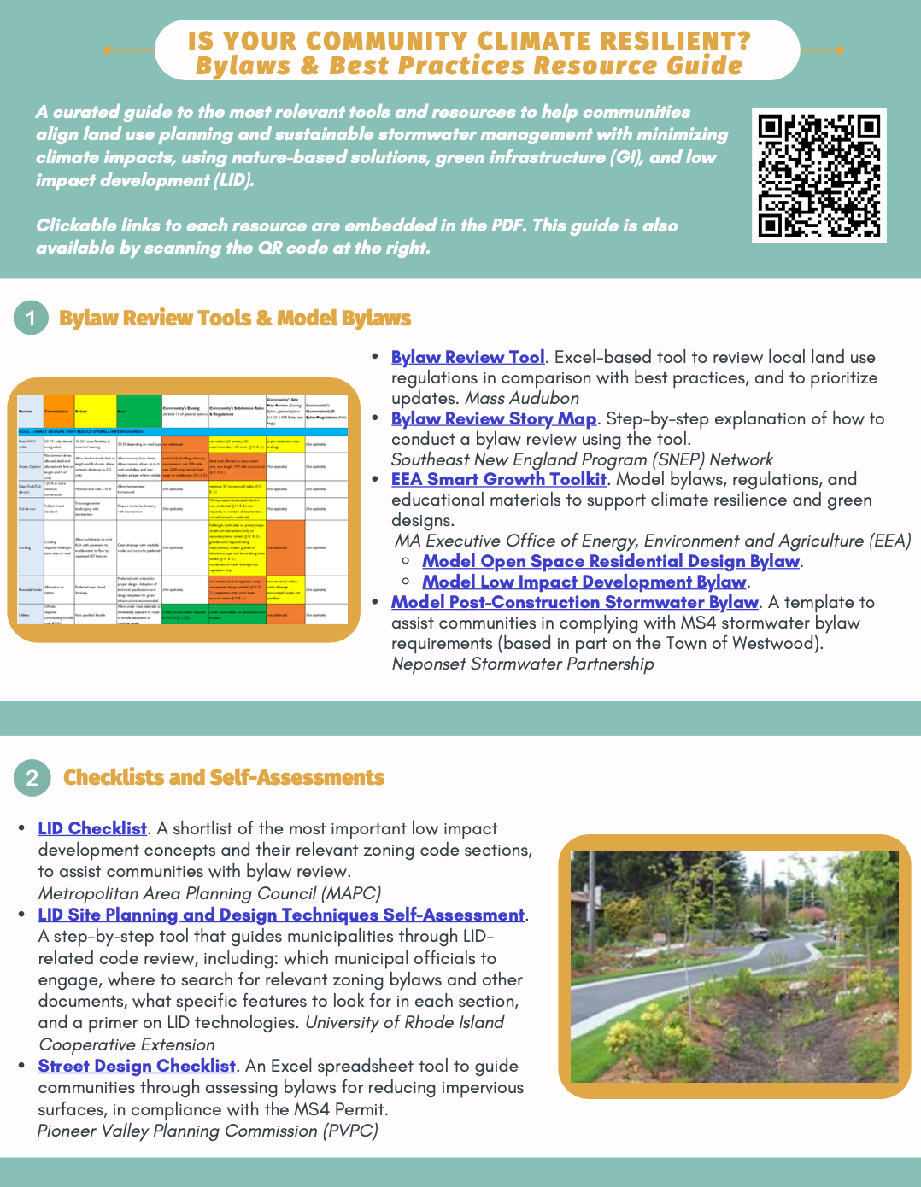
Resources
Mass Audubon LID fact sheets and bylaw tool: massaudubon.org/lidcost
Mass Audubon Losing Ground and Value of Nature factsheets: www.massaudubon.org/valueofnature
EEA Smart Growth Toolkit: mass.gov/smart-growth-smart-energy-toolkit-information-and-resources
MAPC’s Climate Resilience: Toolkit mapc.org/resource-library/climate-resilient-land-use-strategies/
Citizen Planner Training Collaborative: masscptc.org/
Massachusetts Association of Conservation Commissions Electronic Resource Library: maccweb.org/page/ElecResLibrary
EEA Planning Assistance Grants: mass.gov/service-details/planning-assistance-grants
MVP Action Grants mass.gov/service-details/mvp-action-grant
MA Office of the Attorney General Municipal Law Unit: mass.gov/municipal-law-review
UNH Stormwater Center: unh.edu/unhsc/
URI NEMO Program: uri.edu/nemo/
RI Green Infrastructure Coalition: greeninfrastructureri.org
SNEP Network: snepnetwork.org
Find more info in our Resource Guide!

