Slide 1
Notes:
This document is part of a comprehensive curriculum program, Building Climate Resilience Through Local Regulations, developed by Mass Audubon in collaboration with other nonprofit organizations and federal, state and regional agencies. The curriculum contains 8 modules, each of which guides the user through different components of improving community resilience through local regulations that support green designs and nature-based climate solutions. Each module includes a participant guide (e.g., this document) and a PowerPoint presentation.
The full curriculum, supplemental resources and additional information on bylaw review and best practices are available through the Mass Rivers Alliance and Mass Audubon websites (https://www.massriversalliance.org/climate-resilience-planning & https://www.massaudubon.org/our-conservation-work/policy-advocacy/local-climate-resilient-communities). The SNEP Network’s website provides additional resources including an interactive virtual storymap and webinar recordings (https://snepnetwork.org/bylaw-review/).

Slide 2
Notes:
Many people and organizations contributed to this curriculum.
This bylaw curriculum has been developed by SNEP Network Partners Mass Audubon, Cape Cod Commission, the Southeast Regional Planning and Economic Development District, and the Blackstone Watershed Collaborative in partnership with the Massachusetts Rivers Alliance and Citizen Planner Training Collaborative, and financial support from the SNEP Network. The Barrett Planning Group, LLC assisted with planning content.
The Southeast New England Program (SNEP) Network brings together local environmental organizations, academic institutions, regional planners, and consultants who collaborate to provide municipalities, tribes and organizations in Rhode Island and Southeast Massachusetts access to free training and technical assistance to advance stormwater management, ecological restoration, and sustainable financing goals across the region. The SNEP Network is administered through EPA’s partnership with the New England Environmental Finance Center, a non-profit technical assistance provider for EPA Region.
The SNEP Network supports this bylaw review curriculum as a key resource for communities to update their local regulations for improved nature-based climate solution implementation. Find out more about the SNEP Network at www.snepnetwork.org.
This product has been funded wholly or in part by the United States Environmental Protection Agency under Assistance Agreement SE- 00A00655-0 to the recipient. The contents of this document do not necessarily reflect the views and policies of the U.S. Environmental Protection Agency, nor does the U.S. EPA endorses trade names or recommends the use of any products, services or enterprises mentioned in this document.
This project also received funding from the Lookout Foundation.

Slide 6
Notes:
Massachusetts cities and towns have a long tradition of strong local control over regulations, but they are still affected by the laws and policies of the federal government. This is especially the case when local entities collaborate with federal or state agencies to fund and realize projects.
Army Corp. of Engineers:
Deals with issues such as natural disaster preparedness and mitigation, land stewardship, and regulates construction, discharge, and other disturbances in navigable waterways.
Fish & Wildlife:
Enforces several major environmental laws, works to protect endangered species, and preserves important habitats such as wetlands.
EPA:
Enforces laws related to health and the environment, works to ensure clean air, land, and water, and reduces environmental risk.
NOAA:
Manages fisheries, monitors climate, and shapes and enforces environmental regulations.

Slide 7
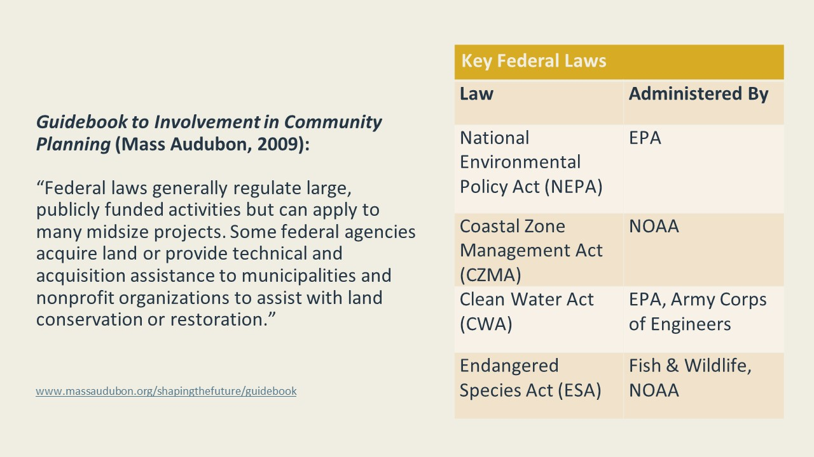
Notes:
NEPA:
“NEPA's basic policy is to assure that all branches of government give proper consideration to the environment prior to undertaking any major federal action that significantly affects the environment.” NEPA requirements are invoked when certain major activities are proposed by federal agencies, such as construction work on highways or in national parks. The most significant requirements are Environmental Assessments and Environmental Impact Statements, which assess the potential environmental impacts of the proposed work.
CZMA:
The CZMA provides for the management of the nation’s coastal resources. The goal is to “preserve, protect, develop, and where possible, to restore or enhance the resources of the nation’s coastal zone.” Under the CZMA, the NOAA maintains partnerships with coastal states such as Massachusetts, which form their own coastal zone management agencies to jointly further the goals of the Act. The Massachusetts coastal zone roughly includes all land within a half-mile of coastal waters and salt marshes, as well as all islands.
CWA:
“The CWA establishes the basic structure for regulating discharges of pollutants into the waters of the United States and regulating quality standards for surface waters.” It applies to municipal stormwater systems and construction areas over an acre. Under the CWA, the EPA has programs like setting wastewater standards for industry. And creating water quality criteria for pollutants in surface waters.
ESA:
“The [ESA] requires federal agencies, in consultation with the U.S. Fish and Wildlife Service and/or the NOAA Fisheries Service, to ensure that actions they authorize, fund, or carry out are not likely to jeopardize the continued existence of any [threatened or endangered] species or result in the destruction or” destroy those species’ habitats.”

Slide 8
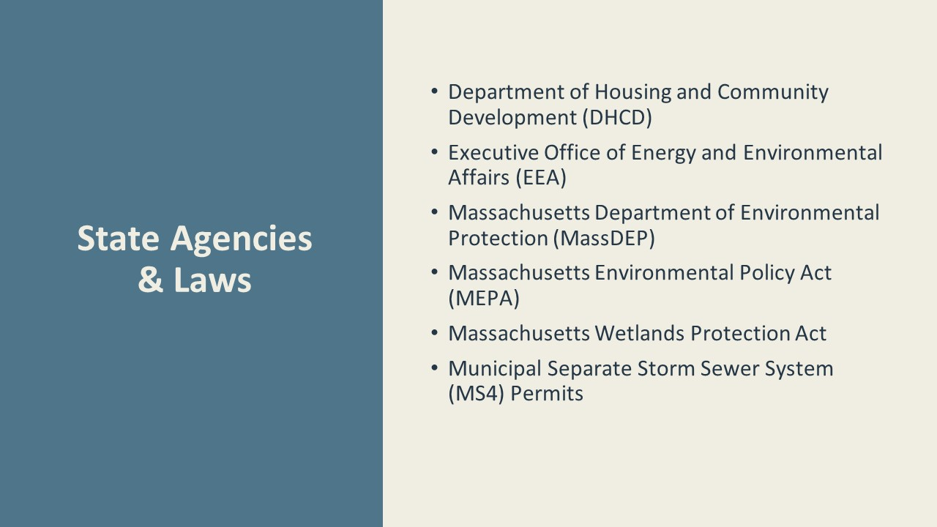
Notes:
DHCD:
DHCD is Massachusetts’ chief agency not just for housing but also for community planning more generally. Their activities intersect with LID when it comes to land use planning. For example, programs that encourage the development of new housing such as Chapter 40R Smart Growth Districts also encourage the clustering of development into smaller disturbed areas. DHCD also administers funding programs such as Low Income Housing Tax Credits that your local projects may be taking advantage of.
EEA:
The EEA is a wide-reaching state agency that deals in matters of environmental preservation, open space, and energy. Many offices and departments fall under the EEA’s umbrella. If your municipality is dealing with state-level environmental regulations, you will likely be into contact with at least one of these entities.
MEPA
MEPA is a state-level mirror of the national-level NEPA administered by the EEA. Similarly, it requires “state agencies to study the environmental impacts of projects requiring state permitting, financial assistance or land disposition, and to use all feasible measures to avoid, minimize, and mitigate damage to the environment or, to the extent damage to the environment cannot be avoided, to minimize and mitigate damage to the environment to the maximum extent practicable.”
MassDEP
MassDEP is a state agency whose “mission is to protect and enhance the Commonwealth’s natural resources - air, water, and land - to provide for the health, safety, and welfare of all people, and to ensure a clean and safe environment for future generations.”
MS4
The MS4 Permit is a federal stormwater permit jointly issued by the EPA and the Massachusetts Department of Environmental Protection. “MS4 permits authorize public entities, such as cities, counties, transportation agencies, and military bases, to discharge pollutants from public stormwater systems to waters of the United States.” Specific stormwater standards for MS4 permits are discussed in greater detail in Module 4.
Wetlands Act
The Massachusetts Wetlands Protection Act “protects wetlands and the public interests they serve, including flood control, prevention of pollution and storm damage, and protection of public and private water supplies, groundwater supply, fisheries, land containing shellfish, and wildlife habitat.” The Wetlands Protection Act is administered and enforced by local conservation commissions in and near jurisdictional wetlands which include areas such as the 100-year floodplain and riverfronts. Municipalities may also enact their own, more stringent wetland bylaws with regulations and standards in addition to the state Wetlands Protection Act.

Slide 9
Notes:
This section lays out the major policy tools used by Massachusetts municipalities to regulate their local land use and stormwater runoff.
The principle of “Home Rule”, formally adopted in 1966, grants municipalities all regulatory powers not expressly denied to them. This gives each city or town wide-reaching powers to regulate land use within their own borders.
General Bylaws:
The Massachusetts Wetlands Protection Act (see above) is administered locally by the Conservation Commission, under state regulations issued by MassDEP. Those regulations also include the state’s stormwater management standards. State law also empowers municipalities to adopt a local wetlands bylaw that is in addition to and more stringent than the state law.
A municipal stormwater bylaw can replace a patchwork of different rules and regulations dealing with stormwater with a single set of standards, resulting in environmentally sensitive development throughout the community with consistent, predictable standards. A stormwater bylaw requires that all projects over certain thresholds obtain a stormwater permit from the Stormwater Authority, including those located entirely in uplands and outside of the Conservation Commission jurisdiction.
Other local land use rules can play a significant role in the extent to which green design and LID are incorporated into projects. For example, conventional zoning often requires large lots, frontage, and setbacks that lead to extensive land clearing and grading, whereas Conservation Subdivision or Open Space Design Zoning retains more of the existing trees and other native vegetation on a site. Similarly, site plan review and subdivision regulations need to be aligned with LID best practices, e.g. minimizing impervious surfaces and supporting dispersed treatment of stormwater in rain gardens and bioswales rather than requiring closed drainage systems.
Consistency across local regulations is important. Adoption of a stormwater bylaw that encourages LID will be most effective if the zoning, site plan review, and subdivision regulations also support use of LID designs.

Slide 10
Notes:
Planning & Zoning Boards:
The two major bodies that govern land use in Massachusetts municipalities are the Zoning Board of Appeals and the Planning Board, although the Conservation Commission and Board of Health are often required to make recommendations to those boards and also have their own directly applicable authority.
This is a diagram of the typical organization of Massachusetts municipal governments, including the main duties of the bodies usually involved in land use decisions.
There is a wide variety of approaches to how cities and towns organize their boards: Zoning Boards are usually appointed by the executive branch and Planning Boards tend to be directly elected by citizens, but it may be the case in your community that both boards are appointed, or both elected, or any combination of the two. The PB and ZBA may share Special Permit granting powers, depending on the type of application, or that power may fall to one board or the other.
While there are characteristics that all Planning and Zoning Boards share based in state law, it is important to be aware of your own community’s practices.

Slide 11
Notes:
A community’s Zoning Bylaw (ZBL) is its primary tool for regulating land use within its borders.“Every city and town in the commonwealth has a zoning ordinance or bylaw. The statute allows municipalities great flexibility in land use regulation and is bounded only by consistency with the constitution and other statutes.”
Zoning can be complex, but at its core it regulates land use in two main ways:
Regulates built form: dictates dimensional standards for all new and existing buildings,
Regulates allowable uses: contains a list of allowable and prohibited uses that me be conducted within any given zoning district
Zoning divides a municipality up into multiple zoning districts, each with its own dimensional and use regulations. By drawing zoning districts, communities across the commonwealth control where (and if!) development will occur and the built character of each specific area.
The figure on this slide shows the various ways in which a ZBL may permit a particular use:
-A “by-right” use is one that may be undertaken without any special permission from any governmental entity.
-Special permits are issued for uses that are normally not allowed, but may be permitted with special permission from a local board, usually the planning or zoning board. A special permit allows a municipality to impose conditions and limitations on a certain use, and may be outright denied
-A variance is essentially special permission to vary or reduce a specific use or dimensional provision a local zoning bylaw, granted by the zoning board of appeals
Site Plan Review (SPR)
a process- outlined in the Zoning Bylaw- through which a board (usually the planning board) can review and impose reasonable conditions upon a major development without being able to outright deny the application.
This is a useful tool for municipalities that do not wish to prohibit a specific use yet have concerns about its potential impacts.
SPR may be triggered by the size of a project or by the type of use itself

Slide 12
Notes:
Subdivision Rules & Regs:
A subdivision is defined under Massachusetts General Law as “the division of a tract of land into two or more lots” for any purpose.
Subdivision Rules and Regs are not part of a Zoning Bylaw; rather, the Planning Board adopts them separately.
The purpose of the Subdivision Control Law is to regulate “the laying out and construction of ways in subdivisions providing access to the several lots therein… and ensuring sanitary conditions in subdivisions and in proper cases parks and open areas.”
Subdivision rules include important design features such as road width and drainage design. It is important to make sure these are updated and consistent with LID best practices.
Other Rules and Regs:
Local Conservation Commission or Board of Health have more specific and limited jurisdiction around land use decisions, although both of these boards are typically called upon to provide recommendations to land use boards and handle their own approvals related to stormwater runoff. Like planning boards, they have their own rules and regulations that they adopt as a board to set guidelines and administrative procedures. Conservation commissions regulate work in or close to wetlands and review stormwater systems for compliance with state standards (and sometimes local stormwater rules). The Board of Health approves septic systems and water supply wells.

Slide 13
Notes:
GENERAL BYLAWS:
Amending your community’s general bylaws falls to the legislative branch, either Town Meeting or City/Town Council.
In a Town Meeting form of government, for example, the Select Board compiles a warrant consisting of many individual articles for the town’s voters to consider. These articles may be proposed by entities within the municipal government, but citizens may directly propose an amendment by submitting a petition signed by ten registered voters.
Passing an amendment that has been proposed in this way requires only a simple majority vote of the legislative body.
The amendment is then submitted to the Massachusetts Attorney General for final approval. This step is meant solely to assess the new bylaw’s legality and does not make any recommendations or judgments based on a qualitative review of the regulations.
ZONING BYLAWS:
Changing your community’s zoning bylaws is more difficult than changing General Bylaws. First, the proposal to adopt a new zoning amendment may be submitted by any of the following:
City Council or Select Board
Board of Appeals
Planning Board
Individual owning land to be affected by the zoning
Ten registered voters (100 for a special town meeting)
The proposal is then referred to the planning board (and/or the city council, depending on your local form of government) which must hold public hearings for any proposed amendments.
A public hearing is a meeting open to all members of a community that allows residents to provide input on a certain topic. The date, time, place, and subject matter of the public hearing must be advertised in a local newspaper no less than 14 days before the day of the hearing.
Making any change to a ZBL requires a two-thirds supermajority vote of Town Meeting or City/Town Council rather than a simple majority.
“If a city or town fails to approve a zoning proposal, the proposal cannot be considered by the council or town meeting within two years unless the planning board recommends adoption.” Finally, just like a general bylaw amendment, a zoning amendment must be submitted to the Attorney General for final approval.
Provisions for Site Plan Review are contained within the zoning bylaw and can therefore be amended in the same way as any other zoning amendment.
In 2020, Governor Baker signed legislation reducing the number of votes required to pass certain zoning provisions to a simple majority vote.
SUBDIVISION RULES & REGS:
Unlike Bylaw amendments, which require a public vote of your community’s legislative body, amending the Subdivision Rules and Regulations takes only a majority vote of the Planning Board. The planning board must hold a public hearing before adopting or amending subdivision rules and regulations, so residents will be able to voice their opinions, but they do not vote directly.
Other boards such as the Board of Health or Conservation Commission may hold a vote to amend their own rules and regulations in the same manner, with benefit of a public hearing process.

Slide 14
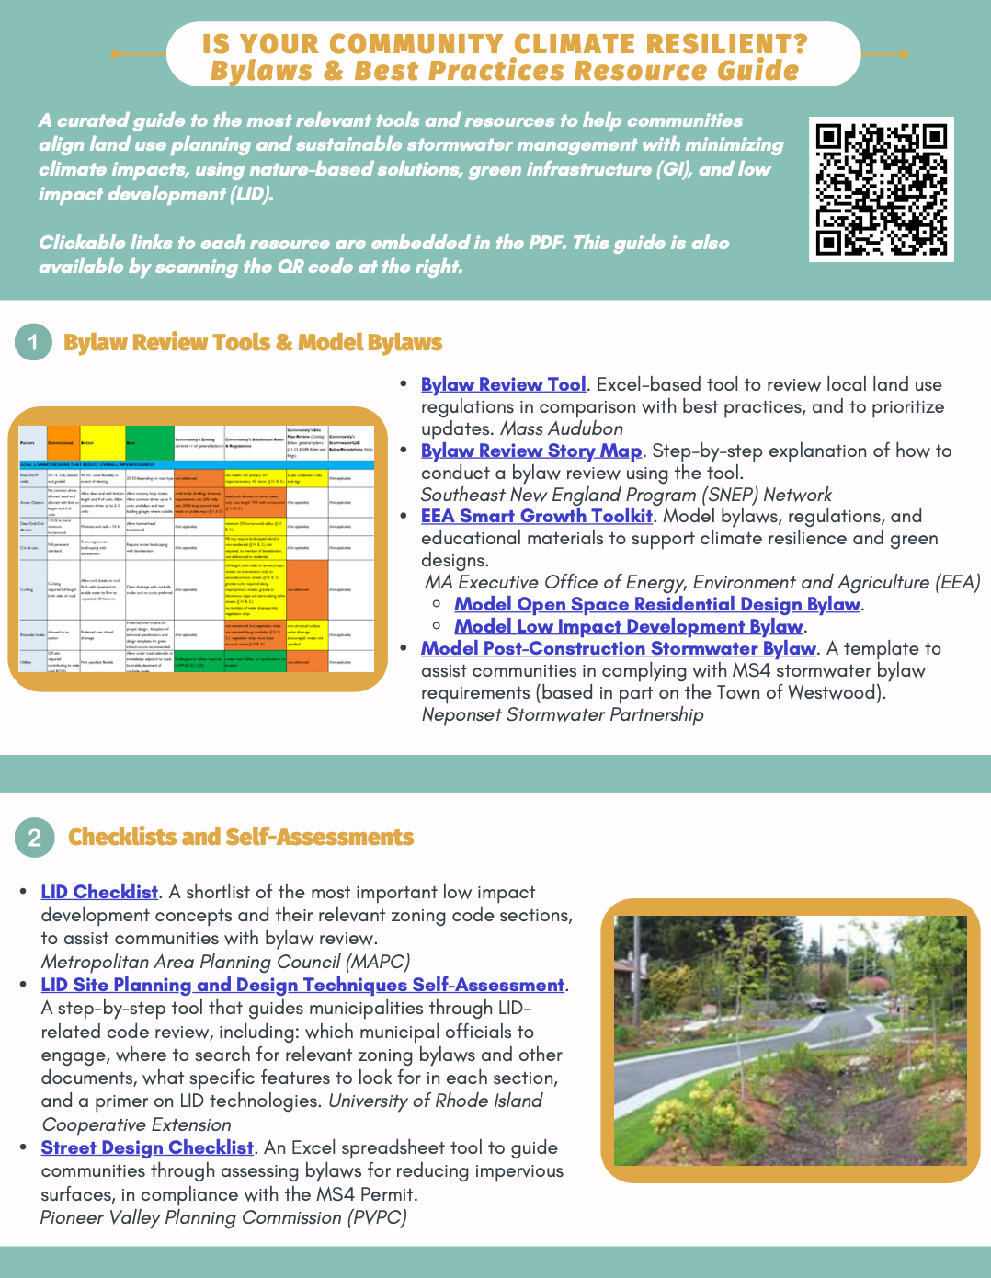
Resources
Mass Audubon LID fact sheets and bylaw tool: massaudubon.org/lidcost
Mass Audubon Losing Ground and Value of Nature factsheets: www.massaudubon.org/valueofnature
EEA Smart Growth Toolkit: mass.gov/smart-growth-smart-energy-toolkit-information-and-resources
MAPC’s Climate Resilience: Toolkit mapc.org/resource-library/climate-resilient-land-use-strategies/
Citizen Planner Training Collaborative: masscptc.org/
Massachusetts Association of Conservation Commissions Electronic Resource Library: maccweb.org/page/ElecResLibrary
EEA Planning Assistance Grants: mass.gov/service-details/planning-assistance-grants
MVP Action Grants mass.gov/service-details/mvp-action-grant
MA Office of the Attorney General Municipal Law Unit: mass.gov/municipal-law-review
UNH Stormwater Center: unh.edu/unhsc/
URI NEMO Program: uri.edu/nemo/
RI Green Infrastructure Coalition: greeninfrastructureri.org
SNEP Network: snepnetwork.org
Find more info in our Resource Guide!

Slide 15
Notes:
Let’s pause here. Are there any questions?
Do you have any experiences with any of the organizations discussed in this module?
What regulatory documents in your town might be high priorities for incorporating LID? In the next module, we will look at some examples of how Massachusetts communities have used their Bylaws and other regulations to promote LID.

